Slide 1
BA (Hons) Leadership and Management Skills for the Workplace
Knowledge and Information Management Skills for the Workplace (BMSW5106)
Week 6:
Introduction to Business Information Systems

Slide 2
Recap
Knowledge management systems(KMS) are process firms use to collect/acquire, organise and store, analyse, exchange and apply them
It could be gathered internally or externally with a view to improve organisational performance
Two factors drove the concept of knowledge management in business namely
Downsizing and
The Development of Technology (Growth of the internet, and the pace of change of technology)

Slide 3
Outline and Objectives
Understand why information systems are essential for running and managing a business
Define an information system, explain how it works, and identify its people, organizational, and technology components
Apply a four-step method for business problem solving to solve information system-related problems

Slide 4
Looking into the Future
Businesses are increasingly spending trillions in IT and information systems
It is predicted that by 2030, (Source: Pearson)
1 billion people will need reskilling
30% of jobs are at risk of automation
83% of organisations experience and may experience skills gap
Most of this influenced by increased competition between physical and online businesses

Slide 5
Competition in the Future
Increased competition between physical and online businesses means firms must think about many factors:
How deploying information technology change the way firms interact with their stakeholders
How deploying new digital tools means firms had to redesign jobs and procedures for gathering, inputting, and accessing information
How deploying new digital technology drive efficiency, improve service delivery and profitability

Slide 6
The New HQ is in the Clouds:
Highlighting need to think about new ways of working and IS and MIS will be crucial for success
The New HQ Is in the Cloud: Salesforce President (youtube.com).

Slide 7
Importance of Management Information Systems
The Importance of MIS (youtube.com).

Slide 8
Information System and MIS
The Information System is the tools and technology (hardware and software) used to manage information
Management Information System is the process firms use to acquire, store, manage, disseminate and apply information and knowledge using the information system

Slide 9
Business Challenges and MIS
How does digital technology change business operations and the role of IS in all this:
There are three areas that the deployment of technology can affect in a business which will culminate in business solutions
Figure in next slide illustrate this

Slide 10
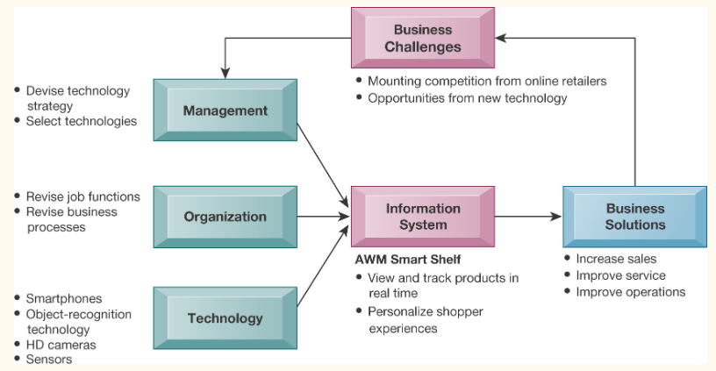
Business Challenges and MIS

Slide 11
Globalization Challenges and Opportunities
Internet and global communications technology has made the world much flatter and have greatly reduced the economic and cultural advantages of developed countries.
Access to knowledge and information and Ideas is not necessarily exclusive
Competition for jobs, markets, resources
Growing interdependence of global economies
Drastic reduction of costs of operating and transacting on global scale means any firm can achieve economies of scale
Hence, businesses requires new understandings of skills, markets, opportunities necessary for success

Slide 12
How Does IS Works or What does IS do
Activities in an information system produces information and knowledge by first using data to input:
  Input
  Processing
  Output
  Feedback: Output returned to appropriate members of the organization to help them evaluate or correct input

Slide 13
Class Exercise!
Speak to five people in your class and ask them their age and the number of times they go for shopping per week or month
Question:
Calculate their average age and determine and oldest and youngest
Determine the person most frequent from highest to lowest visits

Slide 14
Input, Processing and Output
The process of asking people these questions will give you data and Input
Determining their average age and youngest and oldest and shopping frequency is Processing
Displaying the information and knowledge would represent Output

Slide 15
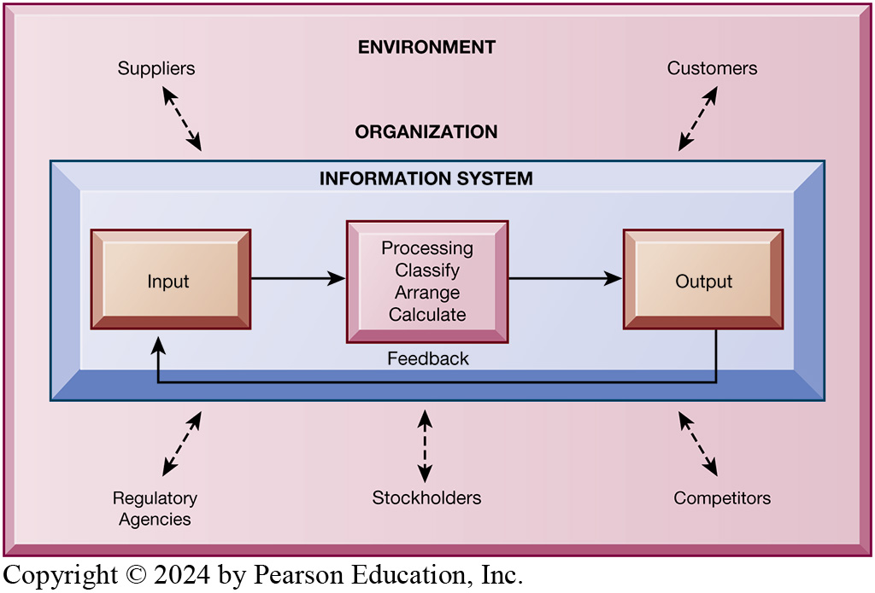
Functions of IS

Slide 16
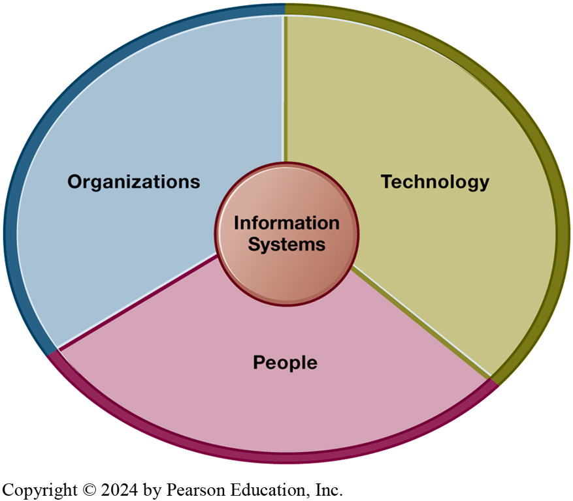
IS is more than Computers
People, the organisation and how it is structured, and the technology used in managing information systems are all important dimensions

Slide 17
Dimension of IS: People
Information systems require skilled people to build, maintain, and use them.
Employee attitudes affect their ability to use systems productively.
Role of managers is important in all this:
Perceive business challenges
Set organizational strategy
Allocate human and financial resources
Creative work: new products, services

Slide 18
Dimension of IS: Organisations
IS should accurately reflect the culture and hierarchy of an organisation
Coordinate work through structured hierarchy and business processes
Business processes: related tasks and behaviours for accomplishing work; may include formal rules or be informal
Examples: fulfilling an order, hiring an employee
Culture: fundamental set of assumptions, values, and ways of doing things within an organization
Parts of culture can be found embedded in information systems

Slide 19
Dimension of IS: Technology
I T Infrastructure: foundation or platform upon which information systems are built including;
Computer hardware
Computer software
Data management technology
Networking and telecommunications technology
Internet, web, extranets, intranets
Voice, video communications

Slide 20
3 Important Technology Today
Internet of Things (IoT)
Network of physical objects (“things”) embedded with sensors, software, and technologies enabling them to connect and exchange data with other devices/systems over the Internet
Big Data
Many millions of data points generated by IoT devices, websites and other sources that can be analysed to create predictions or unearth patterns of behaviour (prompt pop up adverts)
Cloud computing
Centralized system for storing, managing, and processing data across the Internet using a network of remote computing centers

Slide 21
Class Discussion
Can you list how you have interacted with each of these technologies in your everyday life?

Slide 22
A Model of the Problem-Solving Approach
A decision to adopt an IS may not be easy because of resource constraints and to establish if they will add value
There are four-step process associated with solving a problem:
Problem identification
Solution design
Choice
Implementation

Slide 23
1. Problem Identification
Agreement that problem exists (may be many point of views and sometimes no agreement)
Definition of problem
Causes of problem
What can be done given resources of firm

Slide 24
1. Problem Identification
Typical organizational problems includes:
Outdated business processes
Unsupportive culture and attitudes
Political in-fighting
Turbulent business environment, change
Complexity of task
Inadequate resources

Slide 25
1. Problem Identification
Typical technology problems
Insufficient or aging hardware
Outdated software
Inadequate database capacity
Insufficient telecommunications capacity
Incompatibility of old systems with new technology
Rapid technological change

Slide 26
1. Problem Identification
Typical people problems
Lack of employee training
Difficulties of evaluating performance
Legal and regulatory compliance
Work environment, ergonomics
Poor or indecisive management
Lack of employee support and participation

Slide 27
2. Solution Design
Solution design
Often many possible solutions
Consider as many as possible to understand range of solutions

Slide 28
3. Choice
Solution Evaluation and Choice – factors include:
Cost
Feasibility given resources and skills
Length of time needed to implement solution

Slide 29
4. Implementation
Building or purchasing solution
Testing solution, employee training
Change management
Measurement of outcomes
Feedback, evaluation of solution
Problem solving is a continuous process, not a single event
Sometimes chosen solution doesn’t work or needs adjustment

Slide 30
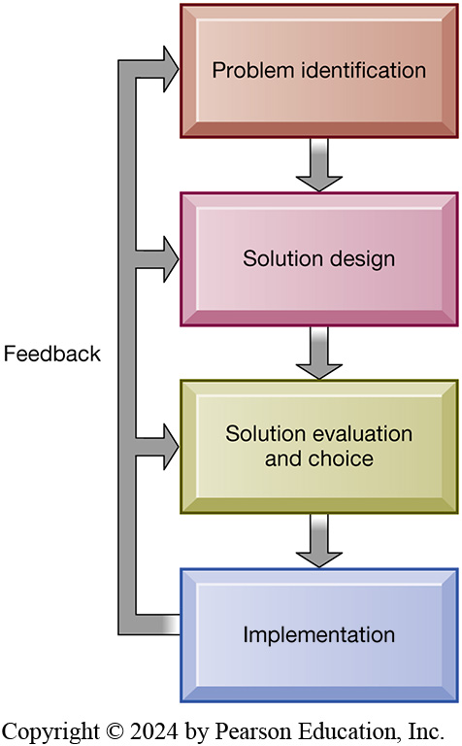
4 Step Problem Solving Process
Should be a continuous process
The outcome must be continually measured, and the information about how well the solution is working is fed back to the problem solvers

Slide 31
Role of Critical Thinking In problem Solving
Without critical thinking, it is easy to jump to conclusions, misjudge a problem, and waste resources
Critical thinking:
Sustained suspension of judgment with an awareness of multiple perspectives and alternatives
Ability to collect and analyse data that might help understand the nature of the problem; a “data driven” approach
Four elements of critical thinking:
1. Maintaining doubt and suspending judgment
2. Being aware of different perspectives
Including technology, organization, and people perspectives
3. Testing alternatives and letting experience guide
4. Being aware of organizational and personal limitations

