Slide 1

Week 4 Tutorial

Slide 2

Safeguarding
The term safeguarding is used to define actions taken to protect vulnerable groups from harm. This harm might come from adults or other children
organisation works with children & vulnerable adults will have strict safeguarding policies
  And regularly updated
Protect vulnerable from abuse, maltreatment and exploitation.
Prevent anything from harming their health or development.
Ensure they can grow up under safe and effective care.
Take action to ensure they have the best outcomes in life.
Keep staff safe

Slide 3
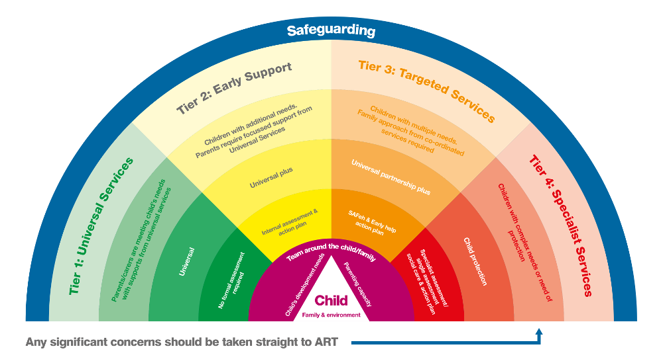
Continuum need of support
Notes:
Continuum need of support

Slide 4
Making ‘never again’ a reality still failing individuals fail to protect the vulnerable
Regular training
Seeing signs
Appropriate language & behaviour
Policies & Procedures

Slide 5
Common Sites For Accidental Injury
FOREHEAD
NOSE
BONY SPINE
CHIN
FOREARM
ELBOWS
HIP
KNEES
SHINS
Notes:
Use this diagram to demonstrate some of the common sites for accidental injury.
Not all bruising or marking is cause for concern.
However when explanations do not correlate or the bruising is in an unusual place, this should be recorded and discussed with the designated safeguarding lead.

Slide 6
What Organisations will ask:
Does the explanation for injury / mark add up?
Does parents explanation confirm child’s explanation?
Parents will go to extra-ordinary lengths to cover up – disguised injury
Explanations may seem plausible at the time but will look at history

Slide 7
Common sites for non-accidental physical injury
EYES - bruising, (particularly both eyes)
SKULL - fracture or bleeding under skull (from shaking)
EARS - Pinch or slap marks, bruising
CHEEK/SIDE OF FACE - bruising, finger marks
NECK -bruising, grasp marks
MOUTH - torn frenulum
UPPER & INNER ARM - bruising, grasp marks
SHOULDERS - bruising, grasp marks
CHEST - bruising, grasp marks
GENITALS - bruising
BACK }
BUTTOCKS }
THIGHS }
Linear bruising. Outline of belt/buckles. Scalds/burns
KNEES - grasp marks
Notes:
Use this diagram to illustrate some of the areas that are suggestive of physical abuse.
Reinforce the need to share any concerns with the Designated Senior Person.
Does the explanation for injury / mark add up?
Does parents explanation confirm child’s explanation?
Parents will go to extra-ordinary lengths to cover up – disguised compliance
Explanations may seem plausible at the time. – Importance of chronologies
Reinforce to staff the importance of reporting a concern, even if unsure. The DSL may have a number of previous concerns, which the member of staff is not aware of and their information may be a crucial piece of the jigsaw.

Slide 8
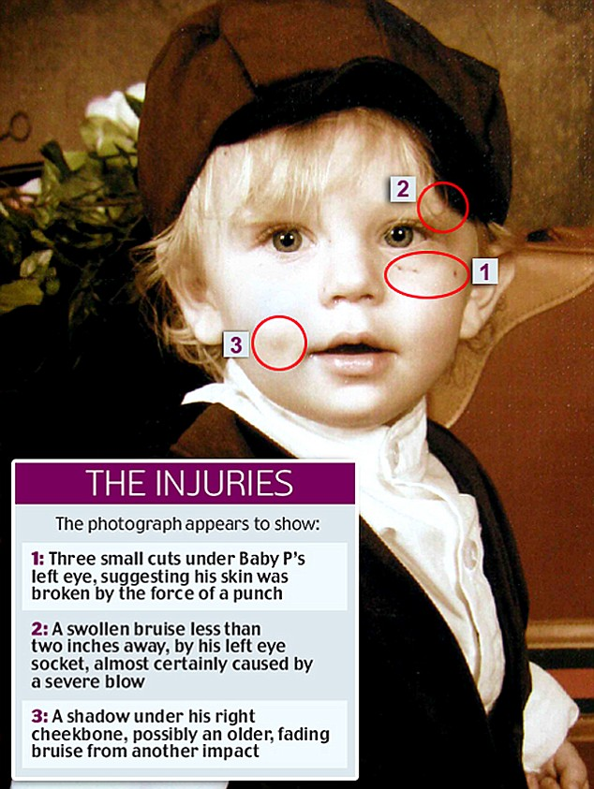
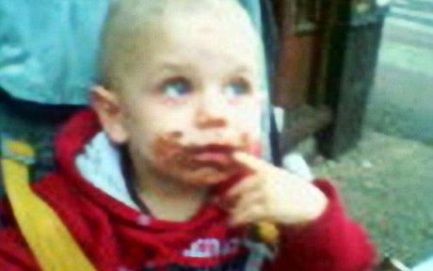
Baby Peter 2007
Notes:
https://www.independent.co.uk/news/uk/crime/coroner-rules-out-inquest-into-death-of-baby-p-2147327.html
1 March 2006: Baby Peter is born to Tracey Connelly.
June 2006: Connelly begins a relationship with a new boyfriend Steven Barker.
November 2006: Barker moves into Connelly's home.
December 2006: Connelly is arrested after bruises are spotted on the boy's face and chest by a GP.
January 2007: The boy is returned home five weeks after being put in the care of a family friend.
February 2007: A whistle-blower, former social worker Nevres Kemal, sends a letter about her concerns over alleged failings in child protection in Haringey to the Department of Health.
12 March 2007: Commission for Social Care Inspection (CSCI) inspectors meet Haringey officials to discuss concerns raised by Ms Kemal in the letter sent by her lawyer, which was dated 16 February 2007.
April 2007: Baby Peter is admitted to North Middlesex hospital with bruises, two black eyes and swelling on the left side of his head.
1 April 2007: Ofsted takes over responsibility for inspecting children's services from the CSCI.
May 2007: After seeing marks on the boy's face, a social worker sends Baby Peter to the North Middlesex where 12 areas of bruises and scratches are found. Connelly is re-arrested.
June 2007: Barker's brother, Jason Owen, moves into the home with a 15-year-old girl.
30 July 2007: Injuries to Baby Peter's face and hands are missed by a social worker after the boy is deliberately smeared with chocolate to hide them.
1 August 2007: The boy is examined at a child development clinic.
2 August 2007: Police tell Connelly she will not be prosecuted after her case is considered by the Crown Prosecution Service.
3 August 2007: Baby Peter is found dead in his cot.
11 November 2008: Owen, 36, from Bromley, and Barker, then 32, are found guilty of causing the death of Baby Peter. Connelly had pleaded guilty to the same charge.

Slide 9
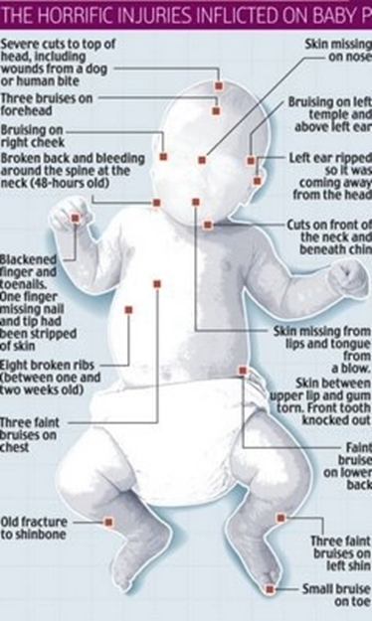
Peter Connelly
Inquest into death? Coroner - No inquest.
50 injuries
Received 60 visits from social workers, doctors and police at home over an eight-months
Coroner believed that the death had been answered in previous investigation
Waste of public money
Potential witnesses?
Lessons learnt? Investigations gave significant criticism leading to changes in practices
Could Inquest reveal more?
Loss of jobs – some Social workers used as scape goats?
Notes:
https://www.theguardian.com/society/2010/nov/30/babyp-coroner-rules-out-inquest
https://www.independent.co.uk/news/uk/crime/coroner-rules-out-inquest-into-death-of-baby-p-2147327.html

Slide 10
Safeguarding in Employment
Ensuring these at risk people are in the safest of hands background checks were used.
Criminal Records Bureau were introduced in May 2002
Currently called Disclosure Barring Service - DBS
Enables organisations to make safer recruitment decisions
DBS identifies those unsuitable for working with children or adults. Gives access to criminal record information of individuals.

Slide 11
DBS Pre- 2002
Under the old system, employers sought police checks locally.
Took months, it was standard practice for people to start work subject to a satisfactory clearance coming through later from the police, provided their ‘List 99 Check’ was clear.
Police Forces found the checks burdensome
Official guidance told employers they should normally "consider" having a check done only on people applying for posts entailing:
"a substantial level of access to children which may also be unsupervised, and will be regular or sustained".
Notes:
Access to children = teachers, youth workers, residential staff in boarding schools, para-medical staff, caretakers, independent visitors to childcare organisations, education welfare officers and psychologists, local authority workers in nurseries, playgroups, youth and community groups.
The guidance was that checks "should not normally be sought" on administrative staff, bus drivers, cleaners, dinner assistants, ground staff, parents and other supervised helpers, and - crucially, in view of the current backlog - student teachers and other trainees except in nursery schools.
99 list is a list of people who appear on the sex offenders register and confirms if they are barred from working with children. Contains the names, aliases, dates of birth and national insurance numbers of all those forbidden to work with children in schools, social work and voluntary settings.
Adults convicted of serious sexual offences committed against children under the age of 16 since 1995 can automatically be placed on List 99. Those convicted of possessing indecent photographs of children can only be automatically barred if they were convicted after 1 June 2003. Since June 2003, a judge can also effectively bar an offender from working with children by giving them a "disqualification order" as part of their sentence.

Slide 12
From May 2002
The Criminal Records Bureau had started work as a central point for all checks and the system was tightened up.
All applicants for posts involving working with children were to seek clearance via the bureau - known as "disclosure" - before starting work.
But by end of May the Bureau could not cope with the demand.
Classroom staff could start work pending completion of their police checks, provided they were not on List 99.
Notes:
99 list - not a sex offender and not banded from working with children.
Because the Criminal Records Bureau could not cope with the demand, the Department for Education announced "interim arrangements".
These were that - as under the old system - classroom staff could start work pending completion of their police checks, provided they were not on List 99.
This exemption did not apply to contractors, ancillary staff such as caretakers, or school governors - they still had to be checked first

Slide 13
Failings
No or limited police checks could only mean a danger for vulnerable people?
Then this happened:
https://www.youtube.com/watch?v=PGOMkQcKRVs
* would be 18 years
Notes:
These offences were on file

Slide 14
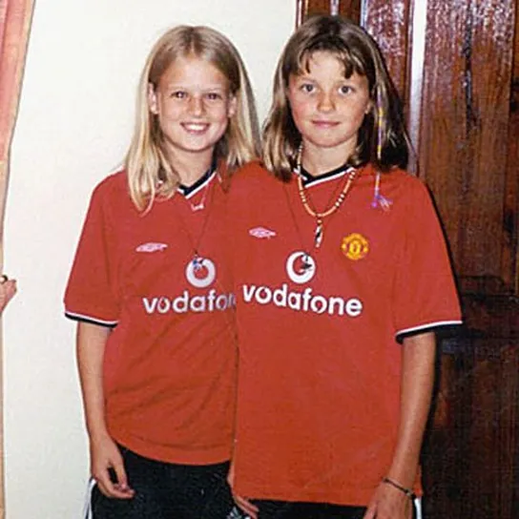
Ian Huntley
last to see the girls
Regular media interviews
charred and cut Manchester United shirts found in school
Holly when accidentally falling into the bath and Jessica when he covered her mouth to stop her screaming.
Forensic phycologist stinging nettles had been stepped on exactly 13 days prior & pollen in Huntley's car
Maxine Carr was in the house – Alibi

Slide 15
Soham Murders 4th August 2002
Huntley was found guilty of murdering Jessica and Holly
His link was being the caretaker of the school they attended.
Maxine Carr girlfriend & classroom assistant
Huntley had been suspected of offences including rape, indecent assault and burglary. But only conviction before the murders was for riding an uninsured and unlicensed motorcycle and burglary. Offences committed in his home area.
Huntley had been hired by the school in November 2001, before the CRB came into force.

Slide 16
Would Huntley have had the job after CRB’s
Huntley had been reported to police in Humberside on 6 occasions over sexual assaults or sexual relationships with underage girls BUT no convictions for sex offences.
Social services investigated 4 relationships between Huntley and schoolgirls.
Police checks on Huntley when he was appointed failed to unearth these details.
At the time Huntley got his job new vetting system was being introduced.
Police state that under the new system Huntley would probably still have slipped through the net as the new Criminal Records Bureau continues to rely on local police forces to provide it with intelligence material.
Notes:
No convictions to put on the 99 list.
Huntley got his job the vetting process was being changed and a new system is now in place.
From Humberside but job else where

Slide 17
Lessons Learnt?
30 August 2002 Education dept. stressed: "We do not advise that people should be allowed to work unchecked if they are supervised.”
4 September: Third U-turn due to the volume of CRB’s waiting. Schools had to turn children away due to not enough staff. Union meetings were held.
The Education Secretary, Estelle Morris - "I have therefore decided to allow teachers, teaching assistants and other to work in schools at the head teachers' discretion after receiving List 99 checks.

Slide 18
The DBS was formed in 2012 by merging the functions of the Criminal Records Bureau (CRB) and the Independent Safeguarding Authority (ISA) under the Protection of Freedoms Act 2012.
It is a legal requirement in the UK for regulated activity employers to refer safeguarding concerns to the DBS.
It is illegal for anyone barred by the DBS to work, or apply to work with the sector from which they are barred.
It is also illegal for an employer to knowingly employ a barred person in the sector from which they are barred.
New job – New DBS even if it is still for the same company.
17 June 2013 DBS introduced an ‘update service’.
Notes:
https://www.legislation.gov.uk/ukpga/2012/9/contents/enacted

Slide 19
Staff Training
Most employers will deliver staff training in safeguarding / protection
Gives staff skills to spot signs of abuse
Know how to report it
Staff are able to monitor children/adults
Best practice for organisations
Safeguarding is the process of working to protect from harm such as abuse, neglect, and exploitation.
Child protection is the process of working with those who have experienced forms of violence, abuse, neglect, or exploitation.

