Slide 1
BMSK5001 Developing workplace critical thinking
Week 5
Workshop

Slide 2
Today we would look at
The assignment brief
24/06/2019
2

Slide 3
Task description
• Produce a formal report which is to consider the critical analyses of the impact of beliefs, attitudes and values on workplace behaviour.
• Identify a management theory relevant to your role, evaluate its modern day relevance and critically assess its impact on your own beliefs, values and attitudes.
3

Slide 4
Task 1
Beliefs, Values and attitudes

Slide 5
Questions
What are beliefs?
What are values?
What are attitudes?
5

Slide 6
Key Question
What is the relationship between beliefs, values and attitudes?
6

Slide 7
Key Questions
What are your beliefs and values?
How can these affect your behaviour at your workplace?
7

Slide 8

Group activity
In your table group, identify two values, their sources and how these values can affect the behaviours of the individuals that hold them.
8

Slide 9
Values can affect behaviours (Example)
Jane has been appointed as team lead in her workplace. Team bonding is one of her values which has made her successful as a team leader in the past. Jane has now proposed team bonding sessions in her new team but Barry would rather spend time alone reading a magazine during these sessions. Jane is very upset with Barry’s attitude.

Slide 10
Values can affect behaviours (Example)
Values can strongly influence employee conduct in the workplace.
  For example, If an employee values honesty, hard work, and discipline, for example, he will likely make an effort to exhibit those traits in the workplace. This person may therefore be a more efficient employee and a more positive role model to others than an employee with opposite values.
Shared values are often the bases of workplace relationships, so when values are not shared conflict may arise.
Notes:
Conflict may arise, however, if an employee realizes that her co-workers do not share her values. For example, an employee who values hard work may resent co-workers who are lazy or unproductive without being reprimanded. Even so, additional conflicts can result if the employee attempts to force her own values on her co-workers.

Slide 11
The workplace context

Slide 12

Shared values in the workplace
12
Notes:
How can companies shared values / Core values affect the behaviours of employees in the workplace?

Slide 13
Organizational values

Slide 14
How can these values affect employees behaviours?
While most organisations would explicitly state their core values, some values may not be written down. For instance, you won’t find the following values written down, but each comes from a real organization.
Look busy even if you’re not.
If you take risks and fail around here, you’ll pay dearly for it.
Before you make a decision, run it by your boss so that he or she is never surprised.
We make our product only as good as the competition forces us to.
What made us successful in the past will make us successful in the future.
If you want to get to the top here, you have to be a team player.
14

Slide 15
ANY QUESTIONS?

Slide 16
Task 2
Critical evaluation of a management theory

Slide 17

Task 2
Select A theorist.
In section 2 of your report, select a theory and explain its relation to you in your workplace, or state why it doesn’t relate to you. Supply references in your report.

Slide 18

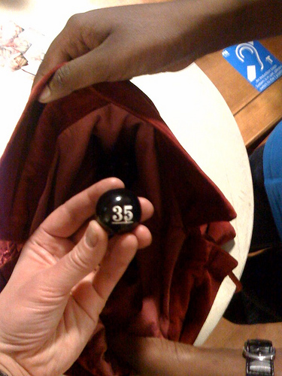
The ‘Theorists’ Draw!’
1.John Adair | 8.Frederick Herzberg
2.Charles Handy | 9.Rensis Likert
3.Henry Mintzberg | 10.Edward de Bono
4.Douglas McGregor | 11.Stephen Covey
5.Daniel Goleman | 12.W. Edwards Deming
6.Elton Mayo | 13.Reginald Revans
7.Henri Fayol | 14.Max Weber

Slide 19
Theorists – Collate the following…
Your report should include, but not limited to the following:
Name of theorist
Brief background
The management theory
Other views, critiques etc
How useful in the workplace
Give a practical example of how its been applied (positive or negative)
Your opinion

Slide 20
ANY QUESTIONS?

