Slide 1
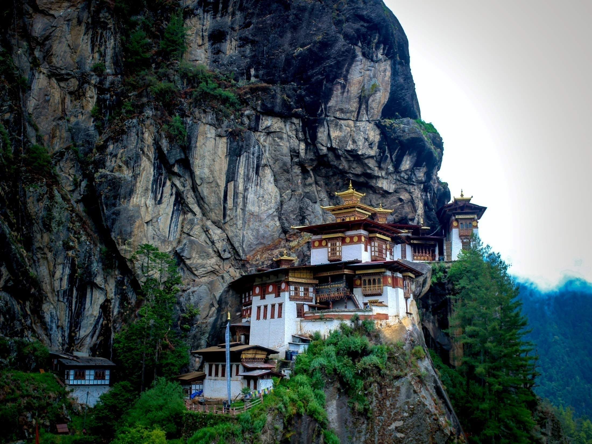


Sustainable Tourism in Bhutan
CRISCITA NICIA DE CARVALHO ROSA CORREIA

Slide 2
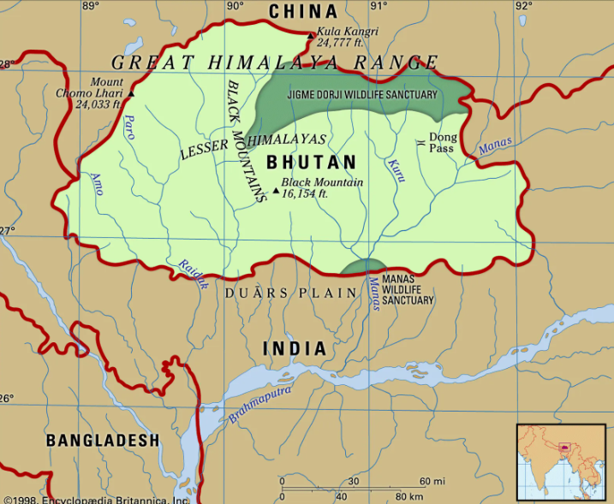
Map of Bhutan
1998, Encyclopedia Britannica. Inc.
Notes:
Bhutan is a small country
It is located in the Eastern Himalayas
It is known for Gross National Happiness rather than Gross Domestic Product(GDP)

Slide 3
Sustainability tourism in Bhutan
Bhutan’s Cultural Tourism
Govt. Plans For Tourism
Ethical issues
Government General Plans
Government Sustainable tourism plans
Preservation of Cultural heritage
Preservation of country’s unique culture heritage
Environmental preservation
Unique art and architecture forms
Festivals and traditions
GNH Index
Community Based Tourism Initiatives
Loss of Cultural authenticity
Environment conservation
Promote Responsible Tourism practice
Monasteries and Sacred sites
Global Tourism Issues
Emphasize on preserving cultural heritages
Climate Change
Cultural preservation
Over- Tourism
Economic Dependence
Cultural Changes/ Undermining of traditional cultures

Slide 4

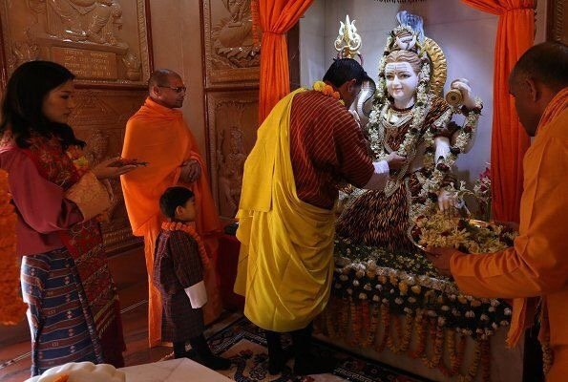
Bhutan’s Traditional Culture and heritage
Religion
Notes:
Bhutan’s society centered around Buddhism religion ; it is covered by around 75%
23% people in Bhutan having beliefs in Hindu religion
A very less population in Bhutan covered by the Muslim religion

Slide 5
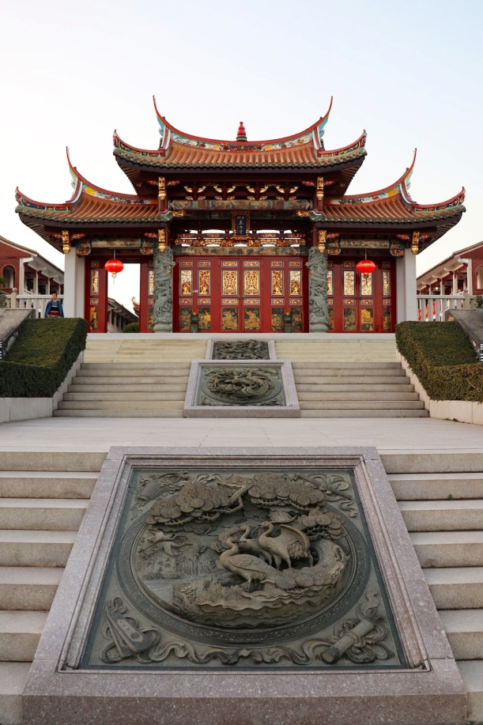
Bhutan’s Traditional Culture and heritage
Monastery
Buddhism Monastery
Notes:
Monastery is a religious home for the Monks, who perform religious activities there.
Monks Join the Monasteries at six to nine years age, and placed under discipleship of headmaster
They learn ancient religious Chhokey, as well as Dzongkha, and English.
The monk got spiritual training in the Monasteries.

Slide 6
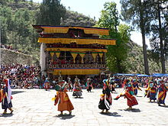
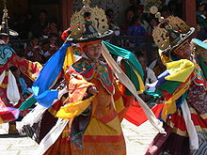
Bhutan’s Traditional Culture and heritage
Religious Festivals
Notes:
Tsechu is the most important festivals held in Dzong village of Bhutan
People from different district come in the monastery and gives their offering to ‘Lama’.
People do Mask dances, or ‘Cham’ in a large courtyard.

Slide 7
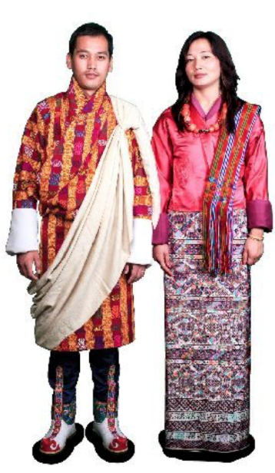
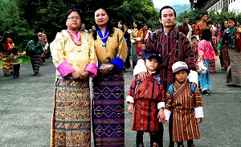
Bhutan’s Traditional Culture and heritage
Behavioral and dress code
Dress Code of Bhutanese
Source:https://www.pinterest.com/pin/306807793372617706/
Notes:
‘Driglam Namzha’ is official behavioral and dress code of Bhutan.
It means ‘The rules of disciplined behavior’.
It also express Bhutanese Art and Architecture.
These are set of manners what to wear, how to eat, talk and boy before the government officials and the clergy.

Slide 8
Tourism ethical issues in Bhutan
In Bhutan, sustainable tourism is directly associated with ethical issues, notably those concerning cultural and environmental preservation, as well as fair and ethical treatment of local communities.
Environment Preservation
Unique culture and Heritage preservation
Tourism Ethical issues in Bhutan
Fair and Ethical treatment of local communities
Loss of Cultural Authenticity

Slide 9
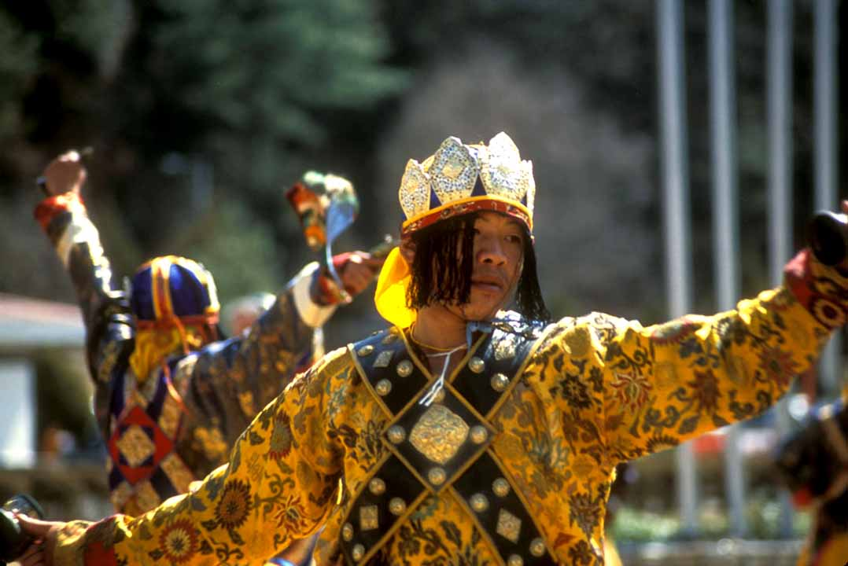
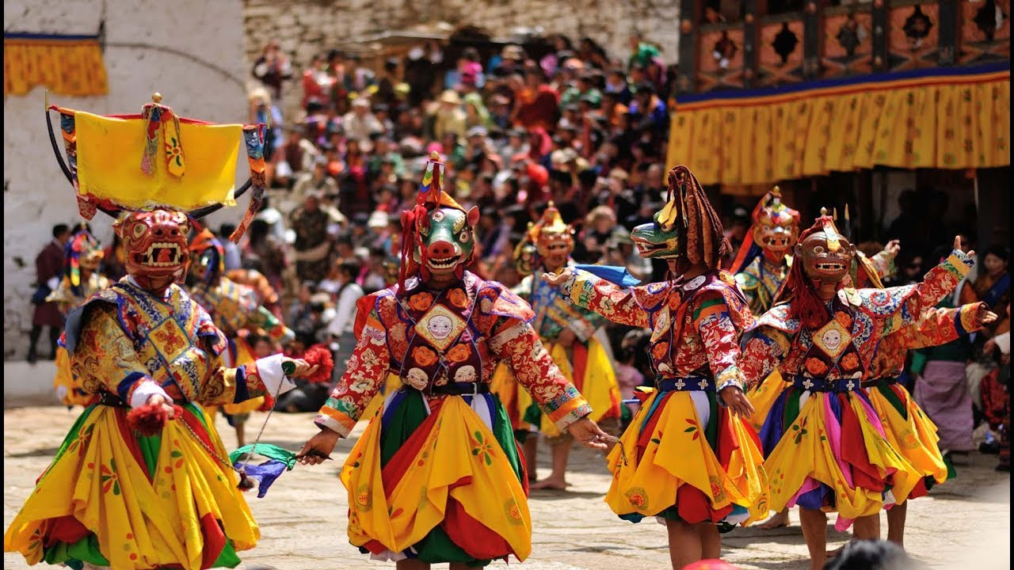
Tourism ethical issues in Bhutan
Unique Culture and Heritage Preservation
Notes:
Bhutan's distinct culture and heritage preservation is one of the country's most serious ethical issues. Bhutan has a rich and distinct cultural history, and the government is working to preserve it by controlling visitor activities and encouraging community-based tourism.
Visitors must respect local customs and traditions, and some sites are off-limits to them. Nonetheless, there have been reports of tourists violating local customs, such as wearing unsuitable apparel in religious locations, leaving local people feeling disrespected and offended.

Slide 10
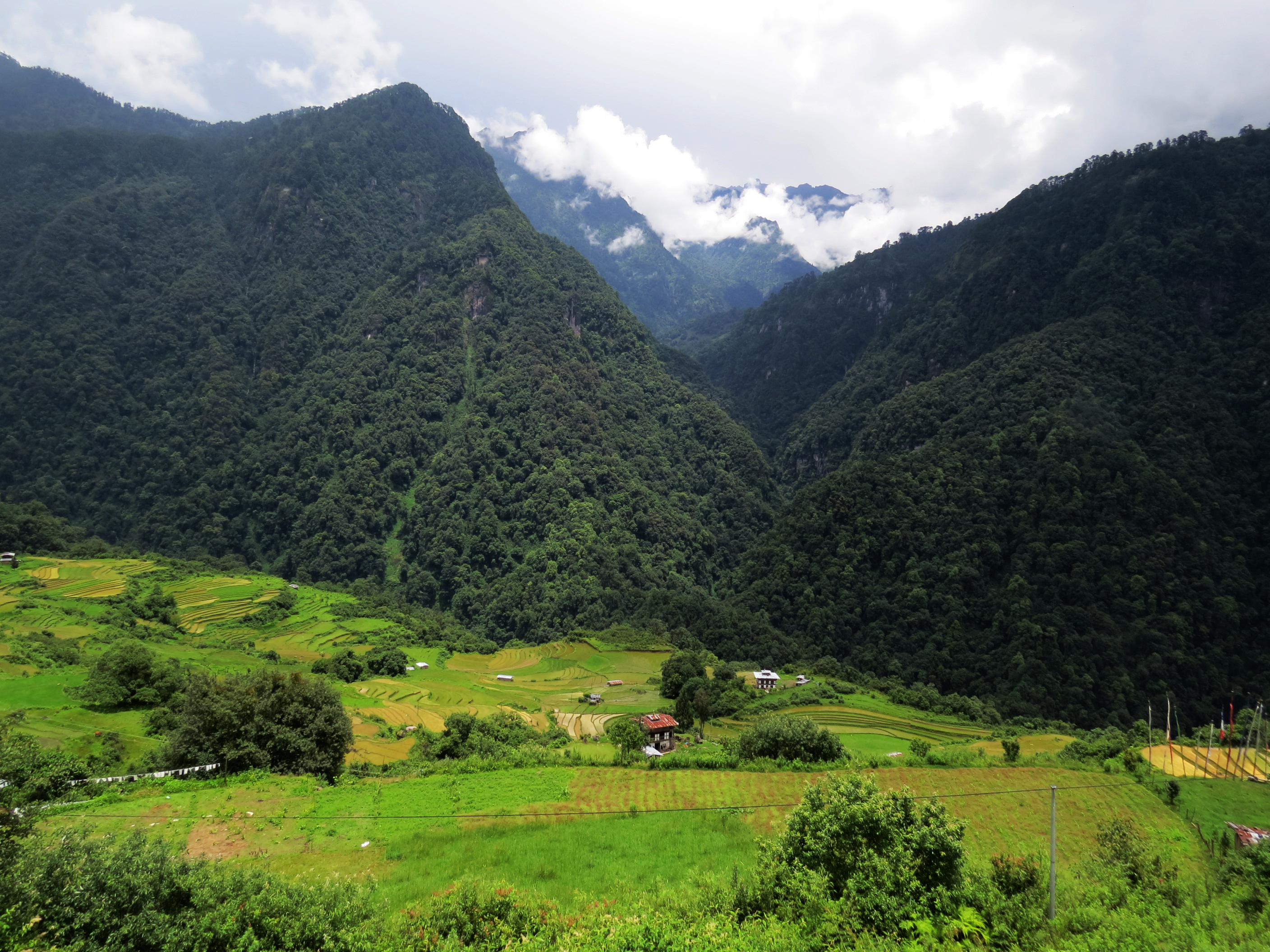
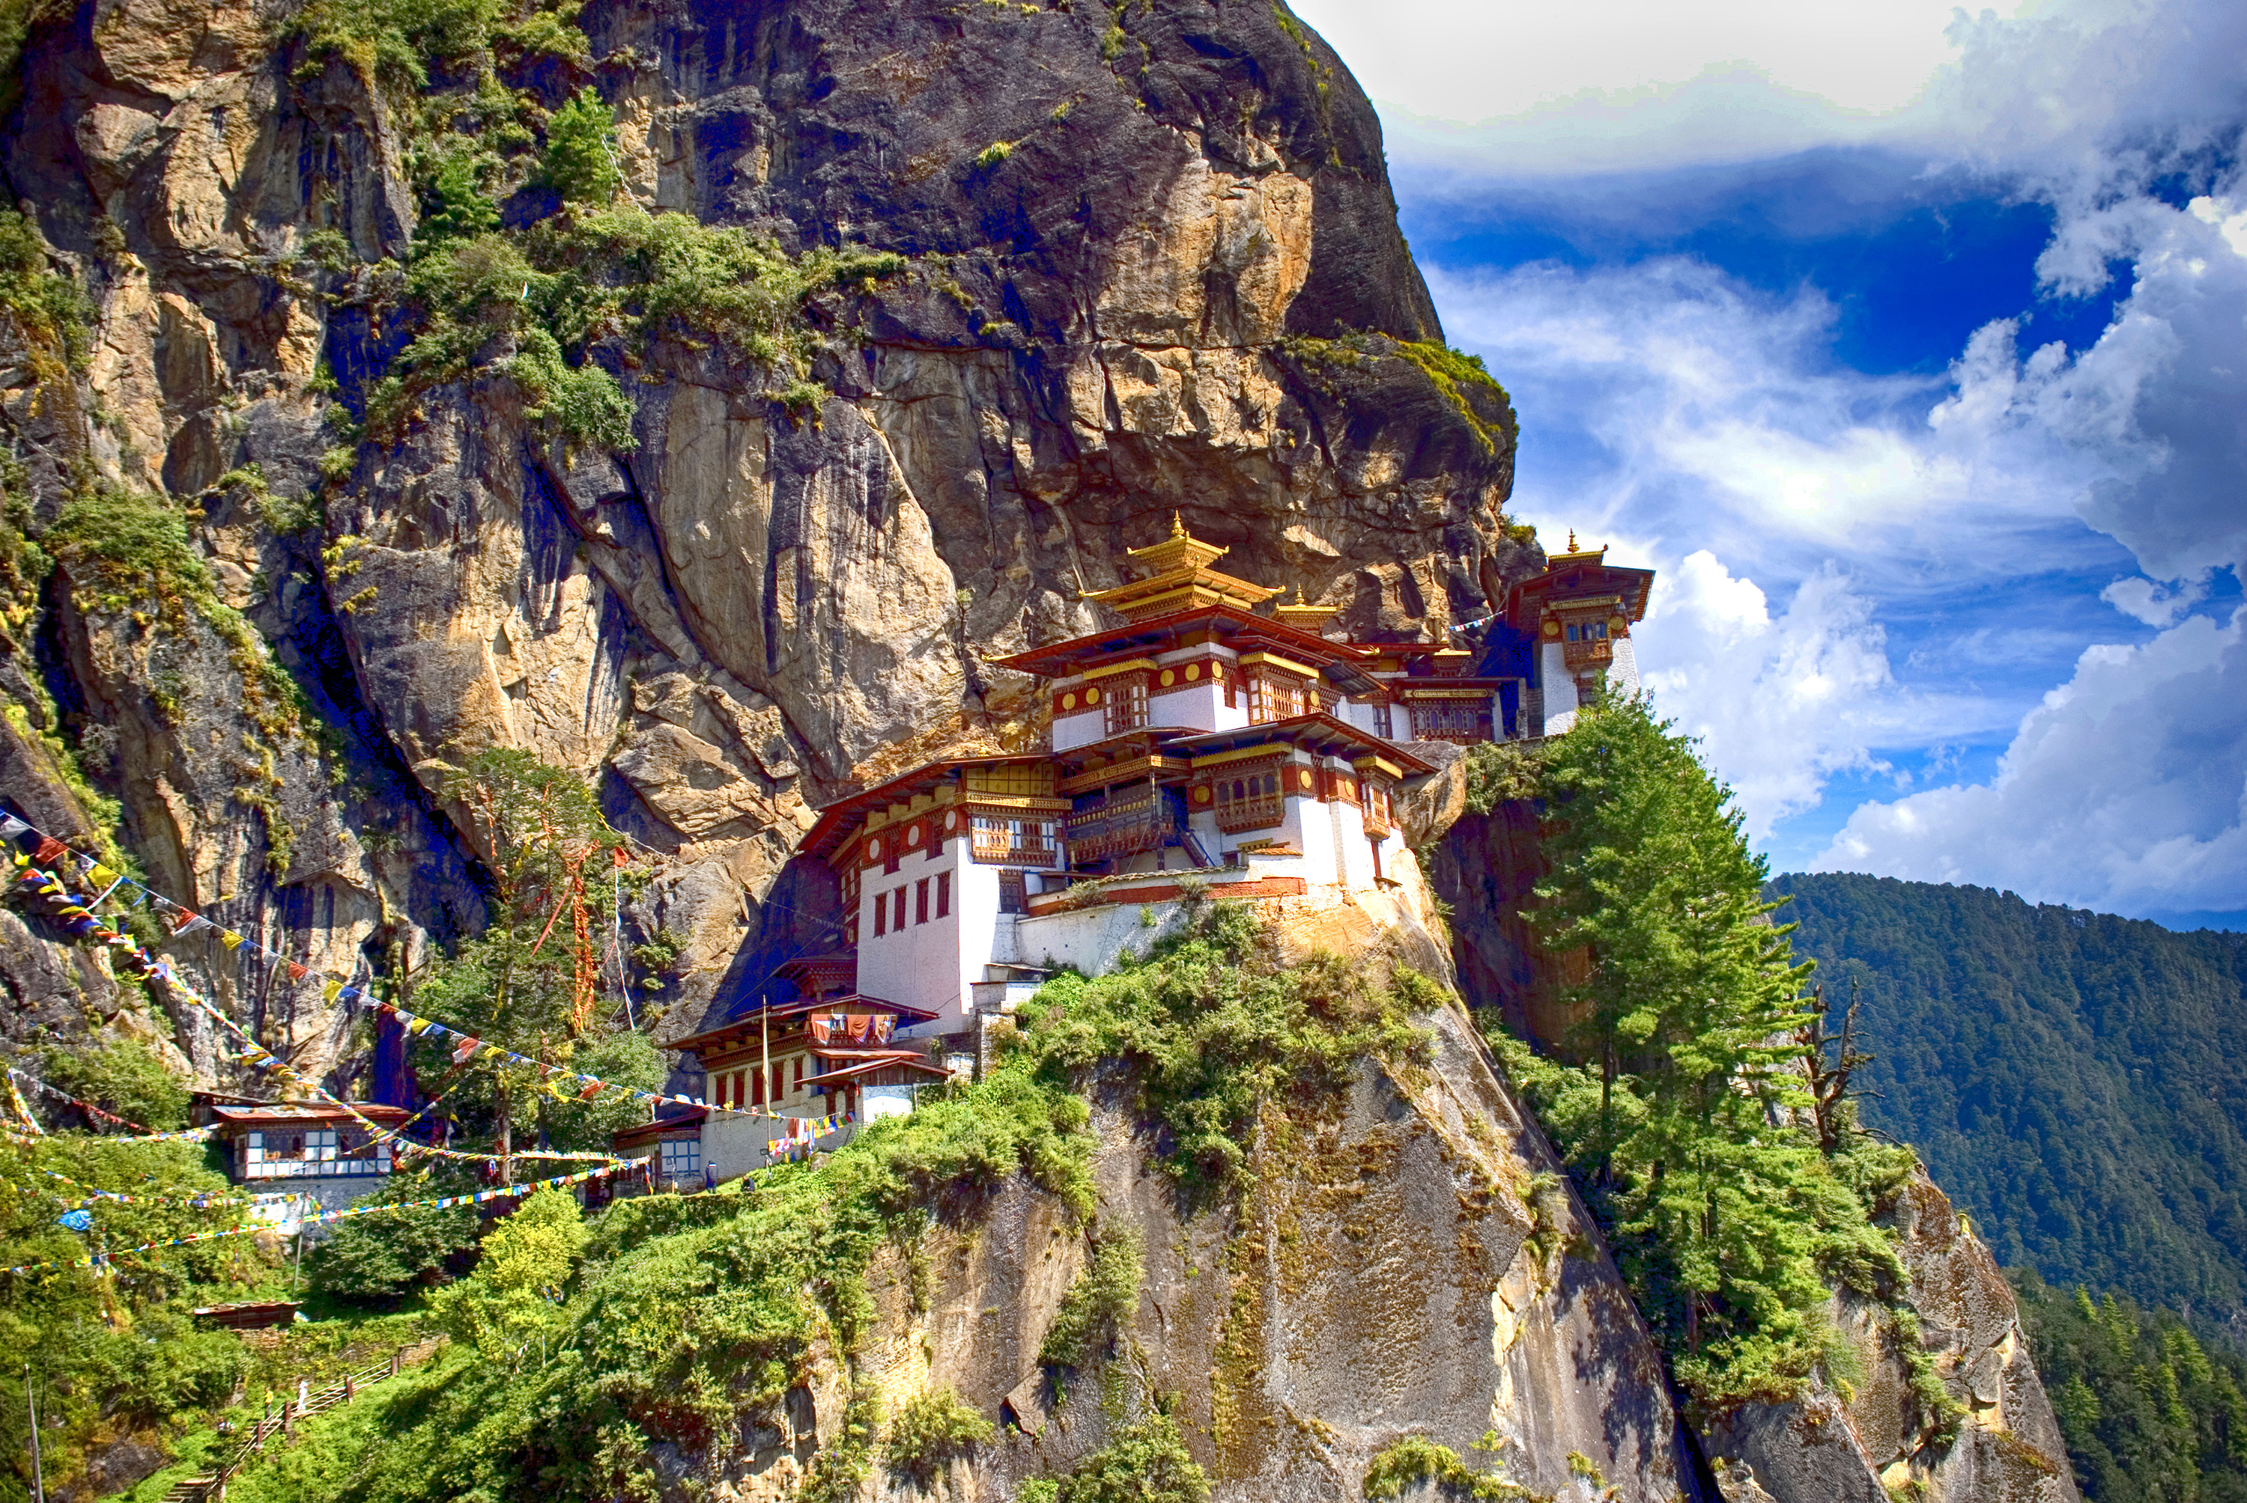
Tourism ethical issues in Bhutan
Environment preservation
Notes:
Environmental protection is another ethical issue in Bhutan's tourism sector. Bhutan is famed for its pristine natural environment, and sustainable tourism techniques strive to reduce the negative environmental impact of tourism. Nonetheless, there have been reports of tourists leaving trash or causing damage to the natural environment, which might have long-term consequences for the country's fragile ecosystem.
Bhutan's government has set serious and stringent laws on the tourism industry to preserve the natural environment, which includes not just resources but also the preservation of animals and natural vegetation in local forest areas. So that the country's natural resources can be preserved for a long period in order to support sustainable tourism.

Slide 11
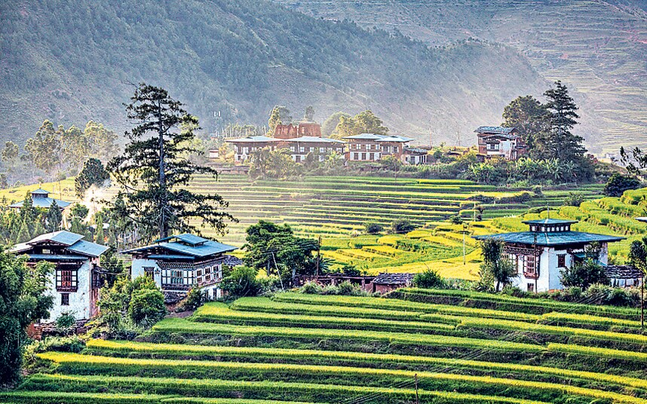
Tourism ethical issues in Bhutan
Fair and Ethical treatment
Treating local communities fairly and ethically
Local communities' benefit
Tour operators exploiting local communities
Notes:
Treating local communities fairly and ethically is also an essential ethical concern in Bhutan's tourism business. To ensure that local communities benefit from the economic benefits offered by tourism, the government has fostered community-based tourism programmers. Unfortunately, there have been cases of tour operators exploiting local communities, which can have a severe impact on the local community and its culture.

Slide 12

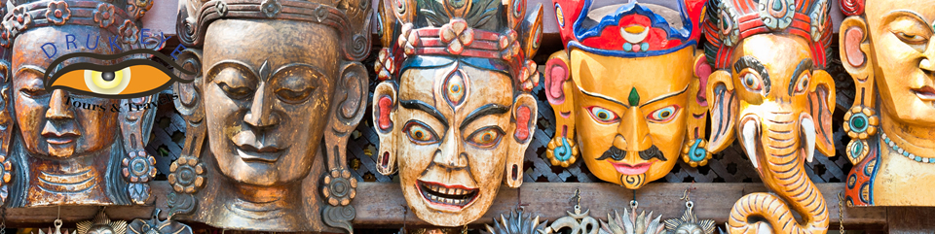

Tourism ethical issues in Bhutan
Loss of Cultural identity
Large amount of western culture to the country
Effect of introducing foreign culture
Lose their traditional culture, behavior, and clothing code. Traditional dress
Significant impact on the local community.
Notes:
Bhutan has a unique culture and identity. It has a rich cultural history. Because of tourism one ethical issue arises that is the loss of original cultural identity.
Tourism delivers a large amount of western culture to the country, which has the effect of introducing foreign culture to the local people, and the local communities are adapting western culture to the country. Locals may lose their traditional culture, behavior, and clothing code.
The worry arises that people may lose their own culture and identity as a result of the introduction of other countries' cultures into local communities. It has a significant impact on the local community.

Slide 13
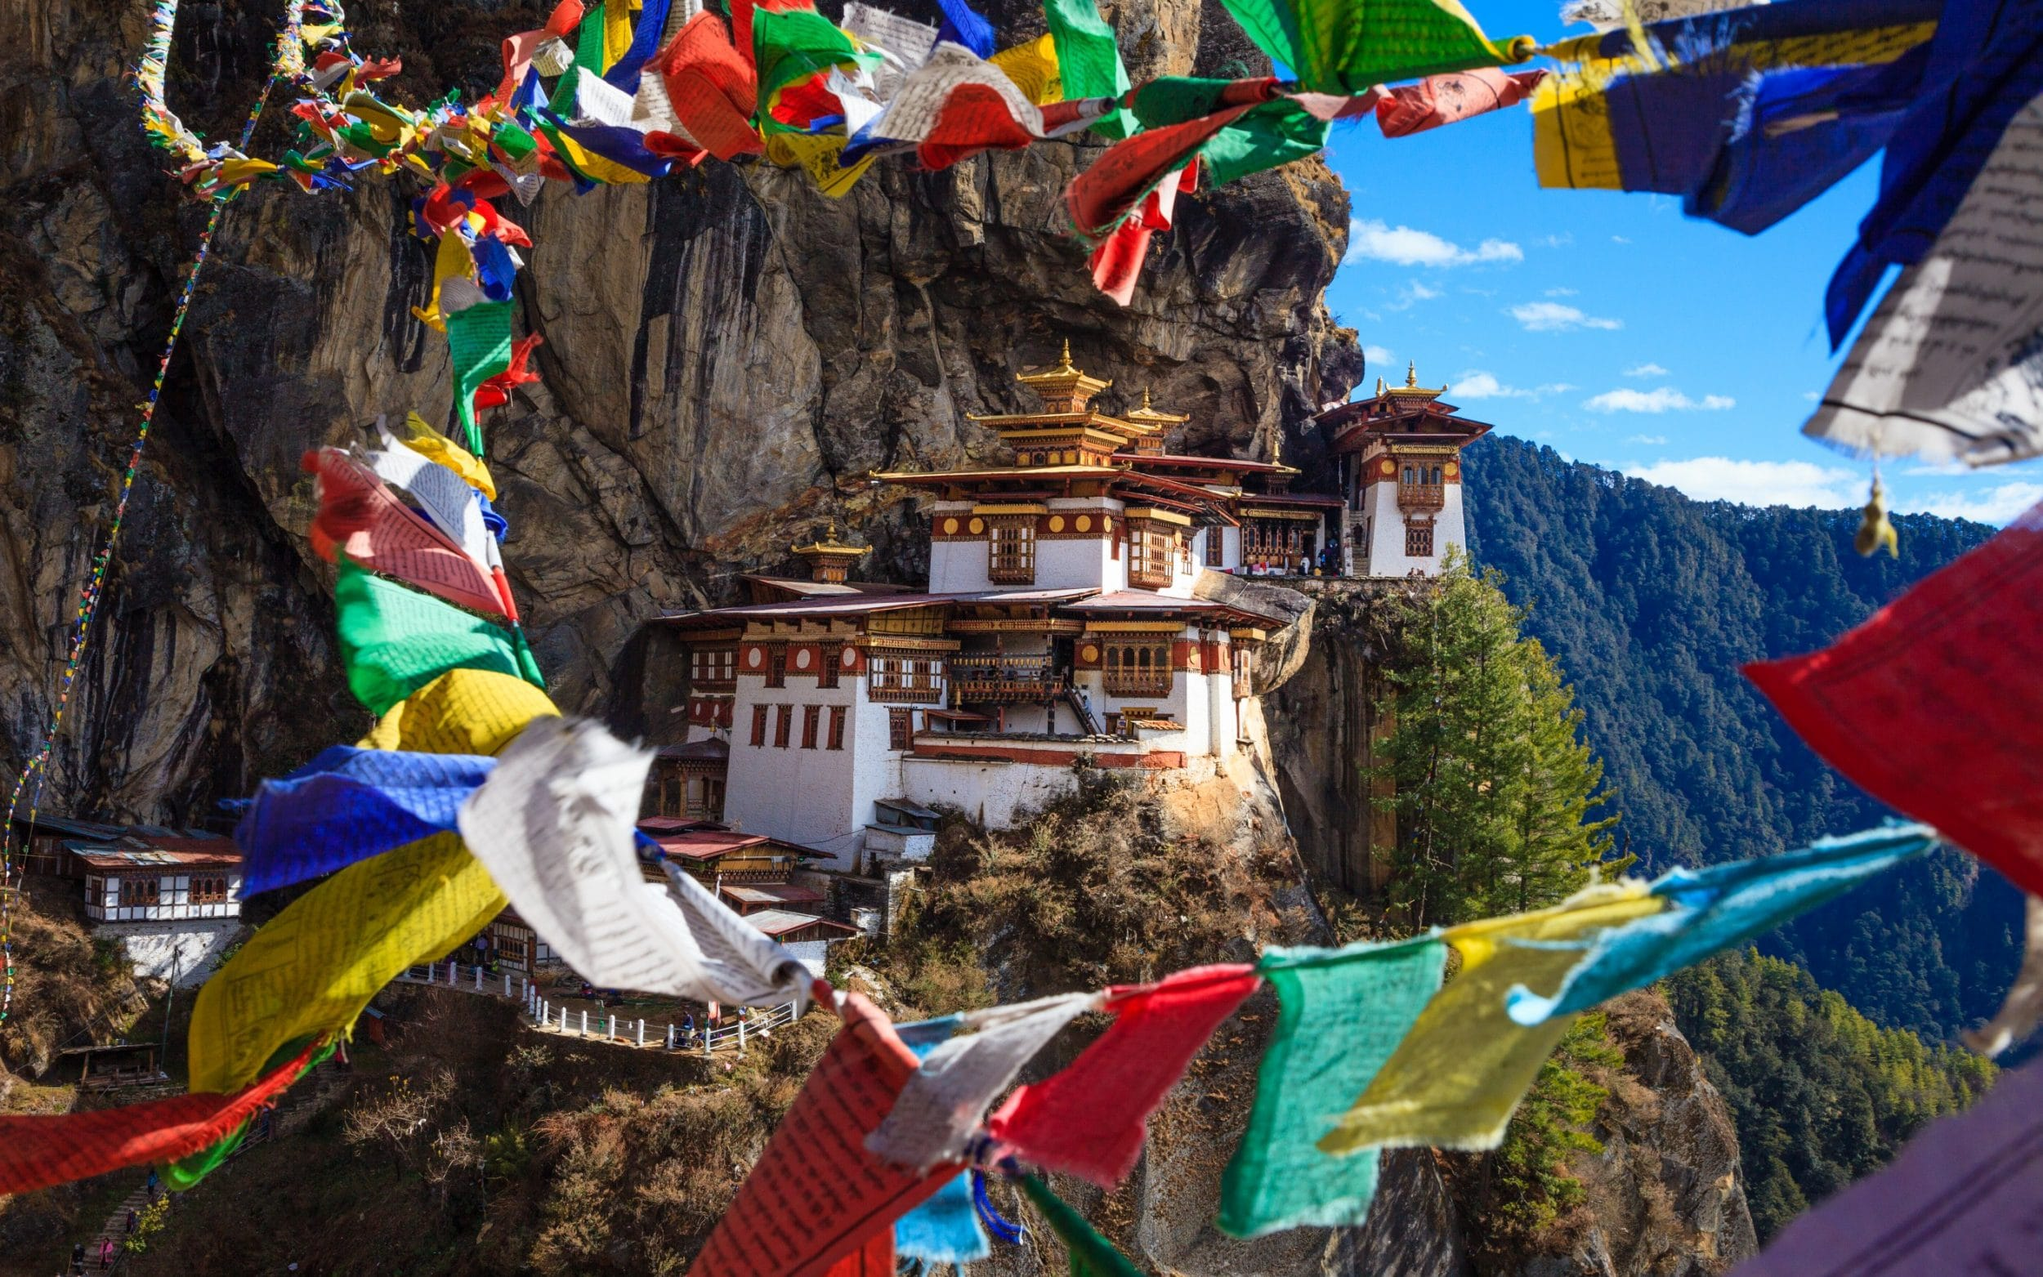
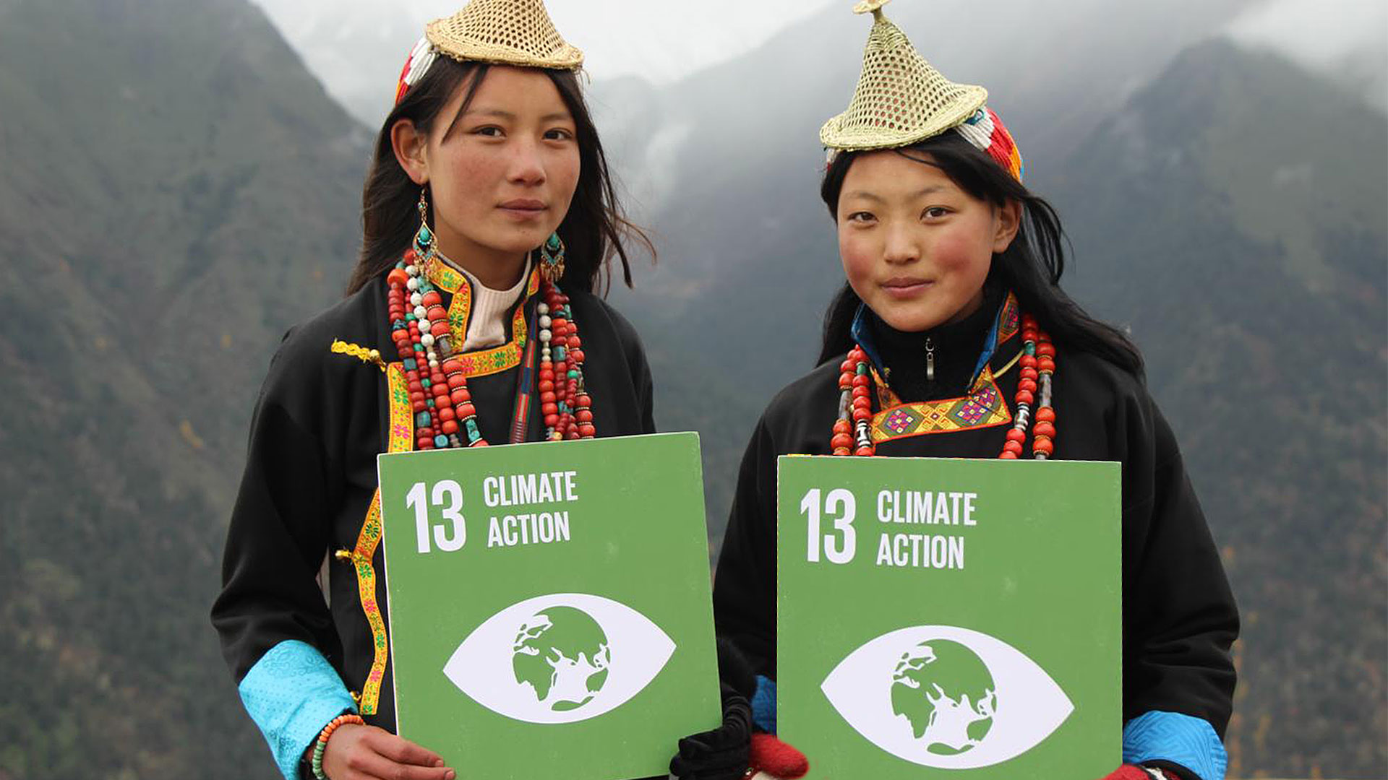
Global tourism issues in Bhutan
Over-tourism
Climate change
Economic Dependence
Cultural preservation
Fair and Ethical Tourism
Notes:
Bhutan, like many other countries, is dealing with a number of global tourist concerns that affect its tourism economy. Bhutan's major worldwide tourism challenges include:
Over-tourism: While Bhutan has a quota system in place to control the number of tourists allowed to enter the nation each year, there is still a risk of over-tourism in some locations. Overtourism can harm the environment, degrade cultural heritage sites, and put a burden on local resources.
Climate change : Climate change poses a huge threat to Bhutan's tourist business, especially given the country's reliance on natural resources and outdoor tourism activities. Weather patterns, natural calamities, and glacier melt can all have a substantial impact on the country's tourism.
Economic Dependence : Bhutan's economy is primarily reliant on tourism, making it vulnerable to economic shocks or shifts in global tourism patterns. Diversification of the economy is critical to reducing this reliance and ensuring long-term economic prosperity.
Cultural preservation : Bhutan's distinct cultural history is a major appeal for visitors, but there is a concern that tourism will lead to the monetization of cultural traditions or the loss of cultural authenticity. It is critical to strike a balance between tourist and cultural preservation efforts.
Fair and Ethical Tourism : As previously said, fair and ethical treatment of local communities, as well as environmental preservation, are critical issues in Bhutan's tourism business. These are not Bhutan-specific challenges, but rather global concerns that must be addressed in order to ensure sustainable tourism practises worldwide.
To address these global tourist concerns, a multi-stakeholder approach involving the government, commercial sector, and local communities is required. Cooperation and cooperation are essential for ensuring responsible and sustainable tourism practises in Bhutan and around the world.

Slide 14

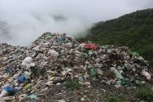
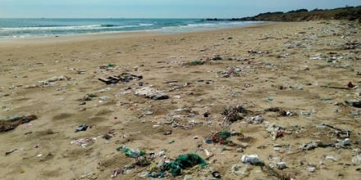

Impact of Tourism on Climate and Eco-system in Bhutan
Carbon Emissions
Waste Generation
Impact on Natural Resources
Impact on Biodiversity
Notes:
Carbon emissions: In tourism there is a much involvement of the transportation, and the emissions from vehicles used to transport tourists contribute to climate change. Bhutan has limited infrastructure for public transportation, so most tourists travel in private vehicles. The government of Bhutan has made efforts to promote electric and hybrid vehicles to reduce the carbon footprint of tourism.
Waste generation: Tourism generates a lot of waste, including plastic waste. In Bhutan, the government has banned the single use plastics, but the enforcement of this ban is not always effective. Tourists can also generate waste by leaving behind litter in natural areas.
Impact on natural resources: Tourism can also damage the natural resources, such as water and energy. In Bhutan, the government has implemented policies to promote sustainable tourism practices, such as encouraging the use of solar energy and promoting water conservation.
Impact on wildlife: Tourism also can disturb the wildlife habitats, which can have a negative impact on wildlife populations. In Bhutan the government has implemented policies to protect wildlife, including establishing national parks and conservation areas.

Slide 15
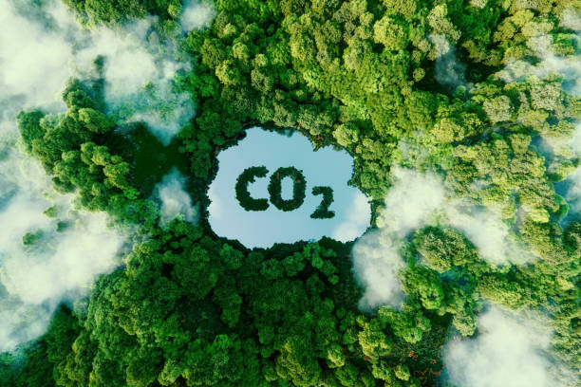

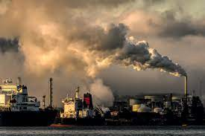
CARBON FOOTPRINTS
Why Carbon emissions occur?
Transportation
Accommodations
Activities and Excursions
Infrastructure
Notes:
Tourism is Highly carbon intensive sector……
This involves following reasons to increase carbon emissions
Tourism can contribute to carbon emissions in several ways, including:
Transportation: It involves use of airplanes, buses, cars, and cruise ships, which emit carbon dioxide gases into atomosphere.
Accommodation: Hotels, resorts and other type of accommodations emit carbon by using energy for cooling, heating, and lighting. Also production and transportation of food, water and other consumable involves in carbon emissions.
Activities and Excursions: Tourists often participate in activities and excursions such as sightseeing tours, skiing, and water sports, which can have impact on the environment by producing carbon.
Infrastructure: Development of infrastructure requires a lot of energy for construction and operation of these facilites so this also involves in the emissions of the carbon.

Slide 16

Bhutan’s Government’s Role in the Tourism Industry
Government policies
Minimum Daily package
Preserve culture and environment
Community Based tourism
Sustainable tourism certification
Notes:
Bhutan’s government plays a critical role in promoting and regulating sustainable tourism in the country. High value and low impact modal is used by the Bhutan’s government which helps to a sustainable tourism where they prioritize sustainability in tourism by cultural preservation, and provide social and economic benefits to local communities.
Here tourism is regulated through a quota system, which limits the visitors in the country to prevent over-tourism.
Government impose minimum daily package for tourists which includes accommodation, food, transportation, and a guide.
The Government play important role to preserve the culture and environment of the country, by making strict guidelines and rules.
The government encourages the community based tourism, which provides the supports to the local community of Bhutan.
Bhutan's government has established a sustainable tourism certification scheme to reward tourism enterprises that adhere to environmental and social requirements.

Slide 17
References and bibliography
Aris, Michael, and Michael Hutt(1994): Bhutan: Aspects of Culture and Development, Published in 1994
Crossette, Barbara, (1995): So Close to Heaven: The Vanishing Buddhist Kingdoms of the Himalayas, Retrieved
Olschak, Blanche C. (1971): Bhutan: Land of Hidden Treasures, pp 80
World Bank(1989): Bhutan: Development Planning in a Unique Environment
Zeppa, Jamie. (1999): Beyond the Earth and the Sky: A Journey into Bhutan
Wikipedia, : Culture of Bhutan, Article on Wikipedia, Retrieved from
https://en.wikipedia.org/wiki/Culture_of_Bhutan#:~:text=Modern%20Bhutanese%20culture%20derives%20from,Tibetan%20language%2C%20known%20as%20chhokey.

Slide 18
Presentation Video and voice Links:
https://youtu.be/Mvb4Wuw9weM

Slide 19
Thank
You

