Slide 1

Improving Patient Safety in the NHS
“A Swiss Cheese Model Analysis of the Mid Staffordshire Case”
MSc Public Health and Social Care in Practice
LCHS7006 – Quality Assurance and Service Improvements
Student Name: Simona Maria Dinu
Student ID: 2229007
Lecturer Name: Fahad Khan

Slide 2
Contents
Acronyms Used in Presentation
Overview
What Went Wrong?
Swiss Cheese Model
Applying the Swiss Cheese Model
Benchmarking – Evaluation and Improvement
Component 2 – Report Summary
Reference List

Slide 3
Acronyms Used in the Presentation
CQC – Care Quality Commission
NHS – National Health Service
NICE – National Institute for Health
and Care Excellence
RCA – Root Cause Analysis
RCP – Royal College of Physicians
PDSA – Plan-Do-Study-Act
PDCA – Plan-Do-Check-Act
CIP – Continuous Improvement Process
HCAI – Healthcare-Associated Infection
HQIP – Healthcare Quality Improvement Partnership
MDT – Multidisciplinary Team
QC – Quality Commissioning
QA – Quality Assurance
QI – Quality Improvement

Slide 4
Overview of the Case Study
Mid Staffordshire NHS Foundation Trust (2005–2009)
Major deficiencies in NHS service quality between 2005 and 2009.
Inadequate leadership, staff shortage, and weak governance contributed to unnecessary harm to patients (Francis, 2013; West et al., 2015).
Basic norms regarding patient care, dignity, and safety have not been maintained appropriately (Francis, 2013; CQC, 2013).
Financial objectives have prevailed over patient-centred care (Francis, 2013; Berwick, 2013).
The Francis Inquiry initiated major quality and safety reforms in NHS (Department of Health, 2013).
Why this case is important
It highlights that safe care relies on effective leadership, governance, and an open organisational culture (West et al., 2015).

Slide 5
What Went Wrong?
Major Quality Gaps
Personnel shortages and inadequate workforce planning (Griffiths et al., 2016).
Weak management and inefficient clinical leadership (Francis, 2013; Mannion and Davies, 2018).
Complaints and safety concerns were often overlooked (Francis, 2013; Freedom to Speak Up Review, 2015).
Poor communication and lack of risk management caused delays in taking action (Francis, 2013; Dixon-Woods et al., 2014).
A "defensive" culture affected the learning process and compromised patient safety (Francis, 2013; Reason, 2000).
Critical Reflection
These failures have been systemic, more than individual, which highlights the need for improved quality assurance within the organisation (Reason, 2000; Francis, 2013).

Slide 6
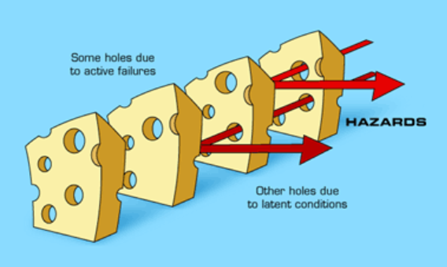
Swiss Cheese Model
Swiss Cheese Model explains how multiple system failures can overlap and cause patient harm (Reason, 2000).
At Mid Staffordshire, failures were observed in areas such: as leadership, workforce, governance, and management (Francis, 2013; Berwick, 2013).
When these weaknesses were aligned, patient safety was compromised, therefore, every layer of defence must effectively function to prevent damages (Reason, 2000).
Source: Duke University (n.d)

Slide 7
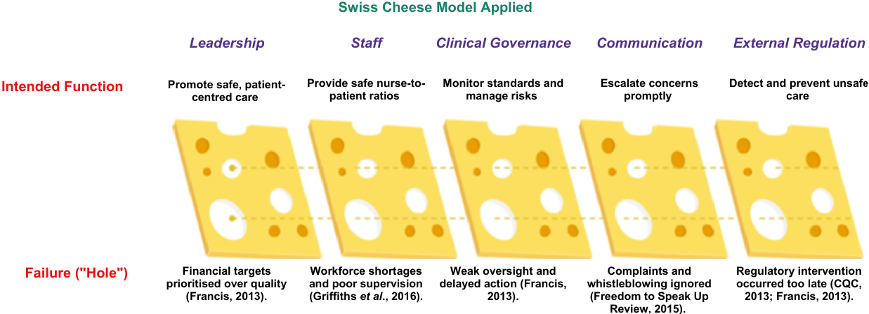
Applying the Swiss Cheese Model

Slide 8
Benchmarking – Evaluation and Improvement
Quality Indicator | Best Practice (NHS/CQC) | Mid Staffordshire
Patient-centred care | Compassionate, safe care (NICE, 2023). | Basic care standards not maintained (Francis, 2013).
Nurse staffing | Safe staffing levels (NICE, 2014). | Persistent staff shortages (Francis, 2013).
Clinical governance | Effective monitoring and learning (CQC, 2023). | Weak governance and poor oversight (Francis, 2013).
Safety culture | Open reporting and learning (NHS England, 2022). | Defensive culture and ignored concerns (Francis, 2013).
Evaluation
There were considerable gaps between NHS standards and everyday practice.
Consistent quality improvements, stronger leadership, and periodic audits are necessary to avoid similar issues in the future (CQC, 2023; NHS England, 2022).

Slide 9
Component 2 – Report Summary
The report will analyse this case study in detail by:
Outlining the context of healthcare quality failures in Mid Staffordshire.
Analysing the underlying causes using the Fishbone diagram, the 5 Whys, and the Donabedian model.
Performing a SWOT analysis to evaluate the organisation's strengths and weaknesses.
A critical discussion concerning policy and governance shortcomings, grounded on modern literature.
Evidence-based recommendations, applying the PDSA, Lean, and Six Sigma methodologies to strengthen patient safety and care quality (Taylor et al., 2014; NHS England, 2022).

Slide 10
Reference List
Berwick, D. (2013) A promise to learn – a commitment to act: Improving the safety of patients in England. London: Department of Health. Available at: https://assets.publishing.service.gov.uk/media/5a7b3d40ed915d4147620f4e/berwick-report.pdf (Accessed: 18 June 2026).
Care Quality Commission (CQC) (2013) Review of lessons learned from monitoring of Mid Staffordshire NHS Foundation Trust. Available at: https://www.cqc.org.uk/publications/themes-care/review-lessons-learned-monitoring-mid-staffordshire-nhs-foundation-trust (Accessed: 17 June 2026).
Care Quality Commission (CQC) (2023) Our strategy and approach to regulation. Available at: https://www.cqc.org.uk/about-us/our-strategy (Accessed: 18 June 2026).
Department of Health (2013) Patients First and Foremost: The Initial Government Response to the Report of the Mid Staffordshire NHS Foundation Trust Public Inquiry. Available at: https://assets.publishing.service.gov.uk/media/5a7b79b0ed915d01ba1c6b7f/Patients_First_and_Foremost.pdf (Accessed: 18 June 2026).
Dixon-Woods, M., Baker, R., Charles, K., Dawson, J., Jerzembek, G., Martin, G., McCarthy, I., McKee, L., Minion, J., Ozieranski, P., Willars, J. and West, M.A. (2014) Culture and behaviour in the English National Health Service: Overview of lessons from a large multimethod study, BMJ Quality & Safety, 23(2), pp. 106–115. Available at: https://qualitysafety.bmj.com/content/23/2/106 (Accessed: 15 June 2026).
Francis, R. (2013) Report of the Mid Staffordshire NHS Foundation Trust Public Inquiry. London: The Stationery Office. Available at: https://assets.publishing.service.gov.uk/government/uploads/system/uploads/attachment_data/file/279124/0947.pdf (Accessed: 16 June 2026).
Freedom to Speak Up Review (2015) Freedom to Speak Up: An Independent Review into Creating an Open and Honest Reporting Culture in the NHS. Available at: https://www.gov.uk/government/publications/freedom-to-speak-up-review (Accessed: 18 June 2026).
Griffiths, P., Ball, J., Drennan, J., Dall'Ora, C., Jones, J., Maruotti, A., Pope, C., Recio-Saucedo, A. and Simon, M. (2016) Nurse staffing and patient outcomes: Strengths and limitations of the evidence to inform policy and practice, International Journal of Nursing Studies, 63, pp. 213–225. Available at: https://www.sciencedirect.com/science/article/pii/S0020748916301127 (Accessed: 17 June 2026).

Slide 11
Mannion, R. and Davies, H.T.O. (2018) Understanding organisational culture for healthcare quality improvement, BMJ, 363, k4907. Available at: https://www.bmj.com/content/363/bmj.k4907 (Accessed: 14 June 2026).
NHS England (2022) Patient Safety Incident Response Framework (PSIRF). Available at: https://www.england.nhs.uk/patient-safety/patient-safety-incident-response-framework/ (Accessed: 19 June 2026).
National Institute for Health and Care Excellence (NICE) (2014) Safe staffing for nursing in adult inpatient wards (SG1). Available at: https://www.nice.org.uk/guidance/sg1 (Accessed: 18 June 2026).
National Institute for Health and Care Excellence (NICE) (2023) Standards and indicators for quality improvement. Available at: https://www.nice.org.uk/standards-and-indicators (Accessed: 18 June 2026).
Reason, J. (2000) Human error: Models and management, BMJ, 320(7237), pp. 768–770. Available at: https://www.bmj.com/content/320/7237/768 (Accessed: 13 June 2026).
Taylor, M.J., McNicholas, C., Nicolay, C., Darzi, A., Bell, D. and Reed, J.E. (2014) Systematic review of the application of the Plan–Do–Study–Act method to improve quality in healthcare, BMJ Quality & Safety, 23(4), pp. 290–298. Available at: https://qualitysafety.bmj.com/content/23/4/290 (Accessed: 19 June 2026).
West, M.A., Eckert, R., Steward, K. and Pasmore, B. (2015) Developing Collective Leadership for Health Care. London: The King's Fund. Available at: https://www.kingsfund.org.uk/publications/developing-collective-leadership-health-care (Accessed: 17 June 2026).

