Slide 1
University of Wales Trinity Saint David Birmingham
Module: Psychology in Health and Social Care
Module Code: LCHS4010
Name of the student: Shabinah Nargas
ID number: 2418906
Name of the lecturer: Alice Clayton

Slide 2
Introduction
Good morning I am Shabinah a Trainee Early years support worker within the children's centre. My role is to analyse Isaac's developmental needs as a four-year-old boy attending the centre and to create a support plan. This assignment examines how Isaac's early experiences could have affected his psychological and developmental outcomes including being raised by a single parent with post-natal depression, low confidence and limited social support. Drawing on relevant psychological theories, this will propose evidence-based support and a plan to address identified needs.I will focus on Erik Erikson’s psychological theory (1902-1994)

Slide 3
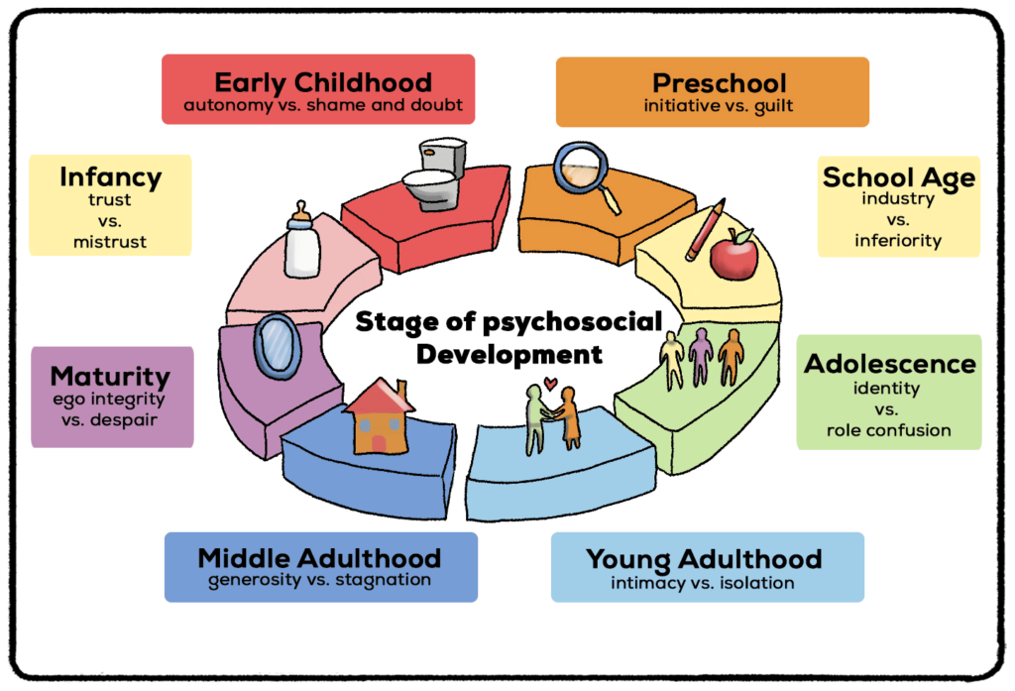
Overview of the theory
Following Erikson's theory, there are eight phases of psychosocial development throughout the course of a person's lifetime.
Each stage is characterized by a fundamental conflict whose resolution affects social functioning and personality (Bing, 2017).
He proposed that to develop a healthy personality, we go through these stages, each of which is characterized by a primary conflict or psychological crisis that needs to be resolved (McLeod, 2025).
Picture(Janani, 2024)

Slide 4
Some important key concepts from this theory are:
According to Erikson, development continues from early childhood into older life.
There are stages because of the epigenetic principle, which says that growth happens in a set order and that each stage builds on the one before it.
There is a main struggle in each of the eight stages, such as Trust vs. Mistrust in Stage 1 (McLeod, 2025).
In Stage 2 ‘Autonomy vs. shame’ a child needs to learn to explore their world with encouragement.
In Stage 3 ‘Initiative vs. guilt’ a child can make choices in life and shouldn’t be criticised for trying new things (Boyd and Bee, 2009)

Slide 5
Application to Issac
Isaac's mother has postnatal depression, so he might not have always been able to rely on her and so developed ‘mistrust’. This might explain why he is particularly anxious when she leaves him at the children’s Centre.
Issac is now at an age where he needs encouragement in order to build his confidence as he explores the world. As he lacks confidence this might mean he won’t develop in his social skills.
Language Development Theories: From Chomsky to Bruner and Beyond describes how children pick-up vocabulary, grammar, words, and interaction. Four perspectives are contrasted: interacting, behaviourism, cognitive, and nativist. According to Chomsky (1959), children acquire language by more than only reinforcement. Bruner (1960) demonstrated to adults how adult Support, and conversation may structure language growth, this is very important for interaction in Isaac’s case. (Structural-learning.com, 2026)

Slide 6
Practical strategies
Isaac should be allocated a key worker in the Children’s Centre so that he can develop a relationship with them in order to build his trust and make him feel more secure.
Issac’s mum should be supported with her mental well-being. She could also benefit from parenting classes to learn how to interact with Isaac, this will help with self-confidence.
It is important to work on Issac’s language ability, for example, by working with a speech therapist to support Isaac’s speech and language, communication skills, we will see faster results. Everyone must collaborate. This implies that the Children's Centre will collaborate closely with his mum and other professionals who may be involved.

Slide 7
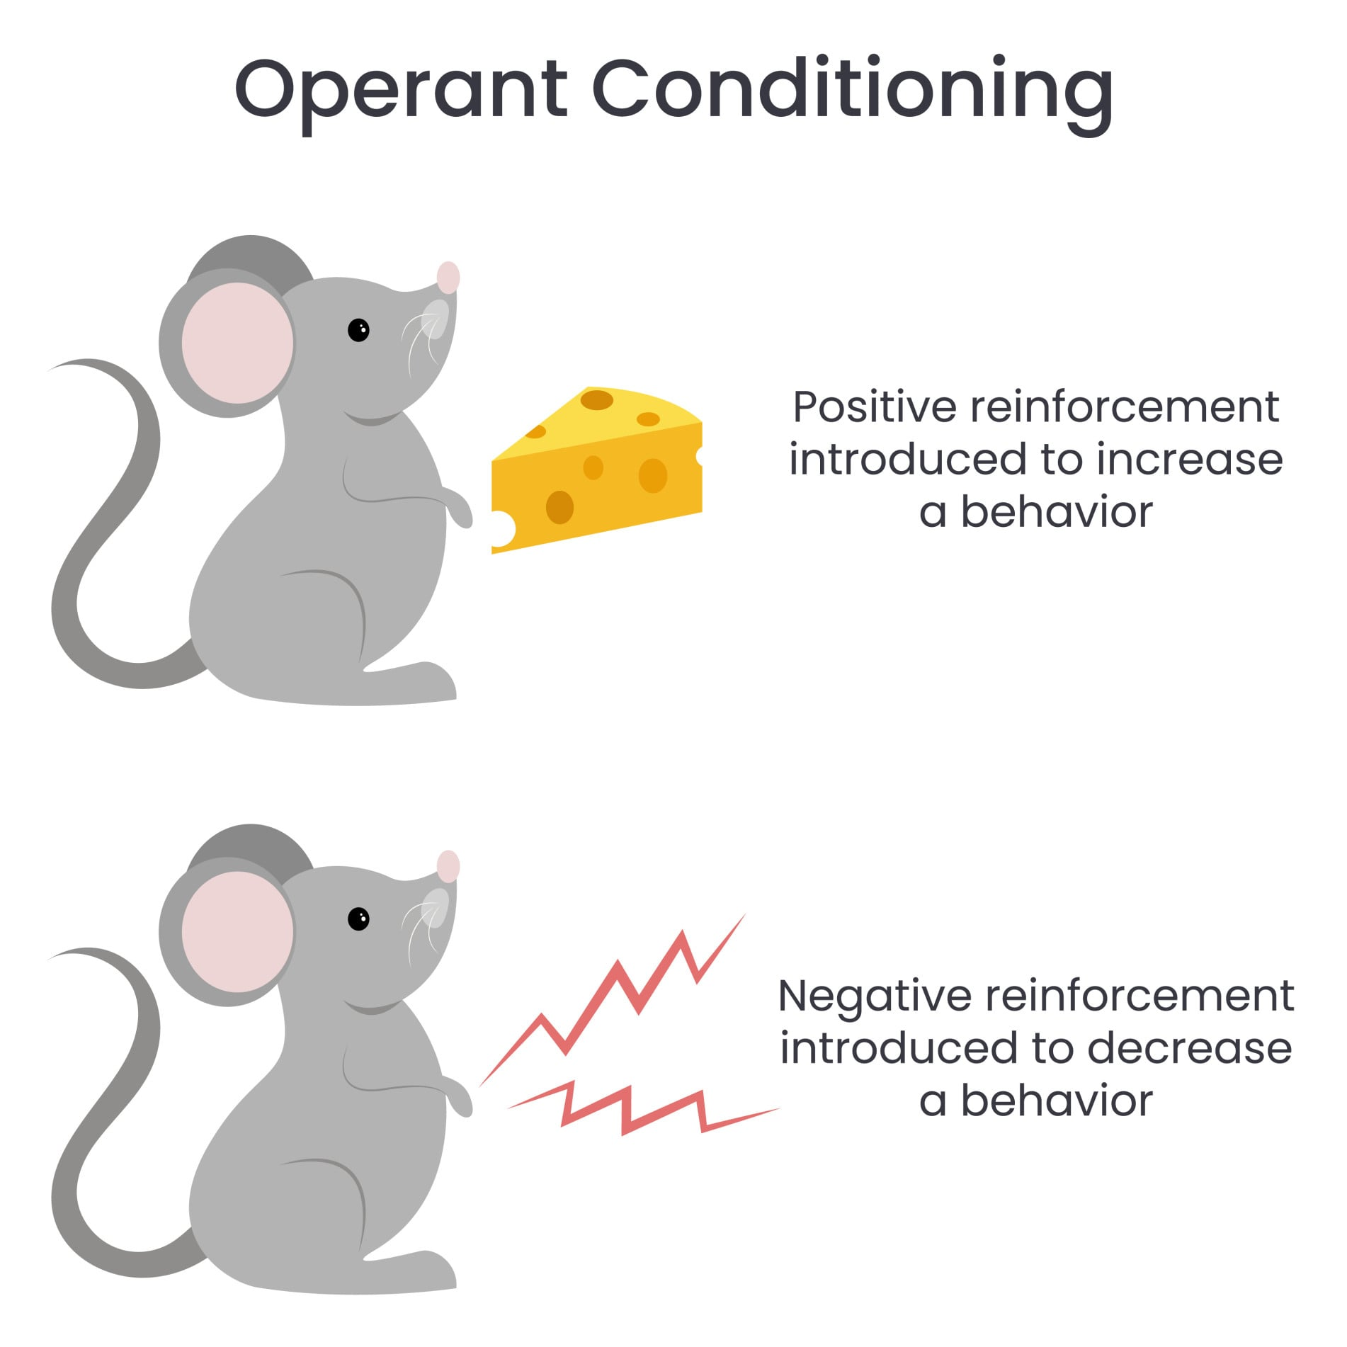
B.F. Skinner’s Theory in Operant conditioning in Psychology is a kind of learning in which actions are molded by their outcomes in this case this is a good way of interacting with Isaac.
Positive reinforcement;
Adding something to encourage good behavior being repeated E.g. praise or recognition, food, extra time, choice of activity.
Negative reinforcement;
For instance, losing or cutting down on golden time, or losing points, losing a favourite toy. (Uwtsd.ac.uk, 2026)
(Simplypsychology.org, 2025)

Slide 8
Nature versus nurture
Nature is the biological influence on our behaviour, behaviour and nurture is the environmental influence.
Issac is only four-years-old so his brain is still developing. Also, he might just naturally have an introverted temperament caused by the activity in his central nervous system,
However, there are lots of factors in his environment which will also impact him such as the love and care he receives from his mum and the fact he has no father figure in his life, which is the influence of nurture.
In this case, we will critically examine the extent to which Isaac's development and well-being are shaped by the environmental influences, including caregiving, social interaction, and key transitions. Drawing on relevant psychology theories. To which analyse had these factors have impacted Isaac and propose an evidence -based support plan for him.

Slide 9
Evaluation
Strengths
Erikson’s theory considers the whole of the lifespan and how social relationships influence us at every stage.
His ideas can be applied to health and social care settings in-order to create practical strategies.
Weaknesses
Erikson’s theory can be criticised for being gender-biased and culture-biased.
It might also be out-dated because society has changed a lot.
An alternative theory which might be more useful is operant conditioning (Skinner) which is learning through consequences and rewards. Issac might benefit from having a reward system which they can use at the Children’s Centre and at home to encourage him to use language.
Additionally, Piaget’s theory of cognitive development could help us promote Issac’s learning through play. For example, Piaget said children at his age are egocentric and are unable to see the world from others’ perspectives.

Slide 10
Conclusion
Overall, Erikson’s theory of psychosocial development explains that Issac’s case study very well because it highlights the importance of building his confidence so that he can play and interact with others. This assignment evaluated the contribution of psychology in health and social care. Using Isaac's case to examine how early experiences and environmental factors shape a person's development. It drew on relevant psychological theories to inform an evidence-based support plan.

Slide 11
References
McLeod, S. (2025). Erik Erikson’s Stages of Psychosocial Development. [online] Simply Psychology. Available at: https://www.simplypsychology.org/Erik-Erikson.html.
Janani (2024). Understanding Erik Erikson’s Stages for Caregivers and Educators. [online] Dyslexia Association of Singapore. Available at: https://das.org.sg/understanding-erik-eriksons-stages-for-caregivers-and-educators/.
Proquest.com. (2026). Redirecting. [online] Available at: https://ebookcentral.proquest.com/lib/trinity/detail.action?docID=5843856.. [Accessed 09 Jun. 2026].
Uwtsd.ac.uk. (2026). Available at: https://librarysearch.uwtsd.ac.uk/discovery/fulldisplay?docid=alma99100339760302421&context=L&vid=44WHELF_UWTSD:44WHELF_UWTSD_VU1&lang=en&search_scope=MyInst_and_CI&adaptor=Local%20Search%20Engine&isFrbr=true&tab=Everything&query=any [Accessed 10 Jun. 2026].

Slide 12
Structural-learning.com. (2026). Language Development Theories: From Chomsky to Bruner and Beyond. [online] Available at: https://www.structural-
learning.com/post/language-development-theories.
Uwtsd.ac.uk. (2026). Log in to the site | Home. [online] Available at: https://moodle.uwtsd.ac.uk/course/section.php?id=177606 [Accessed 11 Jun. 2026].
McLeod, S. (2025). Operant conditioning: What it is, how it works, and examples. [online] Simply Psychology. Available at: https://www.simplypsychology.org/operant-conditioning.html.

