Slide 1

Name: Assma Zahoor
Student ID: 2242809
Module: Population Health and Digital Health Promotion
Module Code: LCHS7009
Lecturer: Raheela Shaikh
Assignment Title: Component 2 Poster – Blog 2

Slide 2



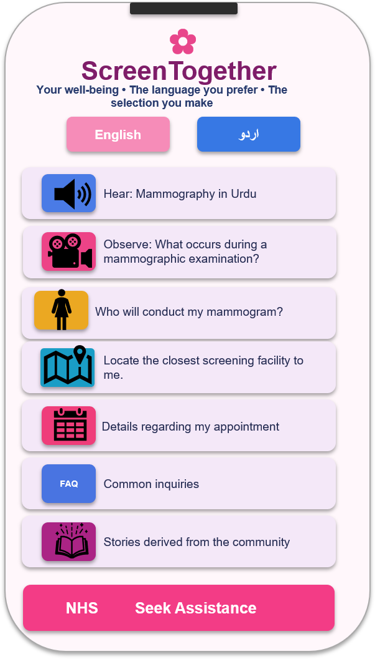
ScreenTogether
A culturally customised digital initiative to enhance breast screening participation among British Pakistani women in England
Your well-being • The language you prefer • The selection you make
(NareA, 2025)
(The Healthy, 2026)
Background
Breast cancer is the main form of cancer among women in the UK.
(Cancer Research UK, 2026)
Key Features
Language English & Urdu
Audio & Videos explaining screening process
NHS breast screening participation continues to be inconsistent throughout England.
(NHS England, 2026)
Text messages reminding of appointments (Kerrison et al., 2015)
Locating screening centers
Obstacles encompass differences in language, insufficient understanding, humility, confidentiality, and reliance.
(Woof et al., 2020a; Khattak et al., 2023)
British-Pakistani share real stories (Woof, 2020)
FAQ
Source: NHS England (2026)
Expected Outcomes
Health Promotion Principles & Values
Behaviour Change Theory: COM-B Model
Higher screening rates
increased knowledge and confidence
Equity
Minimises unnecessary obstacles (OHID, 2022b)
Participation
Jointly developed with British-Pakistani women (Khattak et al., 2023)
Capability
Skills + Knowledge
Reduce health disparities
BEHAVIOUR
Better informed breast-screening choices.
Early detection and better results
Opportunity
Environment support
Empowerment
Empowers women to make educated decisions (NICE, 2021)
Conclusion
ScreenTogether integrates digital health advancement, collaborative design, and the COM-B framework to tackle adjustable obstacles and facilitate informed choices regarding breast screening.
Digital assistance ought to enhance the efforts of reliable experts and traditional methods.
(Khattak et al., 2023; OHID, 2022b)
Respect
Culturally suitable and encompassing
Motivation
Belief
Confidence
(Michie, van Stralen and West, 2011)

Slide 3
References
Ahmad, F., Cameron, J.I. and Stewart, D.E. (2005) ‘A tailored intervention to promote breast cancer screening among South Asian immigrant women’, Social Science & Medicine, 60(3), pp. 575–586. doi: 10.1016/j.socscimed.2004.05.018.
Cancer Research UK (2026) Breast cancer statistics. Available at: https://www.cancerresearchuk.org/health-professional/cancer-statistics/statistics-by-cancer-type/breast-cancer (Accessed: 4 October 2026).
Kerrison, R.S., Shukla, H., Cunningham, D., Oyebode, O. and Friedman, E. (2015) ‘Text-message reminders increase uptake of routine breast screening appointments: a randomised controlled trial in a hard-to-reach population’, British Journal of Cancer, 112(6), pp. 1005–1010. doi: 10.1038/bjc.2015.36.
Khattak, H.M., Woof, V.G., French, D.P., Donnelly, L.S., Ruane, H., Ulph, F., Qureshi, N., Khan, N., Evans, D.G. and Robb, K.A. (2023) ‘The role of knowledge, primary care and community engagement to improve breast-screening access for Pakistani women in the United Kingdom: a secondary analysis of a qualitative study’, Journal of Health Services Research & Policy, 28(3), pp. 149–156. doi: 10.1177/13558196231155824.
Michie, S., van Stralen, M.M. and West, R. (2011) ‘The behaviour change wheel: a new method for characterising and designing behaviour change interventions’, Implementation Science, 6, 42. doi: 10.1186/1748-5908-6-42.
NHS England (2026) Breast Screening Programme, England, 2024–25. Available at: https://digital.nhs.uk/data-and-information/publications/statistical/breast-screening-programme/england-2024-2025 (Accessed: 4 October 2026).
NareA (2025) Benci Berujung Teman. GIGA MIBS, Mega Islamic Boarding School. Available at: https://giga.mega.sch.id/posts/benci-berujung-teman-2 (Accessed: 4 October 2026).
National Institute for Health and Care Excellence (NICE) (2021) Shared decision making (NG197). Available at: NICE guideline NG197 (Accessed: 4 October 2026).
Office for Health Improvement and Disparities (OHID) (2022a) NHS population screening: effective text message use. Available at: https://www.gov.uk/government/publications/nhs-population-screening-effective-text-message-use (Accessed: 4 October 2026).
Office for Health Improvement and Disparities (OHID) (2022b) NHS population screening: identifying and reducing inequalities. Available at: https://www.gov.uk/guidance/nhs-population-screening-identifying-and-reducing-inequalities (Accessed: 4 October 2026).
Office for Health Improvement and Disparities (OHID) (2022c) Screening text message principles. Available at: https://www.gov.uk/government/publications/nhs-population-screening-effective-text-message-use/screening-text-message-principles (Accessed: 4 October 2026).
The Healthy (n.d.) Cancer ribbon colors: The ultimate guide. Available at: https://www.thehealthy.com/cancer/cancer-ribbon-colors/ (Accessed: 4 October 2026).

Slide 4
UK National Screening Committee (UK NSC) (2025) Principles of population screening. Available at: https://www.gov.uk/guidance/principles-of-population-screening/principles-of-screening (Accessed: 4 October 2026).
Woof, V. (2020) ‘Making breast screening more accessible: views from British-Pakistani women’, PHE Screening Blog, 19 February. Available at: https://phescreening.blog.gov.uk/2020/02/19/breast-screening-accessible-british-pakistani/ (Accessed: 4 October 2026).
Woof, V.G., Ruane, H., Ulph, F., French, D.P., Qureshi, N., Khan, N., Evans, D.G.R. and Donnelly, L.S. (2020a) ‘Engagement barriers and service inequities in the NHS Breast Screening Programme: views from British-Pakistani women’, Journal of Medical Screening, 27(3), pp. 130–137. doi: 10.1177/0969141319887405.
Woof, V.G., Ruane, H., Ulph, F., French, D.P., Qureshi, N., Khan, N., Evans, D.G.R. and Donnelly, L.S. (2020b) ‘The introduction of risk stratified screening into the NHS breast screening programme: views from British-Pakistani women’, BMC Cancer, 20, 452. doi: 10.1186/s12885-020-06944-7.
World Health Organization (WHO) (1986) Ottawa Charter for Health Promotion. Geneva: World Health Organization. Available at: https://www.who.int/publications/i/item/ottawa-charter-for-health-promotion (Accessed: 4 October 2026).

