Slide 1

MSc in Cybersecurity and Digital Forensics
Title: Applied Network Security: Contemporary Research, Practical Work, and Demonstrations of Principles and Practices
Lecturer: Renuga Jayakumar
Student Name: Md. Tarequr Rahman Sharif
Student ID Number: 2437470
Submission Date: 1 May 2026

Slide 2
Lab Objective
• Check SmartUpdate software blades, licenses & contracts
• Configure Security Gateway as firewall enforcement point
• Definition of policy by creating host and gateway objects
• Create access control rules with service-based conditions
• Publish and Install policy on Security Gateway
• Validate connectivity - ICMP testing
Notes:
This lab was aimed to configure and verify a firewall policy using Check Point SmartConsole
The SmartUpdate software blades, licenses and contracts were first validated to determine whether systems are ready.
Next, the Security Gateway was set as the enforcement point.
Following this the host and gateway objects were constructed to define security policies.
Implemented service-based access control rules for traffic of type HTTP, SSH and ICMP.
Eventually, the policy was published and the gateway installed and connectivity confirmed through ICMP testing.

Slide 3
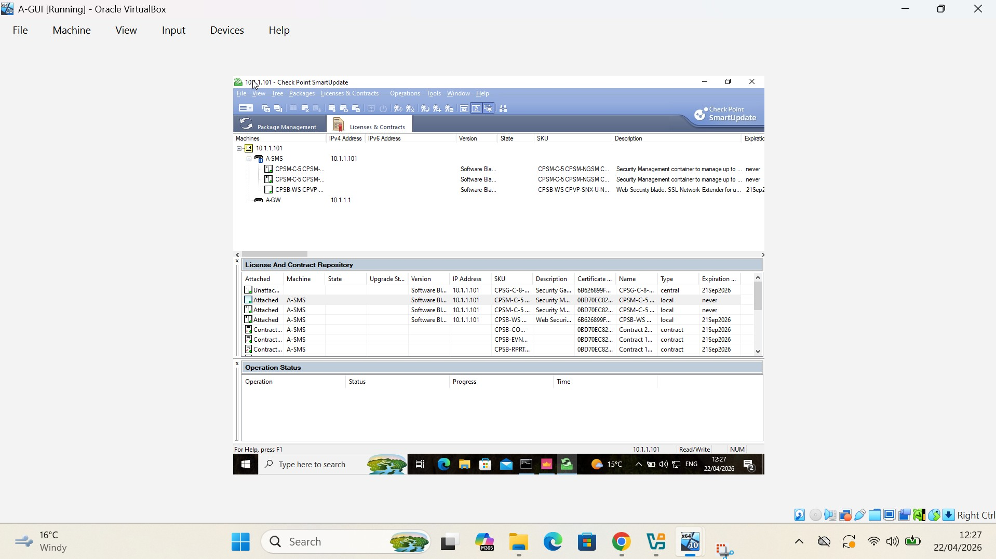
Hints for verifying SmartUpdate License & Package Management
Connect verified status for Security Management Server (A-SMS)
Confirmation of Security Gateway (A-GW) registration in SmartUpdate
· Checked available installed software blades for firewall functionality
· Verified licenses attached to security components
· Reviewed the contracts repository to check which had been eligible for an update
· Verified platform-before-policy release
· Verified Initialized setup of enterprise firewall environment
Notes:
On this slide I confirmed the SmartUpdate License and Package Management configuration.
At this stage I validated that Security Management Server and Security Gateway were communicating and registered.
I verified that the necessary software blades and licenses were enabled (licences are free for NGFW features) and also checked whether update contracts were in order as well.
This step is a must because it will guarantee that your firewall environment is completely ready prior to deploying access control policies in an enterprise network security setup.

Slide 4
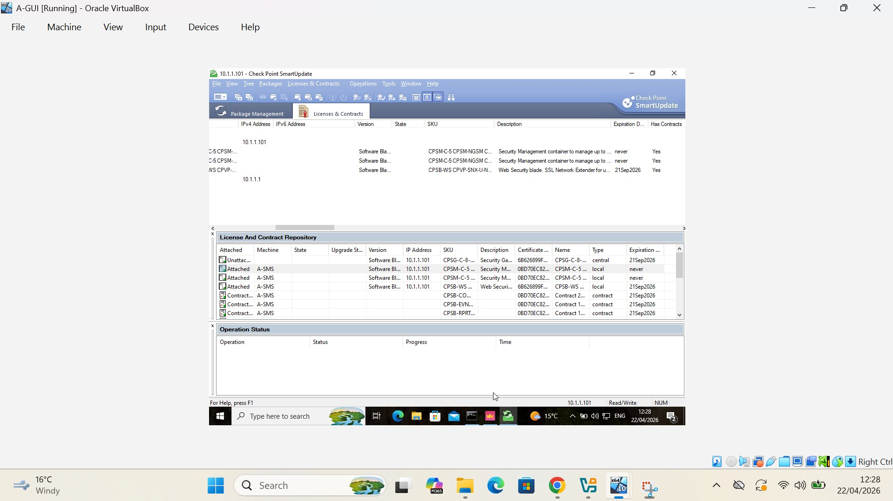
License & Contract Repository Validation
· Active licenses which are valid against the Security Management Server (A-SMS)
· Installed Software Blades – Contract Status
· Qualified for updates Threat Prevention
· Verified expiry of Security Licenses
· Validated single license manager functionality
· Support for enterprise firewall features on a
*gateway(R): Hardware-based, less or no programming gateway(R)
· Environment readiness ensured before policy deployment
Notes:
On this slide, I verified the License and Contract Repository using SmartUpdate.
I verified that active licenses were indeed attaching to the Security Management Server and that installed software blades had support contracts.
I performed Threat Prevention services update eligibility verification and the license expiry check.
This step allows making sure all the enterprise firewall security features are working before performing access control policies deployment.

Slide 5
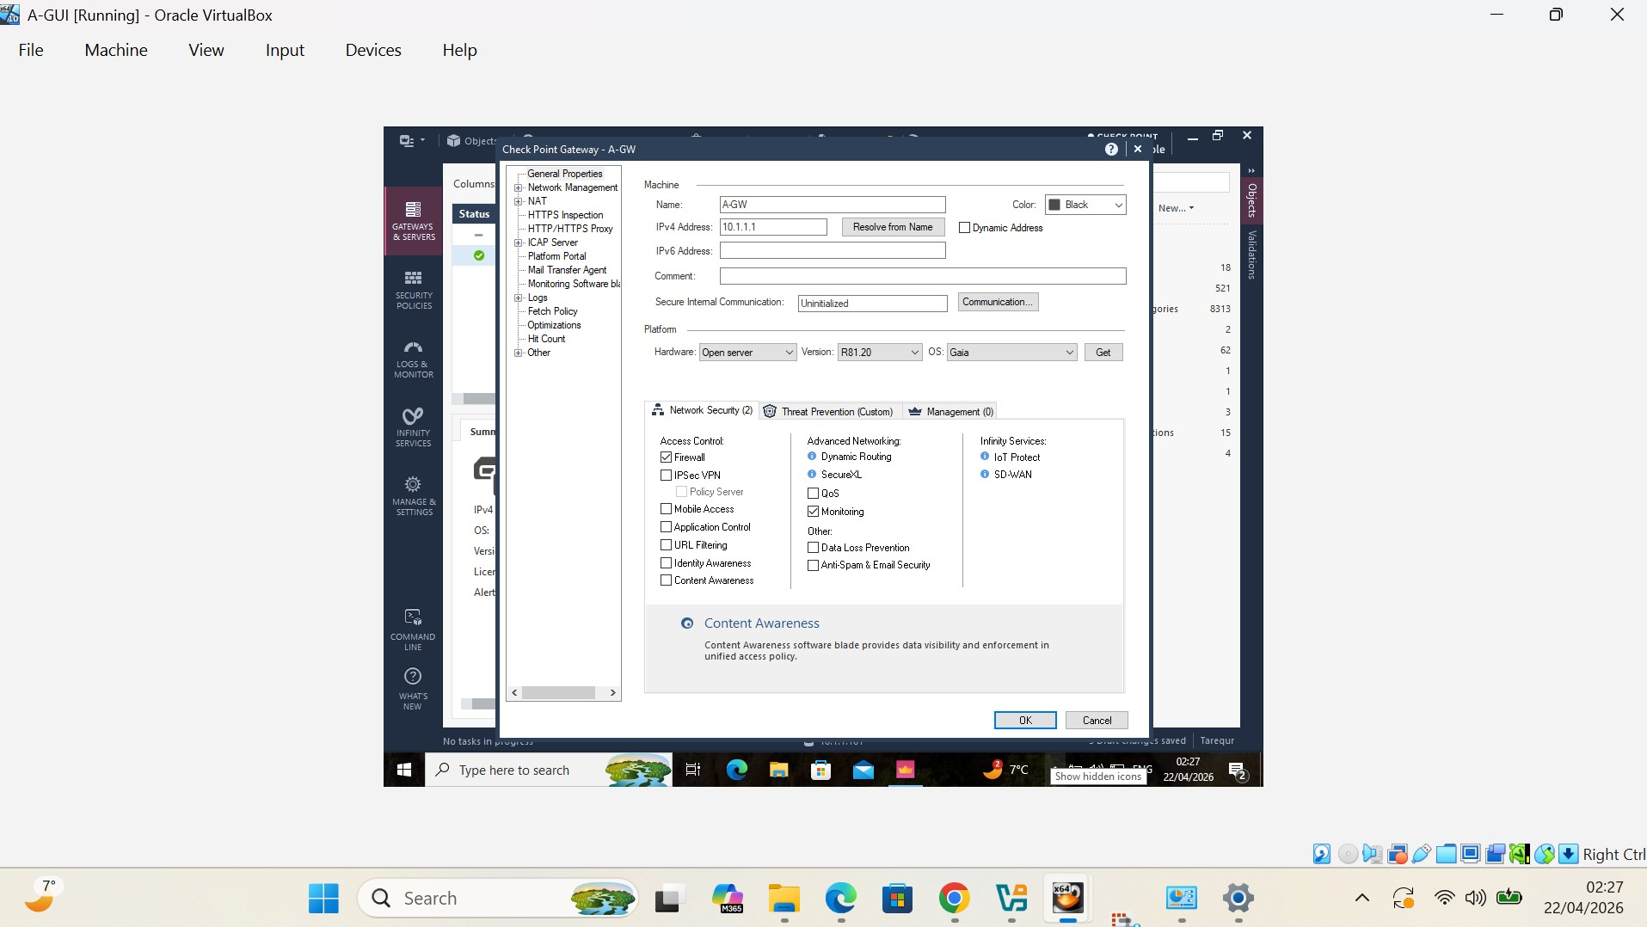
Security Gateway Settings (A-GW)
Configured Security Gateway object (A-GW) as the firewall enforcement member
Plan to Control network distribution via assigned router gateway IPv4 address of 10.1.1.1
Gaia OS version R81 on verified platform 20
Enabled Firewall blade on the SSN product for inspecting traffic and enforcing access control
Activated gateway -- enterprise gateway as the policy enforcement point in Gateway readiness confirmed for Access Control and Threat Prevention policies
Created secure communication in between Management Server and Gateway
Notes:
Here I set up Security Gateway object that will be main firewall enforcement point in enterprise.
I made it the gateway IP address 10.1.1.1 and confirmed that its working on Gaia OS R81 + or last version of this model 20.
I turned on the Firewall blade to inspect network traffic, and enfroce access control policies.
I configured secure communication between Management Server and the Gateway so it was ready to deploy policies and threat prevention protective.

Slide 6
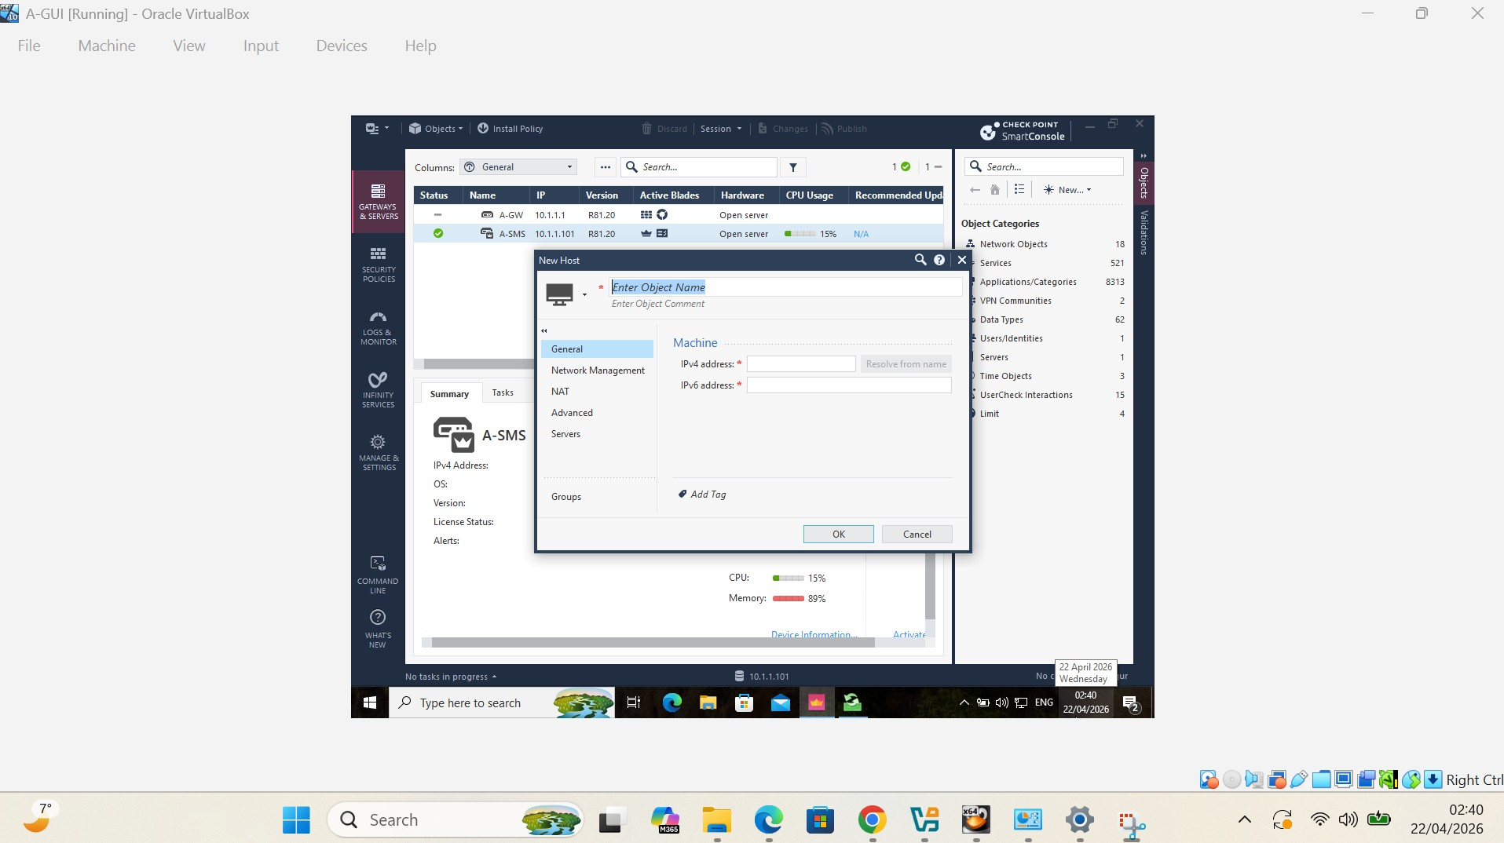
Host Object Filling (A-GUI-201)
· New Host Object Created to Represent one Internal Network Device
· Firewall access control policy allowed device identification setting
· Fulfilled Host object to perform IP address assignment and rule setup
· Enabled structured traffic filtering based on SmartConsole objects
· Better management and visibility of network endpoints in security policies
Notes:
Now, for this slide I am used host object as A-GUI-201 to represent internal network device in SmartConsole.
This enables the firewall to recognize the device by its IP address and enforce access policies against that endpoint.
Leveraging host objects facilitates more granular filtering of structured traffic, as well as greater visibility and management of enterprise network security devices.

Slide 7

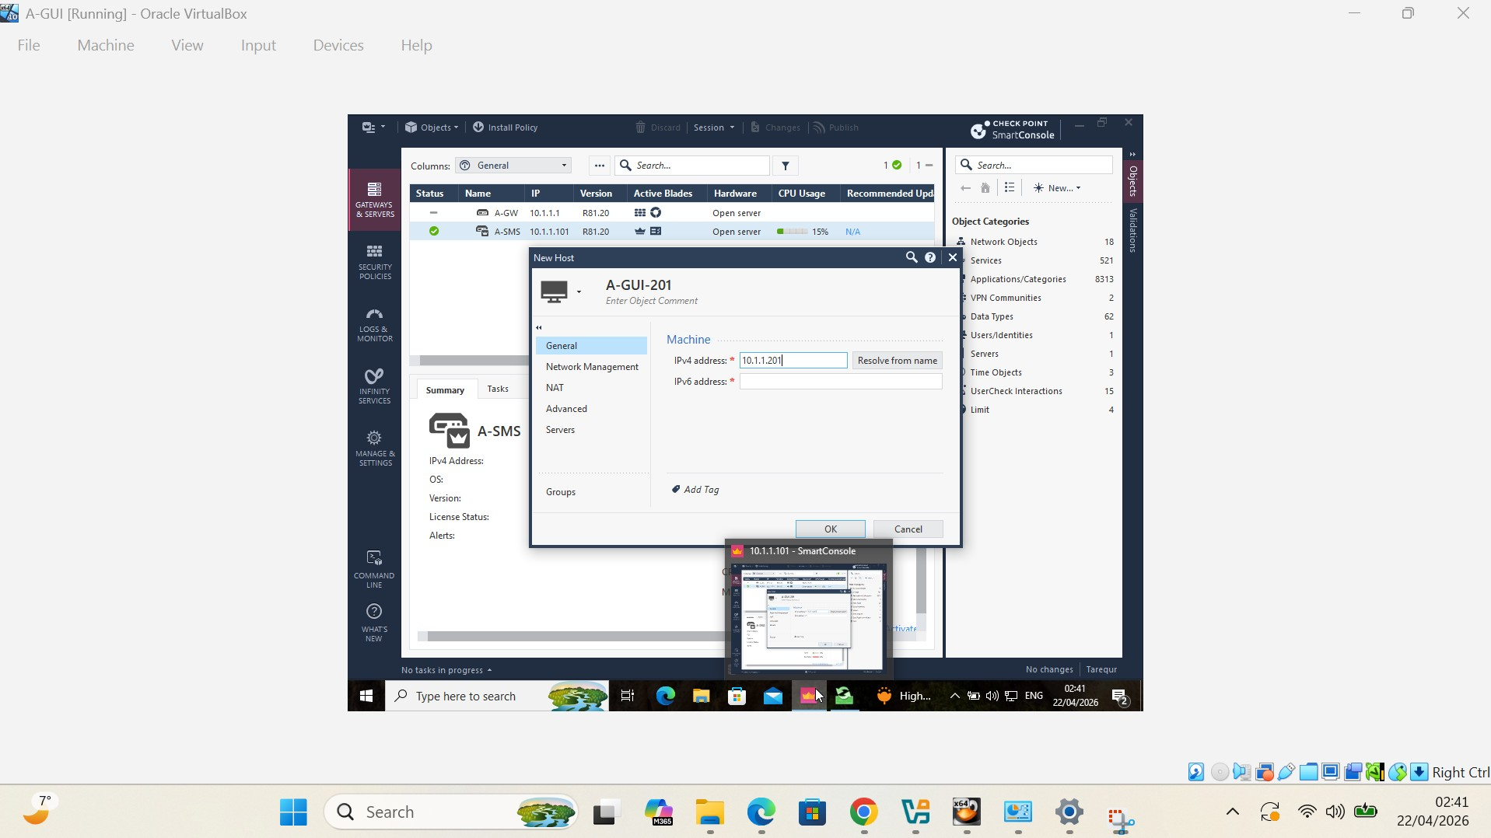
In Command panel of A-GUI-201 Slide — Assign IP Address to Host Object
· IPv4 address, 10.1.1.201 is defined to identify the host device
· Allowed the firewall to see and track network traffic from this host
· Enables host to also act as a source object in firewall policy rules
· Traffic filtering in between host and Security Gateway was fairly accurate
· Centralized security policy management enhancements in SmartConsole
Notes:
This slide is where I entered the host object A-GUI-201 in SmartConsole with IPv4 10.1.1.201.
In this way, the firewall can detect the device and track its traffic activity in the enterprise.
This means that the host can also be used in access control policies as a source object to enable accurate filtering of traffic between Host and Security Gateway.
This enhances centralized policy management and improves enforcement of endpoint-level security.

Slide 8

Generating Security Gateway Object (A-GW-object)
Created A-GW-object in SmartConsole
· Given IP address of gateway: 10.1.1.1
· Configured the gateway to be a policy enforcement point in the application networking space
· Configure a gateway as a destination in access-control rules for firewalls
· Support for centralized traffic inspection & filtering between host & gateway
Notes:
In this slide, I opened SmartConsole and created Security Gateway object with name A-GW-object, and I'm assiging gateway ip 10.1.1.1
The gateway is the central firewall enforcement point for the enterprise network.
With this, it allows gateway to be a destination object in access control policies and centralizes the traffic inspection between hosts and the firewall.
This is needed in support of enforce structured and secure enterprise access control policy.

Slide 9
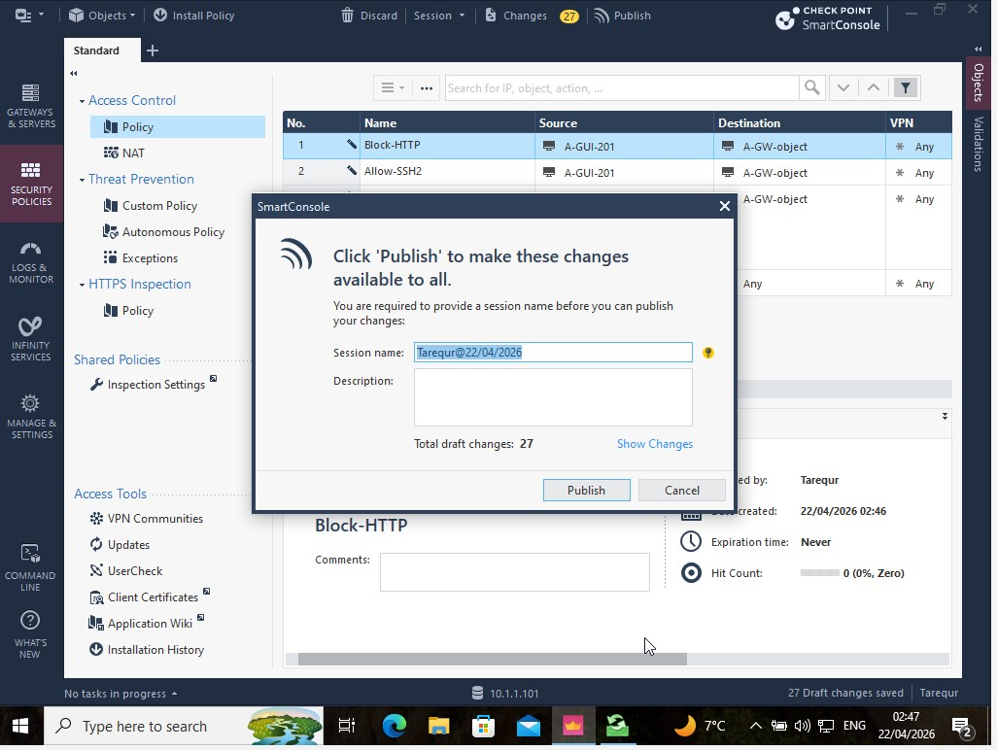
Publishing Security Policy Changes
· Publish — Save firewall rule configuration changes in SmartConsole
· Made better session changes before pushing policies to the gateway
· Make new rules available for the installation (HTTP block, SSH allow, ICMP allow)
· Centralized configuration on the Security Management Server
Notes:
In this slide, I recorded how the security policy has been updated in SmartConsole after defining the firewall rules.
This step wrote the session updates, including HTTP block, SSH allow and ICMP allow rules to the Security Management Server.
Publishing guarantees that the configuration is stored in a central location and it is ready to be installed on the Security Gateway.
It is the critical action that we take just prior to deploying policies throughout the global enterprise firewall environment.

Slide 10
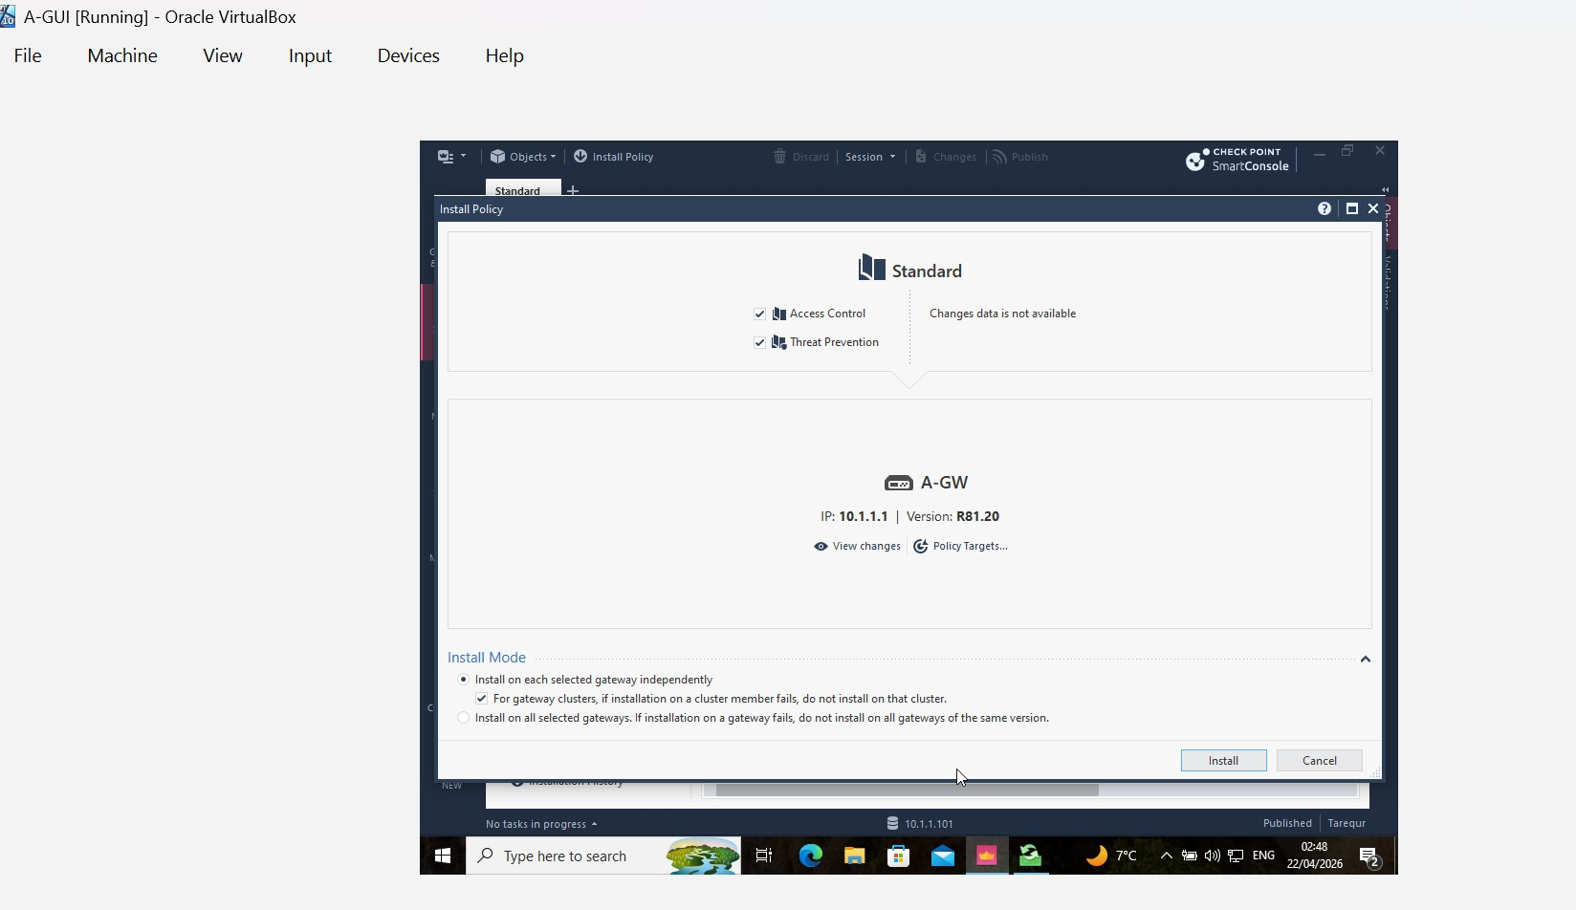
Security Policy Installation on Security Gateway (A-GW)
· Access Control Policy and Threat Prevention Policy applied to Security Gateway A-GW
· Engaged configured firewall rules where gateway IP 10.1.1.1
· Allows real-time inspection and enforcement of traffic
· Used centralized policies to apply from Security Management Server to gateway
· Make firewall rules (HTTP block, SSH allow, ICMP allow) take effect
Notes:
Here I have installed the Access Control and Threat Prevention policies to Security Gateway A-GW from Security Management Server.
Deploy the configured firewall rules to gateway (IP address: 10.1.1.1).
The gateway began to enforce the rules in real–time, blocking HTTP traffic and allowing SSH and ICMP communication.
This proves that the centralized firewall policies at the enterprise level have been effectively applied and are live on the network.

Slide 11
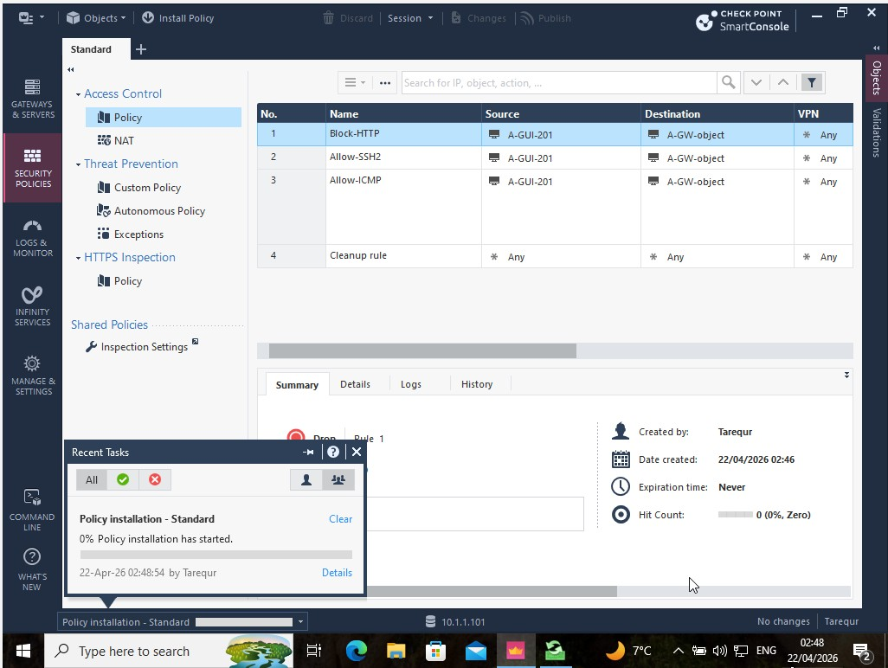
Firewall Access Control Policy Rule Configuration
A Firewall rule between A-GUI-201 (source) and A-GW-object (destination).
· Blocked any HTTP traffic so insecure communication is thwarted
· Enabled SSH Version 2 for encrypted remote administrative access
· Permitted ICMP traffic to verify connectivity and troubleshoot issues
· Deployed the Cleanup Rule to drop all unspecified traffic for better security
Notes:
In the above slide, I configured a firewall access control policy rules between the Security Gateway and the internal host A-GUI-201.
I set up a rule that blocks HTTP traffic to prevent insecure remote login over the Internet (this is inbound on port 80 ) and allows SSH version 2 for secured remote access.
Additionally, I allowed through ICMP for connectivity test and troubleshooting.
Last was the cleanup rule to drop everything not known to be allowed, so as usual it is a fail open policy to use more secure in an enterprise pattern of default-deny.

Slide 12
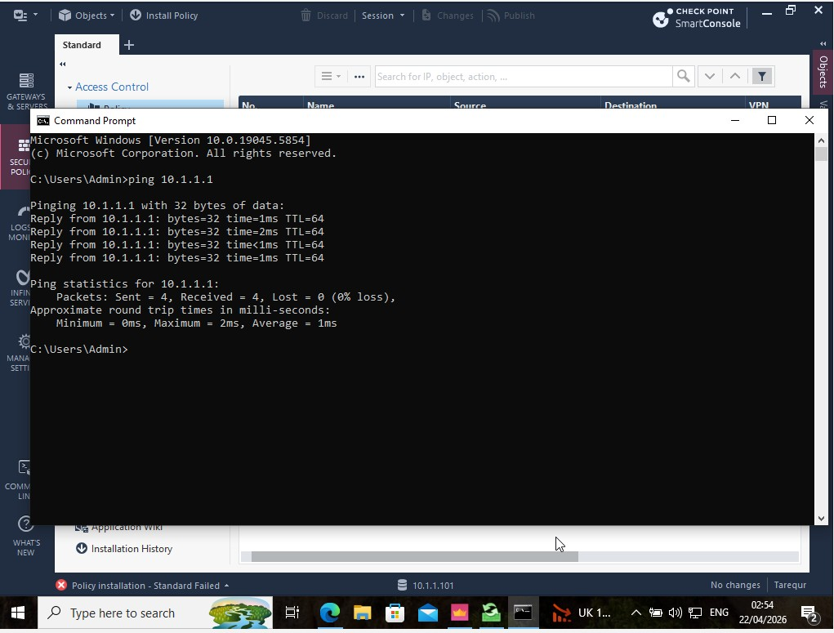
Verifying that Ping Connectivity Test (.Ping test with ICMP Testing.)
· Successfully performing ping test to Security Gateway (10.1.1.1) from host machine
· 0% packet loss, so timed out on receive
· Firewall policy to allow known ICMP traffic
· Check appropriate policy is installed and enforced on the rules
· Successfully showed networking connectivity between host and gateway
Notes:
On this slide, I did a verification of connectivity from the internal host to the Security Gateway with an ICMP ping test.
The output indicates that there are replies from the gateway 10.1.1.1 with a packet loss of 0%.
This verifies that the ICMP allow rule is properly applied and enforced by the firewall.
It also verifies that the installation of the security policy is successful, and communication between the host (blue) and gateway is working correctly.

Slide 13
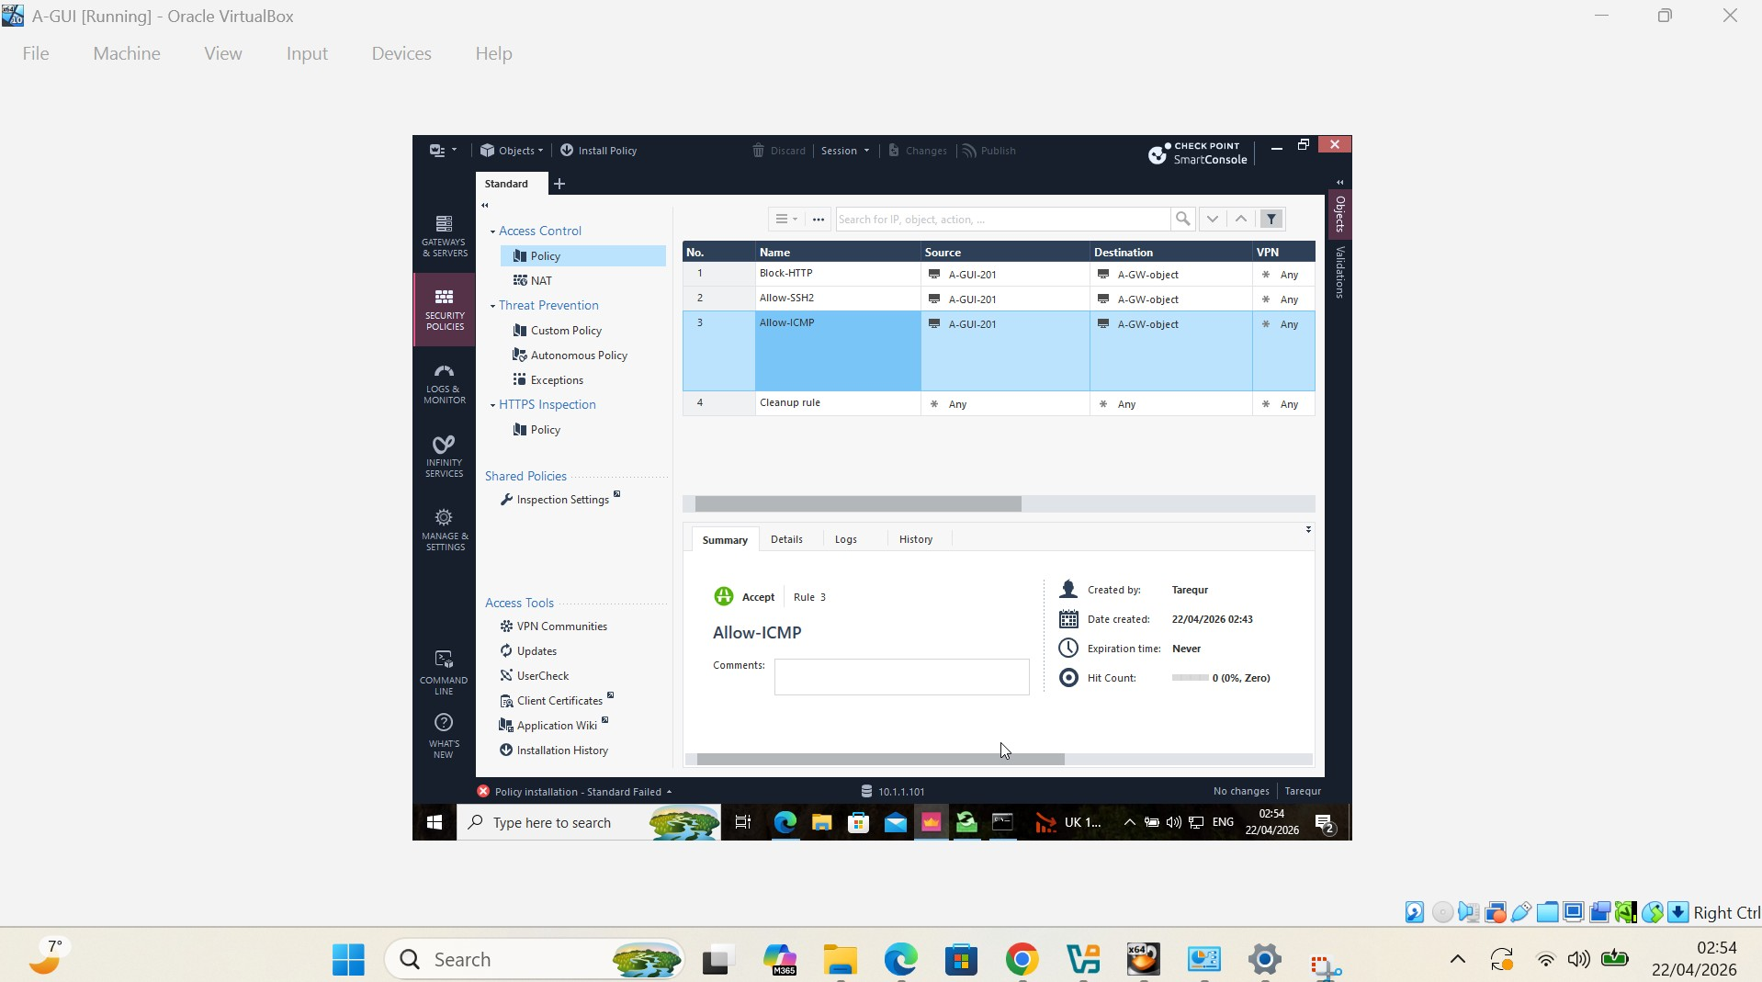
Configuration of Allow-ICMP Rule in Access Control Policy
· Setup an Allow-ICMP rule between A-GUI-201 and an A-GW-object
· Set echo-request and echo-reply for connectivity test
· Enabled the administrators to check that the communication between host and gateway was verified.
· Provided file server-level support for both troubleshooting and monitoring purposes
· Confirmed clean rule for ICMP is enforced before any cleanup rules are applied to the configuration
Notes:
On this slide, I created an Allow-ICMP rule between the internal host A-GUI-201 and the Security Gateway.
I turned on the echo-request and echo-reply messages, which allowed for the use of ping testing to check if connectivity between the host and gateway was successful.
It allows administrators to see the communication status and troubleshoot connectivity problems.
This was put before the cleanup rule inorder to keep up ICMP traffic and also provide a secure default policy enforcement.

Slide 14
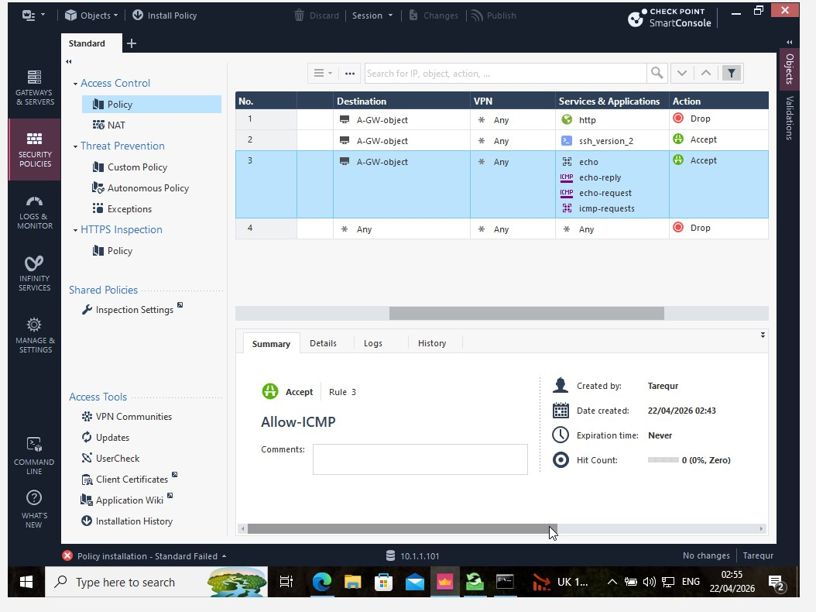
Service-Level Filtering Configuration (HTTP, SSH, ICMP Rules)
· Dropped HTTP traffic in order to prevent unencrypted web access
• Enabled SSH Version 2 for secure remote administrative communication.
· Allow ICMP echo-request and echo-reply for connectivity testing
· Implemented service filtering between host and Security Gateway
· Enforcing a cleanup rule to drop all traffic that is not explicitly controlled for better security
Notes:
This slide shows how I configured service-level filtering rules in the firewall policy between the internal host and the security gateway.
The second rule prevented HTTP traffic to avoid unencrypted transmissions, and enabled SSH version 2 for secure access from an administrator.
ICMP traffic was allowed for troubleshooting connectivity between devices.
Finally, it set a cleanup rule that drops all other traffic for anything else not specified, thus enforcing good enterprise network security with access control.

Slide 15
Conclusion
· SmartUpdate software blades, licenses and contracts verification
· Security Gateway enforcement environment was configured
· Host and gateway object for rules mapping in a structured manner.
· Applied service-level filtering policies of the firewall
· Successfully published and applied access control policies
· ICMP connectivity testing to ensure the functionality of firewall
Notes:
In this project, I confirmed the SmartUpdate software blades, licenses and contracts were validated in order to prepare the firewall environment correctly.
Next I configured the Security Gateway to be the enforcement point and created host and gateway objects for neat rule implementation.
So I went on to add service level filtering policies, blocking HTTP, allowing SSH and ICMP.
Finally, I had published and installed the ACL policy and verified operational firewall status through ICMP connectivity tests.
An Integrated Deployment of Enterprise Firewall Security Policy Using Check Point SmartConsole

