Slide 1
Skills for life: employability and future pathways.
ECGE6001
How the skills and understanding
developed through the module
could be applied to the role social worker

Slide 2
Social worker.
What is a Social Worker? (AGCAS,2017).
Responsibilities:
Support
Conducting interviews
Assessments
Care packages
Providing evidence
Referrals
(BASW, 2019)
Skills that are needed to work effectively as a social worker:
Listening and observational skills
Advocacy and negotiation skills
Organisation skills
The ability to absorb and remember legal procedure information
Initiative
Patience in every situation.
(AGCAS, 2017):

Slide 3
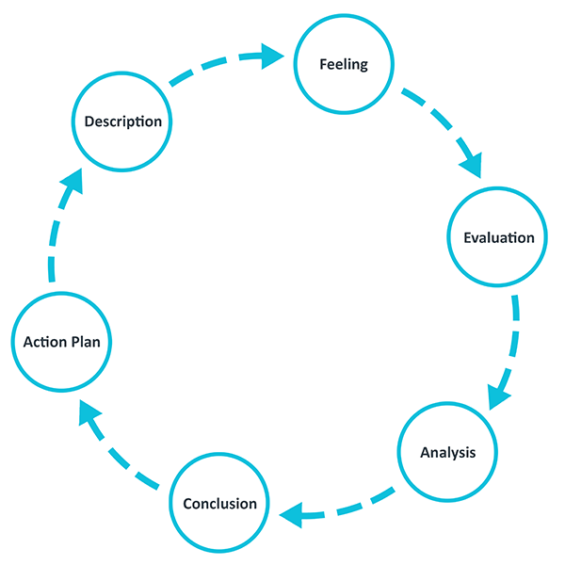
Skills that I have developed throughout this module and in my current work place.
How to improve my CV
Ability to reflect using different reflective theories
Communication skills
Time keeping skills
Problem solving skills
Ability to recognise ethical and moral dilemmas
Organisation Skills
Working with others
Gibbs’ reflective cycle
Picture A

Slide 4
How these skills could be applied and benefit the role of a social worker.
How to improve my CV
First impression
Gives employer all basic information of the applicant
Reflection
Improve practice
Share ideas
Allows continuous learning and development
(Research in Practice
for Adults, 2016)
Time keeping
Complete tasks
Meet clients on time
(APSCO, 2016)
Problem solving
Preventing conflict
Appropriate solutions
(Hardy, 2018)
Communication
Adapting communication
Tones of voice
Ensure communication is able to happen
(APSCO, 2016)

Slide 5
Professionalism in the work place
Different behaviours and characterises affect the workplace. When being a social worker the behaviours that have been identified in this module and can be applied to this role would be:
Being respectful
Time management
Committed to the job
Patient
Empathy
Approachable
How will this help when applying to the job role of a social worker?
(Dicks, 2019)

Slide 6
How do I see myself developing in the role and what specific attributes do you feel would be most use to you?
Understanding of different groups
Becoming a confident professional
Understanding of legislation and strategy's
Theory into practice
New challenges

Slide 7
What are the most important changes happening in your field and how do you see these informing your future development needs/career plans?
Job criteria changes
More Jobs
Higher work loads
(Haynes, 2018)
(NHS, No date)

Slide 8
References
AGCAS (2017) Social worker job profile. Available at: https://www.prospects.ac.uk/job-profiles/social-worker (Accessed: 1st October 2019).
BASW (2019) What do social workers do? Available at: https://www.basw.co.uk/resources/become-social-worker/what-do-social-workers-do (Accessed: 1st October 2019).
Dicks, K. (2019) Skills for Life: Employability and Future Pathways. [PowerPoint presentation].
Hardy (2018) Dealing with conflict at work . Available at: https://www.communitycare.co.uk/2018/01/15/dealing-conflict-work/ (Accessed: 10th October 2019).
Hayne, L (2018) Majority of social workers looking to leave their job within the next 16 months, says new research. Available at: https://www.communitycare.co.uk/2018/10/30/majority-social-workers-looking-leave-job-within-next-16-months-says-new-research/ (Accessed: 16th October 2019).
NHS. (No date) Social worker. Available at: https://www.healthcareers.nhs.uk/explore-roles/wider-healthcare-team/roles-wider-healthcare-team/clinical-support-staff/social-worker (Accessed: 10th October 2019).
Picture A. The University of Edinburgh (2019) Gibbs' reflective cycle. Available at: https://www.ed.ac.uk/reflection/reflectors-toolkit/reflecting-on-experience/gibbs-reflective-cycle (Accessed: 10th October 2019).
Research in Practice for Adults (2016) Social Work Practice with carers. Available at: https://carers.ripfa.org.uk/train-the-trainer/critical-reflection-tool/ (Accessed: 10th October 2019).

