Slide 1
Professional Development plan (PDP)
Name: KasJuan Sullivan
Student ID: 2535557
Learning in the digital era – acca4025
,

Slide 2


Introduction
This presentation outlines my Personal Development Plan, which identifies key career objectives, highlights areas for skill enhancement and maps out a strategic route for professional growth.
Today, I will be highlighting some SMART goals designed to drive my career progression

Slide 3
Self Evaluation
Strengths | Personal Traits | Areas For development
Strong Team player | Introverted, Reflective | Improvement of confidence in Public Speaking & Presentations
Analytical Thinker With Excellent Problem Solving & Creative Skills | Handling Stress Well & Remains Focus Under pressure | Strengthening of Time Management Skills to balance multiple deadlines more effectively
Self Motivated, Detail-Oriented & Precise in Completing Tasks | Visual Learner who prefers Demonstrations & Practical Examples
Demonstrates Strong Leadership Qualities & proficient in Data Analysis | Prefers Individual Study as Solo Study Improves Concentration & Productivity

Slide 4
Self evaluation Review
This review underscores core strengths in analytics, technology & leadership while pinpointing communication and time management as key areas for my continued professional growth.

Slide 5
Reflection
Evaluation
My university coursework has built a strong technical foundation, while group projects have honed my ability to lead, collaborate, and communicate effectively. This combination has equipped me with the hybrid of technical and interpersonal skills that employers value most.
Description
A CertHE student with hands-on project experience, strong analytical problem-solving abilities, and a commitment to continuous professional development.
Action Plan
Complete the Microsoft Learn Security Fundamentals, gain an industry-recognised certification, improve my public speaking skills, strengthen my time management and build a professional cybersecurity portfolio.
Gibbs’ Reflective Cycle
Analysis
I am actively broadening my technical expertise while refining my communication, presentation, and time management skills. I am increasing my employability by pursuing industry-recognised certifications and building practical, hands-on experience through interactive online labs and platforms.
Feelings
An independent and driven cybersecurity student, currently focused on strengthening presentation delivery and deadline management.
Conclusion
This reflection highlights the exact skills I must develop. By embracing ongoing professional growth, I will stay ahead in a rapidly evolving industry.

Slide 6
Long-Term Goals | Specific Career Goals | Skills I Need To Work On | Actions To Take | Key Skills Needed For each Goal | Time Period For Training To Be Completed By
Become a Cybersecurity Analyst | Improve computing skills | Network security, Linux, Windows security, threat detection, security monitoring, communication skills. | Complete Google Cybersecurity Certificate, Study and pass CompTIA Security+. | Networking, analytical thinking, Linux, problem-solving, teamwork. [1] | 12 months
Become an Ethical Hacker | Learn about cyber security | An understanding of hacking, fundamental coding skills, Problem solving skills | Learn Python for automation & complete penetration testing training. | Knowledge of operating systems, Coding, Cloud Security, Problem solving skills, Attention to detail [2] | 18 months
Progress to a Security Engineer | Earn CompTIA CySA+ certification, gain cloud security knowledge | Cloud security, incident response, risk management, digital forensics, security architecture. | Complete AWS Cloud Practitioner training & gain practical experience through internships or work placements. | Cloud security, incident response, leadership, communication, risk assessment, project management.[3] | 3 years

Slide 7
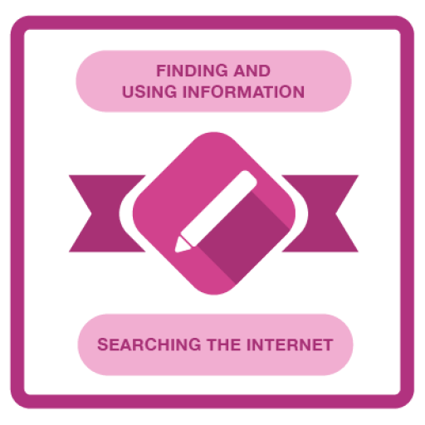
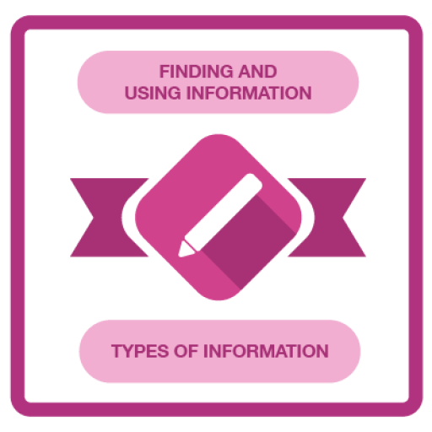
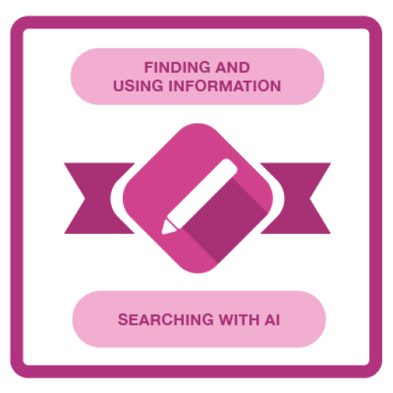
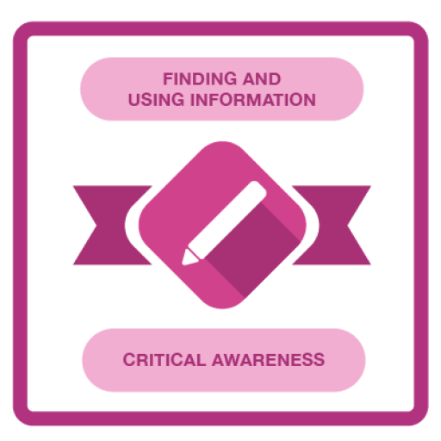
Goal Progress
These are some of the badges obtained from homework completed in weeks 2-4

Slide 8

Topic Summary
This is a roadmap that evaluates my current skills and outlines actionable career goals. By using the SMART framework, this PDP helps me to professionally map out targeted self-improvement. In my chosen career path, this translates to continuous upskilling through certifications and practical experience to keep pace with an ever-changing industry.

Slide 9
Refrences
[1] G. T. Doran, "There's a S.M.A.R.T. way to write management's goals and objectives," Management Review, vol. 70, no. 11, pp. 35–36, 1981.
[2] R. Petersen et al., Workforce Framework for Cybersecurity (NICE Framework), NIST Special Publication 800-181 Rev. 1, National Institute of Standards and Technology, Gaithersburg, MD, USA, Nov. 2020.
[3] CompTIA, CompTIA Security+ Certification Exam Objectives (SY0-701), 2023.

