Slide 1
Social Cognitive Theory and it’s Application to Obesity: A Critical Perspective

Slide 2

Introduction
Obesity is a complex public health issue with behavioural, environmental, psychological, and social dimensions.
Social Cognitive Theory (SCT) offers an agentic perspective on behaviour change, emphasizing reciprocal determinism (Bandura, 1997).
This presentation evaluates SCT’s utility in obesity management and contrasts it with other social cognition models
Figure 1: Di Santolo, (2019)

Slide 3
Overview
Personal Cognitive Factors
belief in ability
Environmental Influences
peer influence
Behavioural Factors
excercise
Social Cognitive Theory (SCT)​​
Key concept: Reciprocal determinism (Bandura, 1986).
Components:
Personal cognitive factors
Environmental influences
Behavioural factors
Application in obesity:
* Behaviours shaped by self-efficacy, social modelling and environmental structures.
Figure 2: Reciprocal determinism, (Bandura, 1986)

Slide 4
Strengths
Self-efficacy: Strong predictor of behaviour change (Anderson et al., 2007)
Effect sizes: 0.25 to 0.45
Mastery experiences (d=0.91) most impactful (Ashford et al., 2010)
SCT addresses adherence challenges:
Dropout rates in obesity programmes often >50% (Teixeira et al., 2012)
Include:
Outcome expectations
Behavioural capability
Environmental barriers and facilitators
Self-efficacy
Mastery experiences
Vicarious experiences
Verbal persuasion
Physiological states
Figure 3: Self-efficacy , (Bandura, 1997)

Slide 5
Strengths continued
Multi-level influence: individual + environment
70% variance in obesity linked to environmental factors (Swinburn et al., 2011)
Observational learning:
Peer modelling effect sizes: 04.43 (diet), 0.38 (activity), (Greaves et al., 2011).
Limitation:
* Interventions targeting>3 SCT constructs yield diminishing returns (Prestwich at al., 2014)

Slide 6
Critical Evaluation
​Assumes rational, goal-directed behaviour:
Contradicted by dual-process models (Kahneman, 2011)
Neurobiological evidence:
Food decisions often driven by reward circuitry (Volkow et al., 2011)
Emotional eating drives 75% of episodes in obesity (Nederkoorn et al., 2010).
Physiological constraints:
Metabolic adaption post-weight lost reduces RMR by 15-20% (Hall et al., 2011).
Environmental change feasibility:
Policy change timelines: 5-15 years (Roberto et al., 2015).

Slide 7
Comparative Critique
Precontemplation
Transtheoretical Model stages: precontemplation –› maintenance (Prochaska & DiClemente, 1983).
Flaws:
Only 31% follow predicted sequence (West, 2005)
Stage transitions explain <15% of behaviour variance (Sutton, 2001)
No casual mechanisms (Bridle et al., 2005)
Ignores environmental/structural influences (Ogilvie et al., 2007).
Maintenance
Contemplation
Transtheoretical Model (TTM)
Action
Preparation
Figure 6: Transtheoretical model (Prochaska & DiClemente, 1983)

Slide 8
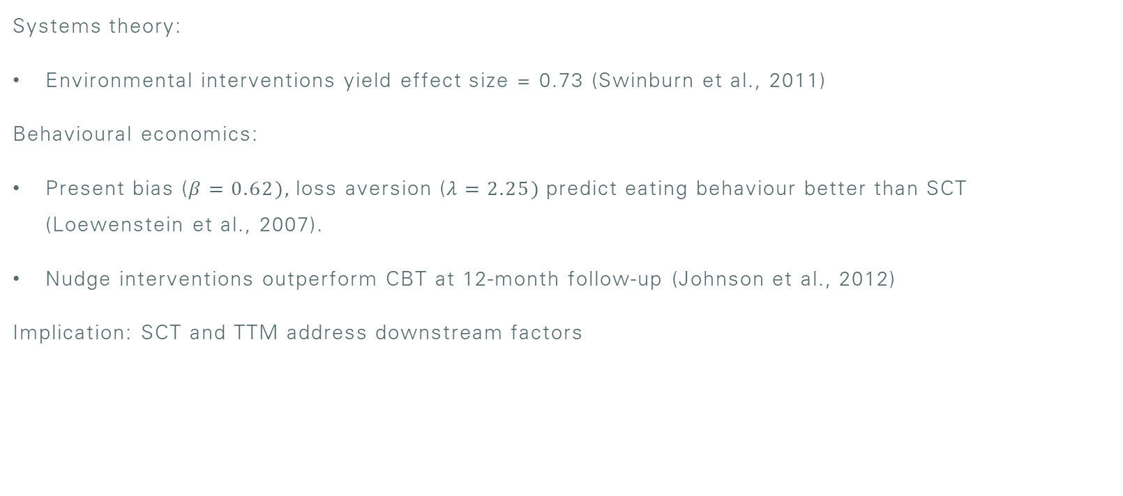
Alternative Theoretical Perspectives​
Systems theory:
Environmental interventions yield effect size = 0.73 (Swinburn et al., 2011)
Behavioural economics:
Present bias ($β=0.62),$loss aversion ($λ=2.25)$predict eating behaviour better than SCT (Loewenstein et al., 2007).
Nudge interventions outperform CBT at 12-month follow-up (Johnson et al., 2012)
Implication: SCT and TTM address downstream factors

Slide 9
Conclusion
Integrated intervention
Future of obesity intervention policy
and Individual action
SCT provides a nuanced framework but overemphasizes rational agency
TTM lacks mechanistic and empirical rigor
Evidence supports a pivot to:
Structural interventions
Emotion-regulation models
Neurobiological constraints
Call to action: Integrate systems, behavioural economics, and neuroscience for effective obesity interventions (Glass& McAtee, 2006; Brownell et al., 2010).
Systems Theory
Behavioural Economics
Neuroscience

Slide 10
Reference List
Anderson, E. S., Winett, R. A., & Wojcik, J. R. (2007). Self-regulation, self-efficacy, outcome expectations, and social support. Annals of Behavioural Medicine, 34(3), 3.4-312. https://doi.org/10.1007/BF02874555
Armitage, C. J. (2009). Is there utility in the transtheoretical model? British Journal of Health Psychology, 14(2), 195-210. https://doi.org/10.1348/135910708X368991
Ashford, S., Edmunds, J., & French, D. P. (2010). What is the best way to change self-efficacy to promote lifestyle and recreational physical activity? Asystematic review with meta-analysis. Health Psychology Review, 4(1), 57-88. https://doi.org/10.1080/1744337190903490932
Bandura, A., & National Inst of MENTAL Health. (1986). Social foundations of thought and action: A cognitive theory. Prentice-Hall, inc.
Bandura, A. (1997). Self-efficacy: The exercise of control. W H Freeman/Times Books/ Henry Holt & Co
Bridle, C., Riemsma, R. P., Pattenden, J., Sowden, A. J., Mather, L., Watt, I. S., & Walker, A. (2005). Systematic review of the effectiveness of health behaviour interventions based on the transtheoretical model. Psychology & Health, 20(3), 283-301. https://doi.org/10.1080/08870440512331333997
Brownell, K. D., Kersh, R., Ludwig, D. S., Post, R. C., Puhl, R. M., Schwartz, M. B., & Willett, W. C. (2010). Personal responsibility and obesity: A constructive approach to a controversial issue. Health Affairs, 29(3), 379-387. https://doi.org/10.1377/hlthaff.2009.0739
Frieden, T. R. (2010). A framework for public health action: The health impact pyramid. American Journal of Public Health, 100(4), 590-595. https://doi.org/10.2105/AJPH.2009.185652
Glass, T. A., & McAtee, M. J. (2006). Behavioural science at the crossroads in public health. Social Science & Medicine, 62(7), 1650-1671. https://doi.org/10.1016/j.socscimed.2005.08.044

Slide 11
Greaves, C. J., Sheppard, K. E., Abraham, C., Hardeman, W., Roden, M., Evans, P. h., & Schwarz, P. (2011). Systematic review of reviews of intervention components associated with increased effectiveness in dietary and physical activity interventions. BMC Public Health, 11, 119. https:// doi.org/10.1186/1471-2458-11-119
Hall, K. D., Sacks, G., Chandramohan, D., Chow, C. C., Wang, Y. C., Gortmaker, S. L., & Swinburn, B. A. (2011). Quantification of the effect of energy imbalance on bodyweight. The Lancet, 378(9793), 826-837. https://doi.org/10.1016/S0140-6736(11)60812-X
Johnson, E. J., Shu, S. B., Dellaert, B. G., Fox, C., Goldstein, D. G., Hӓubl, G., …& Weber, E.U. (2012). Beyond nudges: Tools of a choice architect. Marketing Letters, 23(2), 487-504. https://doi.org/10.1007/s11002-012-9186-1
Just, D. R., Mancino, L., & Wansink, B. (2007), Could behavioural economics help improve diet quality for nutrition assistance program participants? Economic Research Report, 43, 1-28. https://www.ers.usda.gov/publications/pub-details/?pubid=45671
Kahneman, D. (2011). Thinking fast and slow. Farrar, Straus and Giroux.
Loewenstein, G., Brennan, T., & Volpp, K. G. (2007). Asymmetric paternalism to improve health behaviours. JAMA, 298(20), 2415-2417. https://doi.org/10.1001/jama.298.20.2415
Marteau, T., Ogilvie, D., Roland, M., Suhrcke, M., & Kelly, M. P. (2011). Judging nudging: Can nudging improve population health? BMJ, 342, d 228. https://doi.org/10.1136/bmj.d228
McAlister, A. L., Perry, C. L., & Parcel, G. S. (2008). How individuals, environments, and health behaviors interact: Social cognitive theory. In K. Glanz, B. K. Rimer, & K. Viswanath (Eds.), Health behavior and health education (4th ed., pp. 169-188). Jossey-Bass
McLaren, L. (2007). Socioeconomic status and obesity. Epidemiologic Reviews, 29(1), 29-48. https://doi.org/10.1093/epirev/mxm001#
Michie, S., Abraham, C., Whittington, C., McAteer, J., & Gupta, S. (2009). Effective techniques in healthy eating and physical activity interventions: A meta-regression. Health Psychology, 28(6), 690-701. Bhttps://doi.org/10.1037/a0016136

Slide 12
Nederkoorn, C., Smulders, F. T. Y., & Jansen, A. (2000). Cephalic phase responses, craving and food intake in normal subjects. Appetite, 35(1), 45-55. https://doi.org/10.1006/appe.2000.0323
Ogilvie, D., Foster, C. E., Rothnie, H., Cavill, N., Hamilton, V., Fitzsimons, C. F., & Mutrie, N. (2007). Interventions to promote walking: Systematic review. Bmj, 334(7605), 1204. https://doi.org/10.1136/bmj.39198.722720.BE
Prestwich, A., Sniehotta, F. F., Whittington, C., Dombrowski, S. U., Rogers, L., & Michie, S. (2014). Does theory influence the effectiveness of health behavior interventions? Meta-analysis. Health Psychology, 33(5), 465-474. https://doi.org/10.1037/a0032853
Prochaska, J. O., & DiClemente, C. C. (1983). Stages and processes of self-change of smoking: Toward an integrative model of change. Journal of |Consulting and Clinical Psychology, 51(3), 390-395. https://doi.org/10.1037/0022-006X.51.3.390
Toberto, C. A., Swinburn, B., Hawkes, C., Huang, T. T. K., Costa, S. A., Ashe, M., & Brownell, K. D. (2015). Patchy progress on obesity prevention: Emerging examples, entrenched barriers, and new thinking. The Lancet, 385(9985), 2400-2409. https://doi.org/10.1016/S0140-6736(14)61744-X
Sallis, J. F., Owen, N., & Fisher, E. B. (2008). Ecological models of health behavior. In K. Glanz, B. K. Rimer, & K. Viswanath (Eds.), Health behavior and health education (4th ed., pp. 465-486). Jossey-Bass.
Sutton, S. (2001). Back to the drawing board? A review of applications of the transtheoretical model to substance use. Addiction, 96(1), 175-186. https://doi.org?10.1046/j.1360-0443.2001.96117513.x
Swinburn, B. A., Sacks, g., Hall, K. D., McPherson, K., Finegood, D. T., Moodie, M. L., & Gortmaker, S. L. (2011). The global obesity pandemic: Shaped by global drivers and local environments. The Lancet, 378(9793), 804-814. https://doi.org/10.1016/S0140-6736(11)60813-1

Slide 13
Teixeira, P. J., Silva, M. N., Mata, J., Palmeira, A. L., & Markland, D. (2012). Motivation, self-determination, and long-term weight control. International Journal of Behavioral Nutrition and Physical Activity, 9(1), 22. https://doi.org/10.1186/1479-5868-9-22
Thaler, R. H., & Sunstein, C. R. (2008). Nudge: Improving decisions about health, wealth, and happiness. Yale University Press.
Volkow, N. D., Wang, G. J., Tomasi, D., & Baler, R. D. (2013). Obesity and addiction: Neurobiological overlaps. Obesity Reviews, 14(1), 2-18. https://doi.org/10.1111/j.1467-789X.2012.01031.X
West, R. (2005). Time for a change: Putting the Transtheoretical (Stages of Change) Model to rest. Application, 100(8), 1036-1039. https://doi.org/10.1111/j.1360-0443.2005.01139.x
World Health Organization. (2021). Obesity and overweight fact sheet. WHO Press. https://www.who.int/news-room/fact-sheets/detail/obesity-and-overweight

Slide 14
Link to script
Social Cognitive Theory presentation script.docx

