Slide 1
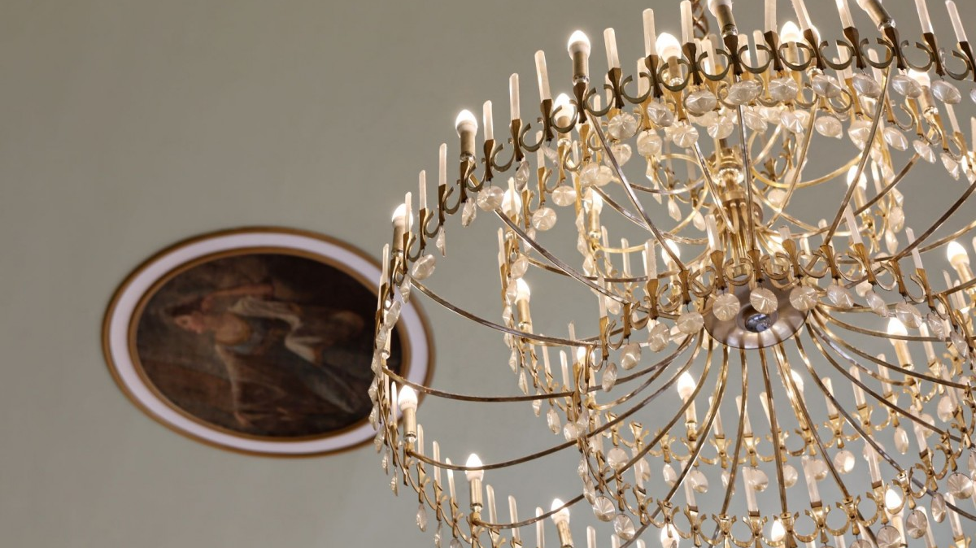
Leicester Events
Name of the Students: Mihaela Catana – 2123169
Tatiana Mocanu - 2122525
Natalia Cojocaru - 2119063
Group: 1
Lecturer Name: Rajesh Kumar

Slide 2
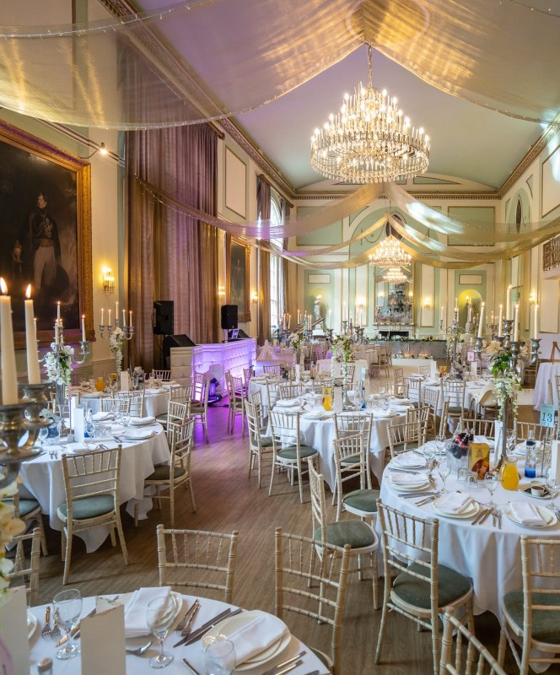
Business Overview
We are the Midlands’ most unique venue, and the perfect setting for the perfect event.
Launched in April 2021, Leicester Events combines inspiring art deco architecture and state of the art technology to create a one-of-a kind atmosphere for your event.
The solution for busy, engaged career women is to outsource their wedding planning.

Slide 3

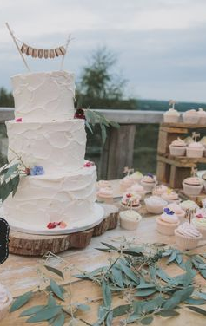
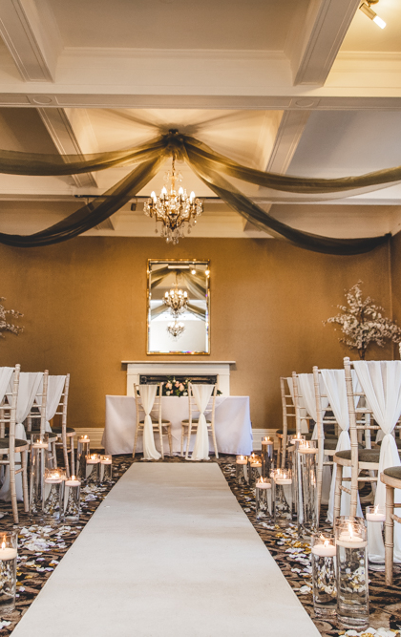
Services
Decor
Entertaiment
Lighting
Media
Wedding Planning
Wedding Cakes & Bakes

Slide 4
Competitors:
Our direct competitors are other event venues from Leicester: Entire Venue and The Paddock Pavilion.
Key things about the competitors
What type of events do they do? Weddings, birthday parties, reunions, corporate retreats, fundraisers.
What types of food and beverage do they offer? It adapts according the guests and the requirements.
What is their pricing? Premium.
What are they good at? Talented chefs, who will create a bespoke menu that is guaranteed to impress the most demanding guests.
What are their weaknesses? Not enough room for guests (less than 200)

Slide 5
Market audit – PESTLE AUDIT
Political factors – Relationship between UK and EU (restrictions and extra money for delivered items and food)
Economic factors – The import tax and energy price contribute an important role in determining the price of the ingredients required for making the cakes.
Social factors – Social trends change people's mindsets; people are not getting married in their early 20's
Technological factors - Technology made the communication with the client easier and accessible.
Legal factors – Licenses and permits required to operate.
Environmental factors - Future pandemics, transportation, sustainable resources, environmental restrictions imposed by in-country governments.

Slide 6
SWOT Analysis
Strengths:
Flexibility for customer's requirements to implement changes to their need
Wide variety of events available for customers to choose from
Personalization of quality service, food and atmosphere to provide ultimate customer satisfaction
Room for up to 350 guests
Proactive rather than reactive
Opportunities:
Technology development
Target markets
New product developments
Expansion and growth
Partnerships
Organizational design
Weaknesses:
Budget constrains
Reputation and brand perception
Bureaucracy
Threats:
Losing staff to competitors
Increasing regulation
New competitors
Changes to market demand

Slide 7

Target Market
Engaged couples (aged between 20 and 40) are our potential clients as they are most likely to dream about their perfect wedding. That is the group of consumers that we need to focus on when advertising our business.

Slide 8
Marketing plan
We are focusing on growth using different marketing strategies (social media, business cards, business website)
Hire the right people
Invest in our business

Slide 9

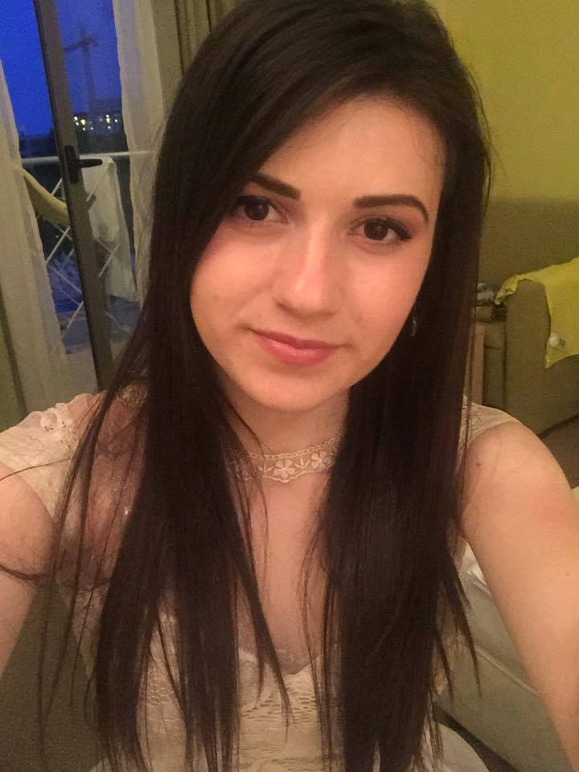
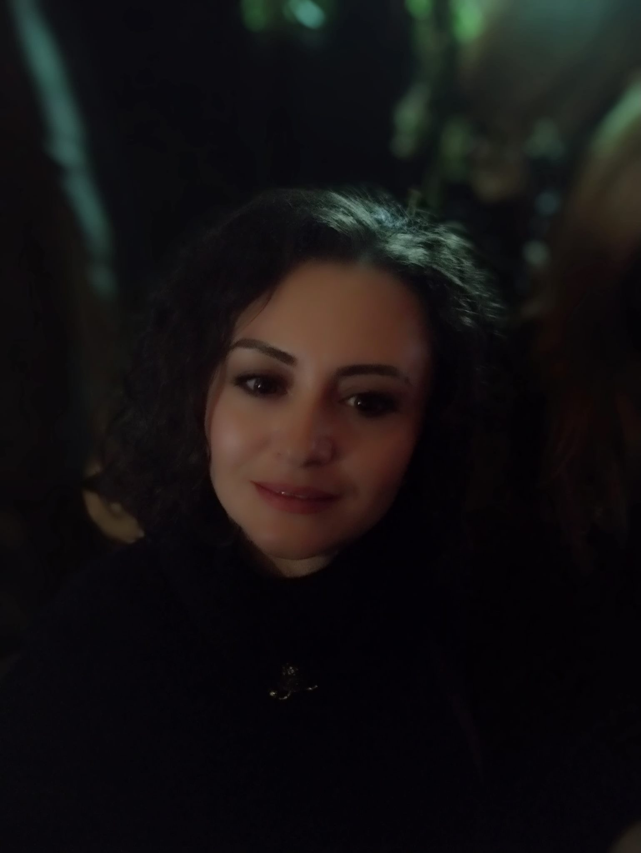
Management Team
Tatiana Mocanu – Executive Assistant
Experienced in customer service and recruitment
Mihaela Catana – Chief Executive Officer
Experienced manager over 5 years
Level 6 Business and Management
Natalia Cojocaru – Business Development Director
Experienced in TV production, digital marketing and journalism

Slide 10
Financial Plan: Cashflow Forecast
 | Mar-22 | Jun-22 | Sep-22 | Dec-22
Sales Income | £0 | £10,000 | £15,500 | £15,000
Grants | £0 | £0 | £0 | £0
Bank Loan | £10,000 | £0 | £0 | £0
Investment by Owner | £0 | £0 | £0 | £0
Any Other Income | £0 | £0 | £0 | £0
Total Incoming | £10,000 | £10,000 | £15,500 | £15,000
Stock/ Materials | £1,000 | £1,000 | £1,000 | £1,000
Rent & Rates | £1,200 | £1,200 | £1,200 | £1,200
Wages | £0 | £4,500 | £4,500 | £4,500
Drawings and N.I.C |  | £0 | £0 | £0.00
Utilities | £250 | £300 | £300 | £300
Insurances | £100 | £100 | £100 | £100
Repairs and Renewals | £1000 | £0 | £0 | £0
Motor Expenses |  | £0 | £0 | £0
Phone/Internet | £30 | £30 | £30 | £30
Advertising | £100 | £100 | £100 | £100
Print/Stationery | £200 | £100 | £100 | £100
Miscellaneous | £50 | £30 | £30 | £30
Loan Repayments | £100 | £100 | £100 | £100
Bank Charges | £0 | £0 | £0 | £0
Accountancy Fees | £100 | £100 | £100 | £100
Total Outgoing | £4,130 | £7,560 | £7,560 | £7,560
Incoming less outgoing | £5,870 | £2,440 | £7,840 | £7,440
Opening Bank Balance | £0 | £5,870 | £8,310 | £16,150
Closing Bank Balance | £5,870 | £8,310 | £16,150 | £23,590

Slide 11
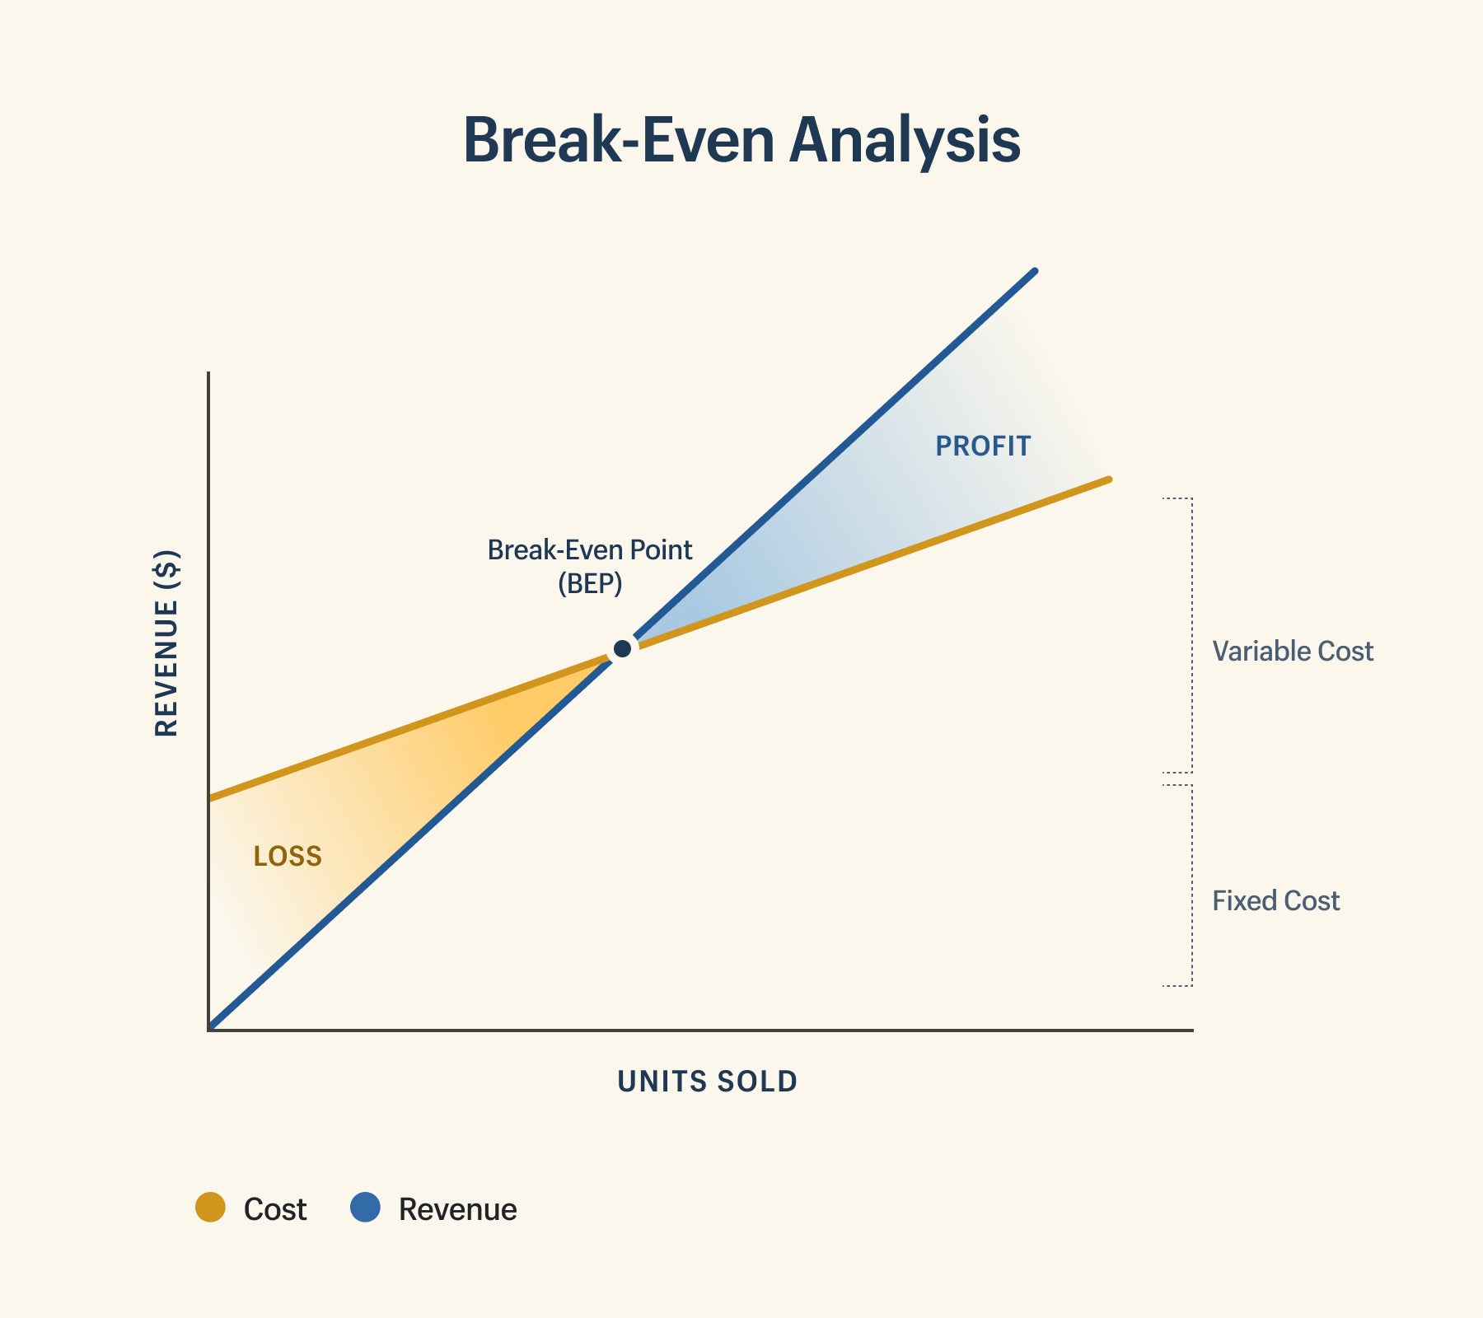
Forecast profit and loss account
Business: Leicester Events
Period: Year to December , 2022 Sales: |  | £ 15,000 | (A)=15,000
Less direct (variable) costs:
materials | £1,000
direct wages | £0
other | £0
Total direct costs
Gross profit/contribution: |  | £ 15,000 | (B)= 1,000/15,000
=Fixed costs (overheads):
wages/salaries (incl. taxes) | £4,500
rent | £1,200
heat/light/power | £300
advertising | £0
insurance | £100
loan | £100
telephone | £30
miscellaneous | £30
repairs/renewals | £100
depreciation | £0
local taxes | £100
other Prof. fees | £0
other Sundry | £0
Total fixed costs |  | £ 6,560 | ( C )= 6,560/8,440
Net profit |  | £ 8,440
Less drawings or dividends |  | £ 0
Profit retained in the business |  | £ 0
Break-Even point = A x C / B

Slide 12
References:
https://www.amazingspaceweddings.co.uk/search/the-city-rooms
https://www.amazingspaceweddings.co.uk/search/kingdom
Daniels, M. and Wosicki, C., 2020. Wedding planning and management: Consultancy for diverse clients. Routledge.
Tsorakidis, N., Papadoulos, S., Zerres, M. and Zerres, C., 2011. Break-even analysis. Bookboon.

