Slide 1


Mark Napieralla: Advanced Coaching & Mentoring:
Week 4

Slide 2
Mark Napieralla: Advanced Sports Coaching:
Today
Basketball reflection / Your games
Coaching the early years
Planning for early years and sports camp delivery

Slide 3

Mark Napieralla: Advanced Sports Coaching:
Basketball session
General discussion
Learning outcomes
Enjoyment
Level

Slide 4
Mark Napieralla: Advanced Sports Coaching:
The delivery of your games
Post it feed back
2 positives
1 thing you would change

Slide 5
Mark Napieralla: Advanced Sports Coaching:
My Feedback from last week
Positives
Communication- EDD
Team work- assistant coach
Participants HAD FUN!!- Challenged
Mixing up the delivery / games / drills
Energy and enthusiasm
Reinforced coaching points – coaching process used to improve performance, 1-2-1, feedback,
Repetition of skills
Good organisation and size of areas
Control of group
Split into two games
Progressions- 2v1, 3v2
To Improve
Demonstrate the whole small sided game- 4v4 at least
Use clock / watch for timings
Make sure skill development takes place
Demonstrations – the correct technique
Reinforce coaching points – coaching process carry out in full
Fault ID and correction – Football Bowling
Demonstrate the correct technique more
Spend longer on demo / repeat demo
Throwing ball up to start games

Slide 6
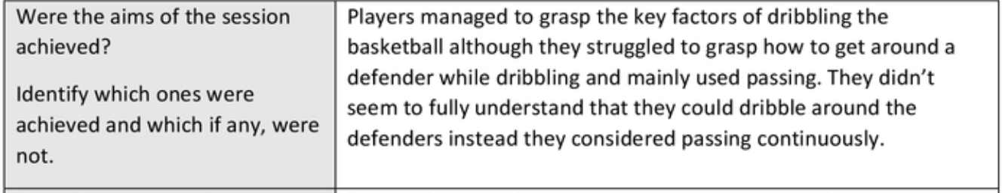
Mark Napieralla: Advanced Sports Coaching: M5X01428
Reflecting

Slide 7
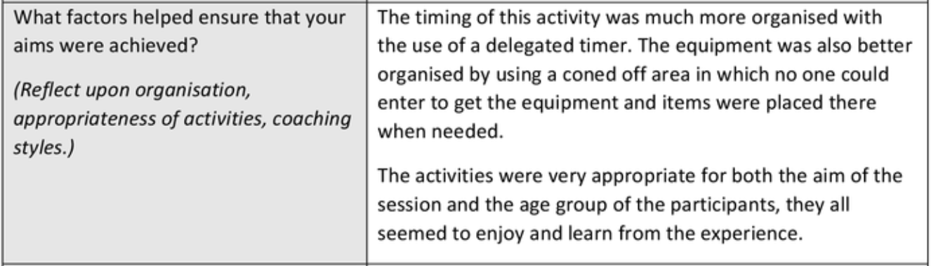
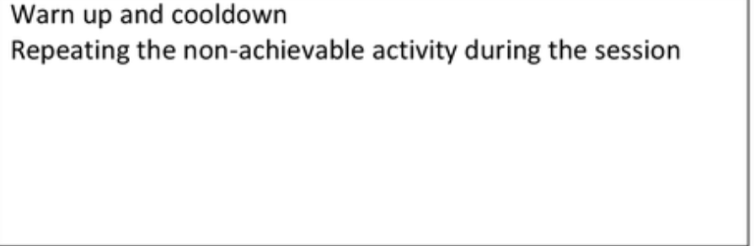
Mark Napieralla: Advanced Sports Coaching: M5X01428
Reflecting

Slide 8
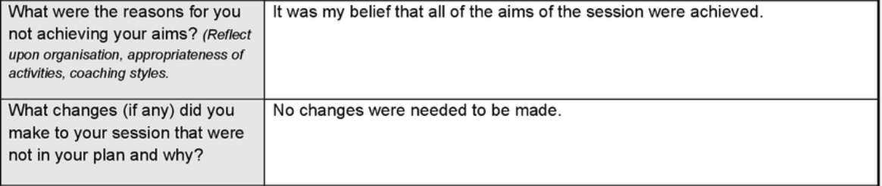
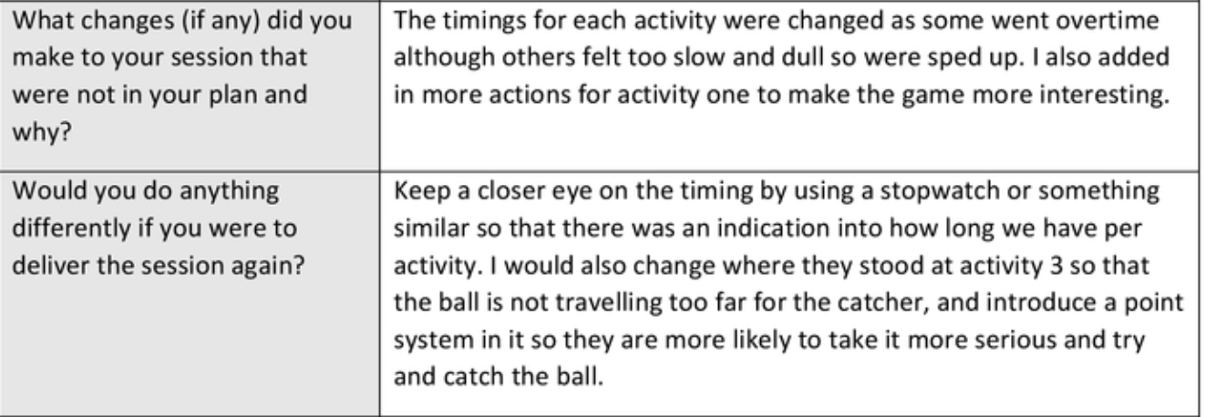
Mark Napieralla: Advanced Sports Coaching: M5X01428
Reflecting

Slide 9
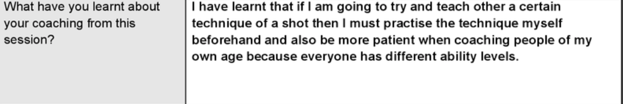
Mark Napieralla: Advanced Sports Coaching: M5X01428
Reflecting

Slide 10
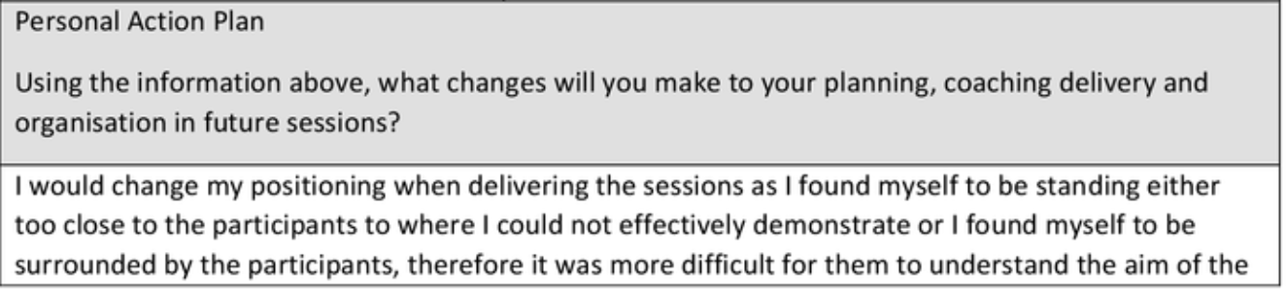
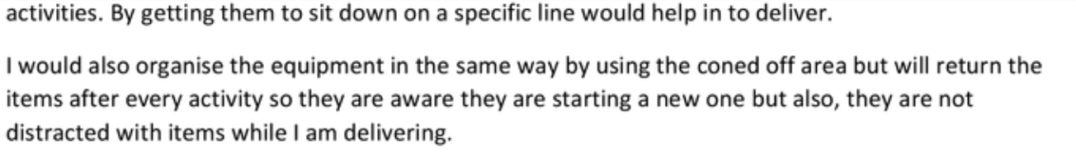
Mark Napieralla: Advanced Sports Coaching: M5X01428
Reflecting

Slide 11

https://www.youtube.com/watch?v=R8PIXqp3JpA
Notes:
https://www.youtube.com/watch?v=R8PIXqp3JpA

Slide 12
Mark Napieralla: Advanced Sports Coaching: M5X01428
What influences the
Development of children?
Add to
The flip
chart

Slide 13

Mark Napieralla: Advanced Sports Coaching: M5X01428

Slide 14
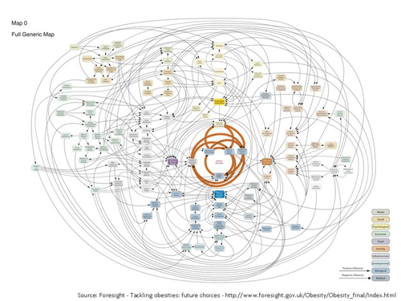
Obesity system map

Slide 15
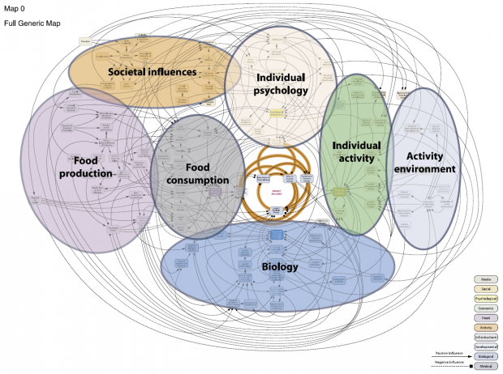
Obesity system map

Slide 16
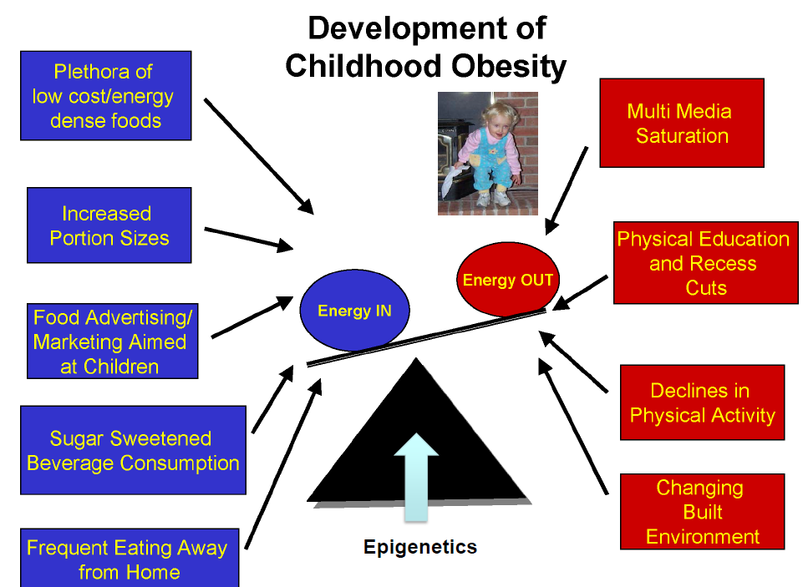
Mark Napieralla: Advanced Sports Coaching: M5X01428

Slide 17
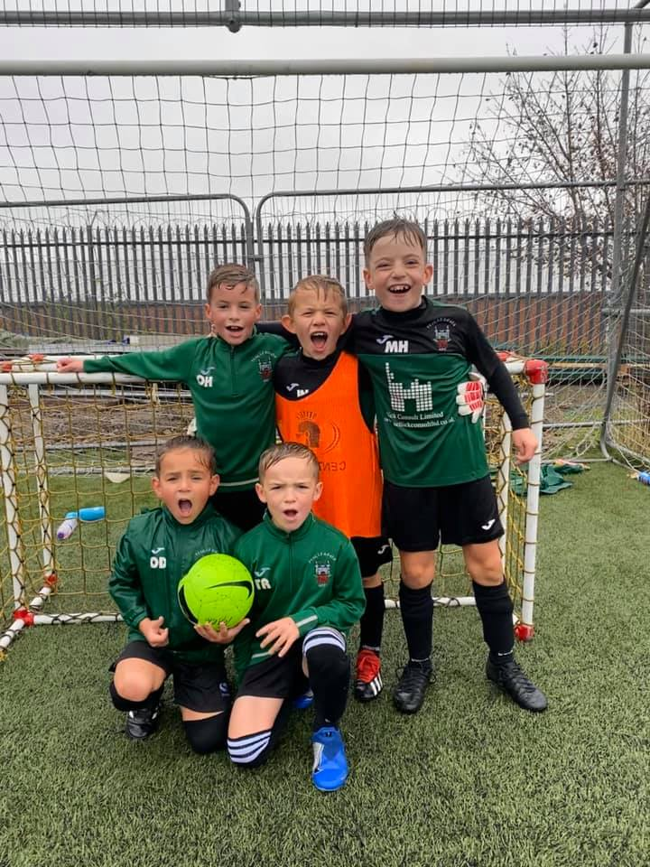
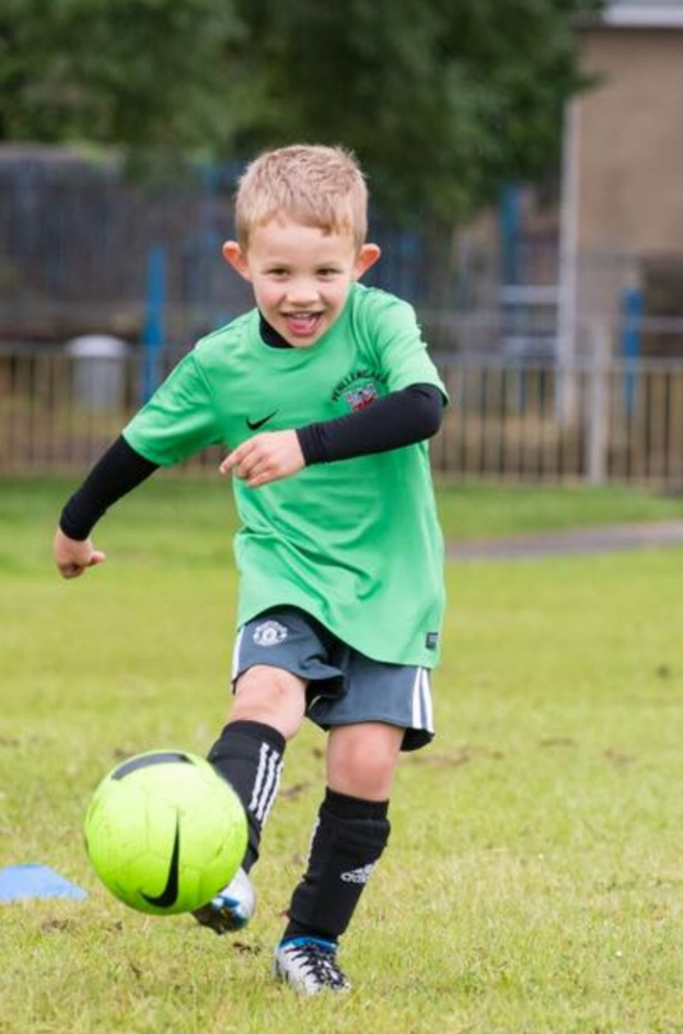
Mark Napieralla: Advanced Sports Coaching:
Making
Sport
Fun

Slide 18
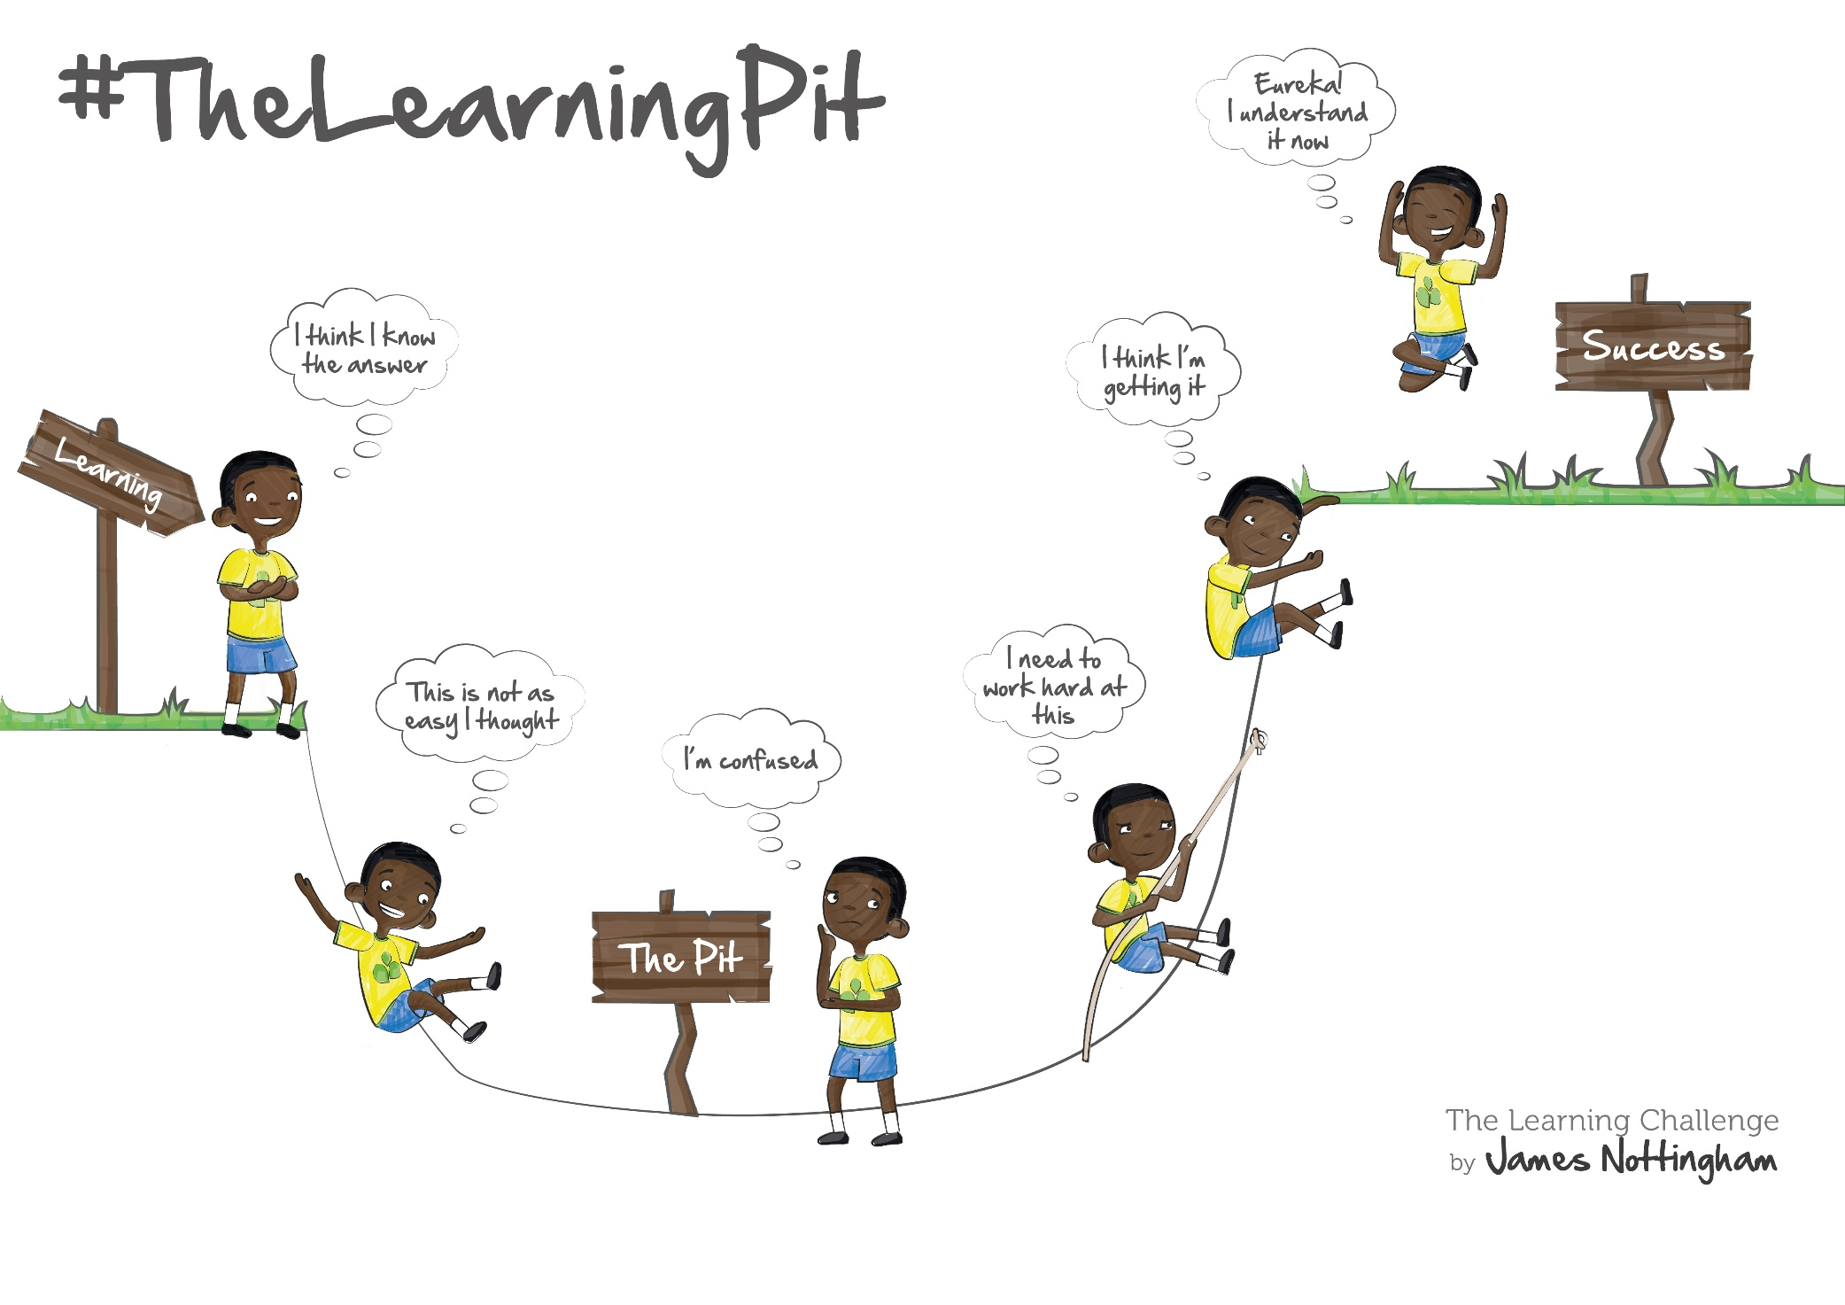

Slide 19


Slide 20
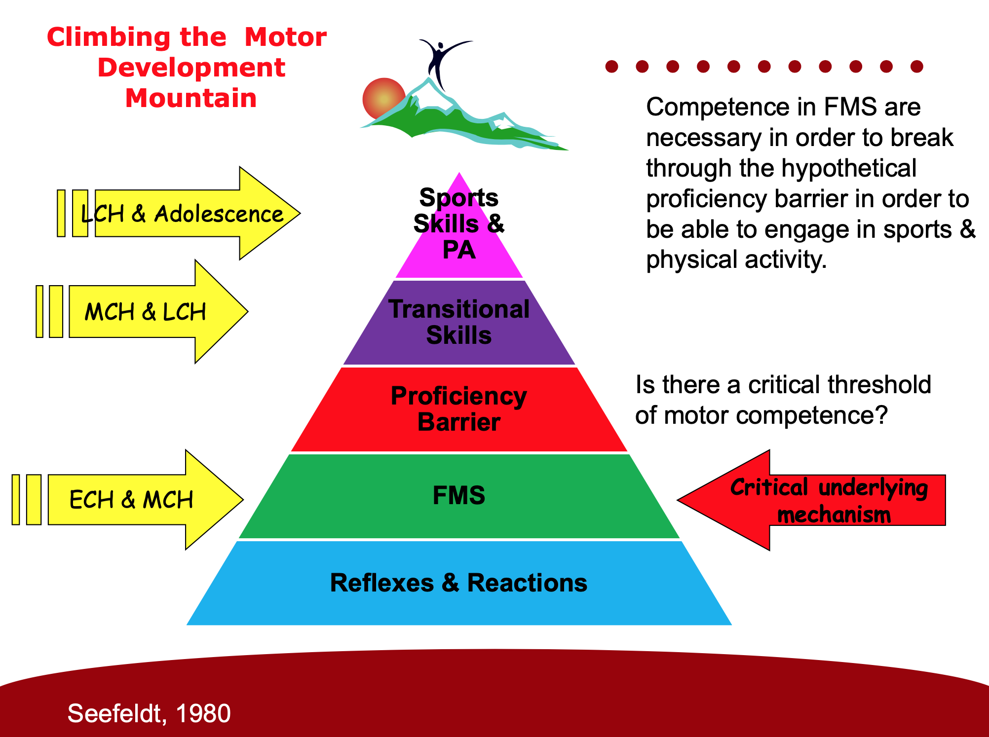

Slide 21
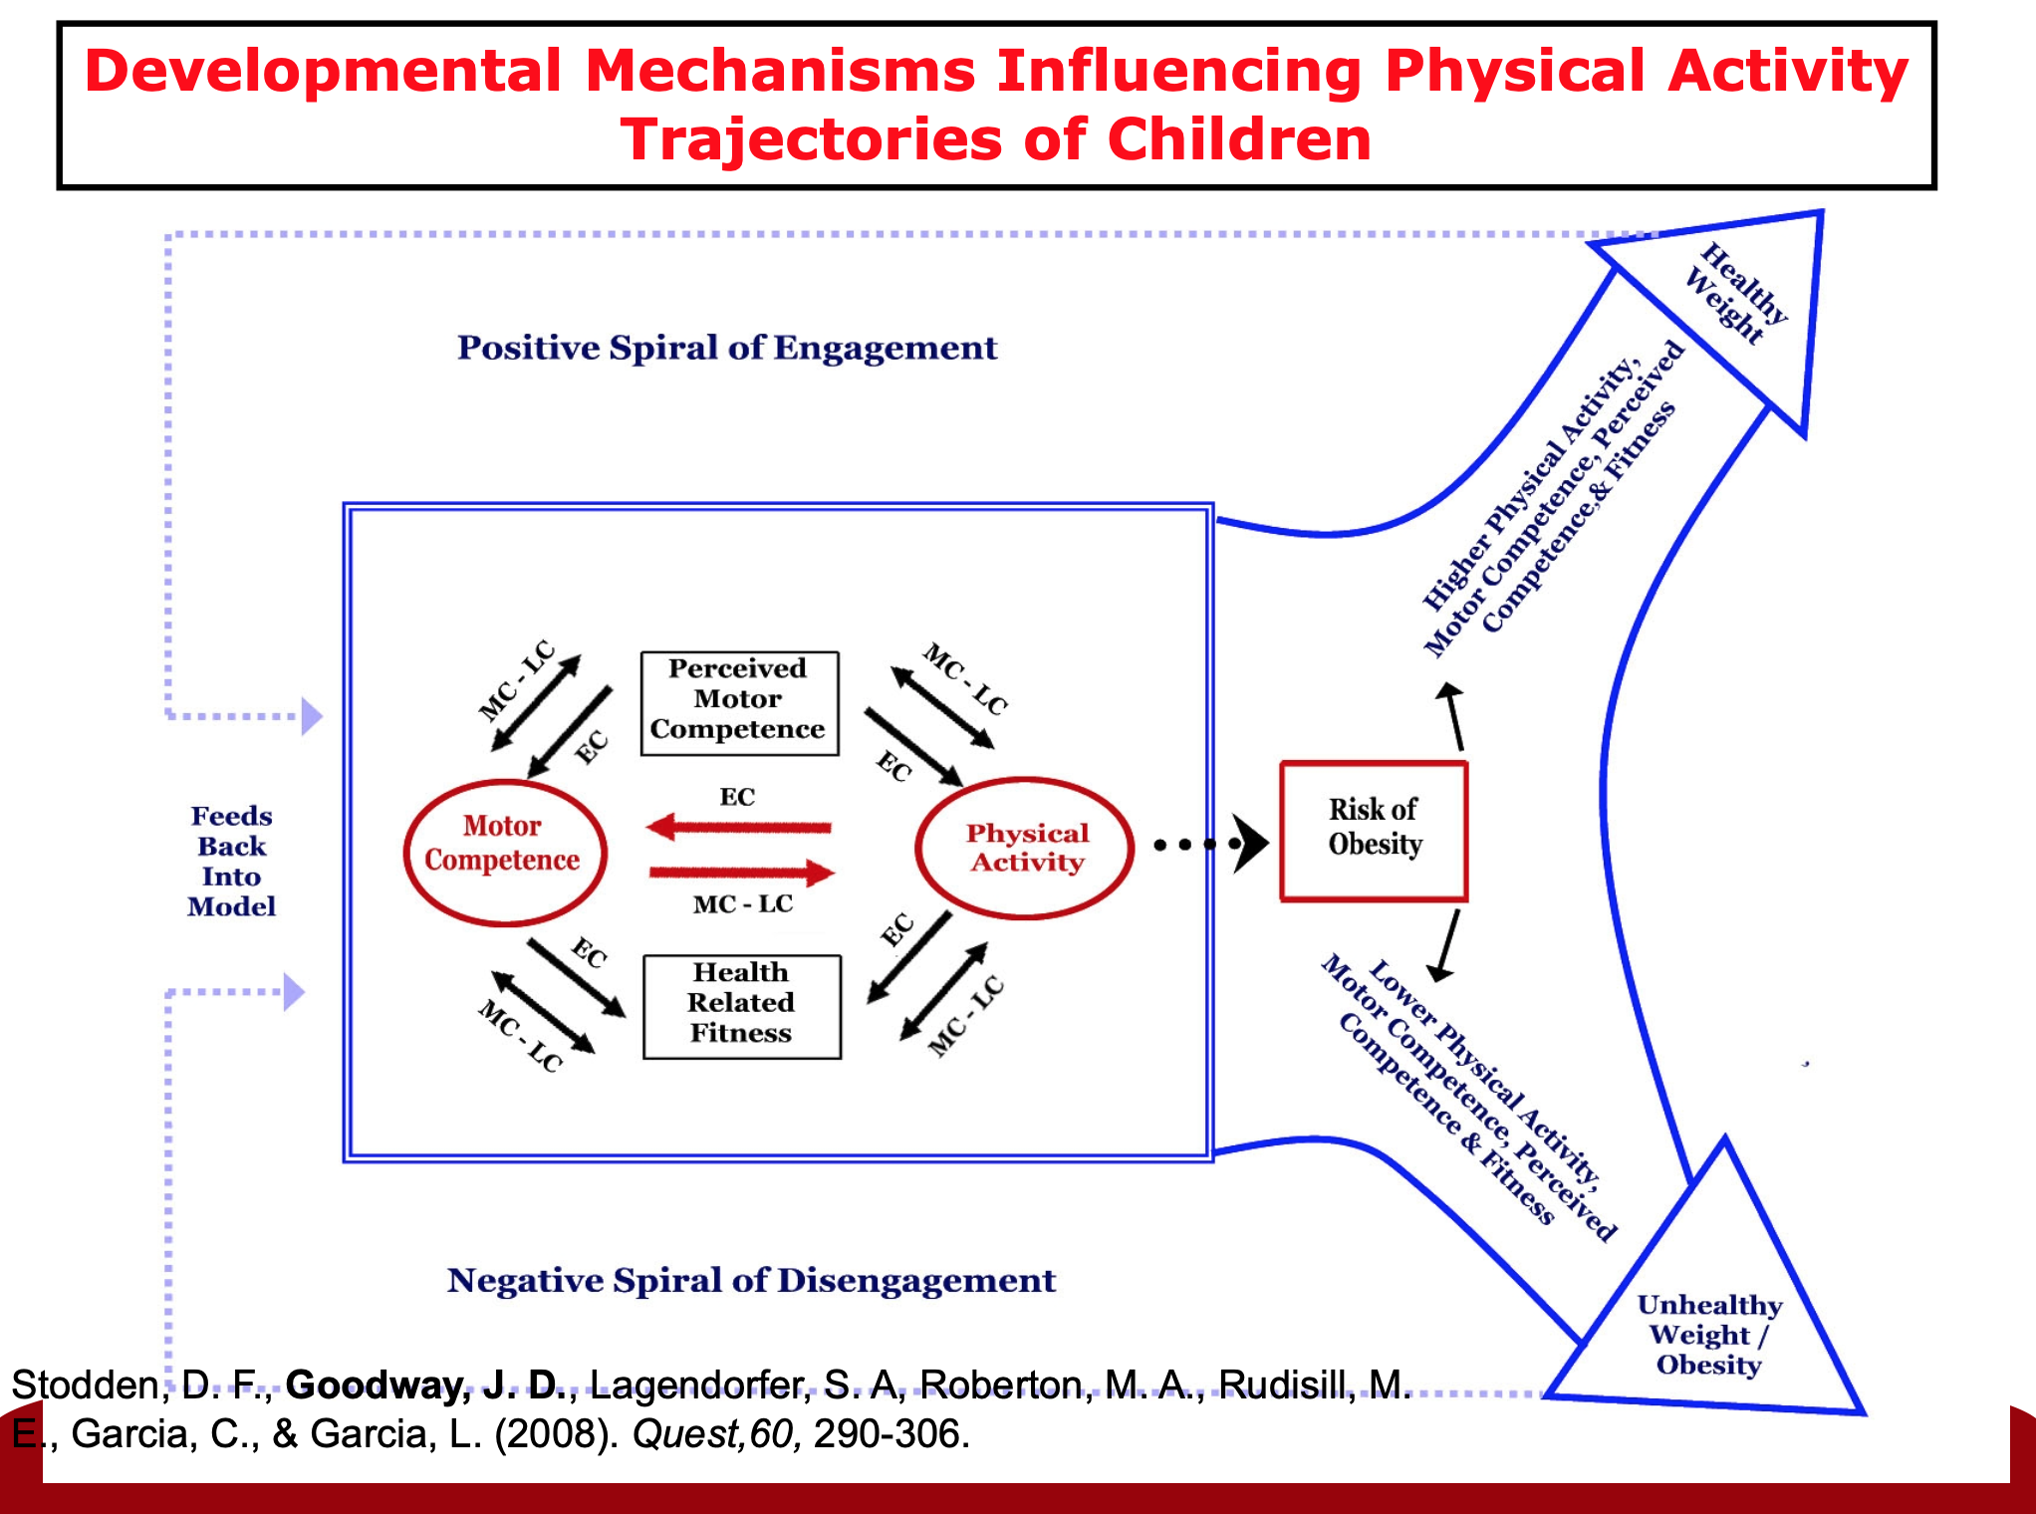

Slide 22
How do we learn
Exposure to the activity
Learning the correct technique
Variety
Challenge
Fun and enjoyment

Slide 23
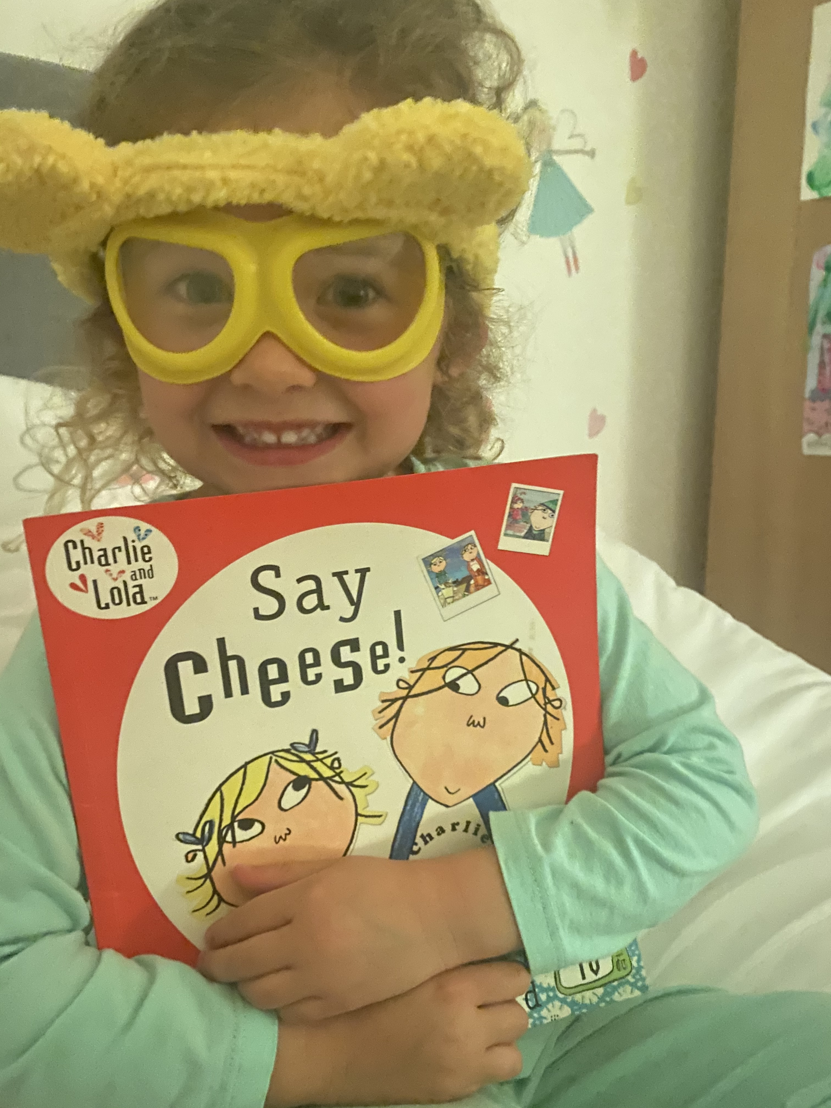
Learning to ride a bike
Exposure
Technique
Challenges
Variety
Progression
Go back
Go forward
Do it!
https://www.youtube.com/watch?v=H-fNhFoW250

Slide 24
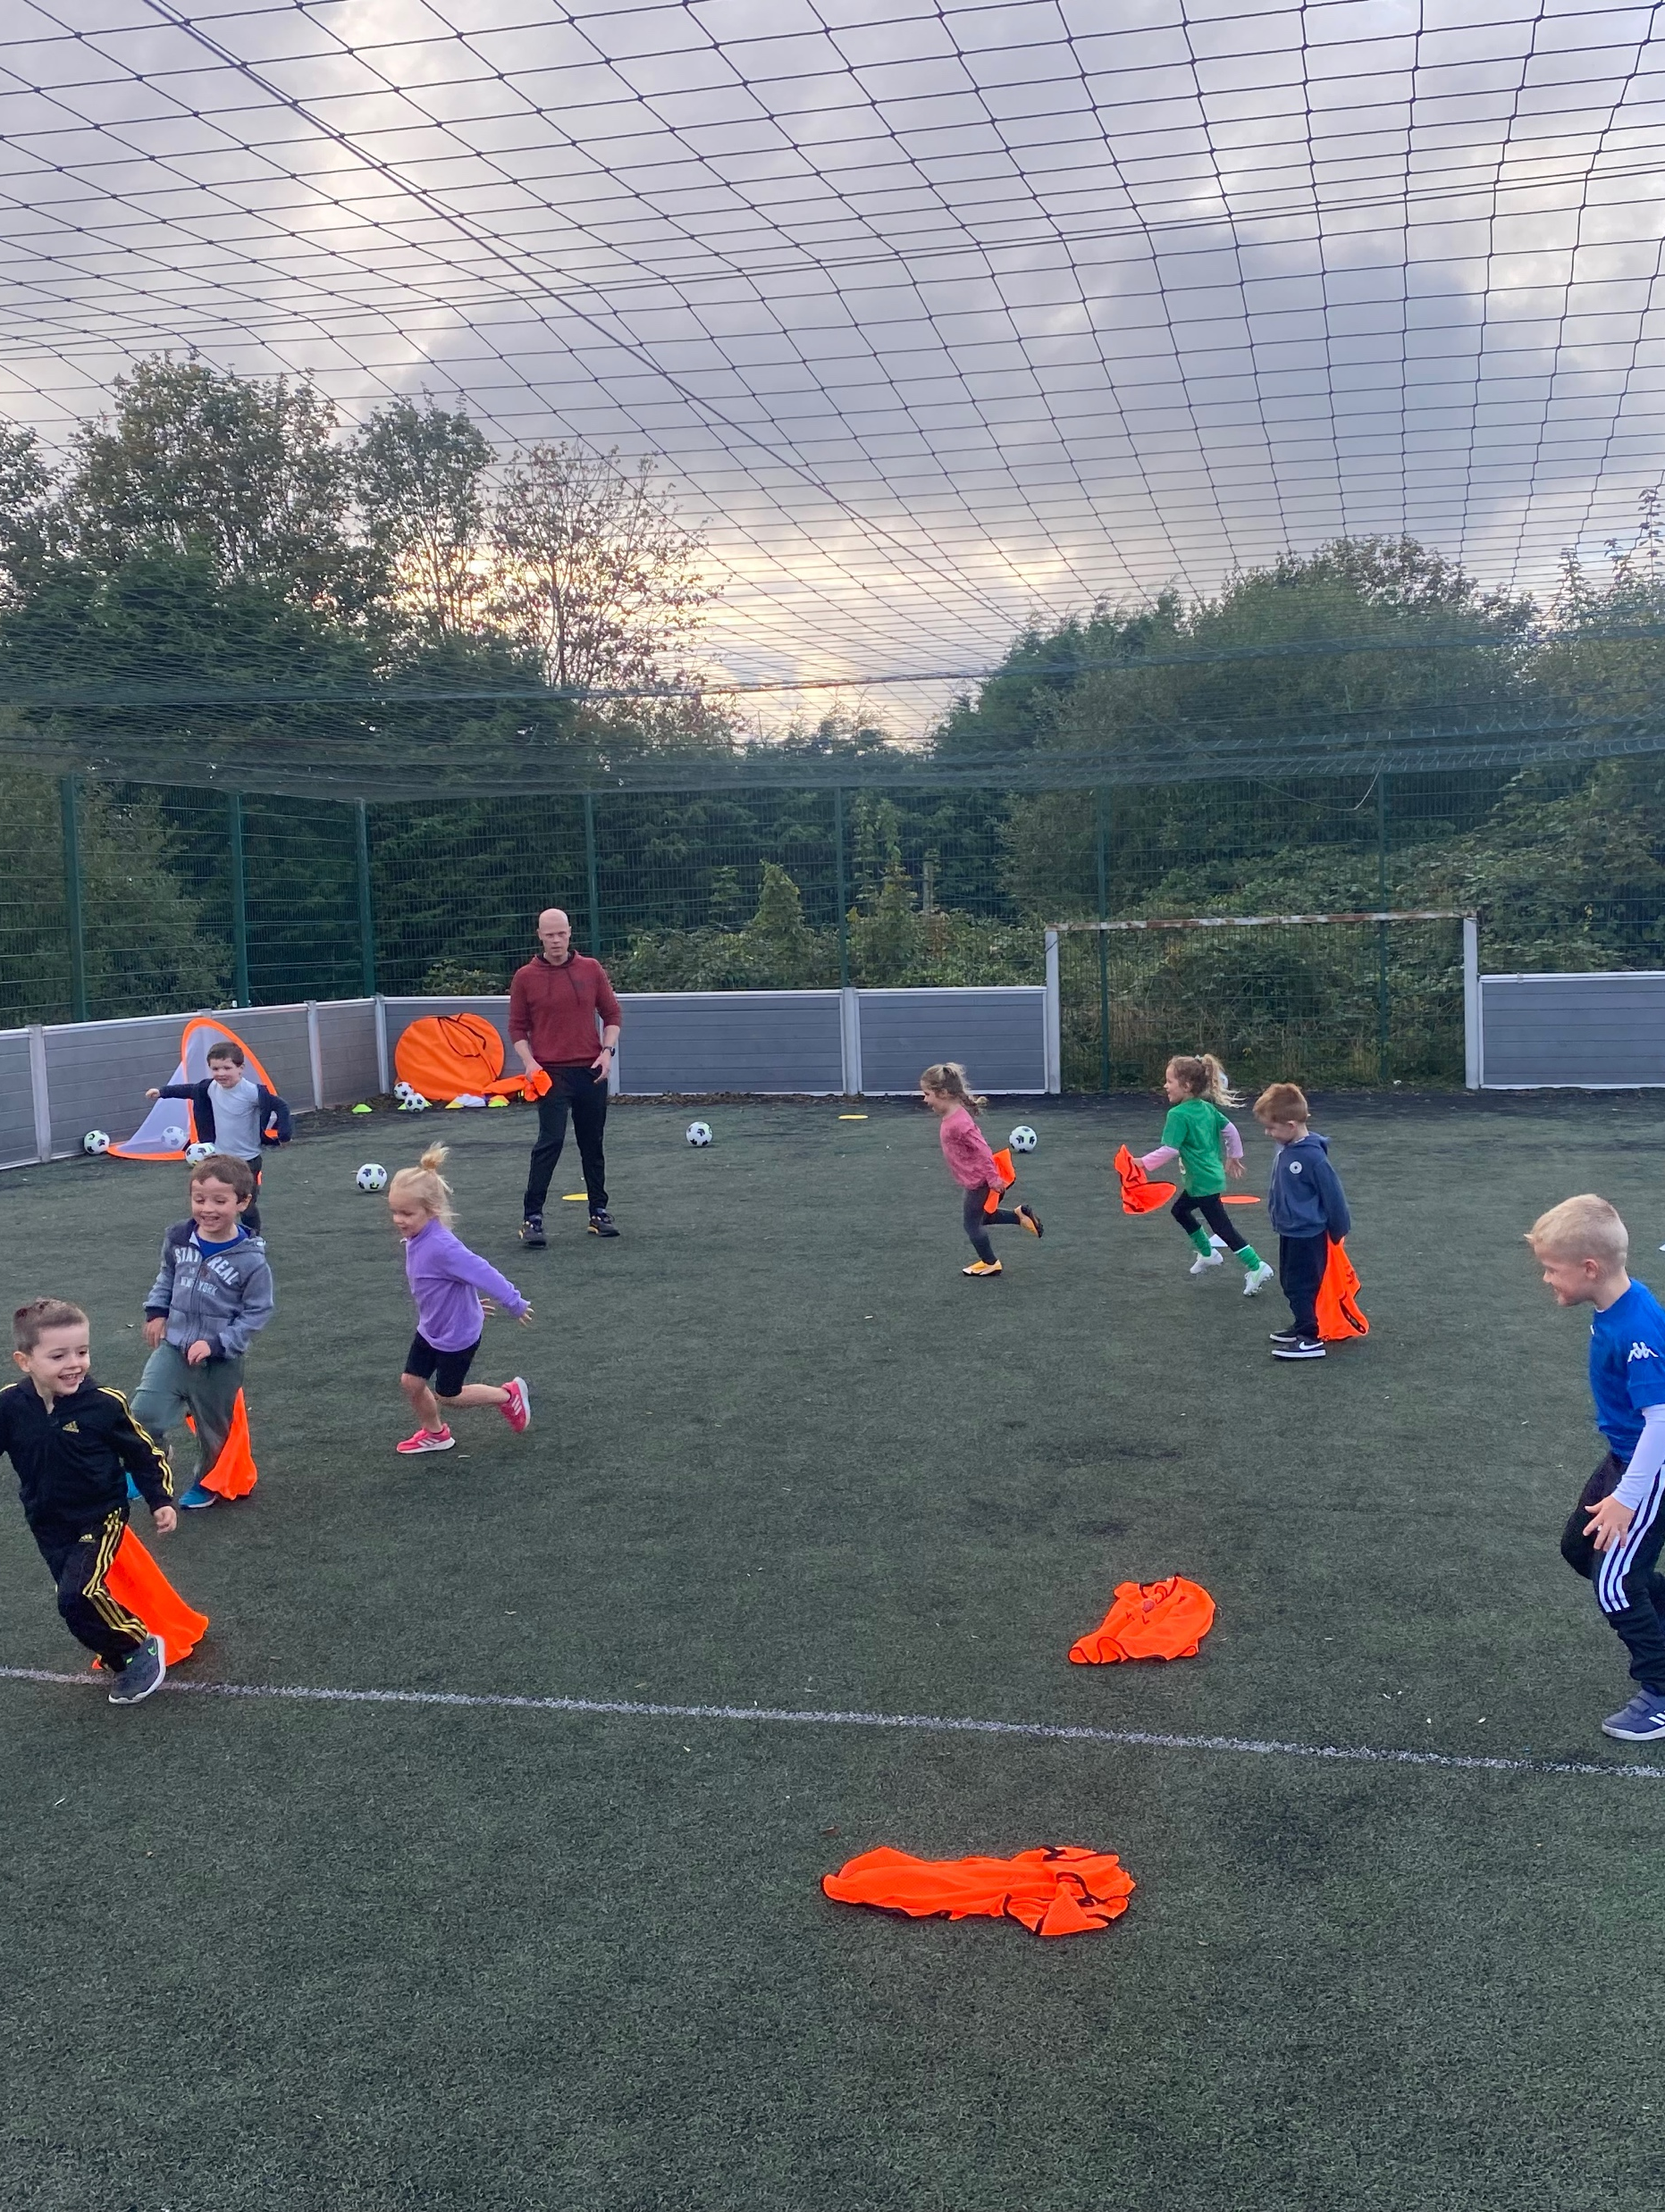
Coaching The Early Years
Easy fun games
Simple challenges
Key coaching points broken down into simple instructions they can remember
Use cheats
Smaller time blocks of activities
Control and boundaries
Smaller groups and carousel activities

Slide 25

Mark Napieralla: Advanced Sports Coaching:
Plan for LC
Netball session AM both year 1 and 2
PM- Deliver your 30 min plan to the other group and swap

Slide 26

Mark Napieralla: Advanced Sports Coaching:
Friday 5th November
Hand in 2 session plans. (must be 2 out of the 3 below)
18th October- Penllergaer- Improving basic skills
21st October- Bronze Ambassador Training – Swansea Uni
25th October- Sports Camp delivery- Meet 9am- arrive back 3:30pm 1st November- Penllergaer – Improving basic skills
22nd November- Crymlyn Primary School- Games to teach skills
Notes:
Submit 2 out of 3 forms

