Slide 1

Week 4
2024

Slide 2
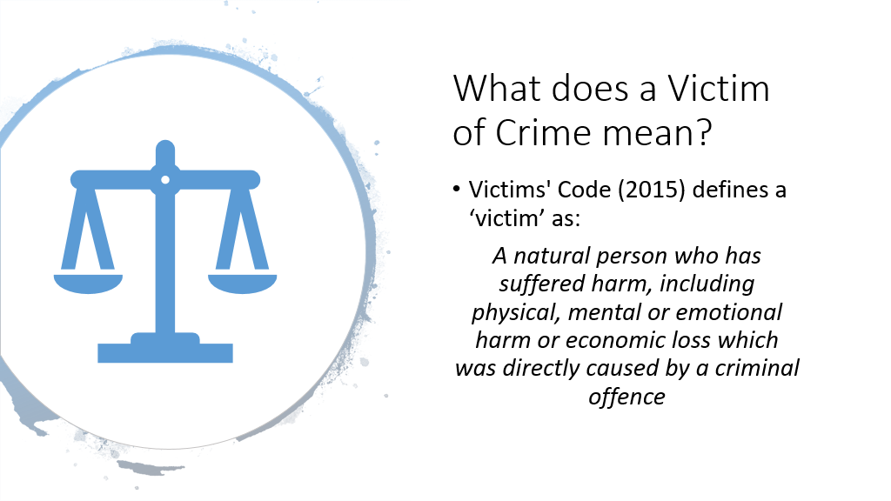

Slide 3

‘By definition a victim is someone who has suffered (suffering that in itself can be multi-dimensional and multi-faceted), sometimes willingly, sometimes not, as a result of forces more powerful than themselves. Thus suffering, power relations, and choice are central to how we understand who is, and who is not, given the label victim and, as a consequence, who acquires or does not acquire victim status. Victimhood is therefore highly contested.’
McGarry & Walklate 2015:7)

Slide 4
Impact of Crime and ASB
Victims may:
Suffer short term & long-term effects
They may have friends, partners & children who may also be affected by the crime
They may have a strong reaction to the crime even if others do not think of the crime as very serious
Notes:
What do you think the impact of crime and ASB has on victims and witnesses? –
Crime and ASB can affect people in many different ways. Although a crime may take only a relatively short time to commit, the effects on the victim can be long-lasting; in some cases for the rest of the victim’s life.
Individual reactions may depend on:
•The type of offence
•Whether they knew the perpetrator
•The support they get from their family, friends, the police and other people they come in contact with
•Their vulnerability
•Their past experiences.

Slide 5
Short Term Impact of Crime
•Nervousness, anxiety, sleeplessness
•Powerlessness, vulnerability & self blame
•Fear of a repeat attack
•Vulnerability to repeat attack
The might also be:
•An increase in fear of crime
•A lack of faith in the police
Notes:
How might this manifest itself within communities? –Crime can be hard to cope with as there is the knowledge that it was probably committed deliberately, unlike an accident where there is normally no harm intended. This can make the victim feel powerless and vulnerable.
This can be especially difficult to deal with if the offence is repeated or ongoing, which is often the case with domestic abuse, racially or religiously motivated crimes, or ASB.

Slide 6
Longer Term Impact of Crime
Feelings of powerlessness
Vulnerability to repeat attack
Depression or anxiety related illnesses
Post Traumatic Stress Disorder
Inappropriate behaviour towards suspect (vigilante behaviour if police take no action)

Slide 7
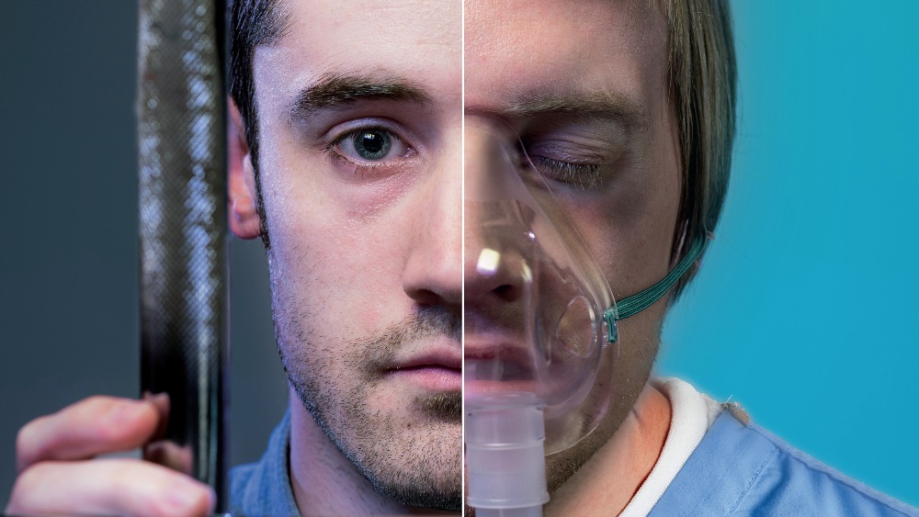
For example: the impact of a punch?
“…can mean totally different things in different circumstances: it can be the punch between two adolescent boys – of absolutely no significance on the level of victimisation. It can be the punch of a policeman on a picket line or the punch of the picket against the police. It can be the drawn-out aggression of a violent man against his wife. It can be the sickening violence of a parent against a small child.” (Young, 1988:174)
How do we measure harms?

Slide 8
What Do Victims Want?
Trust & Confidence in the system - victims and witnesses reporting, providing statements and giving evidence in court
Treated fairly, with proper dignity, with clear, timely & accurate information.
Move through system quickly – part of healing process?
A day in court – simple to say?
Punishment to fit the crime – Many want restorative justice
Do victims want more criminal prosecutions?
  criminal prosecutions are down (Transform Justice, 2020)
  Blame is on police
  Victims not co-operating with police
    Example Caroline Flack

Slide 9
Responses to Victims of Crime
Victims’ Code - the single most important document for victims of crime
Extra support for the most vulnerable people or those who have suffered the greatest impact from crime
Specialist training for CJS members
Support outside of the CJS – victims / witness support
Transforming the Criminal Justice System Paper 2013
  Action plan setting out care to victims, increase public confidence; and ensure that the system is fair and just.
Notes:
https://www.gov.uk/government/publications/transforming-the-criminal-justice-system

Slide 10
‘Getting it Right for Victims and Witnesses’ 2012
Government consultation paper setting out proposals for improving support to victims and witnesses
ID that the Code does not cover all victims - families bereaved by road traffic incidents / seriously injured on the road, families of missing persons and victims of anti-social behaviour.
Should be individual need rather than definitions based on the nature of crime
Victims’ Code - Need to be more accessible to victims.
Notes:
https://www.gov.uk/government/publications/getting-it-right-for-victims-and-witnesses

Slide 11
The Importance of Victims & Witnesses in the Criminal Justice System
Allows the criminal justice system to succeed
Narrows the justice gap
Helps avoid ineffective trials
Government initiated changes
Notes:
Victims & witnesses provide information, intelligence & evidence which enables offenders to be brought to justice. The criminal justice system relies on them to help identify offenders and give evidence. They are essential to successful prosecutions.
A better level of service from the police means a victim is more likely to stay engaged with the system and help bring the offender to justice.
Justice gap - the difference between the number of recorded crimes and the number of convictions.
Ineffective trial - Witness non attendance at court is the most common cause of an ineffective trial (ineffective trials are one reason that a case may not lead to a conviction).
A witness might decide not to give evidence in court for a variety of reasons, including:
•Intimidation
•Underestimating the importance of their evidence to the trial
•A lack of the support needed to enable them to attend court; or
•Unwillingness to be involved in the criminal justice system.
A better level of service from the police means a victim is more likely to stay engaged with the system and help bring the offender to justice.
•
In 2005, the government initiated changes to the criminal justice system to improve the level of care provided to victims and witnesses, bring more offenders to justice and so increase the delivery of justice by:
•Reducing the time between point of charge and trial
•Improving witness attendance at court
•Providing special measures, enabling witnesses to give the best evidence
•Setting up a single point of contact to provide focussed help and support for witnesses
•Improving victim and witness satisfaction with the criminal justice system.

Slide 12
What victims want
2017 Grenfell Tower
Terrorist attacks Manchester
Treated fairly, with proper dignity, with clear, timely & accurate information.
Both brought focus on how victims are treated within the CJS

Slide 13
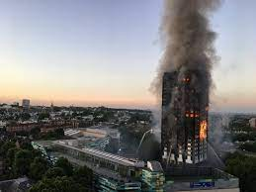
Grenfell Tower
Deaths were the result of policies of previous government parties – social housing/safe housing
4 days after no visit from local authority of Government personnel
PM 30 min visit but kept away from public ‘safety concerns’

Slide 14
Grenfell Tower
Public donations raised £3 million
“Grenfell Tower Residents’ Fund” - £5 million
£500 payment to residents
£5,000 if all their possessions went up in flames
End 2017 £330,000 had been paid out to victims
This was half of the amount spend on the refurbishment of the deadly cladding
£369 Million public money allocated to refurbish Buckingham Palace

Slide 15

Concerns
No co-ordinated emergency response by local authority
No emergency respite including food/shelters
No proper alternative accommodation
Dumped at ‘official rescue centre’
Public who came to help with clothes, food and accommodation
Victims moved out of County and London
Notes:
Royal Borough of Kensington & Chelsea RBKC one of the wealthiest in the area
Rescuse centre – leisure centre with little sleeping bags, pillows etc.

Slide 16
Criminal Charges
Scotland Yard Id two organisations:
Royal Borough of Kensington & Chelsea
Kensington & Chelsea Tenant Management Organisation
  Potential charges of Corporate Manslaughter
  Corporate Manslaughter & Corporate Homicide Act 2007 serious management failings resulting in gross breach of duty of care.

Slide 17

Grenfell
Met Police also viewing London Fire Brigade on their ‘stay put’ policy to remain in their homes.
Fraud investigations after falsely claiming to been survivors
Failings by NHS for mental health support
Public Enquiry to run until 2020

Slide 18
Manchester Bombing
Lisa & Saffie Roussos
Saffie (8) was killed & was the youngest person to die that night
Lisa seriously injured spending 6 weeks in a coma – has had to learn to walk, nerve damage, numbness
Lisa & Andrew £11,000 compensation
‘complete insult’; ‘no help’ from the whole system
Call for a review of the Criminal Injuries Compensation Scheme

Slide 19
FGM
In 1985 FGM was made illegal in the UK
There has since 1985 one FGM prosecution where the defendants were cleared
What is the full extent of this act? Girls are afraid to come forward, no reliable source to report
Govt. estimates 17,000 have undergone the procedure
Wales, Scotland and NI do not collect FGM figures
Female Genital Mutilation Act (2003)
Notes:
140 referrals in the last 4 years
Training for schools, youth workers, social workers and community workers.

Slide 20
Victims Strategy
Writing in 2018 the then Lord Chancellor & Secretary of State for Justice David Gauke stated that
  Victims are let down by the justice system
  Their voice is not heard
  Violent crime is increasing
  Highlighted that Grenfell, Manchester and London terror attacks changed the focus on victims.
Notes:
Now Robert Buckland

Slide 21
Victim Strategy
Commitments Chapter 1:
Strengthening the Victims’ Code by strengthening the powers held by Victims Commissioner
Introduce Victims’ Law
Hold agencies account for compliance
Develop the role of Independent Public Advocate for bereaved families.
Notes:
https://assets.publishing.service.gov.uk/government/uploads/system/uploads/attachment_data/file/746930/victim-strategy.pdf

Slide 22
Victim Strategy
Chapter 2 Support for Victims:
Increase spending from £31 to £39m 2020/21
New delivery model for support
Expand external support
£8m on children who witness domestic abuse
‘Child House’ multiple services use one house to minimise trauma

Slide 23
Victim Strategy
Chapter 3 improve victim support:
Improve police trg, interviews, body worn campers for Victim Personal Statements
Increase communication experts – get best evidence
Alternative solutions to court
Improve over all communication – CPS decisions, process, explaining more

Slide 24
Victim Strategy
Chapter 4 Better support through court process:
New court environment – friendly, accessible
Court time Magistrates Courts deal with no ID victims
Video Links encouraged
Pre-trial therapy

Slide 25
Victim Strategy
Chapter 5 Victims understand court’s decisions
Reconsidered sentencing by the Court of Appeal
Reform Victim Contact Scheme
Improved victim Liaison Officer
Entitlements for victims of mentally disordered offenders

Slide 26
Victim Culture
Victims attract media and public attention
Gives an appetite for learning experiences that people have suffered?
Biographies about victims courage, obstacles and perspectives
Facebook
Media
All can portrayed as ‘heroes’

Slide 27
Victim Culture
The Blame Game:
Domestic and sexual violence portrayed by the media as acts that ‘men were unable to help themselves’
If Children are killed the family up bring/divorce is mentioned
Sexual assaults – women drunk and ‘asking for it’
Clothes don't rape, nor do pubs & clubs, dark lanes or roads, or parties or alcohol.

Slide 28
Two Conflicting Themes?
Victims have survived dangerous conditions
They have come through and made something of it – ‘something good out of something so bad’
Victims are to blame for loss or actions taken on them. Their actions ‘caused’ the crime
Condemned for being a victim can this add to the trauma?
‘I should have done…..’ ‘I should not have gone …….’

Slide 29

Carl Beech
Allegations of childhood abuse in the 1970s and 80s by MPs, generals and senior figures in the intelligence services.
Stated that there was a Govt. high-powered paedophile ring
Seen as a survivor
Between 2014 and 2016, he was the star witness in a high-profile investigation into allegations of sexual abuse and murder
unravelled as a hoax to secure him criminal injuries compensation of £22,000
Investigation cost over £2.5 million
Covering up his own sexual desires
Operation Yewtree – Jimmy Savile

Slide 30
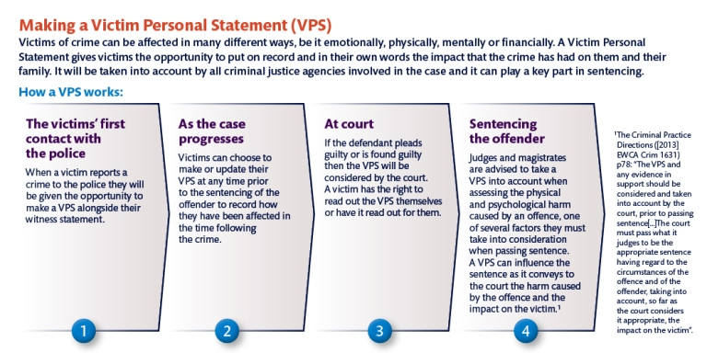
VPS

Slide 31
Task
For Tutorial:
Stanford Rape case see link below:
  https://www.independent.co.uk/voices/stanford-rape-case-why-a-victim-of-sexual-assault-speaking-out-shouldn-t-be-a-shocking-viral-news-a7072491.html
Google the Christchurch, New Zealand 2019 terror attack victim statements.
Netflix – Athlete A USA Gymnastic team abuse by Dr. Larry Nassar.
Notes:
Nabi

Slide 32
Standford Rape Case
The Victim: Chanel Miller
Chinese-American woman
Court questioned victim on what she was wearing; why did she go to the party; her relationship with boyfriend plus what she had drunk that night.
Felt that she was being interrogated
‘revictimized’
“did you know he is a good swimmer?”

Slide 33
Standford Rape Case
Rapist: Brock Turner
Was sentenced for 6 months in an County Prison
Son's life had been "deeply altered forever"
On sex offenders register
Judge was criticised of being too soft stating that prison would have ‘severe impact’ on him. Should have served 14 years
Same judge gave a Latino man 3 years for same crime
Affluent white male hired a powerful legal team and private investigators and got expert witnesses.
Turner could have been an Olympic swimmer – said on many times
Notes:
https://www.independent.co.uk/news/world/americas/stanford-rape-case-judge-aaron-persky-brock-turner-latino-man-sentence-a7110586.html

Slide 34
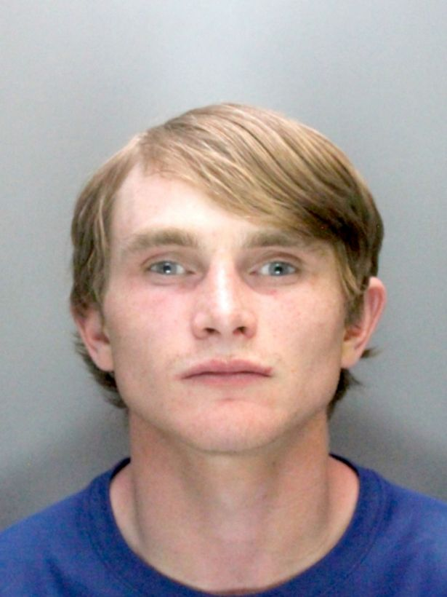
Violet-Grace
83 MPH in a 30 MPH road
Went on the run to Amsterdam
Death by DD = Section 1 of the Road Traffic Act 1988, carries a maximum penalty of 14 years in prison
Received 9.5 years – out sooner?
Sentenced increased due to social media in prison
Notes:
Aidan Mcteer 2017
https://www.bbc.co.uk/news/uk-england-merseyside-41345828

Slide 35
Violet-Grace
VPS - The defendant would find it “too upsetting”
CPS barrister highlighted parts of the impact statement which they could not read out
The whole purpose of the victim impact statement is the impact on the victims and the survivors, not the defendant.
October 2017, the government promised life sentences for death by dangerous driving.
“Innocent people have been killed, but nothing has changed. The law is out of date” (parents of Violet).
Notes:
https://www.theguardian.com/uk-news/2019/jul/10/parents-victim-statement-edited-to-spare-feelings-of-driver-who-killed-child

Slide 36
Victim Impact Statements
Victim’s choice to make one
Explain how the crime has affected individuals
Will be taken into account when a Judge is making decision on sentencing
There are some rules
'VIS can work, do work (for those who bother to make them)’ Chalmers et al., 2007
Evidence that giving VIS help towards the healing and recovery of victims. Anger and anxiety decrease for some victim's
Effectiveness to ease emotional recovery is widely debated
VIS can failing to meet victims' expectations may lead to dissatisfaction (Ashworth, 2000; Edwards, 2001; Sanders et al., 2001)

Slide 37
VPS & Parole
Parole Boards considers whether a offender can be released from prison or moved to an open prison. Certain victims will be able to write a VPS telling the Parole Board what impact releasing the offender or changing their custodial conditions will have on them.
VPS can help the Parole Board to set appropriate licence on offenders upon release, such as exclusion zones and preventing the offender from contacting the victim.
VPS for the Parole Board given to all victims who have opted in to the Victim Contact Scheme, which is available for victims of violent or sexual offences where the offender is sentenced to 12 months or more in prison.
The process of creating a VPS for the Parole Board is separate to the process of making a VPS to be considered in court.

Slide 38
Victims Code
Introduced last week
12 Victim's Rights that victims are entitled from the Criminal Justice system

Slide 39
Enhanced / Special Service
The victim’s code defines 4 distinct ‘cohorts’ of victims who should qualify for an ‘enhanced service’
Victims of serious crime; persistently targeted victims; vulnerable victims and intimidated victim.
The categories are designed to ensure that victims who are most in need will be able to access enhanced support.
Entitlement can overlap more than one category.

Slide 40
Distinct ‘cohorts’
Victims of the most serious crime
Domestic abuse
Sexual offences
Terrorism
Hate crime
Human trafficking
Attempted murder
Wounding / causing grievous bodily harm with intent
False imprisonment
Arson with intent to endanger life
Kidnap

Slide 41
Who we should be focusing on
 | Victims of the most serious crime
 | Domestic abuse | Sexual offences | Terrorism
 | Hate crime | Human trafficking | Attempted murder
 | Wounding / causing grievous bodily harm with intent |  | False imprisonment
 | Arson with intent to endanger life |  | Kidnap
 | Persistently targeted victims
 | A victim that has been targeted repeatedly as a direct victim of crime over a period of time; particularly if they have been deliberately targeted; or they are a victim of a sustained campaign of harassment or stalking.
 | Vulnerable victims
 | All victims who are under 18 years of age at the time of the offence.
 | Victims whose quality of the evidence is likely to be affected because they:
 | suffer from mental disorder within the meaning of the Mental Health Act 1983
 | have a significant impairment of intelligence and social functioning
 | have a physical disability or is suffering from a physical disorder.
 | Intimidated victims
 | Victims whose quality of evidence may be affected because of fear or distress about testifying in court. When assessing whether a victim is intimidated, the service provider must take account of:
 | behaviour towards the victim on the part of the accused, members of the family or associates of the accused, and any other person who is likely to be an accused or witness in a potential court case
 | the nature and alleged circumstance of the offence to which a potential court case relates. Victims of a sexual offence or human trafficking will automatically be considered to be intimidated
 | the victim’s age and, if relevant, the victim’s social and cultural background, religious beliefs or political opinions, ethnic origin, domestic and employment circumstances.
The victim’s code of practice (VCOP) defines 4 distinct ‘cohorts’ of victims who should qualify for an ‘enhanced service’ and referral to support
Notes:
Crime currently 32%
ASB 6 % real concern that we are not identifying the right cohort and people going under the radar.

Slide 42
Special Measures
The measures a court can order to assist vulnerable or intimidated witnesses to give their best evidence in court.
Screens in court; wigs off; video links; video recorded statements/interviews; public gallery cleared; assist the victim
evidence given in private
pre-trial visual recorded
examination of the witness through an intermediary
aids to communication

Slide 43
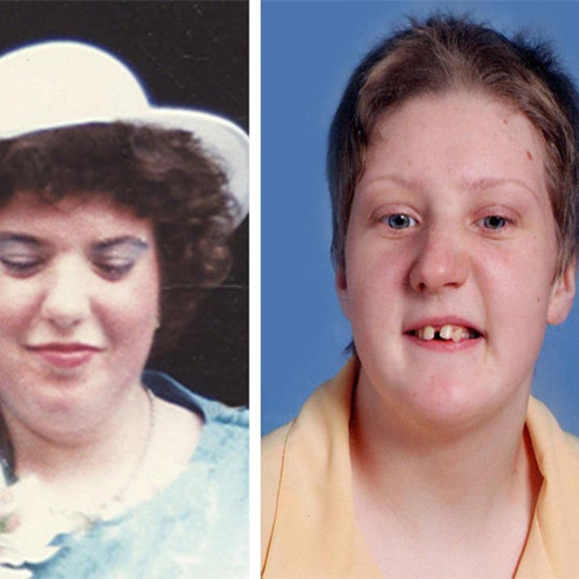
Fiona Pilkington 2007
Killed herself and her severely disabled daughter Franky after 10 years of torment by local youths.
2011 The Independent Police Complaints Commission (IPCC) investigated - police failed to identify that Fiona, her son and daughter as vulnerable.
Leicestershire Constabulary’s failure to implement a cohesive, structured and effective approach to the harassment/anti-social behaviour from which they were suffering.
33 police recorded incidents between November 1997 and October 2007
Incidents were often dealt with in isolation and with an unstructured approach which prevented a true picture of the level of harassment suffered by family.
Notes:
2009-Fiona-Pilkington-Leicestershire.pdf (hampshiresab.org.uk)

Slide 44
Restorative Justice Scheme
Victim satisfaction Brings together victims & those responsible for the crime.
Research shown that 85% of victims were satisfied / reoffending rates reduced
It gives victims the chance to have their say, to get answers to their questions, and to move on with their lives.
Gives offenders the opportunity to look at their behaviour and the impact it has had on the victim’s life.
‘positive psychological impact on victims’ – National Library of Medicine.
Cost / reduce re-offending / save time not waiting for court.
Notes:
https://www.ncbi.nlm.nih.gov/pmc/articles/PMC10240635/

Slide 45
Nirbhaya Movement - ‘The Fearless One’
Jyoti Singh medical student with friend caught a bus home South Delhi Dec 2012
They were both attacked by 4 men on the bus
Singh was brutally gang-raped, beaten, thrown off bus
Caused an outrage and number of rapes started being reported
2011 - 572 rapes 2012 – 706 rapes 2013 - 1,813 rapes
80,000 suggestions to change rape laws
Quicker investigations & prosecution of offenders
6 new fast track courts
BUT:

Slide 46
India & 2020
Rape reporting over 32,000
September 2020 - 2 rape cases
A 19-year-old Dalit woman died after she was gang raped by four upper-caste men.
  Body was cremated by police without family consent.
Same week -
22-year-old Dalit woman died after gang rape same circumstances as above.
  Police did not believe she was raped

Slide 47
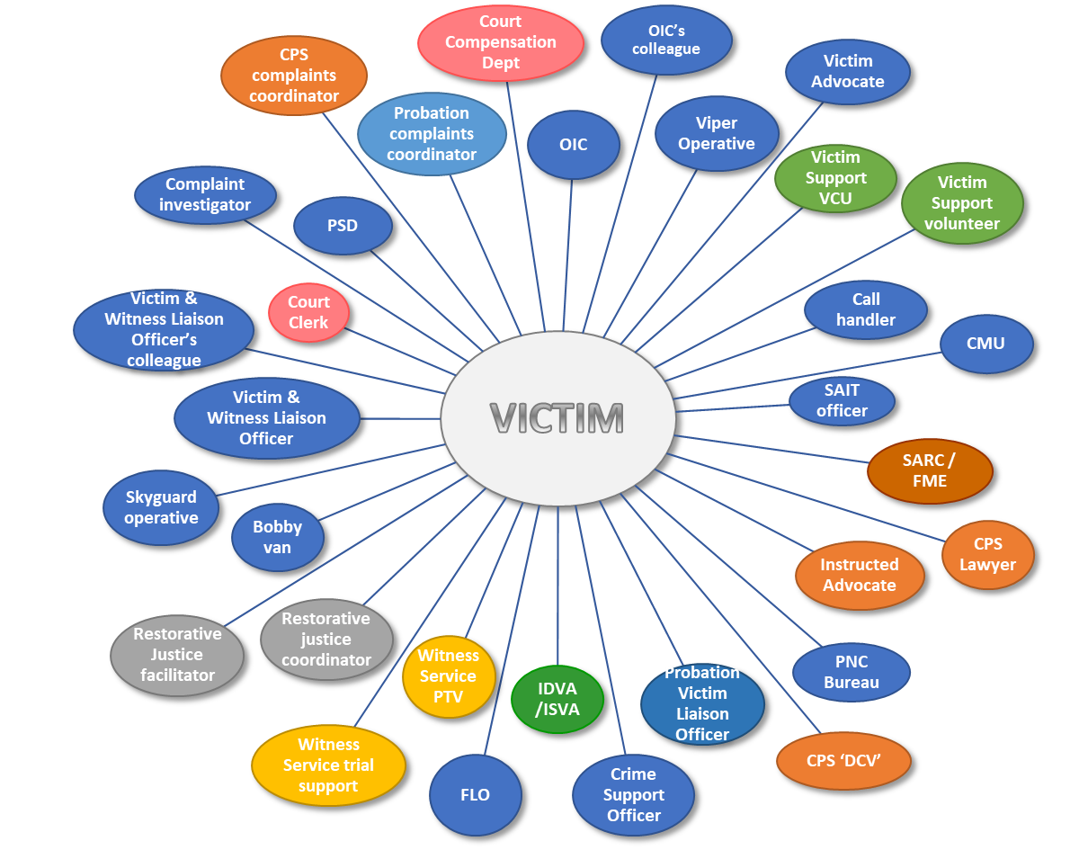

Slide 48
Is there more?
What do victims what?
Why are some victims not satisfied?
Public see victims of crime?
Victims journey through the criminal justice system can be a frustrating experience?
More consultation need with Victims / CJS?
Victims’ Strategy – to follow but sets out improvements for victims of crime.
Notes:
Victims Strategy (publishing.service.gov.uk)

Slide 49
RJ Task
Can the use of the restorative justice in cases of domestic violence work?
Discuss potential issues with this?
Any advantages with this process within these crimes?
Notes:
https://restorativejustice.org.uk/blog/using-restorative-justice-cases-domestic-violence#:~:text=The%20Restorative%20Justice%20Council%20are,on%20the%20perpetrator's%20criminal%20sanctions.
https://www.penalreform.org/blog/can-restorative-justice-offer-victims-domestic-violence/
https://committees.parliament.uk/writtenevidence/63726/html/

Slide 50
Webpages
https://www.cps.gov.uk/sites/default/files/documents/legal_guidance/joint-agency-guide-victim-personal-statement_0.pdf
https://assets.publishing.service.gov.uk/government/uploads/system/uploads/attachment_data/file/831968/victims-code-poster.pdf
https://www.cps.gov.uk/sites/default/files/documents/legal_guidance/joint-agency-guide-victim-personal-statement_0.pdf

