Slide 1
View Models
Lecture 6: Web Development: ASP.NET (WD DotNet)
Dr Kemi Ademoye

Slide 2
Today’s Lecture
View Modules
Client-side Scripts, JavaScript
Select List Items

Slide 3
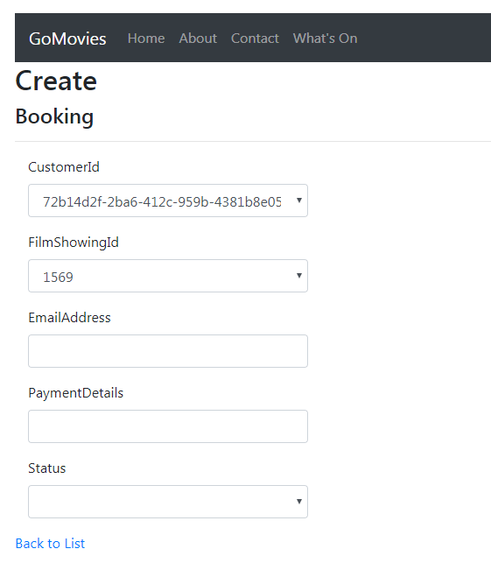

Default Create New Booking View
The Create view VS scaffolds for creating a new booking looks like the following.
What is wrong with it?
Hmmm, should I change these values?
What do I select?
May be I should just guess.

Slide 4
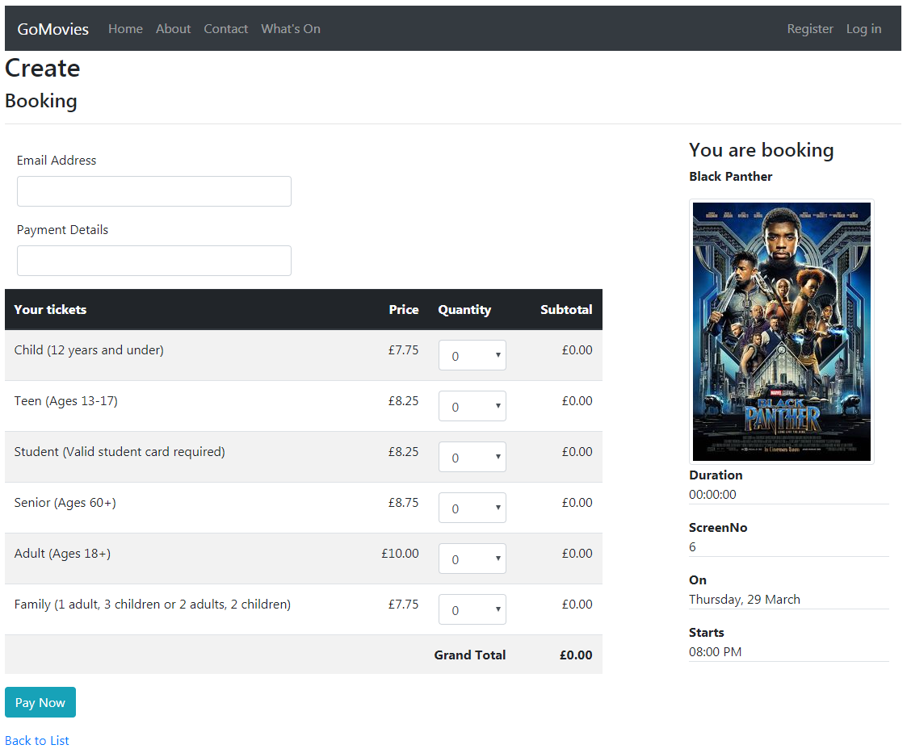
Is this better for Create New Booking?
What entity data models have been used?

Slide 5
View Models
The view needs data from multiple entity models and possibly some extra data too.
Booking Model
Film Model
BookingTicket Model
FilmShowing Model
Notes:
And there are some hidden fields

Slide 6
View Models
View models allow you to create the data needed by a view.
  They are Models specific to the View they serve.
You combine entities from one or more entity data models into a single object.
You can also add additional properties not in any of the entity models being combined.
You the use the custom view model in the controller instead of the normal model class.

Slide 7
Creating a View Model
A View Model is simply a class.
It contains properties representing the data the view needs to display.
For example, it can contain:
  Simple type properties
    public string DiscountCode { get; set; }
  Entity model type properties
    public FilmShowing FilmShowing { get; set; }
  Collections of items
    public ICollection<BookingTicket> Tickets { get; set; }
  Etc.

Slide 8
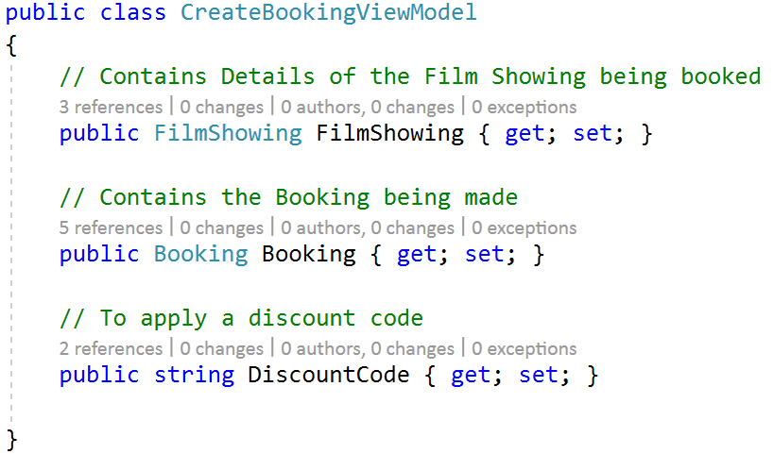
View Models
The following creates a view model for creating a new booking.
It has three properties. What are they?

Slide 9
Posting Parent and Child Data
To make a new booking, the user needs to complete:
  Booking Details: Email, Payment, etc.
  Ticket Details: What ticket types and quantities
Booking (Parent)
BookingTicket (Child)

Slide 10
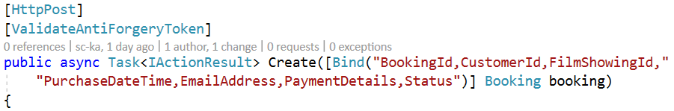
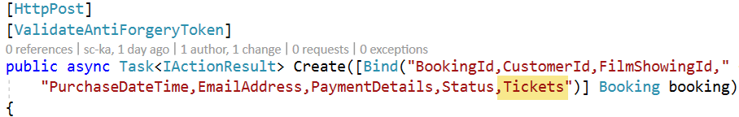
Posting Parent and Child Data
When you scaffold a controller and views, by default it only allows you to post the parent data.
If you to post the child data (Tickets) at the same time, then you need to modify the action method
  Include the child property name in the post data list.
Notes:
Tickets is the name of the navigation property for the child Booking Tickets

Slide 11
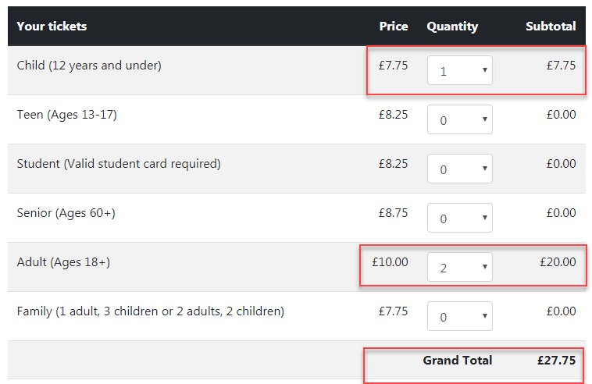
Adding Some JavaScript
When the user selects the Quantity of tickets, it would be nice to update the Sub and Grand totals in the view.
Instead of a trip to the server, use JavaScript to update the totals on the client.

Slide 12
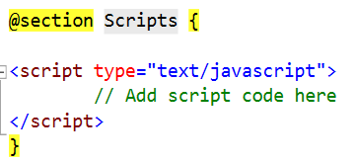
Adding Some JavaScript
You simply add a script block to the end of your view.
You simply add JavaScript and jQuery code and functions to the <script> element.

Slide 13
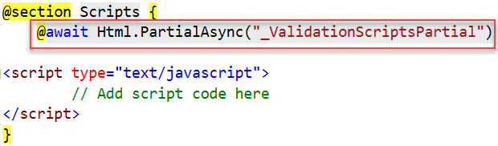
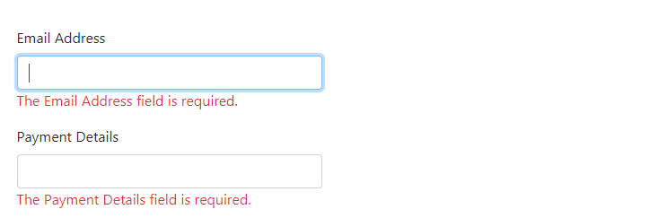
JavaScript: Validate Form Data
To validate the form data on the client before posting to the controller method, add:
It uses the EF Data Annotation attributes to validate the form data.
I clicked submit before filling out:
Notes:
The _ValidationScriptsPartial should have been added by default to the project.

Slide 14


Question
The following ticket types have been defined:
  Child
  Teen
  Student
  Senior
  Adult
  Family
What ticket types should not be allowed if the film is rated:

Slide 15
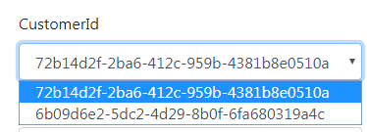
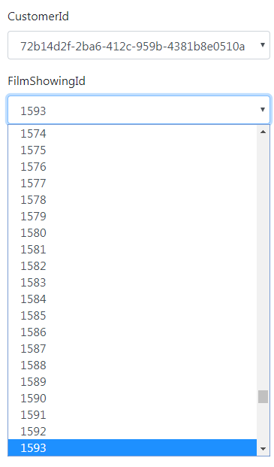

Drop down list values
What’s wrong with the following drop-downs?

Slide 16
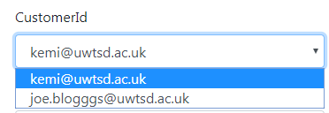
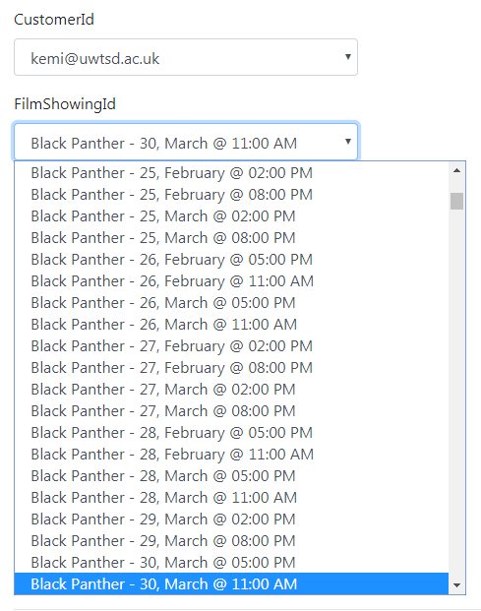
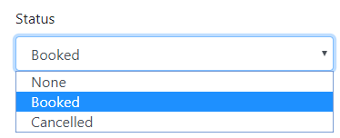
Drop down list values
Is this a bit better?

Slide 17
Drop Down Lists: Enums
If you recall, we defined an enum for Booking Status with the following allowed values:
  None
  Booked
  Cancelled
In your view, you simply
  Import your data project at the top of the view
    @using GoMovies.Data.Entities;
  Create a <select> element for the model item
  Sets its asp-items attribute property to the enum:
    <select asp-for="Status" class="form-control"
    asp-items="@Html.GetEnumSelectList<BookingStatus>()">
    </select>

Slide 18
Drop Down Lists: Database Values
For most drop down lists, you want to use values in a database where the options set:
  Value: is set to the ID of the database item
    This is the value that gets submitted.
  Display Text: is set to a more descriptive field
    This is what the user sees to select.
    <select name="film">
    <option value="1">Black Panther</option>
    <option value="2">Pacific Rim</option>
    </select>
You can use the SelectList() method to specify these values in the controller to send to the view.

Slide 19
SelectList Method
The format is:
  new SelectList (IEnumerable items, string dataValueField, string dataTextField, object selectedValue);
The parameters:
  Items: the items to display in the drop down
    This is the only parameter that is mandatory
    Can be a database table or non-database collection
  dataValueField: the field/property in the items to use as the value to submit behind the scenes.
  dataTextField: the field/property in the items to display to the user when they expand the list.
  selectedValue: the default value selected.

Slide 20
Drop Down Lists: Simple Database Values
In the controller, you create a SelectList and send it to the view as extra data.
  ViewData["FilmId"] = new SelectList(
  _context.Films, "FilmId", "Title", filmShowing.FilmId);
  Sets items to all database Film records
  Sets the data value to the FilmId property
  Sets the display text to the Title property
  Sets selected value to the Film Showing’s Film ID
In the view, you add as follows:
    <select asp-for="FilmId" class="form-control"
    asp-items="ViewBag.FilmId"></select>

Slide 21
Drop Down Lists: Formatted Values
If you look at the following drop down list for Film Showing
For the Display, it uses:
  The Film Title +
  The Showing Date and Time
You have to do something
a bit more complex when
creating the Select List in
the controller.

Slide 22
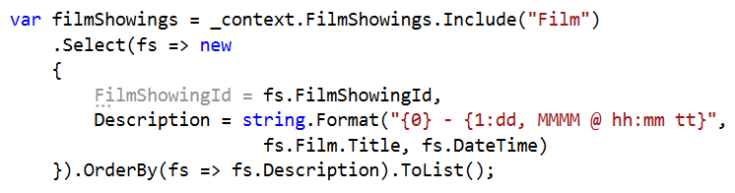
Drop Down Lists: Formatted Database Values
You use a .Select Method to format the items retrieved from the database to display.
Select and format the items to display and store in a variable
Send the select list to the view
    ViewData["FilmShowingId"] = new SelectList(filmShowings, "FilmShowingId", "Description", booking.FilmShowingId);
Queries the Film Showings and includes parent Film record
Creates a formatted string combining the Film title with the showing date and time
Stores the formatted string in a new property called Description
Notes:
filmShowings: the variable storing the list of options retrieved from the database containing the FilmShowingId and the formatted Description.
In the new SelectList(…) method:
The first parameter, is the variable storing the list of options retrieved
“FilmShowingID” specifies what property to use for the value in the option
“Description” specifies what property to show the user when they expand the drop down list
Booking.FilmShowingId: specifies the initial selected value (in this case the current booking’s FilmShowingId)

Slide 23
Lab Exercise
Download Instructions on Moodle

