Slide 1
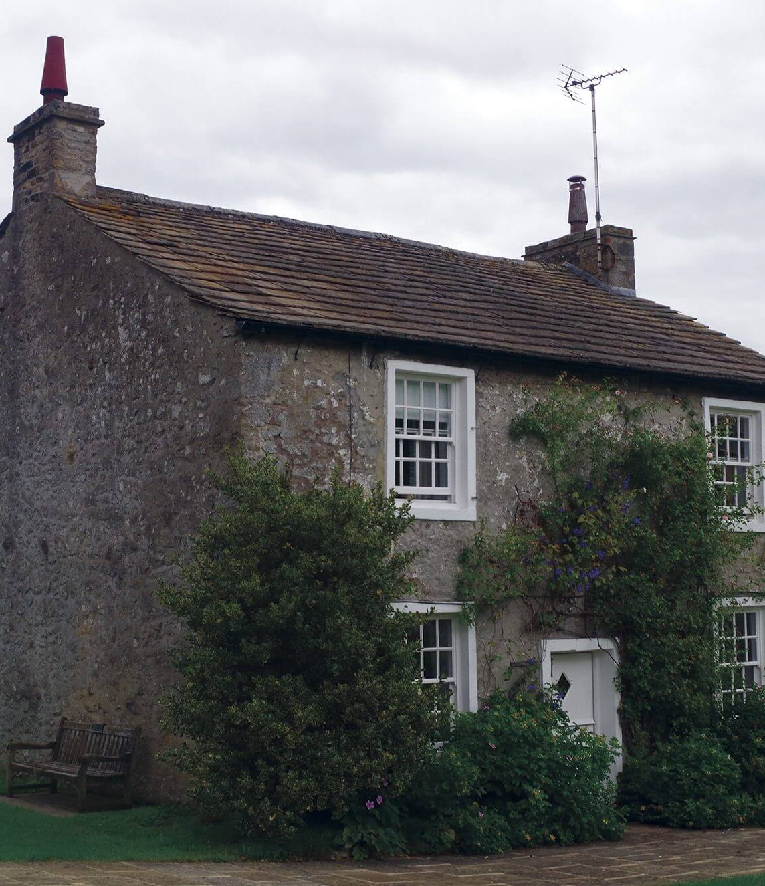
Traditional Floors
R Thomas
Notes:
Line spacing + Page numbers

Slide 2
Agenda
01 Introduction
02 Materials?
03 Solid Ground Floors
04 Suspended ground floors
05 Suspended upper floors
06 Modern alternatives?

Slide 3
A floor typically provides:
Structural support for the contents of the room, its occupants, and the weight of the floor itself.
Resistance to the passage of moisture, heat and sound.
A surface finish which may contribute to the look, feel and acoustics of a space.
Very broadly, floor construction tend to be solid floors, built up from the ground, or suspended floors, supported by wall structures. There are a very wide range of variations around these basic types. The intended use of the floor, its location, the structure of the rest of the building, and the required floor finish will determine which of the many variations is most suitable for a particular application.

Slide 4
What types of materials were used?
Wood/Timber – Joists, floor boards
Concrete
Tiles

Slide 5
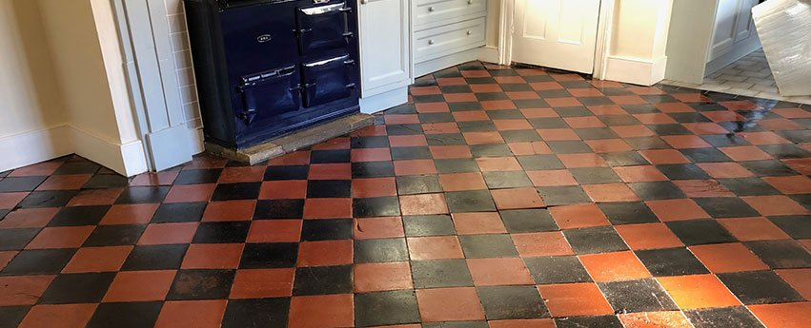
Traditional Solid Ground Floors
Traditional ground floors were usually compacted earth mixed or topped with a fine layer of ash or stone dust.
These floors could be finished with a variety of materials, a common one being “Quarry Tiles”
However this type of floor construction did have negative points.

Slide 6
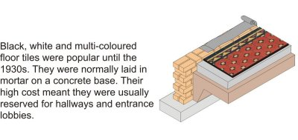
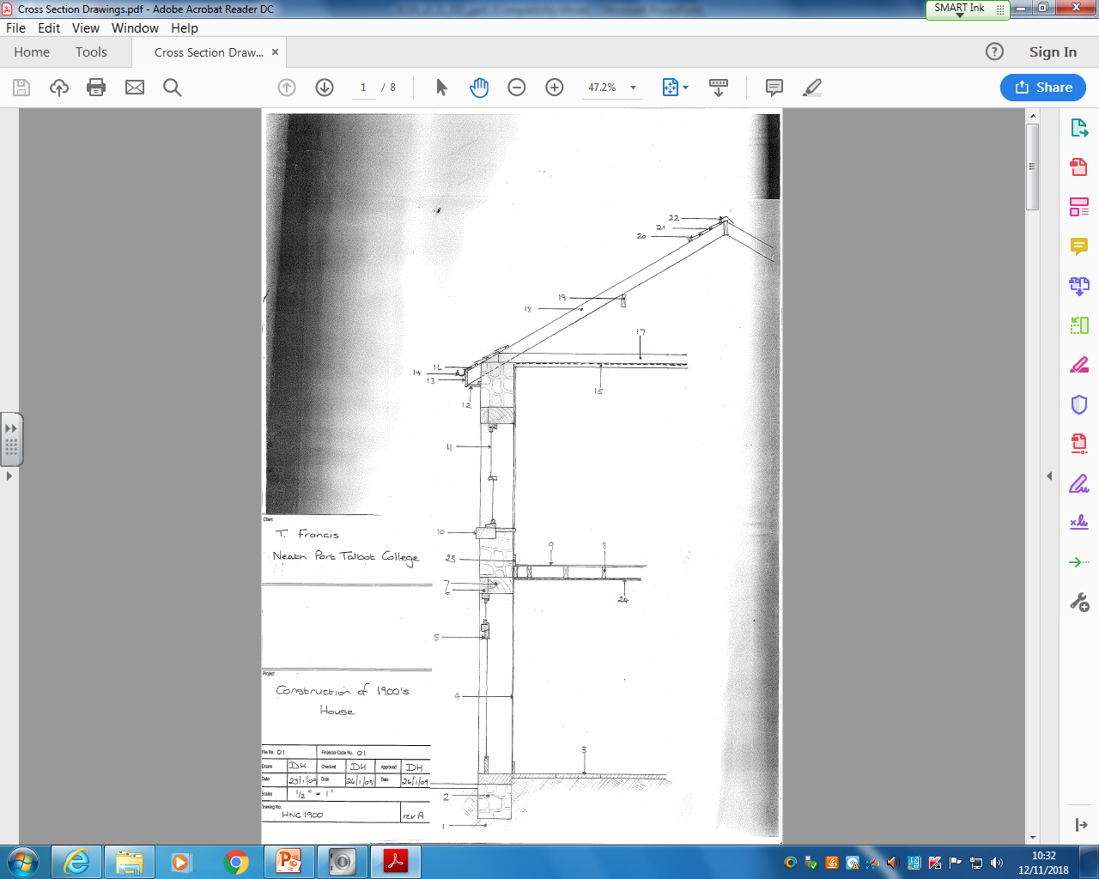
Traditional Solid Ground Floors
1-Earth/ground
2- Stone foundation
3- Quarry Tiles

Slide 7
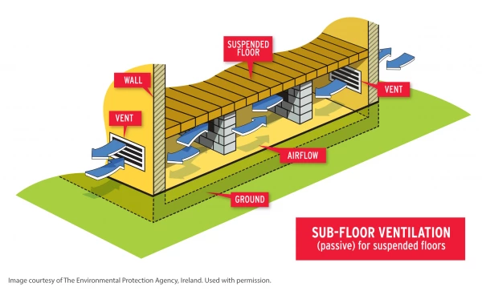
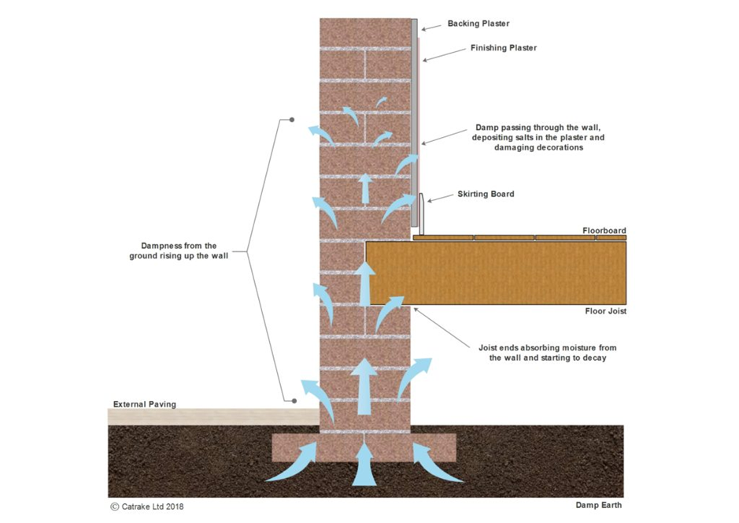
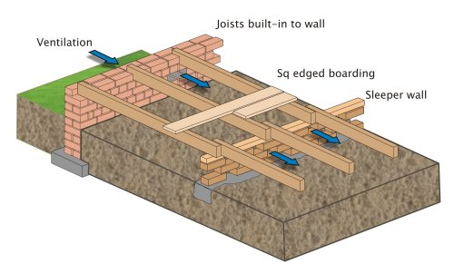
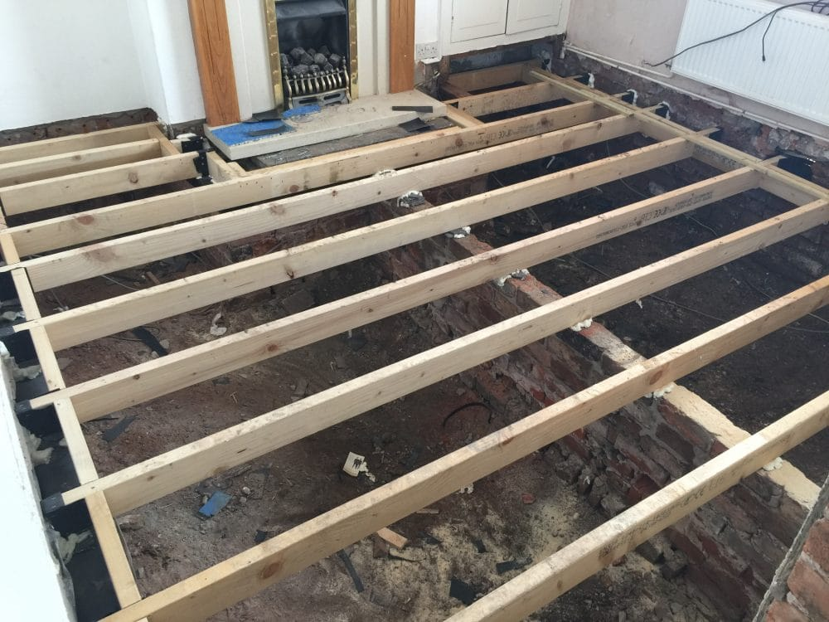
Traditional Suspended Ground Floors
Created warmer floors
Require ventilation
Can use smaller sections of joists
Covered with floorboards
Originally no insulation used

Slide 8
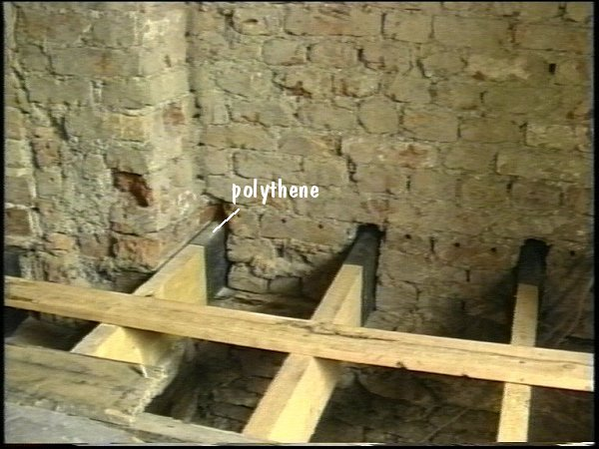
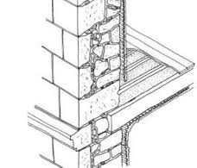
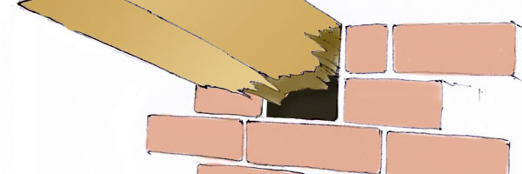
Traditional Suspended Upper Floors
Covered with floorboards
Originally no insulation used
May have rested on int walls
Negative points to consider?

Slide 9
What ideas do you have on how things have changed?
Protecting end of joist with polythene
Use preservatives on timber
Insulation – Thermal/Acoustic
Concrete
Steel
Plastic

Slide 10


Any Questions?

