Slide 1
Itinerant Travelers
In
The UK
Irish Travelers in 1954. (Source: Wikipedia 2024 . https://en.wikipedia.org/wiki/File:Travellers_Decorated_Caravan_(6136023633).jpg )

Slide 2
Lecture Outline:
Introduction (5 Mins)
Group Participation. Bias Identification (10 mins)
History of Itinerant Travelers and demographics and dispersement within the UK (30 mins)
Break (15 mins)
Culture and lifestyle past and present (40 mins)
Break (15 mins)
Legislation: Its impact on Itinerant travelling communities (40 mins)
Revisit Group Participation. Changed attitudes? (10 mins)
Assignment & Q&A (10 mins)
Notes:
Explain to students. Then start with group Bias word cloud exercise.

Slide 3
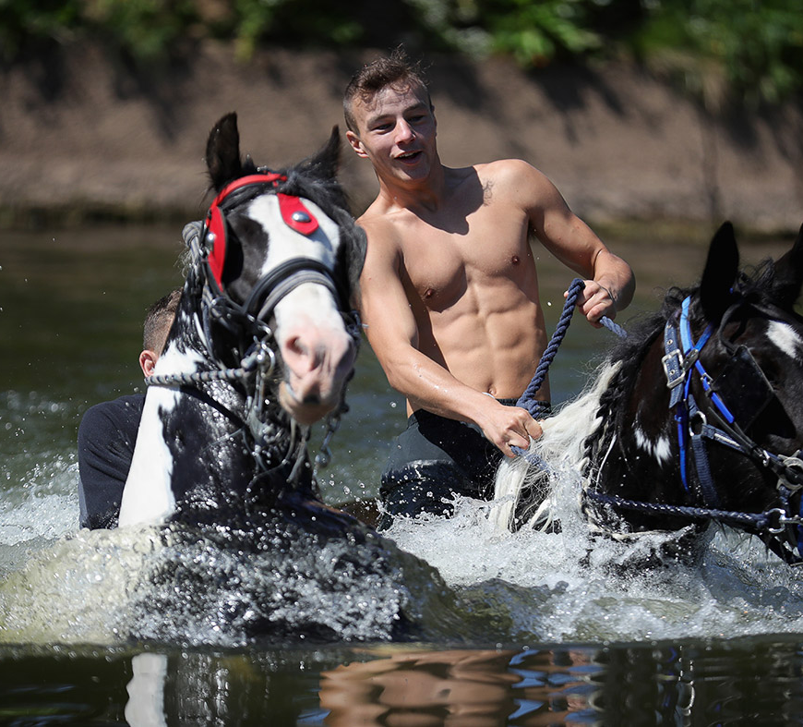
ORIGINS:
History
Migration
Dispersement
Demographics
Jeff Nesham rides Bentley through the River Eden during the Appleby Horse Fair. Source Christopher Furlong/Getty available at: https://www.ibtimes.co.uk/appleby-horse-fair-2016-travellers-arrive-cumbria-worlds-biggest-gypsy-gathering-1563377
Notes:
History: Gypsy records subject to interpretation due to literacy. Believed Egypt 1500s then India 1800s (study of Dialects). Biblical connotation – Gypsies fled with Mary & Joseph. Eygptian cover for persons of no foreign origin. Harsh treatment. Same as vagabonds – deportation or evecuted. Death penalty until 1783. Journal of The Gypsy Lore Journal 1880 by Burrows. Dictionary of Anglo-Romany 1875. Indian connection only in England and Wales – Romani Language with Sanskrit Look at similar societies in Holland, Germany & Balkans.
Dispersement. Refer to moodle page and paper from Manchester University and LGT maps. Discuss Gypsy sites. Travelling regionally in revolutions
Modern Gypsy make up – tribal . Pure bloods and half-castes. Tinkers, Didikois, travellers, house dweller drop outs.

Slide 4
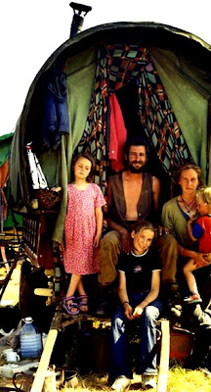
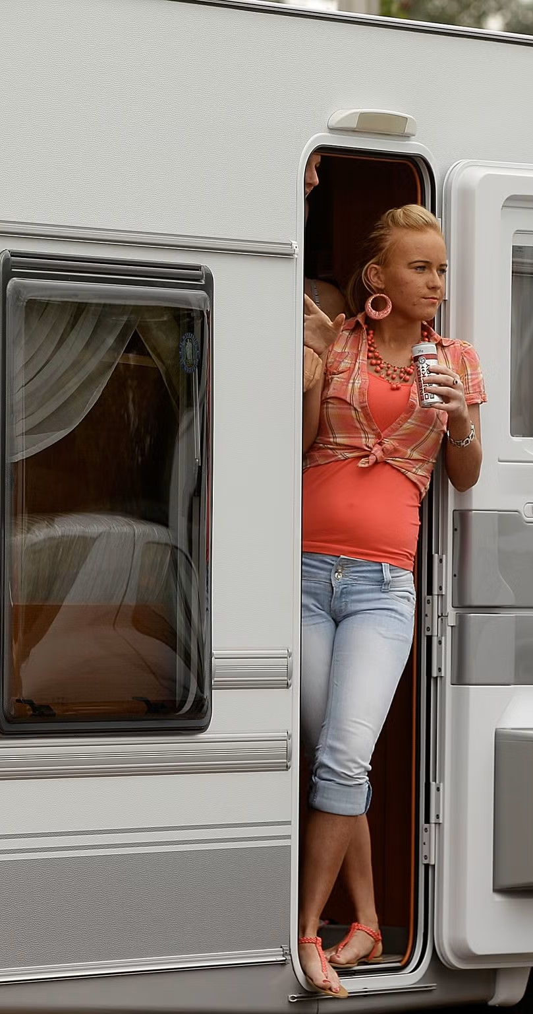
Culture & Lifestyle:
Living conditions
Caravans, static sites
Language
Shelta, Cant or Romani
Education
Traveller craft / Family based
Work
Informal / labour intensive
Relationships
Insular / Outsiders
Leisure
Fairs – Appleby, Barnet, Stowe
Customs
Death /Marriage (Exogamy)
First Image taken from The Flying Tortoise available at: https://theflyingtortoise.blogspot.com/2012/06/gypsy-lifestyle-forever-threatened.html
Second Image taken from Independent Newspaper article Sept 2015 available at: https://www.independent.co.uk/news/uk/home-news/settled-gypsies-could-be-forced-back-on-to-the-road-by-new-planning-laws-10509414.html
Notes:
Councils and static site introduction. Caravans from horse drawn, compelled by intellect– mirrors and chrome. Isolation to give cultural credence. Non Travellers / Gypsies called Gorgios. Explain difference. Different languages of Travellers, Shelta (Irish cant) Romany. Give examples. Refer to moodle page on language.
Education for travellers by example through family. Councils approach – gypsy approach.
Work: skills underestimated due to illiteracy and lack of formal education. Skills evolved to modernity – tarmac, scap metal etc from basket weaving, fencing & ditching
Customs: Inner purity and cleanliness. Inner / outer body. Bowls and cleanliness. Polluting acts of birth and death- burning deseased’s belongings inc caravan.
Animals classification. Mochadi. Horses, dogs, cats, hedgehogs.

Slide 5
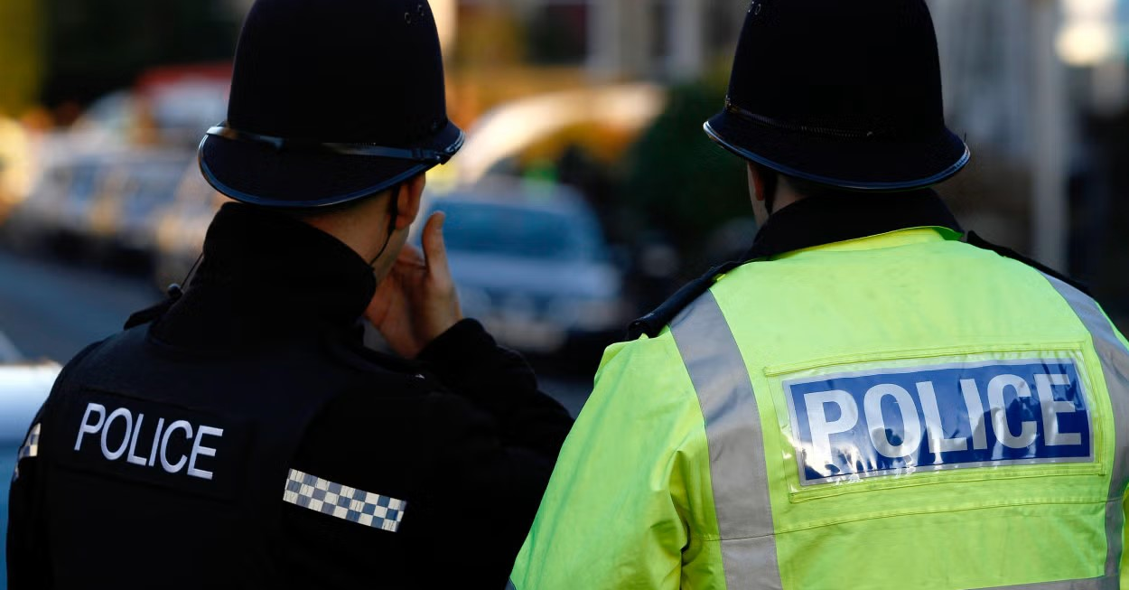

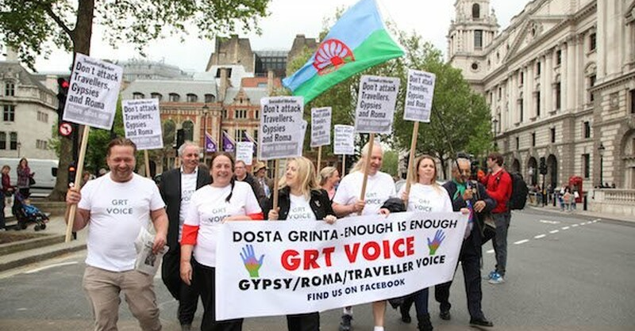
Legislation & Discrimination
“We are the white Blacks” Joseph Jones, vice-chair of the Gypsy Council.
The Economist, (2020), Britain’s Gypsies and travellers demand justice, Gypsy Lives Matter, Available at: https://www.economist.com/britain/2020/07/23/britains-gypsies-and-travellers-demand-justice
The Police Act 2022
Criminal Justice and Public Order Act 1994
The Human Rights Act 1998
Race Relations Act 1976
The Race Relations (Amendment) Act 2000
Case Studies
First Picture of Police was taken from an article in the Independent Newspaper on 18th May 2021 available at: https://www.independent.co.uk/news/uk/home-news/travellers-law-caravans-vehicles-discrimination-b1849603.html
Second Picture of Gypsy Protest was taken from website called Travellers Times available at: https://www.travellerstimes.org.uk/news/2022/11/landmark-court-judgement-rules-gypsy-status-planning-law-discriminates
Notes:
caravan sites and development act 1960 re planning permission and site licences. refer to moodle page. Talk through legislation particular to gypsys. Evictions. Land purchase by gypsies.
Public Health Acts, Highways Acts 1959.

Slide 6
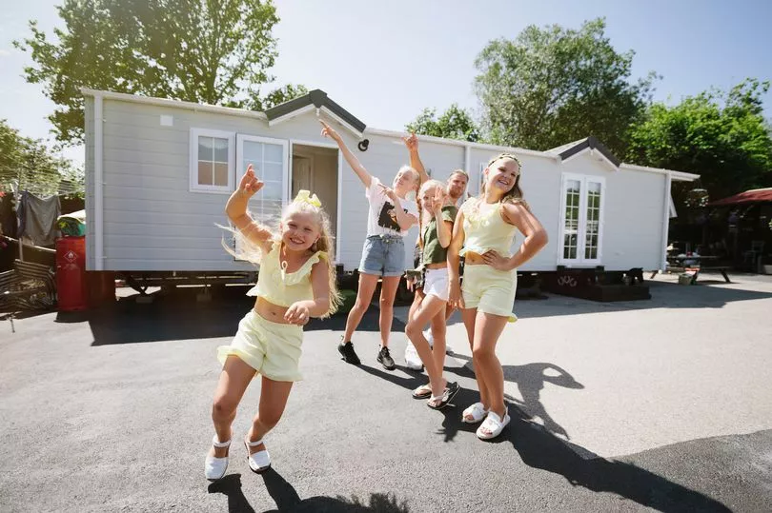
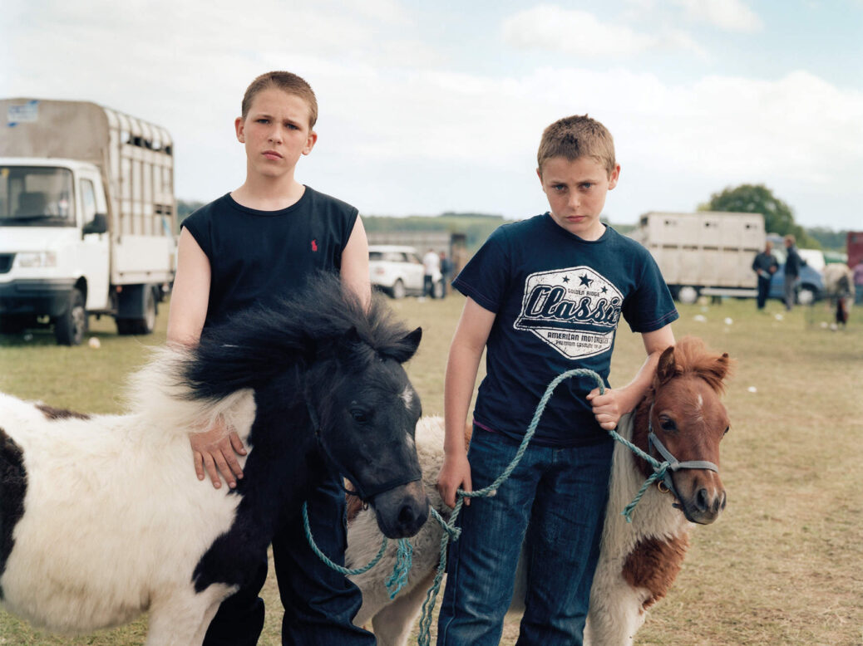
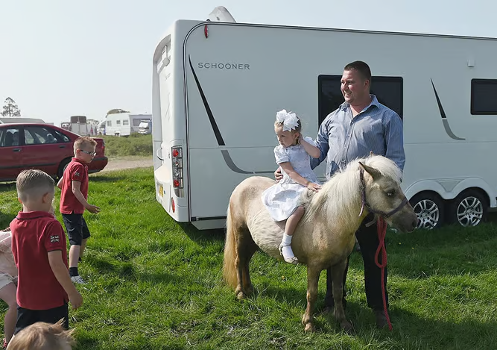
Assignment:
Q & A
Traveller children celebrating (Image: Jonathan Syer) Available at: https://www.cornwalllive.com/news/cornwall-news/how-gypsies-travellers-raising-voices-4254421
Getty Image available at: https://www.economist.com/britain/2020/07/23/britains-gypsies-and-travellers-demand-justice
Part of the tribe: Travellers at the Gypsy Horse Fair at Stow-on-the-Wold in 2011 (Photo By SPENCER MURPHY), available at: https://www.newstatesman.com/culture/2018/07/The-Stopping-Places-Journey-Through-Gypsy-Britain-Damian-Le-Bas-review

