Slide 1

Supervision, Leadership and Management for Professionals:
ECYW7003
28th November 2023
Heidi Holland

Slide 2
Module aims
To provide students with appropriate skills, values & knowledge of supervising & supporting individuals undertaking professional practice placements
To equip students with the in-depth skills, knowledge & understanding to develop approaches to leadership, management & project development

Slide 3
Learning outcomes
Demonstrate in-depth applied planning & management of the role of effective supervision in the youth work workplace & in wider services for young people & critically evaluate the role & function of effective supervision
Locate theories of leadership & management within youth work & their application to practice

Slide 4
By the end of today we will….
Critically explore current context of youth and community work and identified key issues and challenges for leaders and managers;
Reviewed the concept of youth work management and its challenges within current policy context
Examined and analysed management theory and relate it to contemporary youth work practice;
Notes:
Key issues facing YW Managers and Leaders
Policy context
Complex issues facing young people
Contextual safeguarding of young people
Inter and multi-agency working/Teams
Covid-19
Digital Youth Work
Skills required to meet current practice
Funding requirements
Lack of funding
Why should supervision be a key aspect of YW Practice
Professional roles and responsibilities of Youth and Community Workers – Delivering Good Youth Work
Meet organizational requirements
Safeguarding Young People
Meet the requirements of the National Occupational Standards (SDS, 2019)
Registration with the Education Workforce Council
Meeting Welsh Government Policy requirements
Retention in Youth Work roles is a challenge

Slide 5

What did we learn last week?
Definition of management
Theories of management
Reviewed the difference between leadership and management
Legislation and policy in Wales
Role, responsibilities & function of managers
Differences between public sector and private sector managers

Slide 6
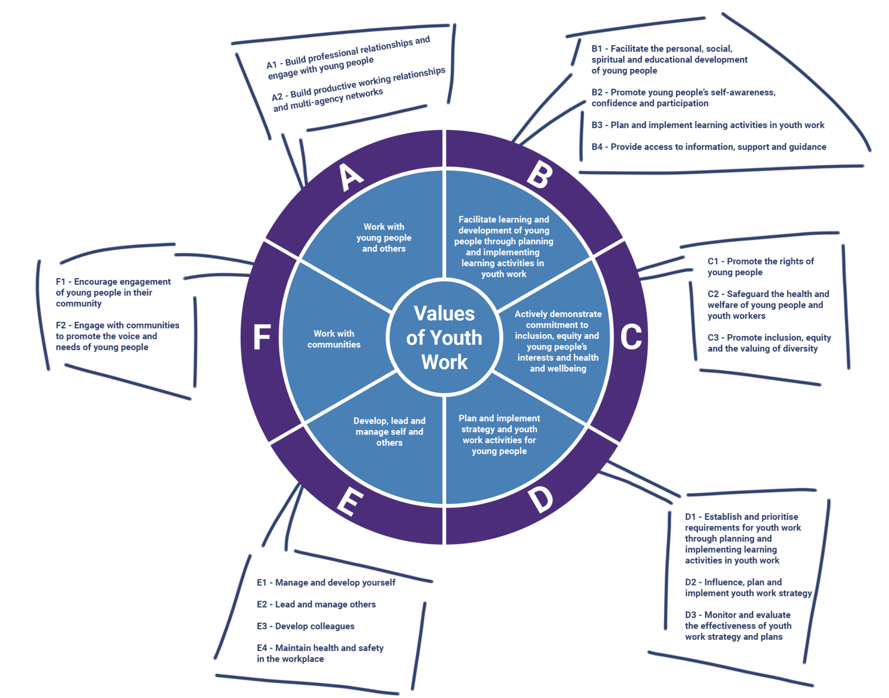
Underpinning everything you do
National Occupational Standards for Youth Work (CLD Standards Council Scotland, 2019)

Slide 7
Assessment Question:
Supervision and Management Portfolio
Part 1:
Practice Logs (3 x 1500 words)
Students will be required to successfully lead and manage students through the supervisory process, including engaging in at least 4 hours of supervision sessions. The practice logs will address the following:
Practice Log 1: The establishment of the supervisory relationship, to include creating the supervision contract, the importance of creating an appropriate supervision environment, and a consideration of how the relationship has developed across the sessions;
Practice Log 2: Your identification, understanding and critical review of the functions of supervision, and how your knowledge of the functions has been used when supervising others, to include specific examples presented anonymously;
Practice Log 3: A critical analysis of your role in supervising others during the supervision sessions that you have led upon.
Part 2:
3000-word critical review
of leadership and management theories, and their application to practice. Students should also consider these in light of the increasingly challenging financial climate that services for young people face, and draw upon a range of supporting material to underpin discussions.
Submission Date: 10th January 2024
Provisional Grade and Feedback: 7th February 2024

Slide 8
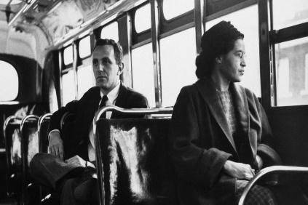
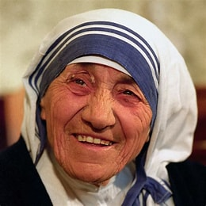
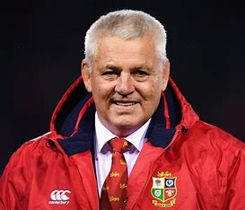
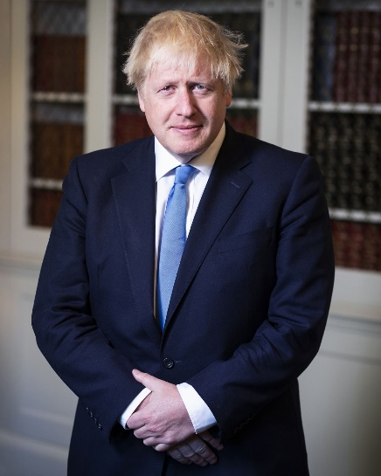
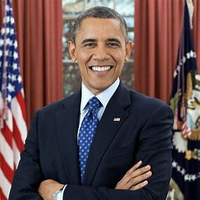
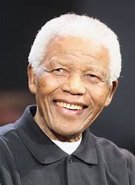
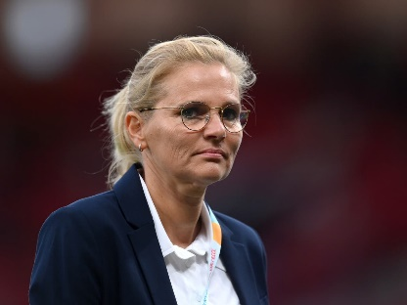

Activity
Think about leaders and managers from public life
  Whilst making a list of their names consider their characteristics
  Which of these characteristics do you admire and…
  Which of these characteristics do you dislike

Slide 9
Manager vs Leader
Manager
Leader
Implements
Does things right
Rational
Transactional
Concerned with means
Maintaining agreements
Static orientation
Achieves desired outcomes by means of influence as feature of contractual exchange – extrinsic motivation
Shapes
Does the right thing
Emotional commitment
Transformational
Concerned with ends
Future aspiration
Dynamic orientation
Management of meaning by means of vision, inspiration, symbols, empowerment, trust – extrinsic motivation

Slide 10

Manager or leader?
Zalesnik (Havard Business School)
  Manager motivates other people and administers resources to ensure company objectives are achieved
  Leader is involved in conceptual aspects, active rather than reactive, shaping ideas rather than responding to them
Notes:
Subordinate As A Leader
Often with small groups, it is not the manager who emerges as the leader. In many cases it is a subordinate member with specific talents who leads the group in a certain direction. "Leaders must let vision, strategies, goals, and values be the guide-post for action and behaviour rather than attempting to control others." [5]
When a natural leader emerges in a group containing a manager, conflict may arise if they have different views. When a manager sees the group looking towards someone else for leadership he may feel his authority is being questioned.
Loyalty
Groups are often more loyal to a leader than a manager. This loyalty is created by the leader taking responsibility in areas such as:
Taking the blame when things go wrong.
Celebrating group achievements, even minor ones.
Giving credit where it is due.
"The leader must take a point of highlighting the successes within a team, using charts or graphs, with little presentations and fun ideas" [6]
"Leaders are observant and sensitive people. They know their team and develop mutual confidence within it." [7]

Slide 11
The difference?
"Managers do things right, while leaders do the right thing." [Pascale, 1990].
This means that managers do things by the book and follow company policy, while leaders follow their own intuition, which may in turn be of more benefit to the company.
A leader is generally more emotional than a manager .
Notes:
"Leaders stand out by being different. They question assumption and are suspicious of tradition. They seek out the truth and make decisions based on fact, not prejudice. They have a preference for innovation." [4]

Slide 12
The leader is followed…the manager rules
A leader is someone who people naturally follow through their own choice, whereas a manager must be obeyed.
A manager may only have obtained his position of authority through time and loyalty given to the company, not as a result of his leadership qualities.
A leader may have no organisational skills, but his vision unites people behind him.
A manager knows how each layer of the system works and may have good technical/practical knowledge

Slide 13
Definition of Management
‘To manage is to forecast and plan, to organise, to command, to coordinate and to control’ (Fayol, 1916 cited in Cole,1996)
‘as a process of planning, organising and staffing, leading, and controlling actions to achieve goals.’(Dubrin, 2000 cited in kelly-heidenthal, 2004)
Notes:
Henri Fayol (1841-1925) French industrialist & theorist. Young mining engineer, worked for the same company all his life. Managing director at 47 and retiring on 77th birthday.
14 principles of management e.g division of work, authority, discipline, unity of command, unity of direction, remuneration, order, stability of tenure of personel, esprit de corps- harmony
kelly-heidenthall, american nurse for the last 40 years has been working in universities and parttime practitoner in A&E

Slide 14
A manager
The main aim of a manager is to maximise the output of the organisation through administrative implementation.
To achieve this, managers must undertake the following functions:
organisation
planning
staffing
directing/leading
controlling

Slide 15

Collapse instead of thrive
In the world of leadership the ‘comfort, stretch & panic model’ is a crucial concept:
Comfort zone- risk of complacency
Stretch zone- challenge, growth & learn, necessary for progress
Panic zone- things are out of control, stress, risk of burnout
Some managers push too hard & teams end up in the panic zone.
Leaders should know the team, understand their limits, set achievable goals, provide support & acknowledge progress- achieve a balance in the stretch zone.

Slide 16
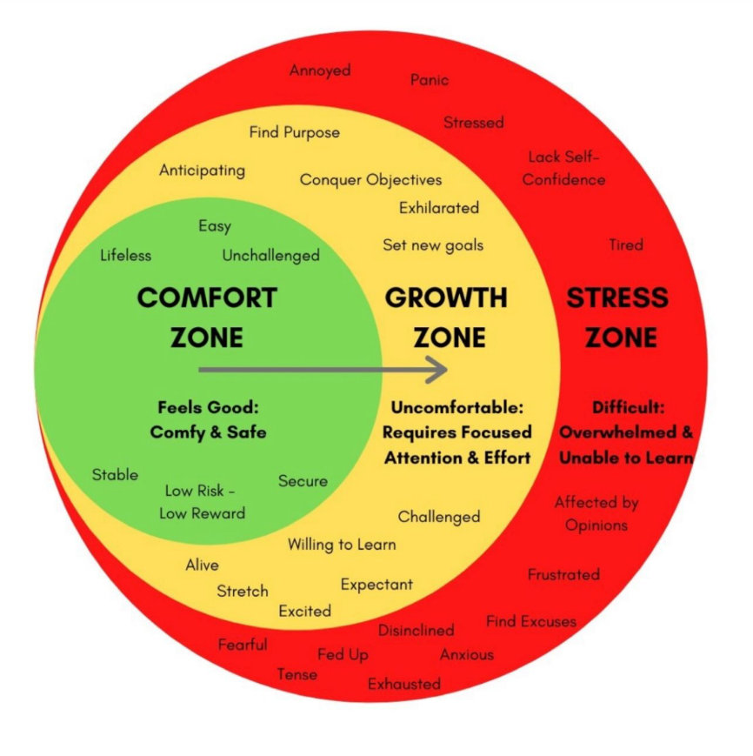

Slide 17

Management
  Directing
    Instructing others to achieve organisational goals, and involves energising, directing, persuading others to achieve those goals
  Controlling
    Comparing actual performance to a standard and revising the original plan as needed to achieve the goals
As professionals we need management skills whether we work alone or are team leaders

Slide 18

Definition of Leadership
‘Leadership defines what the future should look like, aligns people with that vision, and inspires them to make it happen.’ (Kotter,1990)
How is leadership evolving?
In the past, leadership was called “management,” with an emphasis on providing technical expertise and direction.
The context was the traditional industrial economy command-and-control organisation, where leaders focused exclusively on maximizing value for shareholders.
In these organisations, leaders had three roles:
planners (who develop strategy, then translate that strategy into concrete steps)
directors (who assign responsibilities)
controllers (who ensure people do what they’ve been assigned and plans are adhered to)

Slide 19
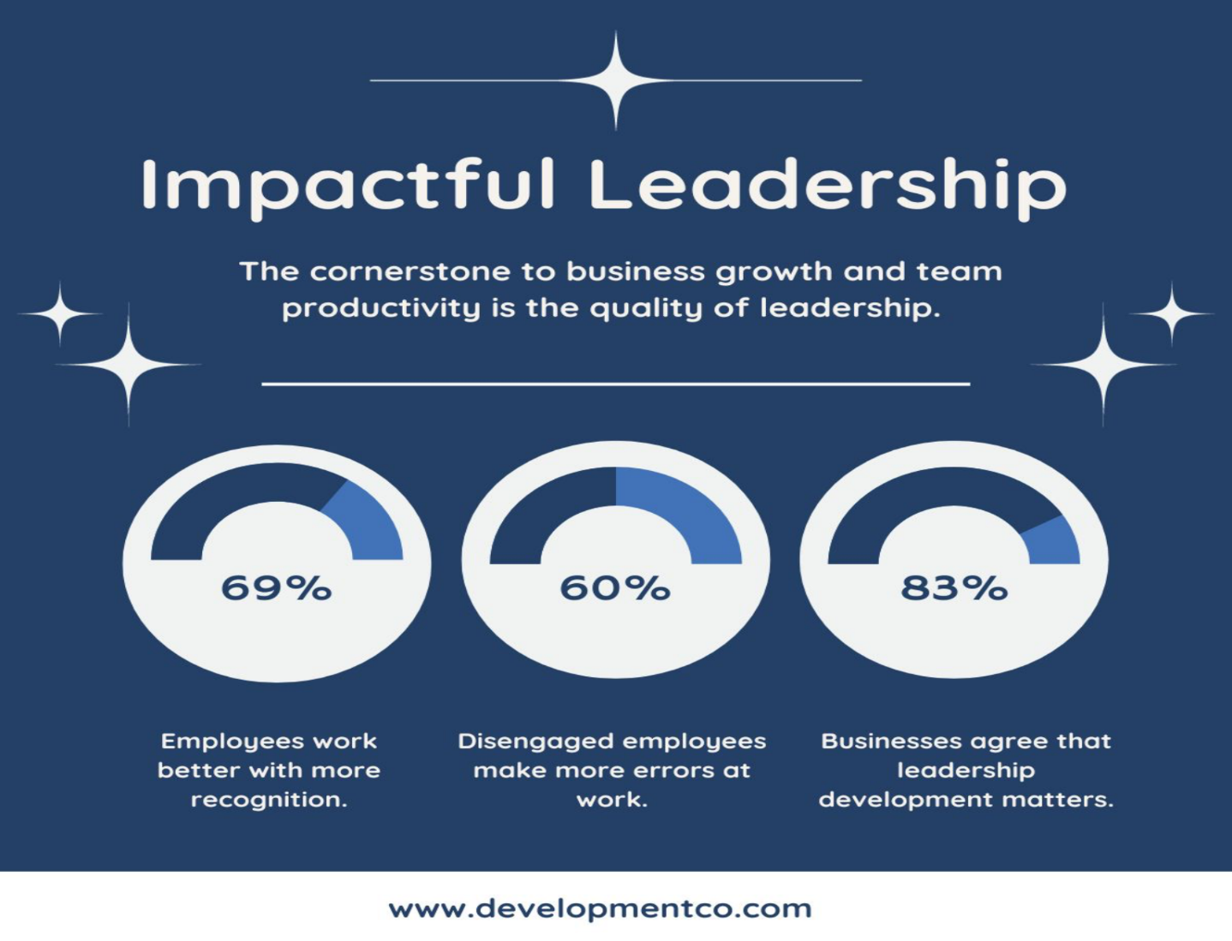
As the notion of leadership evolves there is more understanding of the skills and approaches leaders can utilise to be impactful

Slide 20
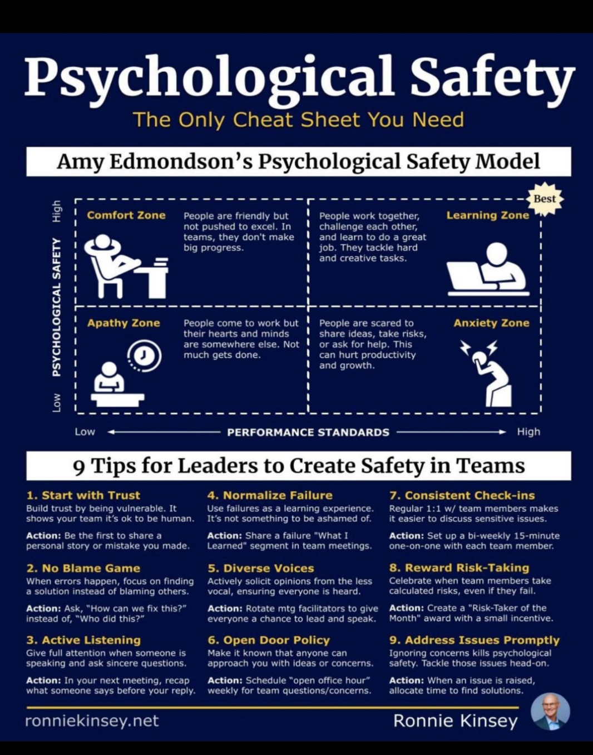
Strategies for being an effective leader & creating productive teams
Supporting others or yourself to move from apathy, comfort & anxiety to learning & developing should include:
Cultivating trust
Focussing on solutions rather than blame
Listening & allowing others to complete their thoughts
Normalise failure
Engage all voices
Openness
Check-in & communicate often
Reward risk-taking & efforts made
Allocate time to address concerns

Slide 21
Challenging thinking
A lack of critical thinking can lead to disaster; it is vital that leaders consistently check their beliefs & facts. Effective leaders can challenge their thinking:
Self-reflection & feedback- seek feedback from their team to provide valuable insights into areas where their thinking may need adjustment
Keep learning- continue to broaden knowledge & expose themselves to new ways of thinking
Seek out diverse perspectives- develop a broader & clearer understanding to reconsider preconceived assumptions
How does this correlate with principles & purposes of youth work?

Slide 22
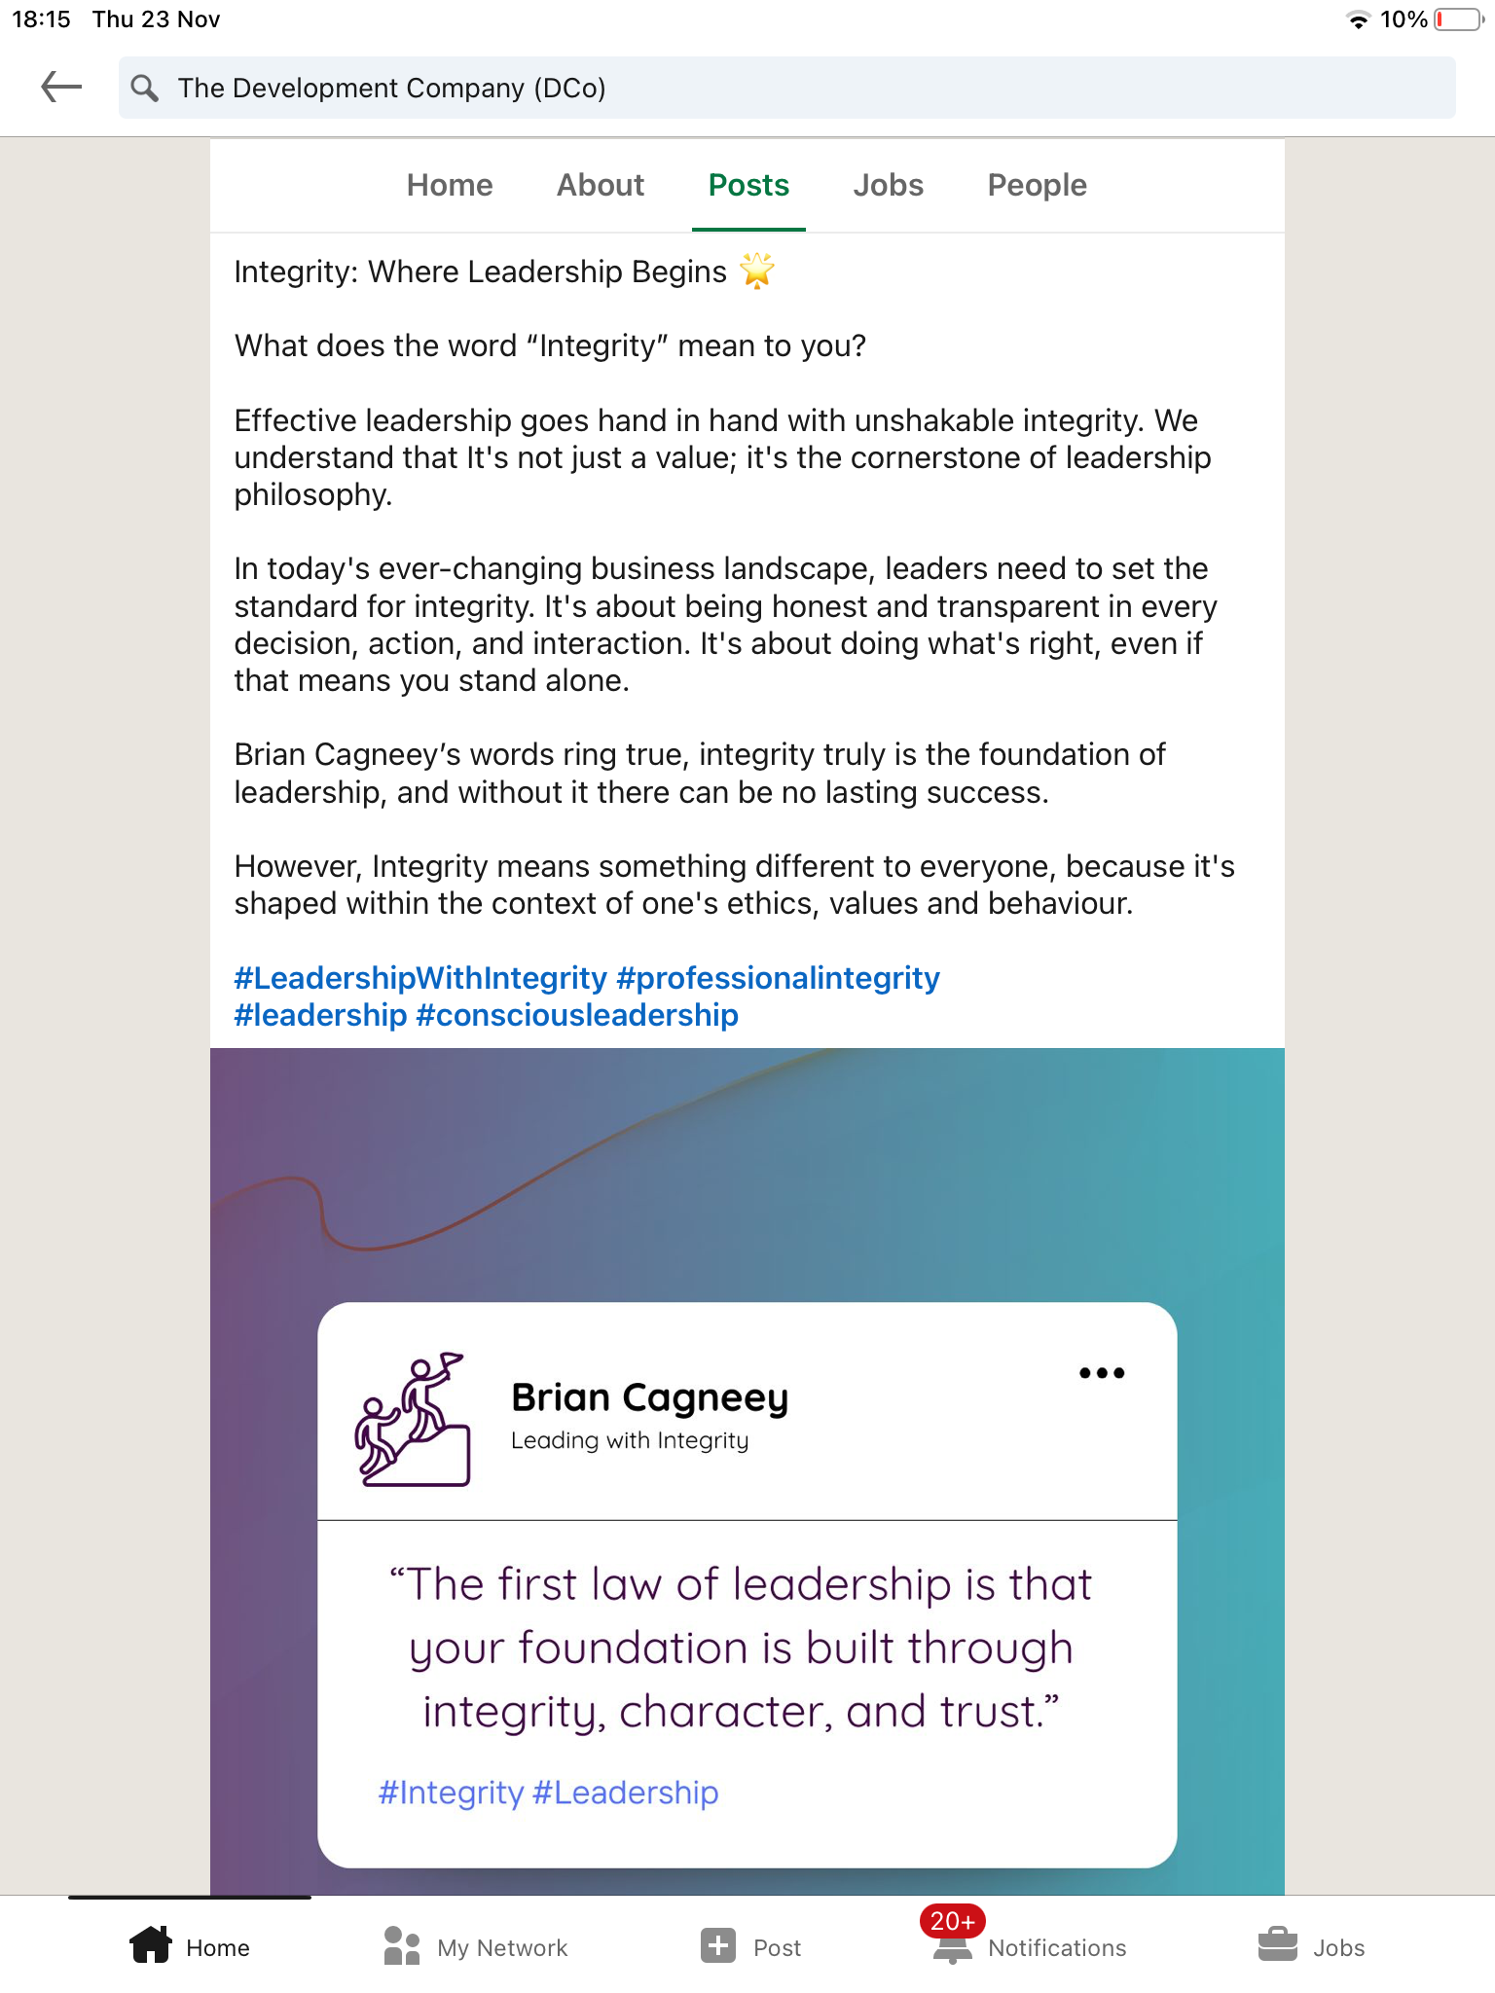
Integrity- where leadership begins
What does integrity mean to you?
Effective leadership goes hand in hand with unshakeable integrity; it’s not just a value but a cornerstone of leadership.
In today’s changing landscape leaders need to set the standard for integrity- it’s about being honest & transparent in every decision, action & interaction.
It's about doing the what’s right, even if that means you stand alone
However, integrity means different to everyone because it’s shaped within the context of one’s ethics, values & behaviour.

Slide 23
Equally a leader doesn’t have to be a manager.
Consider the team where you work or have worked…do you have both a leader and a manager or just the one.
Is there conflict? Or compromise?
Share your experience with the group

Slide 24

Management without leadership
Management & leadership are referred to as two distinct pillars of organisational success
But what happens when there is management without leadership?

Slide 25
Impact on teams/ workplaces
Less emphasis on people- employees viewed as resources so little investment in development & engagement
Short-term perspective- it may not involve a long-term vision, strategic thinking or innovation
Focus on tasks/ processes- emphasis on maintain efficiency & ensuring tasks are executed
Transactional approach- more concern with enforcing rules, monitoring performance & guidance to complete tasks
Whilst management without leadership can help maintain stability & efficiency in the current context of innovation, adaptability & employee engagement a combination of both is often seen as more effective for achieving long-term success

Slide 26
Leaders for change
Research shows that leaders need to both model and communicate their support for change. They must actively listen to the workforce and 'facilitate', and not necessarily 'direct' change (Fauth and Mahdon 2007)
Factors crucial for managers to implement change include:
  clarifying the reallocation of tasks
  allowing sufficient time for individuals to work out ‘who does what’
  ensuring that new tasks motivate staff
  keeping watch over the interpersonal ramifications of task reallocation
  working with the team to develop performance goals (Reay et al. 2003)

Slide 27

Team leaders and managers are responsible for bridging the gap between the vision at the top and the work at the front line (Tenkasi and Chesmore 2003), and therefore have a key role to play in making sense of the change and communicating plans to the workforce.
Discuss

Slide 28
Many organisations have a management matrix with clear lines of reporting, responsibility & communication.
If this isn’t in place is it a risk putting power in the hands of one person?
A manager may not dependant on the organisation for their sense of who they are – they work in, but do not belong to the organisation
‘When times are particularly difficult or uncertain or changing rapidly the clamour for heroic leadership seems to rise, and the behavioural scientists seem to respond by dusting off the Leader as Monster theories yet again.’ (Statt 1994 p340)
Management structure

Slide 29
Management of Attention: ‘…they all had a strong, plausible and compelling vision of where they wanted their companies to go’ ‘the leader provides the important bridge from the present to the future of the organisation’
Management of Meaning: the ability to constantly communicate through the use of analogy, metaphor, vivid illustration
Management of Self: ‘the learning leader looks forward to failure and mistakes…the worst problem in leadership is basically early success.’
Management of Trust: ‘the emotional glue that binds the followers and leaders together’
Warren Gamaliel Bennis was an American scholar, organizational consultant and author, widely regarded as a pioneer of the contemporary field of Leadership studies.
The Handy Guide to the Gurus - Warren Bennis (1985)

Slide 30

Transactional vs transformational
The main difference between transformational and transactional leadership is the type of influence they exert on their ‘followers’.
Transformational leaders appeal to the higher-order needs and values of their followers, such as self-actualization, autonomy, and purpose.
Their aim:
to transform their followers into leaders themselves, by empowering them, developing them, and aligning them with a common vision.
Transactional leaders appeal to the lower-order needs and interests of their followers, such as security, comfort, and rewards.
Their aim:
to achieve specific outcomes and tasks, by directing them, motivating them, and holding them accountable

Slide 31
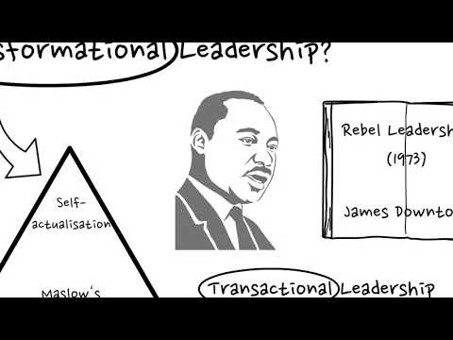
Transactional vs transformational

Slide 32
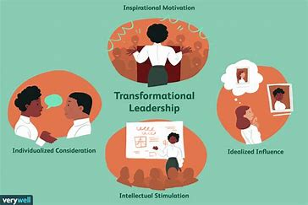
Transformational leader
Transformational leadership is a leadership style that empowers people to accomplish positive change through big vision, inspiration, and a call to action.
Motivates others by behaving in accordance with values, providing vision that reflects mutual values and empowering others to contribute
Identify themselves as agents of change; believe in people; are courageous; are lifelong learners; have the ability to deal with complexity; ambiguity and uncertainty; are visionaries (Tichy & Devanna, 1986)
Notes:
It can happen at any level of the organisation
is about innovation and change

Slide 33
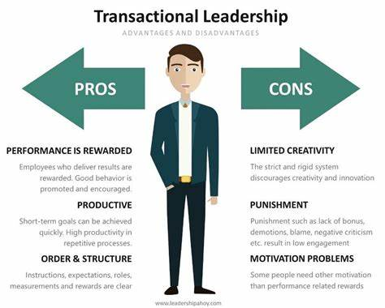
Transactional Leadership
The relations of most leaders and followers are transactional – leaders approach followers with an eye to exchange one thing for another: jobs for votes, or subsidies for campaign contributions.
Such transactions comprise the bulk of the relationships among leaders and followers.

Slide 34
Transforming
Individualised consideration: coaching, mentoring etc
Intellectual stimulation: question the status quo, encourage imagination, creativity, logical thinking and intuition.
Inspirational motivation: Clear vision, problems as opportunities, language and symbols…I have a dream…Ask not what your country can do for you etc. Go the extra mile.
Idealised influence (charisma): Confident in communicating a virtuous vision.
(Bass and Avolio, 1985)
‘Transforming leadership, while more complex than transactional, is more potent. The transforming leader recognises an existing need or demand of a potential follower. But, beyond that, the transforming leader looks for potential motives in followers, seeks to satisfy hunger, needs and engages the full person of the follower…’
Burns (1978)

Slide 35
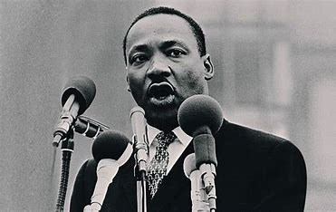
Transforming
‘Moreover, these simple truths are expressed with conviction. The goal – or better still the vision – is rendered clear and it is made to seem both desirable and achievable. Organisational members are asked to forsake mediocrity and routine and aspire instead to reach a future state of such high achievement that it deserves the willing expenditure of extra discretionary effort and commitment.’
Storey (2004)

Slide 36
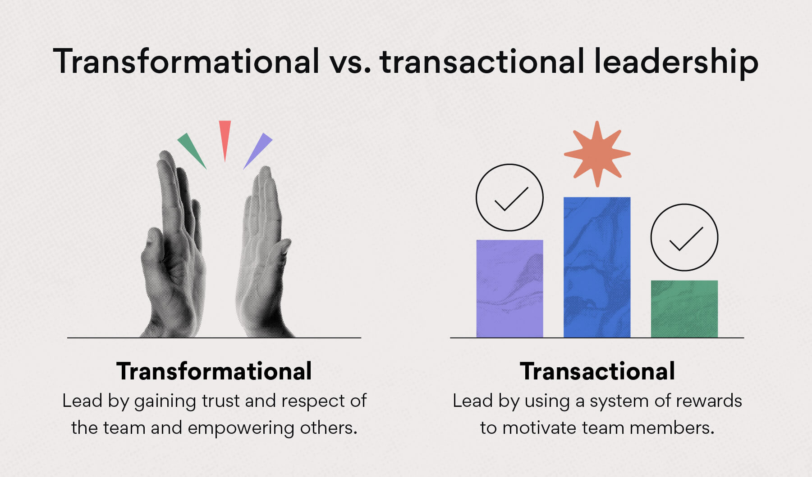
In summary
Manager vs leader differences:
  transformational
    leader who is committed to a vision that empowers others
  transactional
    traditional manager concerned with day-to-day activities
    ‘transformational leader is an extension of the transactional and charismatic leader’ (Bass, 1992)

Slide 37
Leadership development
Leadership theory then began to evolve following research undertaken within a range of settings
For Grint (2005) leadership in collaborative arenas was based on four principles:
inspiring commitment and action;
leading as a peer problem solver;
building broad-based involvement;
sustaining hope and participation.

Slide 38

Collaboration
Recent developments in the past 20 years have seen an emphasis on partnership working and multi-disciplinary environments- WHAT ARE THE BENEFITS?
These are largely outside of the more traditional organisational structures & can involve a wide range of actors and agencies.
The lines of authority often to not conform to the more hierarchical arrangements within single organisations or services.
Connelly (2007: 1231) argued that, although there was an emerging literature on ‘collaborative leadership’, one ‘dealing with leadership in the collaborative inter-organizational domain is not as well developed’.

Slide 39


How collaborative approaches have evolved
Increase an interest in leadership within this type of environment
These may involve formal structures such as Public Service Boards, Community Safety Partnership, Children and Young People’s Partnerships
They could be more ad hoc/ informal arrangements, with partners or stakeholders coming together in response to an identified need or issue.
They can also sit within a framework of accountability, for example a funded project which involves reporting of shared outcomes

Slide 40
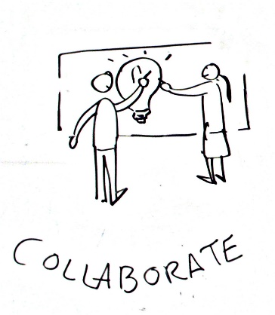
Collaborative approaches
Analysts linked problem type (Grint 2005) with leadership focus, arguing that collaborative settings were populated by ‘wicked issues’ which demanded interorganizational leadership.
Such issues were often deeply entrenched social issues which were involving a number of different services.
These were deemed to be beyond the capacity of a single organisation to resolve.
Example from practice: Wildcamp
Multi- agency project involving police, community safety partnership, RNLI, MAWWFS, Army, youth service targeting young people aged 15-17 who were vulnerable to engaging in crime

Slide 41
Challenges of collaborative approaches to working stem from who is leading the work, who has control and who is steering the outcomes.
Should the lead be:
- based on resources
- based on expertise
- based on knowledge
And how is it decided?
Since hierarchical relationships generally do not feature in collaborative settings (Thompson et al, 1991), this is not centered around the formal senior business or public figures that are the subject of much leadership research (Bass, 1990).
Risks of collaborative working

Slide 42
Huxham and Vangen (2005) proposed that structure, processes and participants provided the framework for ‘contextual leadership’ which could be informal, emergent or shared.
Enacting this form of leadership to achieve collaborative advantage was considered to be dependent on embracing the ‘right’ kind of members, and empowering, involving, supporting and mobilizing them to make things happen.
Collaborative membership

Slide 43
Alexander et al. (2001: 160) outlined a case for leadership for collaboration which they argued was ‘unrecognised or rarely discussed in the collaborative leadership literature’.
Five distinctive leadership themes were identified:
systems thinking
vision based leadership;
collateral leadership;
power sharing;
process-based leadership.

Slide 44
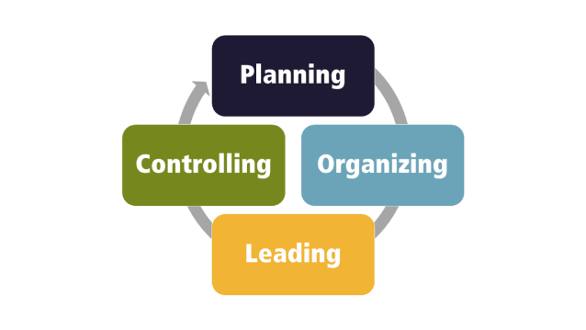
Project planning
A key element of leadership and management roles is the ability, capacity and skills to effectively plan areas of development. These may be identifed through:
Young people/ community need
Specific funding criteria
Response to emerging issues
Opportunities identifed through collaborative approaches
In order to plan effectively there are a range of approaches to use including:
SWOT analysis
NAOMIE planning model
PESTLE analysis
The approach you utilise is based on the features of the work and intended outcomes

Slide 45
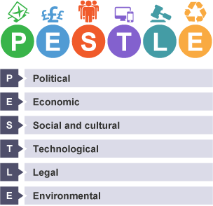
PESTLE analysis
PESTLE analysis
Collecting information is a key part of the problem-solving process.
There are many techniques that can be used to help identify what information to collect.
One of these techniques is called PESTLE analysis.
PESTLE analysis is a technique used to understand the impact of outside factors on a location, business or organisation.
It allows an individual or organisation to understand the ‘big picture’ of the environment they are situated in

Slide 46
The PESTLE analysis
Provides an analysis of the wider macro environment of an organisation
Focus is on key drivers or key developments in the external environment that will impact upon or influence the organisation
These factors may differ depending upon the nature of the organisation and the sector in which is situated

Slide 47

Political
Clearly a major influence for the public sector and could include:
Change of government
Outsourcing to the private sector
New policies such as a new strategy for youth work
Additional demands placed on organisation by government, usually related to legislation or finance
Real-life example
The Educational Maintenance Allowance is a financial scheme that involves young people between the ages of 16 and 19 receiving an allowance of money on a fortnightly basis in order to support them in their education. The scheme has been withdrawn in England, although it is currently still available in Wales (in 2017).
The current voting age in Wales is 18. If the voting age is reduced in Wales to 16, it may mean that young people are better able to influence political decisions that involve issues such as whether to withdraw schemes such as the Educational Maintenance Allowance
If you are a manager within a local authority youth service what may be the key issues in this category?

Slide 48

Economic
Refers to the macro economic factors including:
any restrictions on exports or imports
continued cuts to public services or the third sector
cost of resources or materials needed for the business
factors related to the market that you are targeting e.g. a new under 18 nightclub opens on a youth club night
changes to their economic circumstances may have a knock-on effect for your organisation.
What economic factors would impact on your if you were running a voluntary sector project?

Slide 49
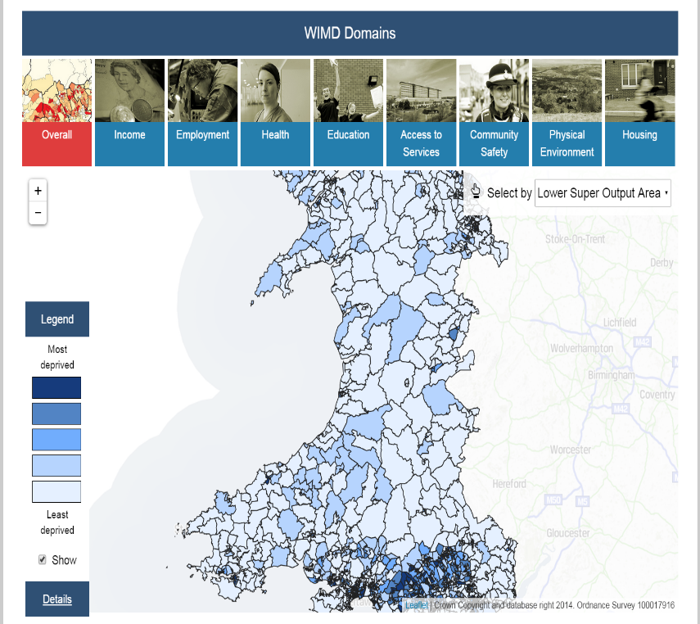
Social
Social influences include factors relating to demographics including :
Ageing Population
Real-terms pay cuts
Poverty increasing – including food poverty
Pockets of serious deprivation & unemployment despite headline figures
Widening gap in schools performance leading to widening gaps in opportunities
Austerity impacting public services e.g health services, policing, schools etc
Employment opportunities- if a local large employer closes
Deprivation is measured in Wales (WIMD) across a number of key indicators:
Income/employment:
Health
Education: Access to services:
Community safety:
Physical environment:
Housing

Slide 50

Technological
Influences such as the internet, advances in technology within your setting- other examples include:
The university’s ability to respond and adapt to the Covid crisis through use of technology
Negative factors such as the dangers of the internet for children & young people
Implementation of strategies to promote internet safety
Investment in technology and the development of digital literacy of young people
There may be elements of this which crossover with other categories of the PESTLE analysis- can you identify any?

Slide 51
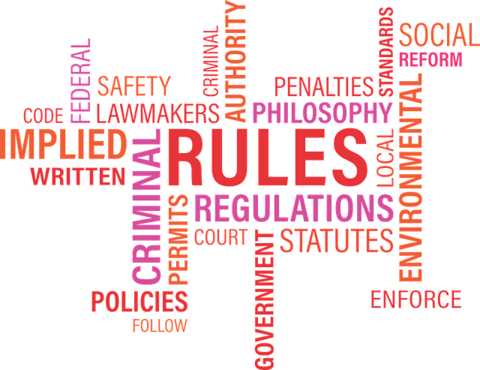
Legal
Proposed changes in legislation which will impact on the organisation including:
Health & safety legislation
Safeguarding
GDPR
Environmental legislation
Guidance for delivery of public services
Government imposed targets
Which legislation did we discuss last week which would have an impact?

Slide 52

Environmental
Green issues such as pollution or waste
There may be specific legislation or controls imposed by government which have an impact on the organisation which may include:
Plastic free initiatives (plastic bags)
Electric pumps
Sustainable transport
Solar and wind power developments
Corporate social responsibility (CSR)
Climate change
Environmental protection
Impact of flooding & coastal defences

Slide 53

Task
Consider the ‘case study’ that you have been given.
Identify the approach you would utilise to plan and deliver this piece of work.
Link to theory- which approaches would work within your plan
Reflect on your approach and role which will support this piece of work- what do you need to consider for everyone involved?
What would be the best outcome…..and what barriers are their likely to be?
Present your planned approach to the group in next week’s session through sharing your plan when we meet on Teams

Slide 54
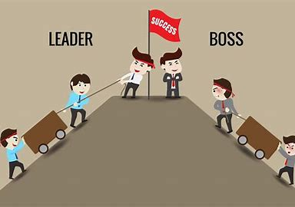

Slide 55
References
Cole GA (1996) 5th Edition. Management Theory and Practice. Continuum.
Code of Occupational Ethics for the Youth Service in Wales. February 2012. Cardiff: ETS Wales & YMCA Wales Community College. [On Line] Available from: [Accessed: 2nd November, 2023]
Currie,G. and Lockett, A. (2007) ‘ A critique of Transformational Leadership: Moral, Professional and Contingent dimensions of Leadership within public service organisations,’ Human Relations 60 (2): 341-370
Education Workforce Council. (2019). Code of Professional Conduct and Practice. [On Line]. Available from: http://www.ewc.wales/site/index.php/en/ [Accessed: 2nd November, 2023]
Handy C (1999) 4th Edition Understanding Organizations. Penguin
Hoggarth, L (2009) “Managing People” in Tyler, M. Hoggarth, L, Merton, B. (Eds) (2009) Managing Modern Youth work, Essex: Learning Matters, pp. 41-59.
Ingram, G. & Harris, J. (2001) Delivering Good Youth Work: A Working Guide to Surviving and Thriving. Lyme Regis: Russell House.
Institute of leadership and Management
Luthans F et al (1988) Teal Managers. Cambridge MA. Ballinger publishing
Mintzberg H (1979) The Nature of a Manager’s Work. Englewood Cliffs. NJ Prentice Hall
Pascale, R (1990) ‘ Managing on the Edge’, Penguin Book, pp 65,
Predpall, D (1994) ‘Developing Quality Improvement Processes In Consulting Engineering Firms’, Journal of Management in Engineering, pp 30-31, May-June
Robb, M. (2007) ‘Youth in Context: frameworks, settings & encounters, Sage.
Van Wart, M. (2003) ‘Public-sector Leadership Theory: An Assessment,’ Public Administration Review, 63 (2): 214-226

