Slide 1
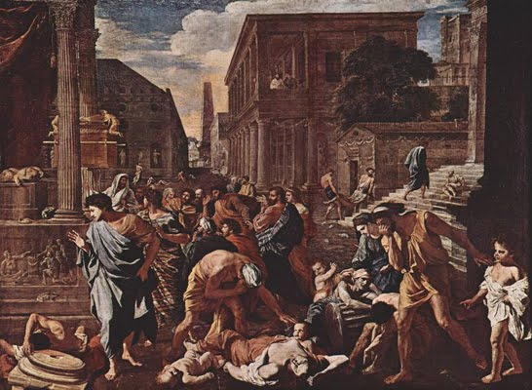
Everyday Life in Ancient Rome
Session 3 – part 2
Disease in the Ancient World
HPAH4001

Slide 2
Causes of Disease
Pathogens – viruses, bacteria, and protozoans.
Parasites (e.g. worms).
Distinct from medical conditions that are metabolic, dietary or degenerative in origin.
Endemic (continually present within a population) vs. epidemic (spreading suddenly and widely, affecting large numbers).
Disease more easily spread by concentration of human and animal populations.

Slide 3
Ancient notions of Disease and Illness

Slide 4
Notions of Disease
“This Art [medicine], however, has been cultivated among the Greeks much more than in other nations… but only for a few generations before ours…From the same authority [Homer], indeed, it can be learned that diseases were then ascribed to the anger of the immortal gods…” – Celsus De Medicina Prooemium 2, 4.
Hippocratic corpus disease is connected with environment and seasons, but not specifically with concentrated urban living – Hippocratic ideas influential into Imperial period.
Roman era writers Diodorus (12.45.2) and Plutarch (Pericles 34) note the belief that bad air was a contributory cause of the disease the famous plague of Athens (c. 430-425 BC).
  Thucydides who notes the high morality resulting from overcrowding in Athens (2.52.1).

Slide 5
Disease in the
Roman World

Slide 6
Pestilence in Rome
The highest population density in the Empire, perhaps around 1 million during first and early-mid second century AD.
High level of mortality – probably higher death rate than birth rate, population growth due to immigration.
Rome is located on malarial plans close to the river and between the hills – general Tiber valley area and lowland of Latium.
Limited sanitation facilities and cramped housing, flooding Tiber and water run-off from the hills a problem.
“As for the soldiers, the barracks were crowded, and the overflow spread through the city, finding shelter in colonnades and temples… Many of them even imperilled their lives by settling in the pestilent Vatican quarter, thus increasing the rate of mortality. They were close to the Tiber, and the Germans and Gauls, who were particularly liable to disease and could ill stand the heat, ruined their constitutions by their passion for the river.” – Tacitus Hist. 2.93.

Slide 7
Malaria and Seasonal Mortality
Endemic disease –specific to certain locations and peoples.
Medical writers describe symptoms of malaria in the Mediterranean:
  - malignant tertian fever (caused by plasmodium falciparum) - can cause a fever of up to 41 ºC and induce anaemia;
  - benign tertian fever (P. vivax)
  - quartan fever (P. malariae).
Those born in the city (who survive into adulthood) develop a degree of immunity to locally active strains.

Slide 8
Seasonal Mortality
Seasonal distribution of deaths recorded on funerary epitaphs – ‘In late antique Rome, about 38 per cent of close to 4,000 attested deaths occurred in August, September and October.’ – 1.8 times the average for the year - Scheidel (2003) 162.
This season coincides with high prevalence of malaria, and other disease typical of the hot-season:
  “Now with fading autumn giving way to frost, now with invalids prone to less frequent fevers.” – Juv. Sat. 4.56-57.

Slide 9
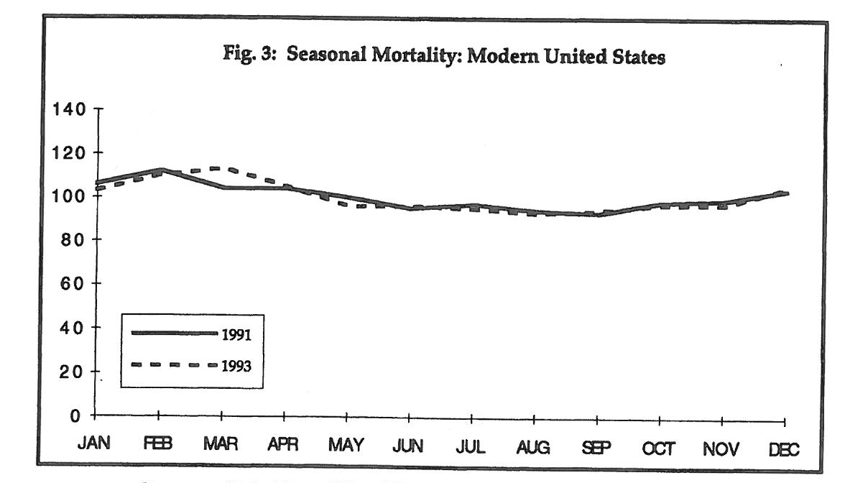
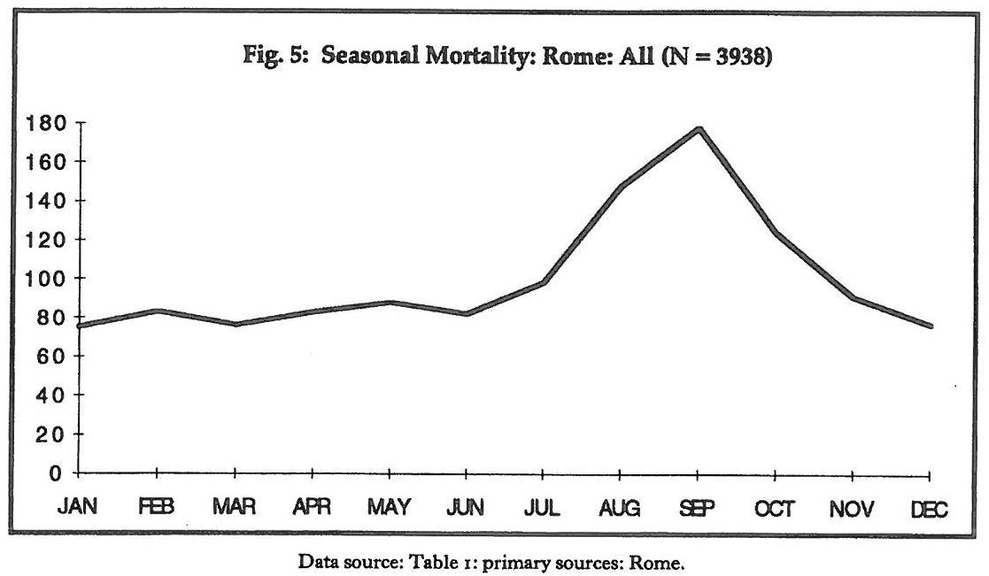
Tables from Shaw (1996).

Slide 10
Summer “Recess” for the Elite
“It is true that the side of Tuscany, which extends along the coast, is unwholesome and pestilential; but this property of mine is a long way from the sea, and, moreover, underlies the Apennine range, the most salubrious of mountains. – Pliny the Younger Letters 5.6.
“I hope to be at in Rome about the Ides of October…” – (1.7.4).
“I promised I’d only stay a week in the country, I’m a liar, I’ve been missing all August. And yet If you want me sound and in good health, Maecenas, As you indulge me when I’m ill, you’ll indulge me. When I fear illness, when heat and the early figs. Honour the undertaker with dark attendants, When pale fathers, fond mothers, fear for their children, When dutiful zeal, the petty affairs of the Forum, Bring on feverish bouts, break open sealed wills.” – Horace Epistles 1.7.1-9.

Slide 11
Common Ailments

Slide 12
Afflictions and Remedies
Dioscorides (De Materia Medica) repeatedly notes stomach pain and flatulence as problems.
Inflammations and discharges from the eyes – Celsus (De Medicina book 6) mentions various salves and compounds of plan products.
Other areas that Celsus mention are affected by infections include mouth, teeth, tonsils, ears, genitals and the anus.
Diseases mentioned by Pliny (NH 26.1-8)
  - leprosy (and elephantiasis)
  - linchen (pustules on the face)
  - carbuncle (pimples appear, and patients succumb to drossiness).
“…this populous city, where daily ten thousand people can be discovered suffering from jaundice [yellowing of the skin], and ten thousand from dropsy [edema – swelling caused by fluid accumulation]…” – Galen 11.328.

Slide 13
Leprosy
Mycobacterium leprae.
“Men’s faces have recently been subject to new forms of disease, unknown in ancient times, not only to Italy, but to almost the whole of Europe. Still, however, they have not as yet extended to the whole of Italy, nor have they made any very great inroads in Illyricum, Gaul, or Spain, or indeed any other parts, to so great an extent as in Rome and its environs. Though unattended with pain, and not dangerous to life, these diseases are of so loathsome a nature, that any form of death would be preferable to them.” – Pliny the Elder Natural History 26.1.

Slide 14
Hygiene in Rome
Visiting the baths?
“There is, again, another affliction which the Greeks call tenesmos, lesser than all those last spoken of. It should be counted neither with acute nor with chronic diseases, since it is readily relieved, and never by itself fatal. As in the case of dysentery, there is equally the frequent desire to defecate, and equally the pain when anything is passed. There is a discharge resembling phlegm and mucus; sometimes it is even slightly bloodstained; but mingled with properly formed faeces derived from food. The patient should sit in hot water, and make application frequently to his anus. – Celsus De Medicina 4.25.

Slide 15
Antonine Plague

Slide 16
The Great Outbreak – AD 165/66
“It was his [Lucius Verus] fate to seem to bring a pestilence with him to whatever provinces he traversed on his return, and finally even to Rome. It is believed that this pestilence originated in Babylonia, where a pestilential vapour arose in a temple of Apollo from a golden casket which a soldier had accidentally cut open, and that it spread thence over Parthia and the whole world. Lucius Verus, however, is not to blame for this so much as Cassius, who stormed Seleucia in violation of an agreement…”- S.H.A. Verus 8.1-3.
Galen describes a number of symptoms, including fever, vomiting, rank breath, mucus, coughs and ulcerations of the larnyx and trachea.
Various identifications for the plague have been made on basis of literary descriptions – exanthematous typhus, bubonic plague, or small-pox.
Estimates of mortality rates vary from 1 to 2 % of Empire to 25%. R. Littman and M. Litmann (1973) – argue for around 7 to 10 % on the basis of its identification as small-pox.
Recent discovery near what would become catacombs of St Peter reveal rooms with large numbers of tightly stacked corpses.

Slide 17
Outbreak of AD 189
“About this time, plague struck all Italy. The suffering was especially severe in Rome, since the city, which received people from all over the world, was overcrowded. The city suffered great loss of both men and animals… for some said that the sweet odour, entering first, filled up the sensory passages and kept out the poison in the air; or, if any poison should enter, it would be neutralized by the stronger odours. The plague, however, continued to rage unchecked for a long time, and many men died, as well as domestic animals of all kinds. – Herodian 1.12.
Dio Cassius (72.14.3) mentions 2,000 fatalities a day during this epidemic.

Slide 18
Plague of Justinian
Plague strikes the Byzantine Empire (eastern Roman Empire) in AD 540s.
“During these times there was a pestilence… which the whole human race came near to being annihilated… with some the body broke out with black pustules about as large as a lentil and these did not survive even one day, but all succumbed immediately. With many also a vomiting of blood ensued without visible cause and straightway brought death… Now the disease in Byzantium ran a course of four months… and afterwards the tale of dead reached five thousand each day, and again it even came to ten thousand and still more than that. – Procopius History of the Wars 2.22-23.
Examination of teeth from a plague victim in Bavaria has identified the disease as a earlier form of bubonic or septicemic plague (Yersinia pestis).
See brief summary of this from the Guardian http://www.theguardian.com/science/2014/jan/28/plague-victims-shed-light-disease-origins

Slide 19
Bibliography
Patterson, J. R. 2008: ‘Living and Dying in the City of Rome: houses and tombs’, in Coulston, J., and Dodge, H. (eds.), Ancient Rome: The Archaeology of the Eternal City (Oxford: Oxford University School of Archaeology): 259-289.
Littman, R. J., and Littman, M. L. 1973: ‘Galen and the Antonine Plague’, The American Journal of Philology 94 (3): 243-255.
Shaw, B. D. 1996: ‘Seasons of Death: Aspects of Mortality in Imperial Rome’, JRS 86: 100-138.
Morens, D. M., and Littman, R. J. 1992: ‘Epidemiology of the Plague of Athens’, Transactions of the American Philological Association 122: 271-304.

