Slide 1
HPHP 4009
Pathway to Evil: Genocide – Theory, History, Denial

Slide 2
Defining Genocide
Genocide (Encyclopaedia Britannica) available at: www.britanica.com
the deliberate and systematic destruction of a group of people because of their ethnicity, nationality, religion, or race. The term, derived from the Greek genos (“race,” “tribe,” or “nation”) and the Latin cide (“killing”), was coined by Raphael Lemkin, a Polish-born jurist who served as an adviser to the U.S. Department of War during World War II. [accessed 11 September 2020]

Slide 3
Genocidal intent
As old as man himself
Homo-Sapiens destruction of Neanderthal man?
Evidence from the Paleolithic - destruction of rival communities
The Three Ages – from the Neolithic , success of farming and surplus production
Increased ability to wage war over resources and land – defending established communities
First theme – Agriculture and animosity towards non-agriculturalists (the other!)

Slide 4
Ethnicity
Early examples of ethnic hatred driving acts of Genocide
Old Testament / Biblical :
‘but thou shalt utterly destroy them…the Hittites, Amorites, Canaanites, Perizzites, Hivites, and Jebusites (Deutoronomy 20.23)
Early anti-Jewish ethnic hatred apparent in Babylonion Conquest of Jerusalem (6thc B.C)
Links Imperial and territorial conquest and ethnic hatred

Slide 5
Emerging Themes
Sectarianism – Agriculturalist vs Other
Religious, Ethnic, Racial Hatred
Imperial Conquest based upon:
Aggrandisement, territorial gain, conquest
Irredentism – restoration of lost territory holding peoples of similar ethnic origin
Revanchism – will to reverse territorial losses

Slide 6
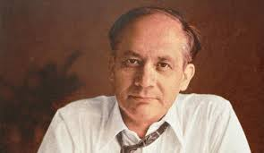
Defining Genocide (in the Modern era)
The term emerged from the Nazi era and the determination to punish perpetrators of the Holocaust
Coined by Raphael Lemkin (1900-59)
Polish-Jewish lawyer
Tireless study on international law and crimes against humanity
Driving force behind 1948 UN Convention

Slide 7
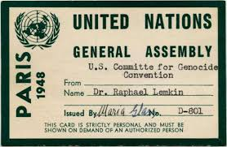
UN Convention – Paris 1948
The UN Convention on the Prevention and Punishment of Genocide
Defines the crime of Genocide as:
‘acts committed with the intent to destroy, in whole, or in part, national, racial, ethical, or religious groups’

Slide 8
UN Convention – Paris 1948
The UN Convention also covers the following in their declaration on Genocide:
Forcible removal of children from their families
Acts that make it difficult for a group(s) to sustain themselves
Acts that impacts upon the physical and mental well being , with the intent to destroy
Not covered: Cultural destruction and political extermination

Slide 9
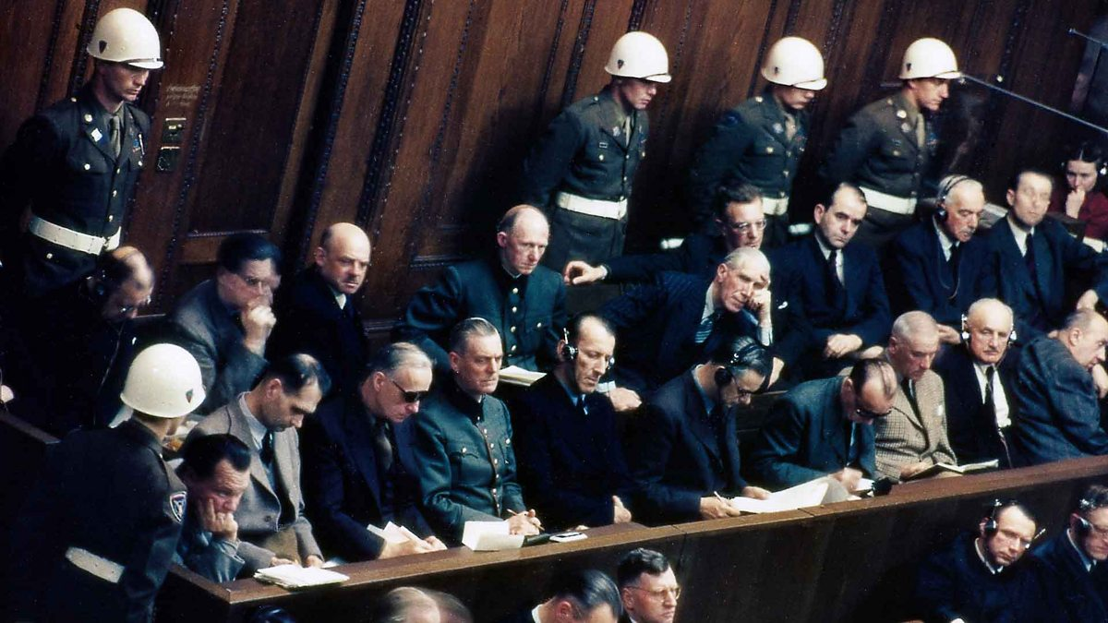
UN Convention
The Convention and the impact of the Nuremberg Trials witnessed the ‘rapid evolution of the crime (Genocide) from an academic concept to a firmly established principle of international law’ (Kiernan, p.11)
Strong link between Convention intent and Nazi atrocities

Slide 10
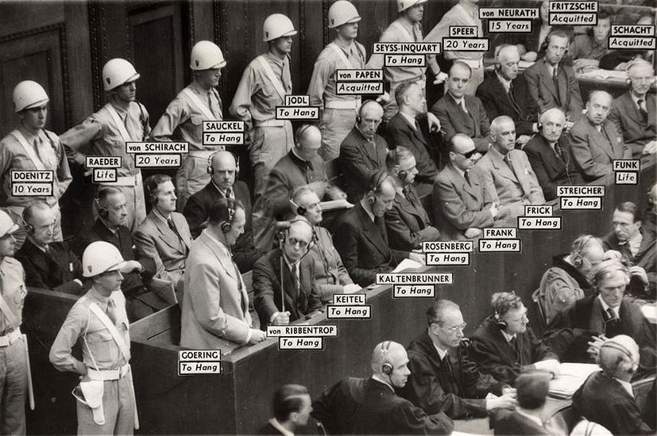

Slide 11
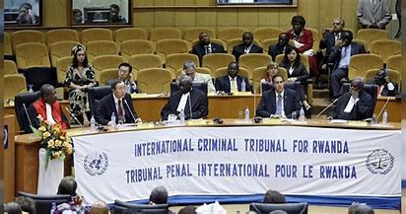
Impact!
Fifty years between the UN Convention and first conviction in 1998, relating to acts of atrocity in Rwanda
Hutu-led slaughter of Tutsi, Twa, and moderate Hutu
April-July 1994

Slide 12
Categorising Genocide
1. Physical Genocide:
killing, but also bodily or mental harm to a group or members of a group. Also, use of force towards the same
This also includes:
Forcing a subsistence diet
Limiting medical supplies
Limiting living conditions
2. Biological Genocide
Enforcing restrictions on procreation, birth, and the enforced removal of children from families to another family or group

Slide 13
Categorising Genocide
3. Evolving element when categorising Genocide within international law:
GENDERCIDE – Genocidal intent that targets women through rape or camps
4. Not covered – ‘cultural Genocide’ or Ethnocide: Imposing a new culture on a group through enforced education/restrictions on language
Destruction of a political group.

Slide 14
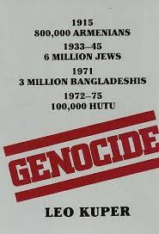
UNSPECIFIED
Genocidal Massacres
Coined by South African sociologist Leo Kuper (1908-94)
Short episodes of killing against specific group
State or communally instigated, or combination of both

Slide 15
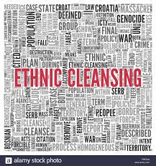
Semantics
Some thoughts on terminology:
‘Extinction’; ‘Extermination’; ‘Ethnic Cleansing’; ‘War Crimes’
All concepts associated with Genocide
Sometimes independent concepts , sometimes overlapping

Slide 16
Predilections in the Modern Era
Racism – prejudice based upon perceived inferiority of certain race; or threat from certain race or group, or fear of domination by group deemed superior (all absent of any rational basis)
Predilection to violence on massive scale vs vulnerable group
Fuelled by: expansionism, irredentism, revanchism, feelings of loss, religious or racial resentment

Slide 17
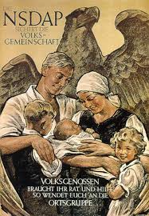
Predilections in the Modern Era
Fuelled by:
Notions of biological purity;
fear of historic decline;
rural romanticism;
Cult of antiquity

Slide 18
Combined
Force and violent intent
Racial Hatred – the ‘other’
Lost history – victimisation – nostalgic glorification – revival of utopian past – cult of antiquity
Territorial aggrandisement and aggression
Imperial and industrial power
Scientific racism – eugenics and social Darwinism

Slide 19
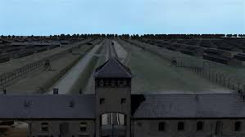
Organisation
Paradox – ideological irrationality combined with organisational guile and skill that can mobilise human effort, material support, administration structure

Slide 20
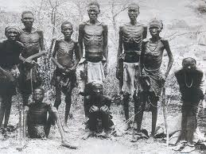
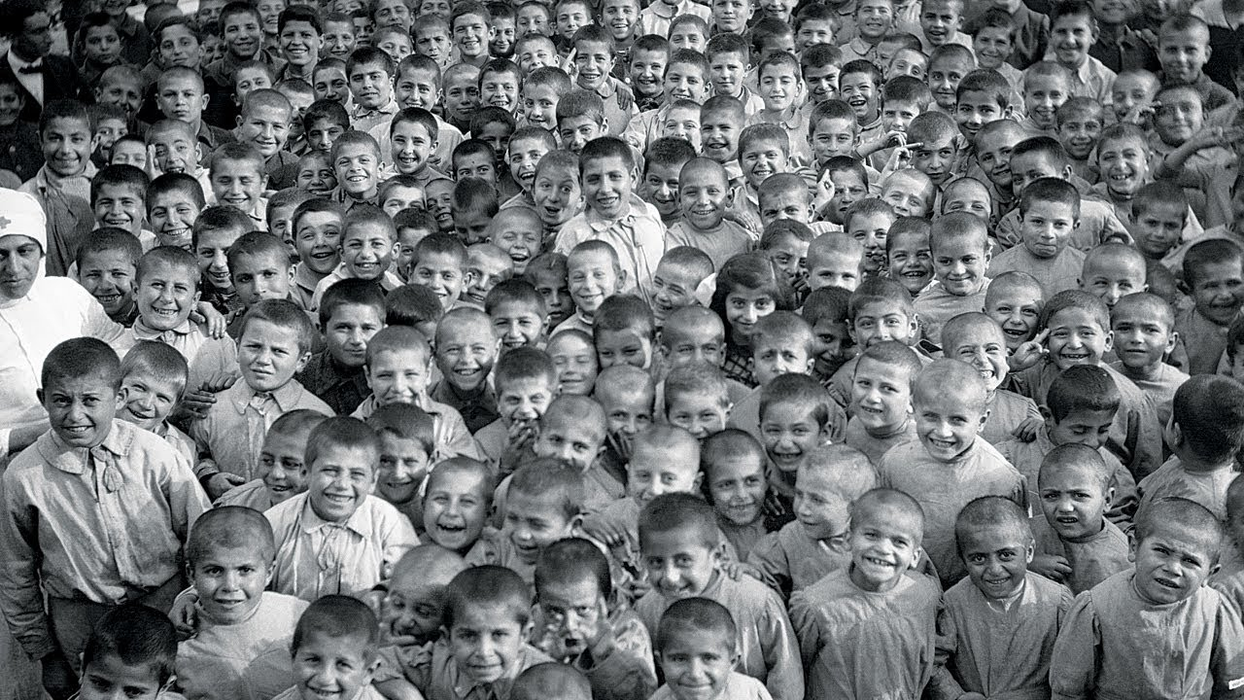
Connections

