Slide 1

University Of Wales
Trinity Saint David
MSc Property and Facilities Management
MSc Viva Voce
An Evaluation of Whole Home Assessment for Retrofit: The Case of Social Housing

Slide 2

An Evaluation of Whole Home Assessment for Retrofit: The Case of Social Housing

Slide 3
Contents
Introduction
Aims & Objectives
Literature Review
Methodology
Findings
Analysis
Recommendations
Conclusion
References
List of Figures

Slide 4
Introduction
This research aims to address the pathway to net zero for socially rented homes in Wales and how that pathway gets assessed and reassessed.
WHQS 2023 & PAS 2035/PAS2038 and the Climate Change Act 2019 (Amendment) have now set new requirements for social landlords to produce a whole home assessments and a targeted energy pathways for each property, considering both building condition and social condition of properties
  (Welsh Housing Quality Standards 2023)
  (PAS 2035:2019 Retrofitting dwellings for improved energy efficiency, 2019)
  (PAS 2038:2019 Retrofitting non-domestic buildings for improved energy efficiency, 2019)
UK and Welsh housing stock is amongst the oldest housing stocks in world sitting in third place, this housing stock is predominantly from the industrial era
(Justine, et al., 2020)
Wales has an estimated 1.36 million homes and around 1.1 million of these use a form of fossil fuel as its main heat source
(Welsh Government, 2020)

Slide 5
Aims & Objectives
Research Aim
What juncture should a Whole Home Reassessment take place and what are the parameters that trigger a reassessment and what elements do you reassess. This aim was chosen because of the lack of guidance and/or steer on how, when and what to assess after the initial assessment.
Objectives
The objectives below have been allocated a Primary or Secondary status; both are linked to each other with the secondary objectives underpinning the primary objectives. They have also been allocated numbers based on collective issues.
Primary 1- Identify what gaps exist within current guidance documents and legislation to support reassessment.
Secondary 1 - Evaluate PAS 2035/2038 and its role in reassessment.
Primary 2 - Assess customers understanding of reassessment.
Secondary 2 - Consider the role of communication in best practice/legislation reassessment.
Primary 3 - Propose a best practice set of recommendations (or decision-making tool) for reassessment.
Secondary 3 - Assess what social markers are fit for reassessment.

Slide 6
Current Literature Within the Social Housing Sector
Legislation
Climate Change Act 2019 (Amendment).
Rented Homes Wales Act 2022 (Amendment).
Guidance/Standards Documents
Welsh Quality Housing Standard 2023
Housing Health and Safety Rating System Wales 2006.
PAS 2035:2019 Retrofitting dwellings for improved energy efficiency.
PAS 2038:2019 Retrofitting non-domestic buildings for improved energy efficiency.

Slide 7
Current Literature Within the Social Housing Sector cont.
Academic Literature
Current academic literature around whole home assessments is limited and reassessment is sparse, with only limited mentions within articles and journals, most of the academic literature forces on technology and how to implement that technology not the assessment or the reassessment.
Questions are out there are as to what are the best metrics to use when declaring a properties is net zero… EPC, SAP, etc.
Should thermal comfort be taken into consideration in the context of WHQS23 … currently it's not
Clear research gap exists for reassessment across all forms of literature and legislation

Slide 8
Current Literature Within the Social Housing Sector cont.
“whole house” deep approach can provide huge financial, comfort, carbon and social benefits but that costs to undertake the retrofit works were still prohibitively high to undertake at scale”
(Patterson, 2016)
“Specific retrofit opportunities are identified via on-site home energy assessments that can be inconvenient to homeowners, expensive, and of variable accuracy”
(Zeifman, 2020)
“Understand the effectiveness of different retrofit approaches in practice, and the degree to which these approaches are evidence based, and applicable to the Welsh context”
(Green, 2020)
“PAS 2035 sets out a requirement for the proper assessment of dwellings and design and implementation of retrofits”
(Edwards, 2020)

Slide 9
Methodology
Research based data collection and analyses on pragmatic approach based on real world problem solving and this will be based on grounded theory using mixed methods approach utilising both quantitative and qualitive research to help formulate new approaches to the retrofit question (Creswell, 2009).
Quantitative and Qualitive research methods will allow for further deep dives if needed it will also allow for analysing numerical data based on Likert scale (O'Dwyer & Bernauer, 2016).
Grounded theory approach, it will allow for the development of theories which offers explanations around the main concerns when analysing the data and formulating hypothesis (Tarozzi, 2020).
The gap in the academic literature demonstrates a need for new and creative ways of thinking about retrofit based not only on sound building pathology techniques but on human factors and how they both interlink.

Slide 10
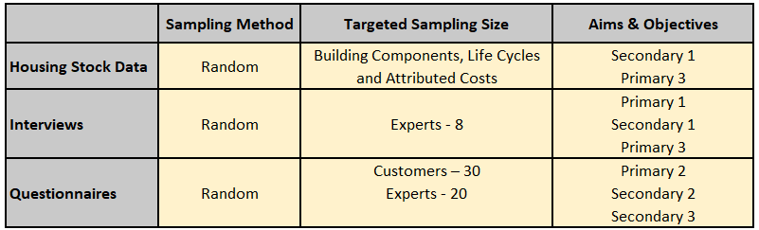
Methodology cont.
Sample Methods & Size
Figure 1

Slide 11
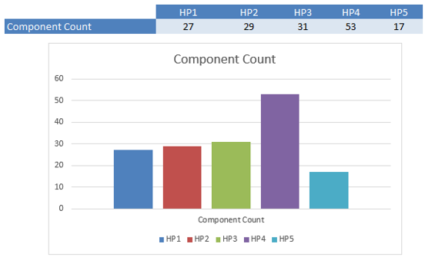
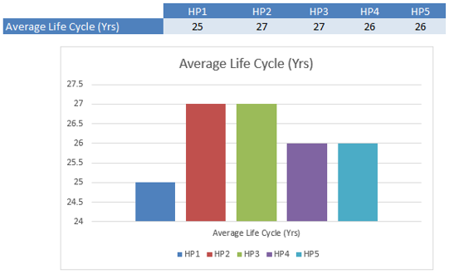
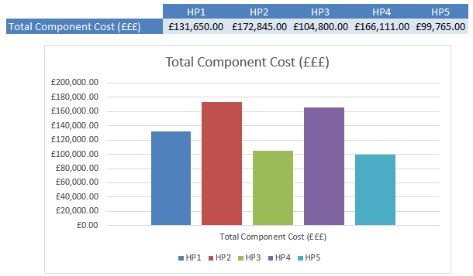
Findings
Housing Stock Data
5 data sets from 5 different housing providers in Wales
  Total Component Count
  Average Life Cycle in Years
  Total/Average Component Cost
Figure 2
Figure 3
Figure 4

Slide 12

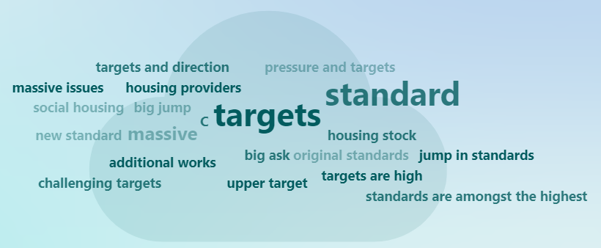
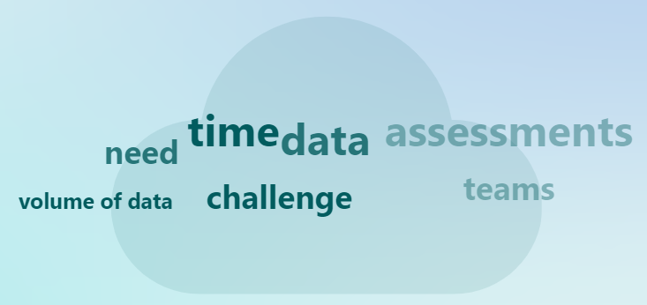
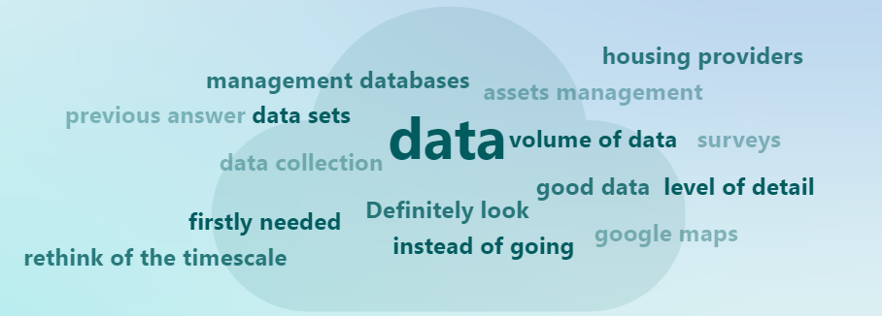
Findings cont.
Interviews
8 interviews undertaken with industry experts with 8 questions be asked per interview.
What is your job title?
What is your view on the role of PAS 2035/2038 in the context of social housing retrofit planning?
Does WHQS 23 go to far or not far enough?
What asset stock data be harmonised between social housing providers if not why? in providing best practice and industry targets?
What asset stock data be harmonised between social housing providers if not why?
What is your view on Whole Home Assessments?
How could the initial Whole Home Assessment be improved?
How do you think retrofit reassessment should be undertaken if undertaken at all?
Question 1 Answers - Figure 5
Question 4 Answers - Figure 6
Question 6 Answers - Figure 7
Question 7 Answers - Figure 8

Slide 13
Findings cont.
Questionnaires
Customer 35 customer questionnaires were completed via an online Microsoft Form.
Industry Experts 22 expert questionnaires were completed via an online Microsoft Form.
The questionnaires both customer and industry experts had a total of 57 responses which has generated very interesting data comparisons especially between questions 7, 8, 9 & 10.
Customers have a very clear view on what technologies they would like to have installed in their homes and the industry experts also have a view on this, but they do differ.
Question 10 around what social markers could be reassessed has also drawn some very interesting responses where customers and industry experts have very contrasting views on what they deem acceptable.

Slide 14
Analysis
From the data collected between all three data sets there are clear threads and themes that have been identified,
Housing Stock Data
Some commonalities between components
Non comparable data
Geographical and service delivery difference which influence costs.

Slide 15
Analysis cont.
Interviews
The current WHQS is sufficient and does not need to be strengthened further.
Main headline data sets should be harmonized but how to implement his was still up for further discussion.
Reassessment should happen at void/change of tenancy.
Data that is currently being collected in the initial whole home assessments needs to be streamlined with either existing data or cloned data.
Industry skill shortage will hinder the progress to decarbonisation of the housing stock in Wales.
PAS 2035 cost and lodgment process needs a rethink and possibly a different approach.

Slide 16
Analysis cont.
Questionnaires
Knowledge and understanding of retrofit as a whole process is lacking between both customer and some experts.
Social markers for reassessment need proper and meaningful discussion between the housing provider and their customer base, but overall customers are receptive to a variety of social markers being reassessed.
Rural customers have a better knowledge and understanding of retrofit than urban and suburban customers.

Slide 17
Recommendations
Reassessment be added to WHQS23 to provide greater clarity and strengthen the standard
Overhaul of PAS 2035 to streamline the process and look to lower costs like building control notifications
Housing providers to provider decarbonisation and net zero courses to tenants at the start of their occupation contracts
Welsh Government to provide a central location where information can best practice can be shared
Reassessment to be undertaken in the following instances
    At void stage when the property becomes vacant
    At a mutual exchange of a property
    Every 5 years unless one of the above is met first.
The following social markers should be reassessed
    Gas, Water & Electric Meter Readings
    Number of People Living in the home
    Working Patterns
    If Animals Live in the Home
    Number of Children
    Cleanliness

Slide 18
Conclusion
This research has demonstrated that there is a significant gap in academic literature, legislation & industry best practice guidance around whole home reassessment.
Housing sectors current focus is delivering the minimum within WHQS 23, and it does not look beyond it.
Highlights how little the sector is currently focusing on reassessment.
Highlights a clear breakdown of knowledge and communication between housing provider and customer.
Future research could focus on how to mandate collaboration between social housing providers to provide more of a joined-up holistic approach to all areas of delivery.

Slide 19
References
BSI Group (2019). PAS 2035:2019 Retrofitting dwellings for improved energy efficiency. London British Standards Ltd.
BSI Group (2019). PAS 2038:2019 Retrofitting non-domestic buildings for improved energy efficiency. London British Standards Ltd.
Creswell, J. W. (2009). Research Design: Qualitative, Quantitative, and Mixed Methods Approaches. London : Sage Publications Ltd.
Edwards, J. (2020). New standards in retrofit. Property Journal, 20-21.
Green, E. (2020). Decarbonising the Welsh housing stock: from practice to policy. Buildings & Cities, 277-292
Justine, P., Simon, N., Helen, G. & Matthew, C., 2020. The Housing Stock of The United Kingdom, Watford: BRE Trust.
Patterson, J. L. (2016). Evaluation of a Regional Retrofit Programme to Upgrade Existing Housing Stock to Reduce Carbon Emissions, Fuel Poverty and Support the Local Supply Chain. Sustainability, 1261-1261.
Welsh Government, 2020. Gov.wales. [Online]
Available at: https://gov.wales/household-estimates-mid-2019
[Accessed 12 December 2023].
Welsh Government. (2024, April 22). WHQS23. Retrieved from Gov.Wales:
https://www.gov.wales/sites/default/files/publications/2024-04/welsh-housing-quality-standard-2023%20%281%29.pdf
Zeifman, M. (2020). Residential retrofits at scale: opportunity identification, saving estimation, and personalized messaging based on communicating thermostat data. Energy Efficiency, 393-405

Slide 20
List of Figures
Figure 1
Data Collection Overview Table – Slide 10
Figure 2
Housing Stock Data Table 1– Slide 11
Figure 3
Housing Stock Data Table 2 – Slide 11
Figure 4
Housing Stock Data Table 3 – Slide 11
Figure 5
Question 1 Answers – Slide 12
Figure 6
Question 4 Answers – Slide 12
Figure 7
Question 6 Answers – Slide 12
Figure 8
Question 7 Answers – Slide 12

Slide 21
Thank you very much any questions?

