Slide 1

Finding your Business Idea
BMSW 4006: Managing Enterprise in the 21st Century
Week 2
NVC 2e

Slide 2
Recap of Last Week Lecture
Last week we examine:
Definition of entrepreneurship, enterprise and enterpreneurs.
Entrepreneurial activities.
Understand your motivations for wanting to start your own business.
Identify the different types of entrepreneurs.
Determine the characteristics of successful entrepreneurs.

Slide 3

In Today’s Lecture…..
We will:
Define opportunity
Identify opportunities and generate a business idea

Slide 4
Entrepreneurial Opportunity Recognition
What is an opportunity?
An opportunity is a favourable set of circumstances that creates the need for a new product, service, or a business idea.
Most entrepreneurial firms are started in one or two ways:
  An entrepreneur decides to start a firm, searches for and recognizes an opportunity, then start a business
  An entrepreneur recognizes a problem or an opportunity gap and creates a business to fill it.
To stay ahead and on top of the market, companies must constantly recognize opportunity as they continue to grow and evolve.

Slide 5
How to Generate Business Ideas.
Anyone who puts in enough practice and who makes a conscious effort to notice problems and identify needs can improve their ability to come up with new ideas.
Solve problems
Solve things that may become problems
Adapt to evolving needs
Save people money
Make people’s lives easier
Turn a hobby or something you’re passionate about into a business.
Fulfil a need

Slide 6
Solve Problems
The easiest way to come up with business ideas is to solve problems you have. The second easiest is to solve problems others have. These don’t have to be big solutions like Google search or Amazon, they could be much smaller.
All you have to do is get good at identifying problems. Once you’ve realized that each of your own frustrations is actually an idea in the making, you’re actually going to start having fun!
Read this article: Mum Turns Children's Favourite Soups into £1million Business Stocked in Tesco @: https://www.msn.com/en-gb/foodanddrink/other/mum-turns-children-s-favourite-soups-into-1million-business-stocked-in-tesco/ar-AASXXNK?ocid=msedgntp
Question: what are your own frustrations?

Slide 7
Solve Things That May Become Problems
Why not think of solving problems that will occur, but don’t yet. For example:
Preventative medication for diseases that could become problems (like Ebola),
Makeup and accessories to protect privacy when face recognition software really takes off,
Breeding programs/nature reserves for animals that without help, will become extinct.
Watch this video:
https://www.bbc.co.uk/news/av/uk-england-birmingham-53489085

Slide 8
Protecting the Environment with Sustainable
Products
Have you heard of Coconut charcoal and its advantages? Watch this video and discuss your understanding of business idea from this video:
https://www.youtube.com/watch?v=bzDIjEQ3AvA
Shoes made from chicken skin! Watch this video and discuss your understanding of business idea from this video:
https://www.youtube.com/watch?v=_FCHm_BwK9g

Slide 9
Adapt to Evolving Needs
The easiest products to market are also products that fulfil a real or contemporary need.
An example of a service that has quickly become popular is “cloud storage.” It’s a result of our very contemporary need to have access to our data, information, photos, music, and so on, no matter what device we’re on.
Google sells cloud storage, as does Dropbox, Amazon, Apple, Microsoft, and a host of private companies that do as well.

Slide 10
Save People Money
Yet another great way to come up with ideas is to think about saving people money.
Even though I am desperate for real-life bookstores not to vanish as a consequence of sites like Amazon, I still prefer to buy my books on Amazon because it saves me a lot of money.
This is why, if you can figure out how to save people money, you’ll have a good business idea, new or not.

Slide 11
Make People’s Lives Easier
For example:
A central vacuum cleaning system that needs only carrying a hose and brush around the house rather than the full unit.
Shopping baskets placed at convenient intervals in the store in case you decide you want to purchase more than what your arms can hold.
Remember, coming up with business ideas doesn’t mean you have to focus on inventing new products or services. In fact, you could just as easily adapt an existing service or introduce a new benefit that makes peoples’ lives easier.
Question: Can you think of something -an action, product, service, or routine that could be adapted to make your life easier?

Slide 12
Turn a Hobby or Something you are Passionate about into a Business.
Things that I do on a regular basis that could potentially be turned into business ideas include: writing, researching, social media training, and so on.
Everyone has things they do on a regular or semi-regular basis. If you’re good at any of these things and are looking for business ideas, you just might want to think about turning your hobby into a business.

Slide 13
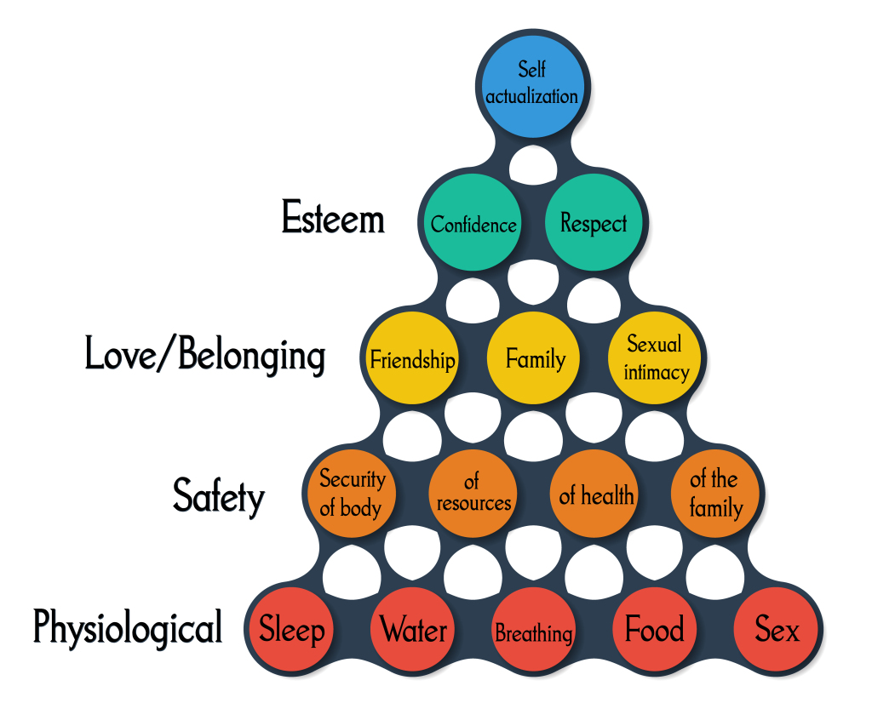
Fulfil a Need
Market Your
needs Skills
Take any of the human needs on Maslow’s Hierarchy of Needs and think of the products and services created to meet these needs. Then, build on those.

Slide 14

Finding a Business Idea
Market need
Changes in technology, law & regulation, market & industry structures, demographics, culture, moods & fashions
Product/service deficiencies
Unmet demand
Create opportunity
Radical product or market innovation
Spot opportunity
Incremental product or market innovation
Getty Images/ iStockphoto/Samohin

Slide 15

Discovery Skills
Networking - finding & testing ideas
Observing others - particularly potential customers
Questioning common wisdom – asking ‘why?’ & ‘why not?’
Experimenting - trying things out
Associating seemingly unrelated things - connectivity
=
Innovation
See Dyer et al., 2009
Jeff Dyer HBR interview

Slide 16


Discovery Skills
Networking
Exposure to diverse influences, ideas & people
Observing
Questioning
Associating
Corbis
Curiosity
Connectivity
Experimenting
Incubation
Creativity
See Dyer et al., 2009

Slide 17
Techniques for Exploring Change
Brainstorming
PESTEL analysis
Futures thinking
Mind maps
Political
Economic
Social
Technological
Economic
Legal

Slide 18

Spotting Opportunity: Change
Brainstorm changes using PESTEL Analysis
Develop a vision of the future after that change using futures thinking
Brainstorm commercial opportunities coming out of identified change
Develop & refine opportunity using mind maps
Getty Images/ iStockphoto/Samohin

Slide 19

Spotting Opportunity: Inadequate Products
List attributes of product / service
Brainstorm how these attributes can be improved
Develop & refine opportunity using mind maps
Getty Images/ iStockphoto/Samohin

Slide 20

Spotting opportunity: Gap analysis
Exploring Existing Products
List attributes of product / service
Brainstorm the dimensions onto which these attributes might be mapped
Identify the gaps in the mapping
Verify dimensions & gaps using market research

Slide 21
Innovation
Analyse opportunities, internally & externally. Innovate for NOW - timing is everything
Innovation is conceptual & perceptual, so look at financial implications & analyse whether it meets the opportunity
Keep innovation simple - KISS!
Start small, take an incremental approach
Think long term - aim at market leadership & dominate the competition as soon as possible
See Drucker, P. (1985) Innovation and Entrepreneurship: Practice and Principles, London: Heinemann

Slide 22

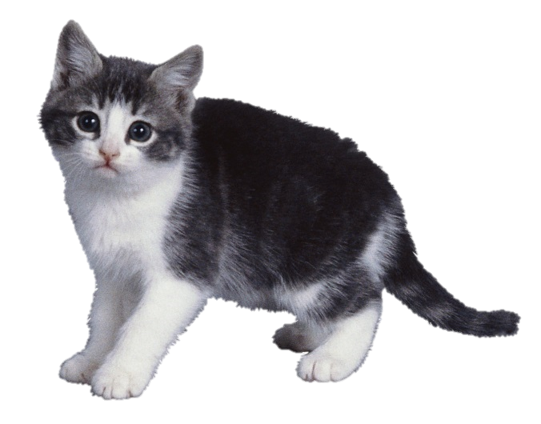
Creativity
Example
Can you think outside the box?

Slide 23
Activity: Group Task
Watch this video:
How to Find Business Ideas: https://www.youtube.com/watch?v=cIsA1s9SwEU

Slide 24
Activity: Group Task
Complete the session 2 activity on Moodle.
NB: Before completing this task. You are expected to have be in groups of 3 – 5 students.
The task should be completed in your group settings with the mind of generating business idea for your group assignment.

Slide 25

Group Task, Question & Answer
Thank you for listening

Slide 26
References
Burns, P. (2014). New Venture Creation: A Framework for Entrepreneurial Start-ups. Basingstoke: Palgrave-Macmillan.
Drucker, P. (1985) Innovation and Entrepreneurship: Practice and Principles, London: Heinemann
Dyer, J., Lindsay, J., Gregersen, H. and Garber, C. (2009) How Do Innovators Think? Available at: http: blogs.hbr.org/hbr/hbreditors/2009/.../how_do_innovators_think.htm (Accessed 11/09/2020).
Mariotti, S. and Glackin, C. (2016). Entrepreneurship: Starting and Operating A Small Business, 4th Edition, Global Edition, Pearson.
Maund, A. Schriek, M. and Tinkler, P. (2017). Certificate in Higher Education: Skills for the Workplace Student Yearbook. Sage Publications.

