Slide 1
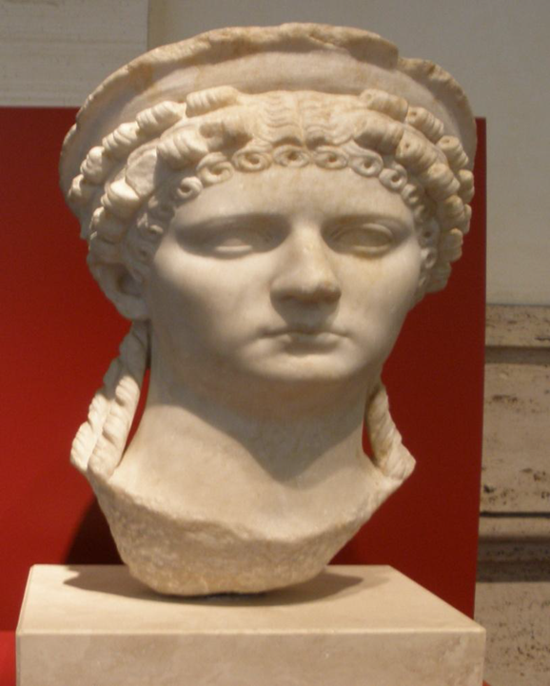
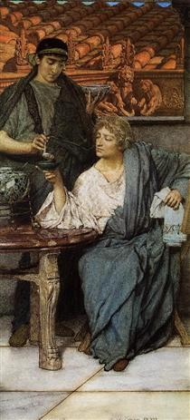
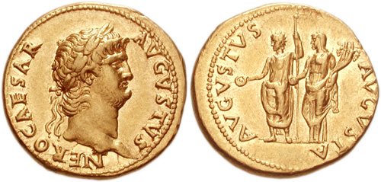
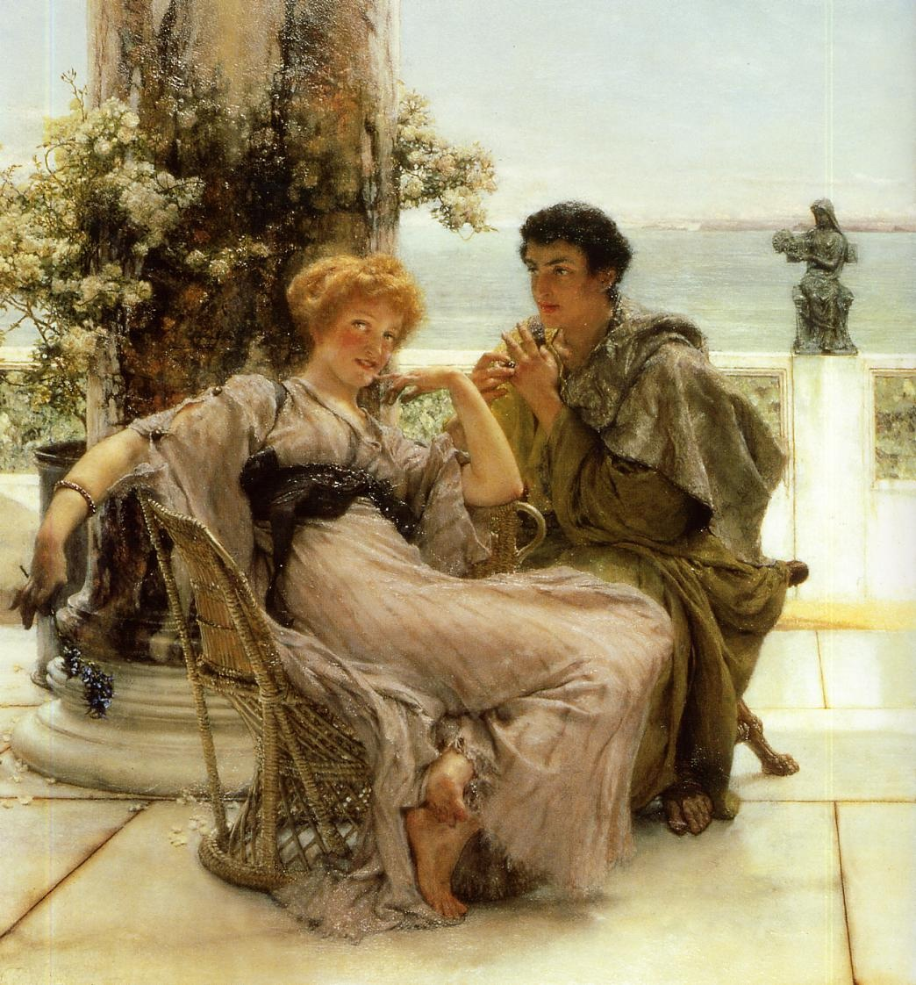
Murder, Mayhem and Megalomania: The Life and Times of the Emperor Nero
HPAH5037; HPAH6037
Tyranny and Debauchery Unchecked
The Roman Wine Tasters, Lawrence Alma-Tadema
Courtship The Proposal, Sir Lawrence Alma-Tadema

Slide 2
End of the “Golden Years”?
When did Nero supposedly go bad?
AD 59 – death of Nero’s mother?
  Death of Agrippina, freed from constraints – Dio 61.19-21.
  Rise of Poppaea Sabina AD 58 – “Henceforward Nero sought no veil for his debaucheries and crimes.” – Tac. Ann. 13.47.
    “Sabina on learning of this persuaded Nero to get rid of his mother, alleging that she was plotting against him.” – Dio Cassius 62.12.
Death of Burrus (AD 62), Seneca‘s departure from public life (increasingly from AD 63-64), and the rise of the Praetorian Prefect Tigellinus - Tac. Ann. 14.51-52.
Suetonius lists without chronological precision various virtues and condemnatory acts, though he emphases a decline in behaviour – “At last, after nearly fourteen years of Nero‘s misrule, the earth rid herself of him.” – Nero 40.

Slide 3

Poppaea Sabina
Marriage to Nero in AD 62, gave birth to a daughter Claudia in 63.
“Otho, possibly by an amorous indiscretion, began to praise the looks and the graces of his wife in presence of the emperor; or, possibly, his object was to inflame the sovereign's desire, and, by the added bond of joint ownership in one woman, to reinforce his own influence… to prevent his acting as Nero's rival in Rome, he was appointed to the province of Lusitania; where, till the outbreak of the civil war…” – Tac. Ann. 13.46.
“Thus it was to Otho, the person privy to his lusts, that Nero had entrusted the imperial whore Poppaea Sabina, until he could get ride of Octavia.” – Tac. Hist. 1.13.
Museo Nazionale Romano

Slide 4
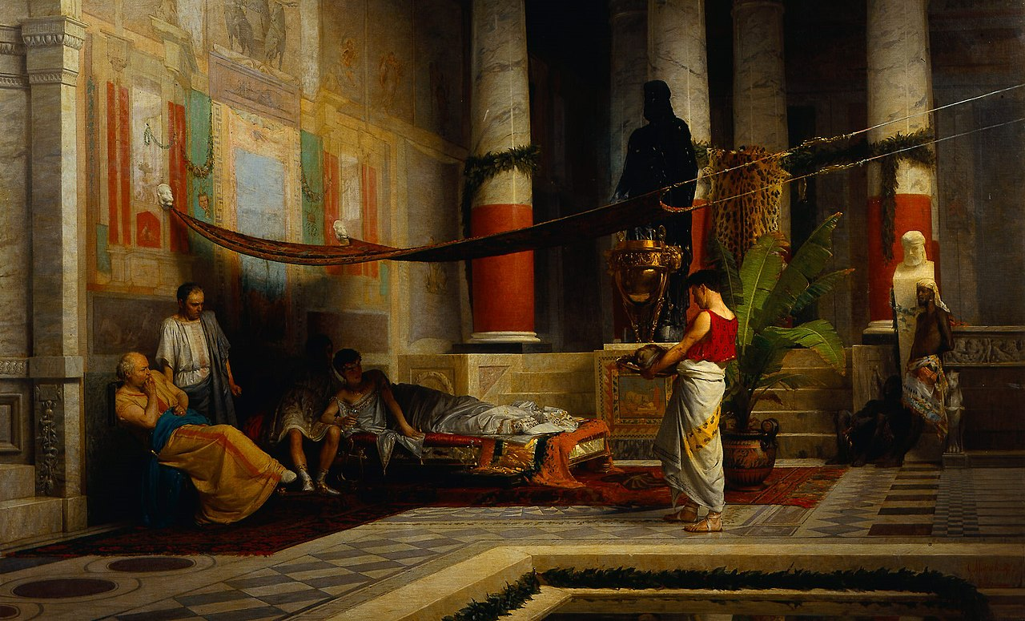
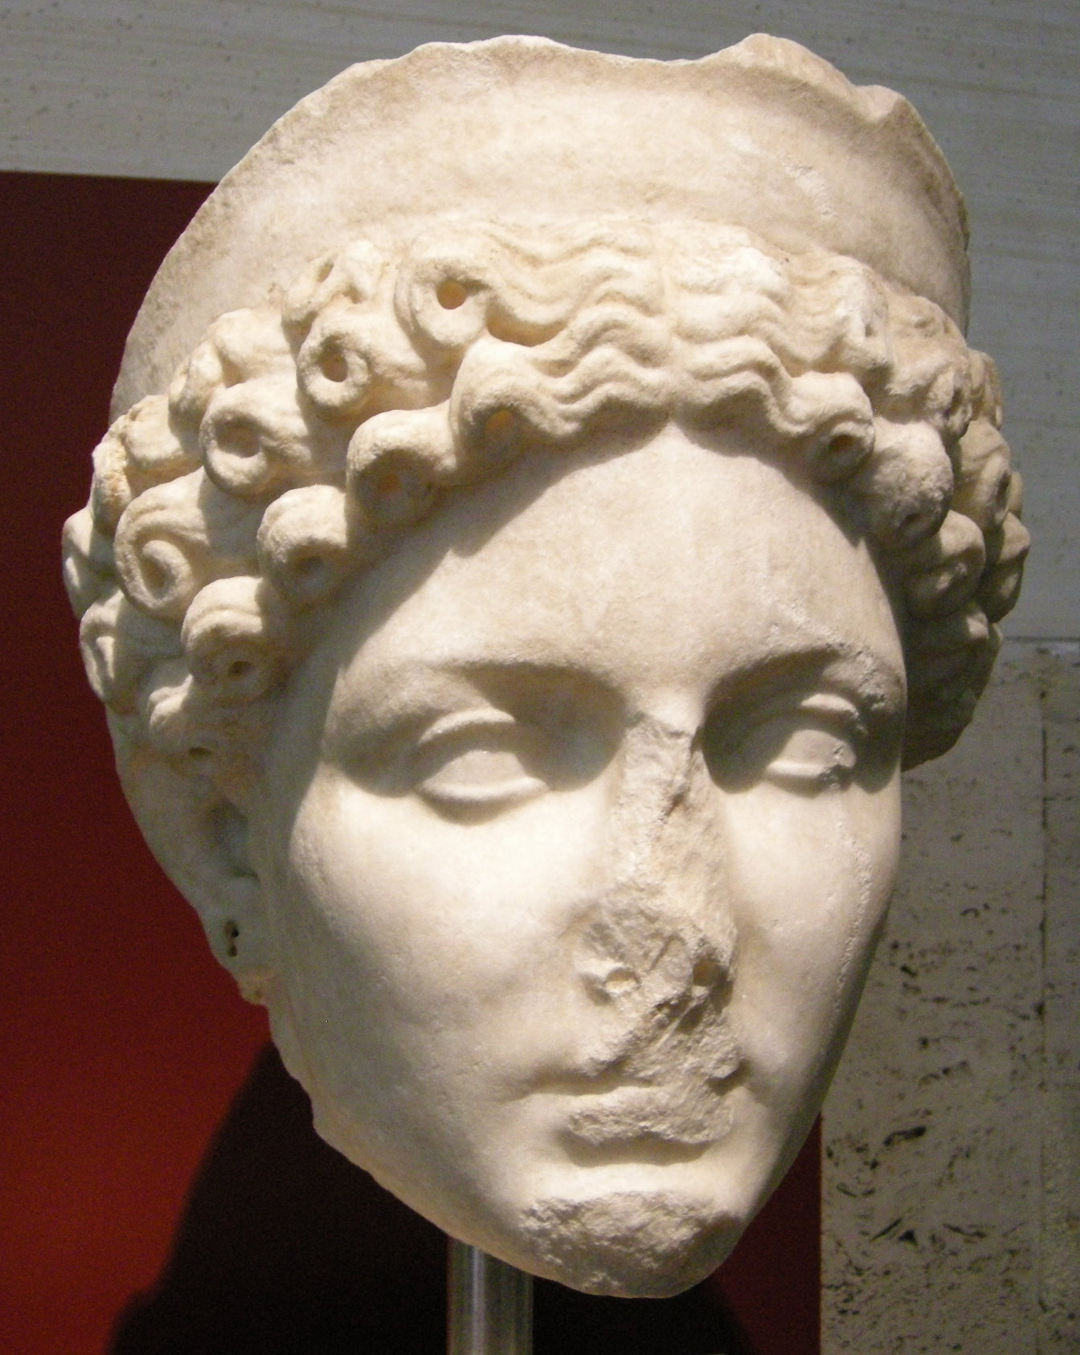
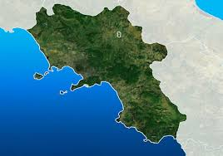
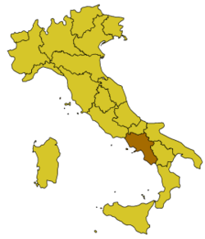
Divorce of Octavia (AD 62)
“…he rejected Octavia on the pretext of sterility, then consummated his union with Poppaea. Long time lover of Nero… she [Poppaea] incited one of the domestics of Octavia to accuse her of a love affair with a slave… She was removed, however, first under facade of a civil divorce… A little later, she was banished to Campania and put under military supervision…” – Tac. Ann. 14.60.
“The measure led to general and undisguised protests from the common people, endowed with less discretion than their superiors, and — thanks to their humble station — faced by fewer perils. Then came a rumour that Nero had repented of his outrage and recalled Octavia to his side.” – Tac. Ann. 14.60.
“He tried to strangle her on several occasions – Suet. Nero 35.
Poppea Brings the Head of Octavia to Nero by G.Muzzioli (1876)

Slide 5
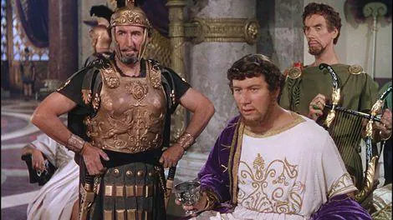
Rise of Tigellinus
Gaius Ofonius Tigellinus.
Exiled for adultery with Caligula‘s sisters in AD 39.
Made joint Praetorian Prefect with Faenius Rufus in AD 62.
Forced to commit suicide under Otho – Tac. Hist. 1.72.
“Tigellinus, who had outstripped all his contemporaries in licentiousness and blood-thirstiness, succeeded Burrus. He won Nero away from the others and made light of his colleague Rufus.” – Dio Cassius 62.13.3.
“With Seneca brought low, it was a simple matter to undermine Faenius Rufus, the charge in his case being friendship with Agrippina…” – Tac. Ann. 14.57.

Slide 6
Debauchery and Excess

Slide 7
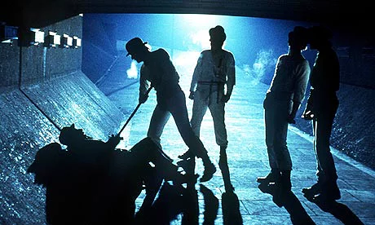
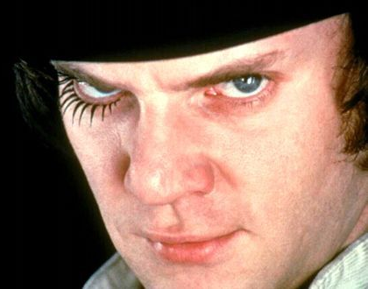
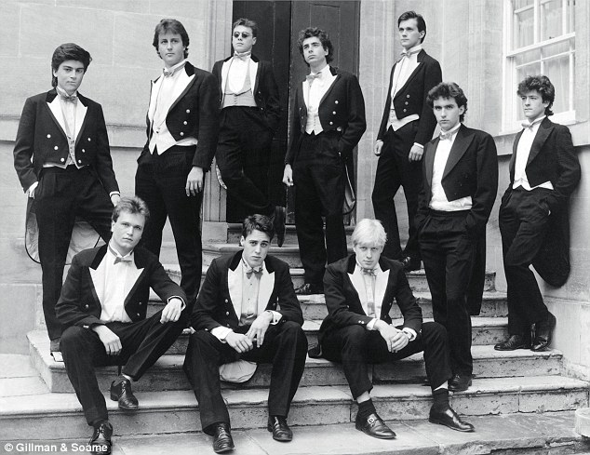
Hooliganism
“The consulate of Quintus Volusius and Publius Scipio [AD 56] was marked by peace abroad and by disgraceful activities at home, where Nero — his identity hidden under the dress of a slave — roamed the streets, brothels, and wine-shops of the capital, with an escort whose duties were to snatch wares exhibited for sale and to assault all persons they met, the victims having so little clue of the truth that he himself took his beats with the rest and bore their marks on his face... Julius Montanus, a member of the senatorial order, though he had not yet held office, met the emperor casually in the dark, and, because he repelled his offered violence with spirit, then recognized his antagonist and asked for pardon, was forced to suicide, the apology being construed as a reproach.” – Tac. Ann. 13.25.

Slide 8
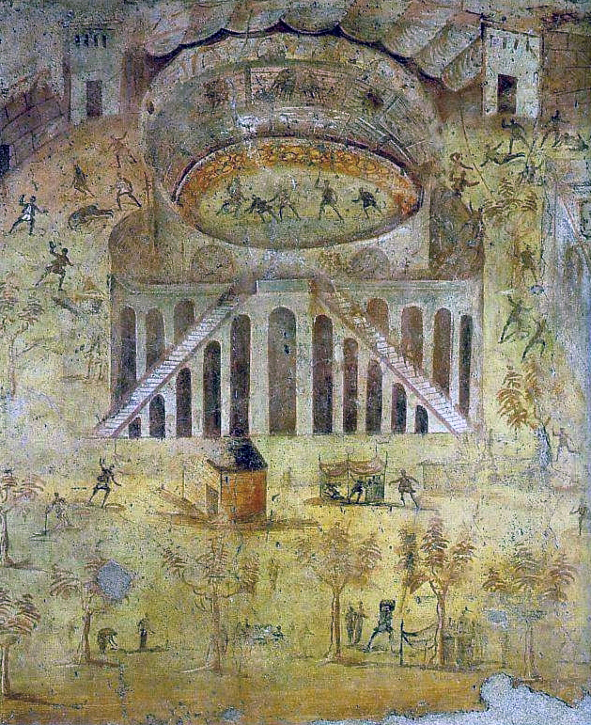
“Even the licence of the actors and of the theatrical claques he converted into something like pitched battles by waiving penalties, by offering prizes, and by viewing the riots himself, sometimes in secret, very often openly; until, with the populace divided against itself and still graver turmoil threatened, no other cure appeared but to expel the actors from Italy and to have the soldiers again take their place in the theatre.” - Tacitus Annals 13.25.
House of Actius Anicetus – Museo Archeologico Nazionale di Napoli (inv. nr. 112222). – riot in ampihteatre AD 59

Slide 9
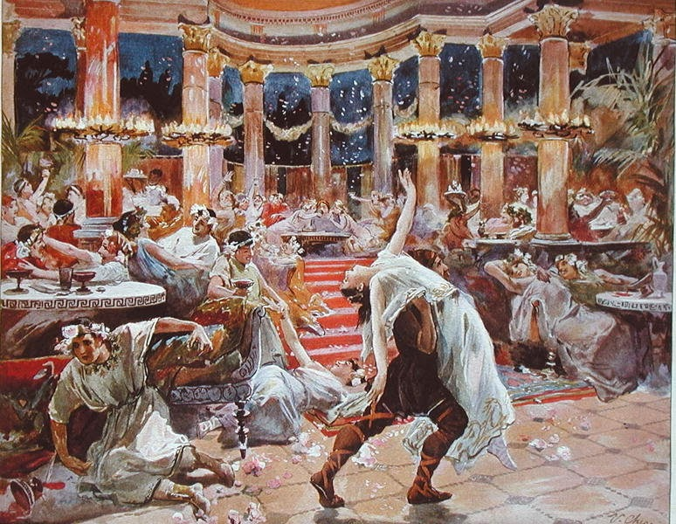
Extravagance and Nero’s Circle of Vice?
Is there an easy distinction between liberalitas and luxuria? Would this be condemned if Nero was not considered a “bad emperor”?
“But a short time since, Calenus, you had not quite two millions of sesterces; but you were so prodigal and open-handed, and hospitable, that all your friends wished you ten millions. Heaven heard the wish and our prayers; and within, I think, six months, four deaths gave you the desired fortune. But you, as if ten millions had not been left to you, but taken from you, condemned yourself to such abstinence, wretched man, that you prepare even your most sumptuous feasts, which you provide only once in the whole year, at the cost of but a few dirty pieces of black coin; and we, seven of your old companions, stand you in just half a pound of leaden money. What blessing are we to invoke upon you worthy of such merits? We wish you, Calenus, a fortune of a hundred millions. If this falls to your lot, you will die of hunger.” – Martial Ep. 1.99.
Common topoi of “bad” emperors being profligate and decadent.
  Gaius (Caligula) – spends ten million sesterces on one dinner – Seneca De Consolatione ad Helviam Matrem 10.
  Elegabalus – feeding parrots to lions - SHA Elagabalus 20-21.
“[Nero] believed that fortunes were made to be squandered and whoever could keep track of his expenses seemed to him a stingy miser; ‘True gentlemen’, he said, ‘always throw their money about’.” – Suet. Nero 30.1.
“120,000,000 sesterces had been squandered by Nero in gifts. It was voted that individuals should be summoned, and that a tenth part of the gifts which Nero had made them should be left with each. But Nero's favourites had hardly one-tenth left, for they had wasted the money of others on the same extravagances as they had their own; the most greedy and depraved had neither lands nor principal, but only what would cater to their vices.” – Tac. Hist. 1.20.
“He also forced his friends to provide him with dinners; one of them spent four million sesterces on a cena mitellita, and another on a rose banquet.” – Suet. Nero 27.
A Banquet in Nero's palace, Ulpiano Checa y Sanz (1910)

Slide 10
“He himself, to create the impression that no place gave him equal pleasure with Rome, began to serve banquets in the public places and to treat the entire city as his palace. In point of extravagance and notoriety, the most celebrated of the feasts was that arranged by Tigellinus… He constructed, then, a raft on the Pool of Agrippa, and superimposed a banquet, to be set in motion by other craft acting as tugs. The vessels were adorned with gold and ivory, and the oarsmen were catamites marshalled according to their ages and their libidinous attainments. He had collected birds and wild beasts from the ends of the earth, and marine animals from the ocean itself. On the quays of the lake stood brothels, filled with women of high rank; and, opposite, naked harlots met the view…” – Tac. Ann. 15.37.

Slide 11
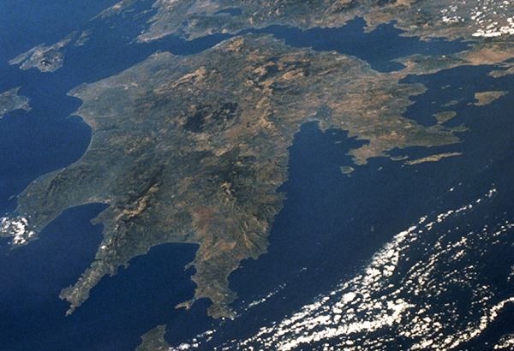
Acts of “Megalomania”?
“The Gulfs… are known as the Corinthian and the Saronic Gulfs… the frontiers of this narrow passage, which thus necessitates a wearisome and perilous circumnavigation for vessels as a result of their enormity cannot be carried across by land on vehicles. For this reason it is that both King Demetrius, Caesar the Dictator, the prince Gaius, and Domitius Nero, have at different times made the attempt to cut through this neck by forming a navigable canal; a blasphemous design, as may be clearly seen by the result in every one of these instances.” – Pliny NH 4.4.10.
“Nero‘s unreasonable craving for immortal fame made him change a number of well-known names in his own favour. The month of April, for instance, became ‘Neroneus’, and Rome was on the point of being renamed ‘Neropolis’.” – Suet. Nero 55.
Month of Neroneus mentioned on an inscription from Pompeii – ILS 6326.

Slide 12
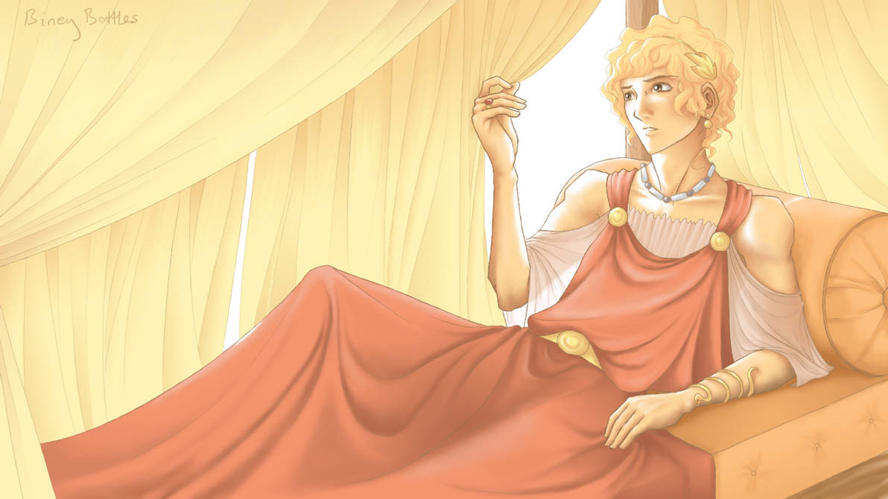
Sexual Habits
“Not satisfied with seducing freeborn boys and married women, Nero raped the Vestal Virgin Rubria… Having tried to turn the boy Sporus into a girl by castration, he went through a wedding ceremony with him (AD 67) – dowry, bridal veil and all – which the whole court attended, then brought him home and treated him as a wife.” - Suetonius Nero 28.
“Nero himself, defiled by every natural and unnatural lust had left no abomination in reserve with which to crown his vicious existence; except that, a few days later, he became, with the full rites of legitimate marriage, the wife of one of that herd of degenerates, who bore the name of Pythagoras. The veil was drawn over the imperial head, witnesses were despatched to the scene; the dowry, the couch of wedded love, the nuptial torches, were there: everything, in fine, which night enshrouds even if a woman is the bride, was left open to the view.” – Tacitus Annals 15.37.
 | Vagina | Anus | Mouth
Active Activity Person (Vir) | futuere fututor | pedicare pedicator/pedico | irrumare irrumator
Passive Activity Person (Male) Pathicus (Female) Femina | Futui cunnilinator Femina / puella | pedicari cinaedus / pathicus pathicus | Irrumari / fellari fellator fellatrix
“Nero missed her so greatly after her [Poppaea] death that on learning of a woman who resembled her he at first sent for her and kept her; but later he caused a boy of the freedmen, whom he used to call Sporus, to be castrated, since he, too, resembled Sabina, and he used him in every way like a wife.” – Dio 62.28.2.

Slide 13
Executions and Erratic Behaviour

Slide 14
Executions and Exiles
More irrational or petty motives for murder?
“This was what was going on in Greece. Is it worthwhile adding that Nero ordered Paris, the pantomimic dancer, to be slain because the emperor had wished to learn dancing from him but had not the aptitude? Or that he banished Caecina Tuscus, the governor of Egypt, for bathing in the bath that had been specially constructed for the emperor's intended visit to Alexandria?” – Dio Cassius 63.18.1.
Sulpicius Camerinus and his son condemned for not giving up their ancestral title Pythicus – seen as irreverent toward Nero's Pythian victories - 63.18.2-3.
Faustus Cornelius Sulla Felix – grandson of Antonia the Elder, husband of Claudia Antonia (daughter of Claudius) – exiled in AD 58, assassinated in 62.
Gaius Rubellius Plautus – son of Julia, great-grandson of Tiberius, exiled in AD 60, killed in 62.
Decimus Junius Torquantus Silanus – son of Aemilia Lepida, great-great-grandson of Augustus, compelled to commit suicide in AD 64.
Cold blooded but rational move to preserve the security of Nero’s “throne”?

Slide 15
Cause of Nero’s Downfall?
Was Nero‘s downfall caused by extravagance and cruelty?
“[Speech of Galba] ―It was not Vindex with a powerless province at his back, nor I with a single legion, that freed Rome‘s shoulders of that burden: it was his own barbarity and profligacy. And that was before there was an precedent for conviction of an emperor.” – Tacitus Histories 1.16.2.

Slide 16
Bibliography
Dalby, A. 2000: Empire of Pleasure Luxury and Indulgence in the Roman World. London: Routledge.
Edwards, C. 1993: The Politics of Immorality in Ancient Rome. Cambridge: Cambridge University Press.
Kragelund, P. 2000: ‘Nero’s Luxuria, in Tacitus and the Octavia’, The Classical Quarterly 50 (2): 494-515.
Murgatroyd, T. 2013: ‘Petronius’ Satyrica’, in A Companion to the Neronian Age (Buckley, E. and Dinter, M. T. eds.), Wiley-Blackwell: 241-257.

