Slide 1
LCBB6022
Leadership and management, theory and practice
WEEK 2
Session 1
Emotional and Cultural Intelligence in Leadership

Slide 2
Content of the Session
Introduction to Emotional Intelligence (EI)
Affect, Emotions, Moods
Emotional Intelligence Models
  Daniel Goleman’s EI Model (1998)
  Salovey and Mayer Model (1990)
Cultural Intelligence Models
  Earley & Ang’s Cultural Intelligence (CQ) Model (2003)
  Hofstede’s Cultural Dimensions (1980)
Benefits of High Emotional Intelligence
Developing Emotional Intelligence
Emotional Intelligence vs. Cultural Intelligence

Slide 3
Introduction to Emotional Intelligence (EI)
Emotional Intelligence is the ability to recognise, understand, and manage emotions (self & others).
It is important in personal and professional settings.

Slide 4
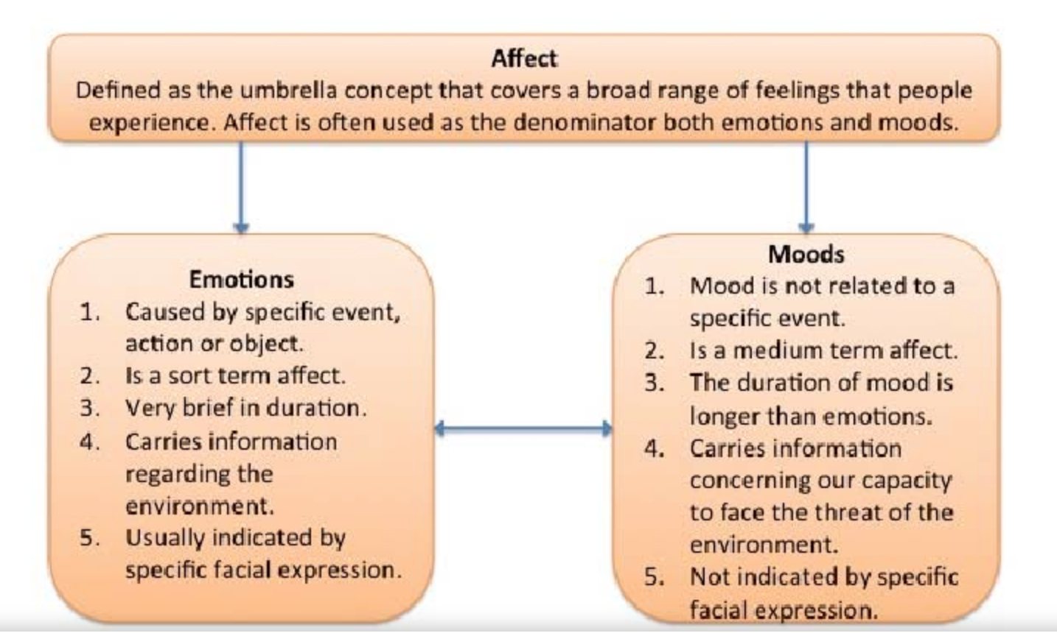
Affect, Emotions, Moods
Affect Theory (Tomkins, 1962).

Slide 5
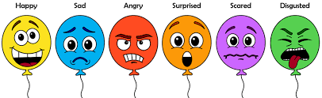
Affect
Affect is a broad term that includes all types of feelings that a person experiences.
It serves as an overarching category that encompasses both emotions and moods.

Slide 6
Emotions
Emotions are short-term reactions to specific events, actions, or objects. They are intense but brief and usually come with noticeable facial expressions. Here are the key characteristics:
  Triggered by a specific cause
  Short-lived
  Brief duration
  Carry information about the environment
  Expressed through facial expressions

Slide 7
Moods
Moods are longer-lasting and are not necessarily tied to specific events. They affect an individual’s overall emotional state and influence behaviour over time. Here are the main characteristics:
  Not linked to a specific event
  Medium-term affect
  Longer duration
  Carry information about coping with the environment
  Not expressed through specific facial expressions

Slide 8
Emotional and Cultural Intelligence In Leadership
Emotional Intelligence Models
Daniel Goleman’s EI Model (1998)
  Self-awareness, self-regulation, motivation, empathy, social skills.
  Use: To show how emotionally intelligent leaders handle people and make fair decisions.
Salovey and Mayer Model (1990)
  Perceive → Use → Understand → Manage emotions.
  Use: To explain emotional awareness and adaptability in workplace situations.
Cultural Intelligence Models
Earley & Ang’s Cultural Intelligence (CQ) Model (2003)
  Cognitive (knowledge), Motivational (drive), Behavioural (action), Metacognitive (awareness).
  Use: To explain how leaders adapt communication and behaviour across cultures.
Hofstede’s Cultural Dimensions (1980)
  Power distance, individualism, masculinity, uncertainty avoidance, etc.
  Use: To analyse differences in leadership expectations across countries or teams.

Slide 9
Emotional Intelligence (EI) in Leadership?
EI in leadership means the ability to recognise, understand, and manage emotions in oneself and others.
Leaders with high EI can inspire, guide, and support their teams effectively.

Slide 10
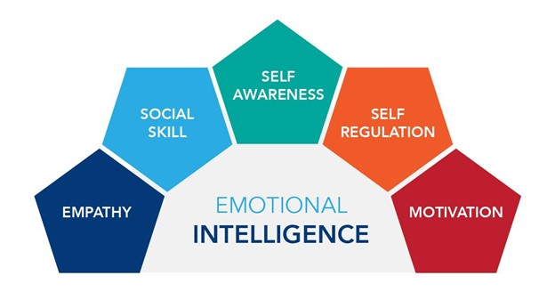
Emotional Intelligence Models
Daniel Goleman’s EI Model (1998)
  Self-awareness, self-regulation, motivation, empathy, social skills.
  Use: To show how emotionally intelligent leaders handle people and make fair decisions.

Slide 11
The 5 Components of EI
(Daniel Goleman’s Model)
Self-awareness – Recognizing own emotions.
Self-regulation – Managing emotions effectively.
Motivation – Inner drive beyond external rewards.
Empathy – Understanding others’ emotions.
Social skills – Effective communication & relationship management.

Slide 12
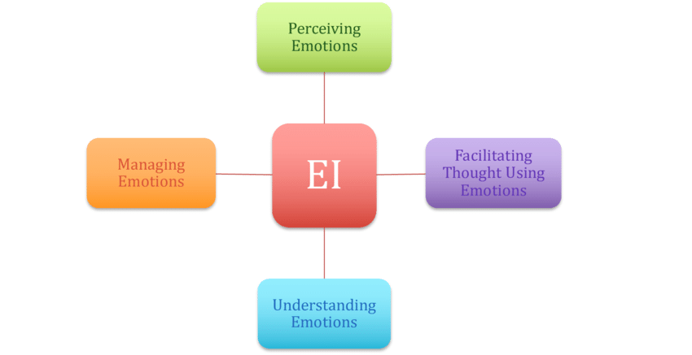
Emotional Intelligence Models
Salovey and Mayer Model (1990)
  Perceive → Use → Understand → Manage emotions.
  Use: To explain emotional awareness and adaptability in workplace situations.

Slide 13
Benefits of High Emotional Intelligence
Better leadership & teamwork.
Enhanced conflict resolution skills.
Increased adaptability & resilience.

Slide 14
Developing Emotional Intelligence
Practice mindfulness & self-reflection.
Improve active listening & empathy.
Learn to manage stress and emotional triggers.

Slide 15
Cultural Intelligence
Cultural Intelligence is the ability to function effectively across different cultural contexts.
It is very important and relevant to today’s globalised world.

Slide 16
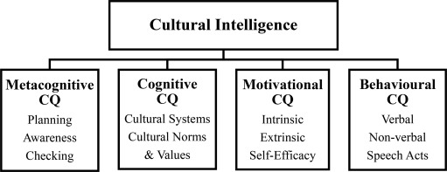
Cultural Intelligence Models
Earley & Ang’s Cultural Intelligence (CQ) Model (2003)
  Cognitive (knowledge), Motivational (drive), Behavioural (action), Metacognitive (awareness).
  Use: To explain how leaders adapt communication and behaviour across cultures.

Slide 17
The 4 Components of CQ (Cultural Quotient)
CQ Drive – Interest & motivation to interact with different cultures.
CQ Knowledge – Understanding cultural norms & differences.
CQ Strategy – Awareness & planning for cross-cultural interactions.
CQ Action – Adapting behaviour effectively in diverse environments.

Slide 18
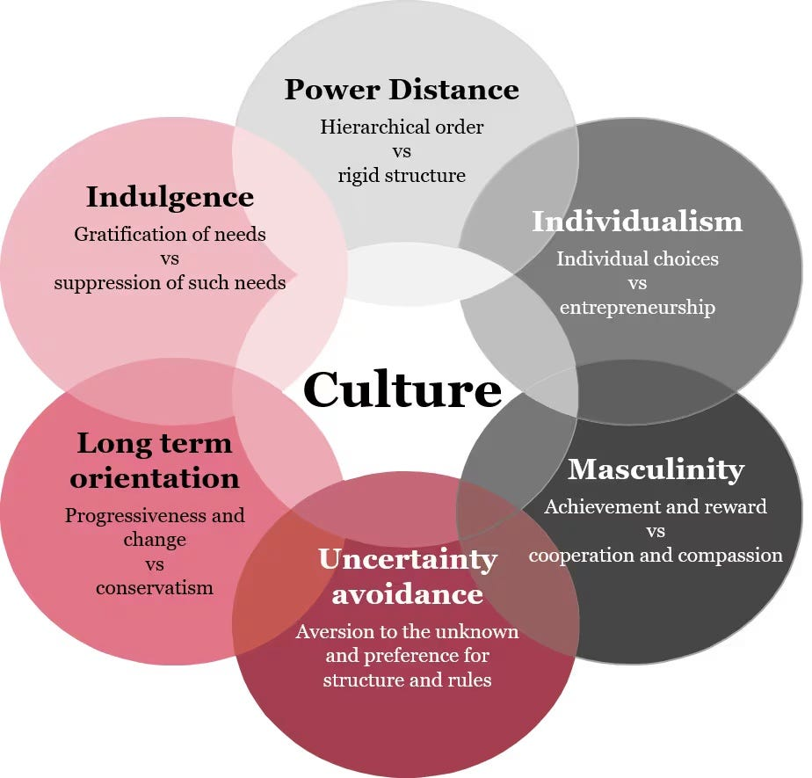
Cultural Intelligence Models
Hofstede’s Cultural Dimensions (1980)
  Power distance, individualism, masculinity, uncertainty avoidance, etc.
  Use: To analyse differences in leadership expectations across countries or teams.

Slide 19
Why Cultural Intelligence Matters
Enhances teamwork in diverse environments.
Reduces misunderstandings & unconscious bias.
Strengthens global business relationships.

Slide 20
Developing Cultural Intelligence
Developing Cultural Intelligence
Exposure to different cultures (travel, media, interactions).
Learning about cultural norms, values, and communication styles.
Practicing adaptability in cross-cultural settings.

Slide 21
Emotional Intelligence vs. Cultural Intelligence
EI focuses on emotions & interpersonal relationships.
CQ focuses on cross-cultural adaptability & interactions.
Together, they help thrive in a diverse environment (as shown in the Venn diagram).

Slide 22
Emotional Intelligence vs. Cultural Intelligence – Key Challenges
Challenge | Explanation | Example
Balancing EI and CQ | Leaders may be emotionally intelligent in one culture but misread cues in another. | A UK manager showing open empathy may be seen as unprofessional in Japan.
Cultural Misinterpretation | Emotions are expressed differently across cultures, leading to misunderstandings. | Direct feedback (common in the West) may seem rude in Asia.
Over-emphasis on Emotion | Too much focus on empathy may reduce objectivity in decision-making. | A leader avoids giving negative feedback to maintain harmony.
Adapting Behaviour | Switching between cultural norms requires high self-awareness and flexibility. | A leader must adjust tone, communication, and hierarchy expectations in global teams.
Developing Both Skills | Emotional and cultural intelligence require time, exposure, and reflection to grow. | Global leaders undergo cross-cultural training and self-reflection programs.

Slide 23
Group Activity 1 - Assessment Preparation
Sit in your assigned groups and carefully review the Assessment Brief for this module.
Identify what is expected for the presentation and individual reflection components.
Discuss how you can apply the concepts of Emotional Intelligence (EI) and Cultural Intelligence (CQ) within your chosen leadership examples.
Begin outlining your group presentation structure - decide who will cover which parts (e.g., theories, examples, reflection).
Note down any questions or clarifications you may have regarding the assessment, which we can discuss together at the end of the session.

Slide 24
Activity 2: EI test
Complete the following psychometric test: https://www.psychologytoday.com/gb/tests/personality/emotional-intelligence-test
Reflect on the outcomes of the psychometric test.

Slide 25
References
Crawford, J. (2023) Leadership: Advancing Great Leaders and Leadership. IntechOpen.
Earley, P. C. and Ang, S. (2003) Cultural Intelligence: Individual Interactions Across Cultures. Stanford, CA: Stanford University Press.
Goleman, D. (1998) Working with Emotional Intelligence. New York: Bantam Books.
Hofstede, G. (1980) Culture’s Consequences: International Differences in Work-Related Values. Beverly Hills, CA: Sage Publications.
Salovey, P. and Mayer, J. D. (1990) ‘Emotional Intelligence’, Imagination, Cognition and Personality, 9(3), pp. 185–211.
Tomkins, S. S. (1962) Affect Imagery Consciousness: Volume I – The Positive Affects. New York: Springer Publishing Company.
Yukl, G.A. and Gardner, W.L. (2020) Leadership in organizations. Ninth edition. Harlow: Pearson Education Limited.

