Slide 1
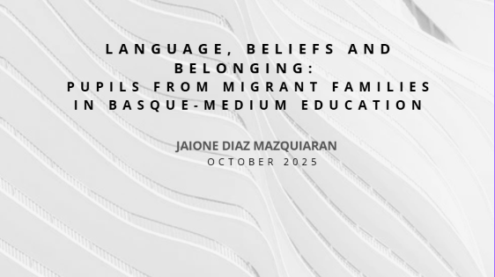




jaione.diazmazquiaran@monash.edu

Slide 2

SEMINAR STRUCTURE
1st block:
-Aims of seminar
-Introductions with students
-Background context: The Basque Country and the revitalization of Euskera over the years
-Current sociolinguistic and educational situation of Navarre
2nd block:
-My research – research gap and summary of key findings
-Discussion: Similarities/ differences between Basque & Welsh immersion programs
3rd block:
-Collaborative activity – implications for different stakeholders
-Comments and questions

Slide 3
AIMS OF THIS SEMINAR
To explore language revitalization, immersion programs, and professional implications for education stakeholders in both Cymru and the Basque Country.
Explore the current educational and immersion context in Navarre.
Examine the dynamics between:
  Students’ language attitudes and practices (local and from migrant backgrounds)
  Parents’ and teachers’ language beliefs and expectations
  Institutional structures and language policies
  Sociolinguistic variables affecting languages in these students’ multilingual repertoires (status, usefulness, proficiency)
Present key findings from my research and identify research gaps.
Discuss similarities and differences between Basque and Welsh immersion programs.
Engage in collaborative activities to explore implications for different stakeholders in multilingual education.
Share comments, questions, and reflections on multilingual education settings with a minority language at the core.

Slide 4

INDIVIDUAL INTRODUCTIONS
Who are you, and what brought you to this postgraduate course?
What is your current professional role, and how does it connect to language or education?
What interests or areas within language, culture, or education are you most passionate about?
Which languages do you speak, and what is your relationship with each of them?
Do you have any cultural backgrounds or influences that are important to you? How have they shaped who you are?
Can you share a memorable moment or experience from your language learning or professional journey?
What challenges have you faced in learning or promoting languages, and how have you addressed them?
How do you connect or collaborate with others who share your passion for language (for example, Cymraeg)?
In your opinion, what makes language promotion successful in your context (school, college, university, etc.)?
Looking ahead, what kind of impact would you like to make — personally or professionally — in the field of language or education?

Slide 5
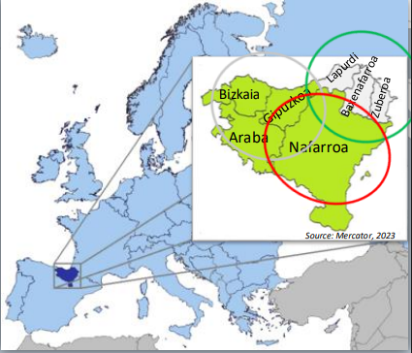
CURRENT CONTEXT I
The Basque Country: Iparralde, Basque Autonomous Community (BAC) and Foral Community of Navarre.
The lands where Basque language is spoken.
Three different administrations: one in the French state and two in the Spanish state
Four linguistic models:
  The A model: immersion in Spanish and Basque as a subject.
  The B model: immersion in Spanish and Basque.
  The D model: immersion in Basque and Spanish as a subject.
  The G model: immersion in Spanish and no Basque.

Slide 6
CURRENT CONTEXT II
BAC | NAVARRE | IPARRALDE
-Spanish and Basque are official languages -Considerable promotion of Basque since 1983/138 decree was issued -Enrollment rates to linguistic models (2023/2024): • D model: 78% • B model: 18% • A model: 3% • X model: 1% | -1986/18 Foral Law: Basque has official status only in the Basque speaking zone -The promotion of Basque has been limited -%25 of the population knows Basque (active + passive) -1988/159 Foral Decree: teaching of Basque is limited to the linguistic zoning: • Basque-speaking zone (green): A, B and D models. • Mixed zone (yellow): A, B, D and G models. • Non-Basque speaking zone (red): A and G models. | -French only policy in the whole state -Basque is not mandatory in the curriculum - 20% of the population in Iparralde has some knowledge of Basque (Soziolinguistika Klusterra, 2023) -1/3 of students received Basque language classes (“bilingual”, fully or partial immersion): • 48% in pre-school. • %40 in primary school. • 23% in secondary. • %5 vocational training. -Steady increase in the overall; decrease in the number of French-Basque bilinguals (Mercator, 2023).

Slide 7
CURRENT CONTEXT III
Aspect | BAC | Navarre | Iparralde
Official status of Basque | Co-official with Spanish throughout the entire territory | Co-official only in the Basque-speaking zone | Not official (French is the only official language)
Administrative use | Fully bilingual administration | Bilingual only in certain areas (mainly north) | Very limited; French required for all official matters
Public employment | Basque required or valued in most public positions | Required/valued only in some zones | Not recognized in civil service; no official value
Education | Widespread bilingual and Basque-medium models (A, B, D) | Available depending on zone (mostly north) | Voluntary Basque-medium schools (ikastolak, Seaska); no state requirement
Social use | High, especially in Gipuzkoa | Variable: high in north, low in south | Moderate overall; higher in inland areas, cultural revival ongoing
Government policy | Active promotion and normalization | Mixed approach depending on political leadership and zone | No official policy; local support and cultural promotion only
Legal framework | Statute of Gernika (1979), Basque Language Act (1982) | Foral Law on the Basque Language (1986) | French Constitution (French as sole official language)

Slide 8
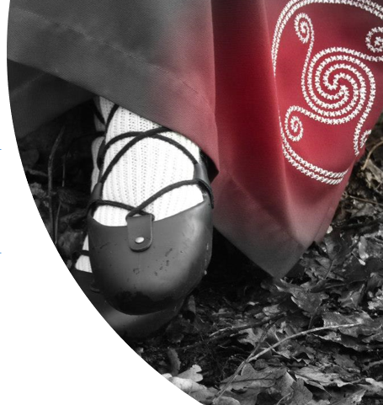
“Euskararen egiazko misterioa iraupena da, ez jatorria”
Koldo Mitxelena
“The true mystery of Basque is not its origin, but rather its endurance”

Slide 9
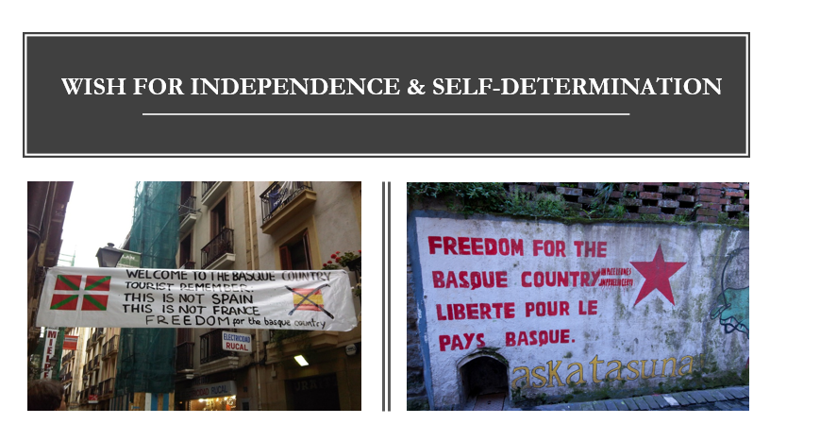

Slide 10
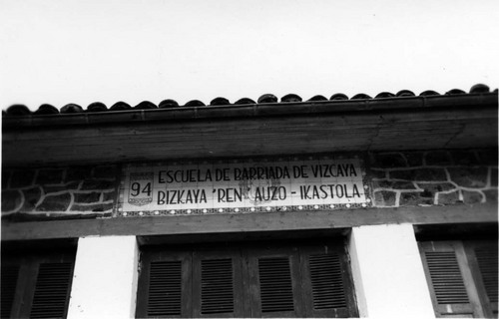
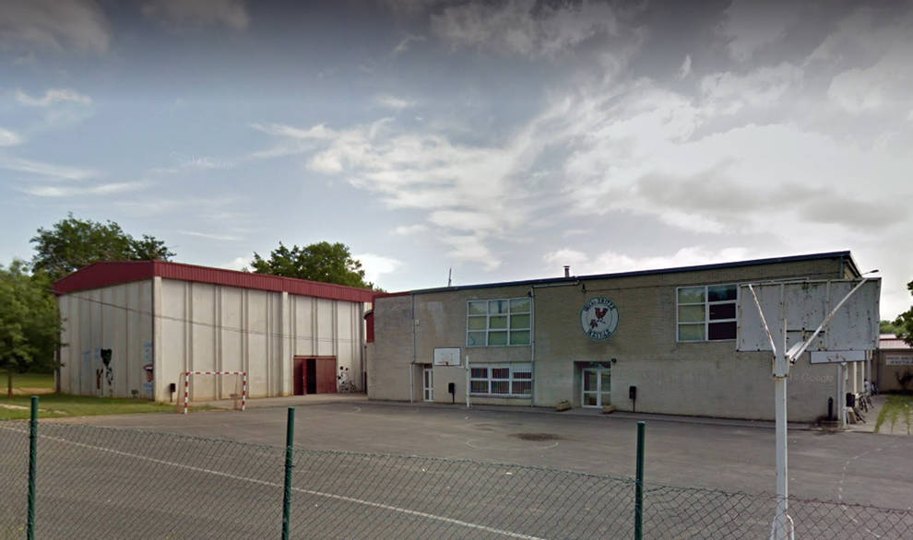
HISTORICAL OVERVIEW OF THE IKASTOLA MOVEMENT
Early origins (1914–1930s)
  First Ikastola founded in 1914.
  In 1932, the first association of Ikastolak was created.
  Aimed to provide education through Euskara and strengthen Basque identity.
  Flourished during the Second Spanish Republic (1931–1936).
Suppression under Franco (1939–1950s)
  After the Civil War, the public use of Basque was banned.
  Many Ikastolak were closed or went underground, teaching secretly in garages, kitchens, lofts.
  Language transmission relied on families, parishes, and community networks.
Resurgence and Expansion (1957–1975)
  In 1957, the first post-war Ikastola opened in Bilbo.
  A grassroots revival led by parents, teachers, and activists.
  Late 1960s: Euskara Batua (standardized Basque) created by Euskaltzaindia, enabling unified teaching.
  Ikastolak became symbols of cultural resistance and community pride.
Legal Recognition and Institutionalization (Post-1978)
  After the 1978 Constitution, Basque-language education gained official status.
  Ikastolak integrated into public and semi-private systems in the BAC and Navarre.
  Basque schools in northern Navarre still receive less government support than those in BAC.
  Today, Ikastolak remain central to Basque language revitalization and multilingual education.

Slide 11
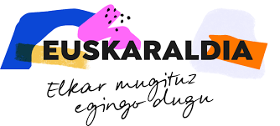
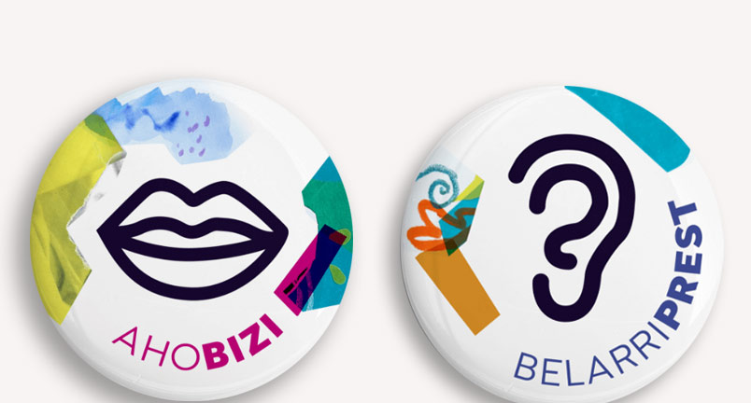
CURRENT CONTEXT: CHALLENGES
Improve Basque proficiency across all age groups and regions.
Uneven progress due to political, legal, and administrative differences — three administrations and two states.
Linguistic rights under pressure, especially in public services, businesses, and administration.
Increase the visibility and presence of Basque in daily life.
Expand Basque in media and culture – Pantailak Euskaraz (“Screens in Basque”) promotes films, cartoons, and adverts; demand for higher-quality Basque TV content.
Encourage active language use through initiatives like Euskaraldia (11 days of immersion) with roles: https://www.youtube.com/watch?v=mdpUd6J4r7g
  Ahobizi (“ready to speak”)
  Belarriprest (“ready to listen”).
Protect and grow Basque-speaking spaces (arnasguneak) where the language thrives naturally

Slide 12
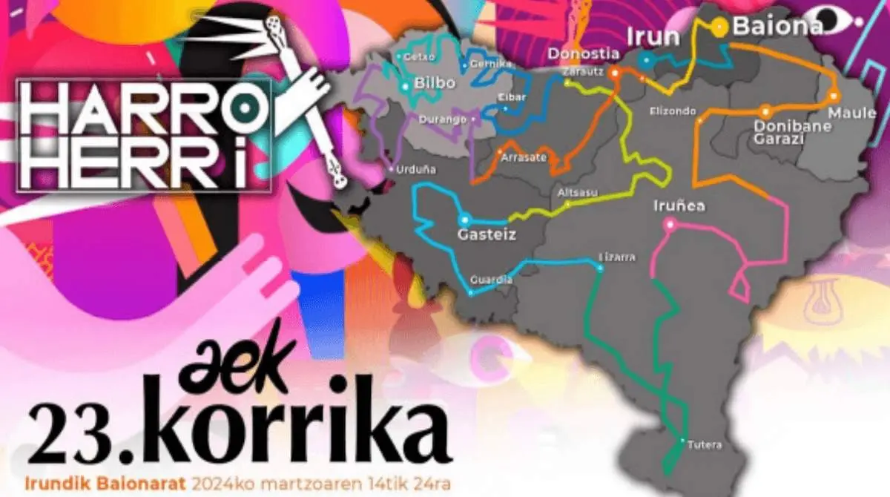
LANGUAGE REVITALIZATION THROUGH SCHOOLING & MEDIA
The main institutions: EUSKALTEGI
  Social initiative AEK:
      Governments HABE (BAC)
      Euskarabidea (Navarre)
      Euskararen Erakunde Publikoa (North)
      Local councils
Language use and knowledge: Korrika bianual race
https://www.youtube.com/watch?v=wXRJVFng4Ug&list=RDwXRJVFng4Ug&start_radio=1
Spin-offs:
  In Cataluña: "Correllengua“ since 1993.
  In Galicia:"Correlingua since 2000.
  In Bretagne: "Ar Redadeg“ since 2008.
  In Ireland: "Rith“ since 2010 to restate Gaelic.
  In Wales: "Ras yr Iaith“ since 2014.
SOCIAL CONSCIOUSNESS
TRADITION
FUNDING

Slide 13

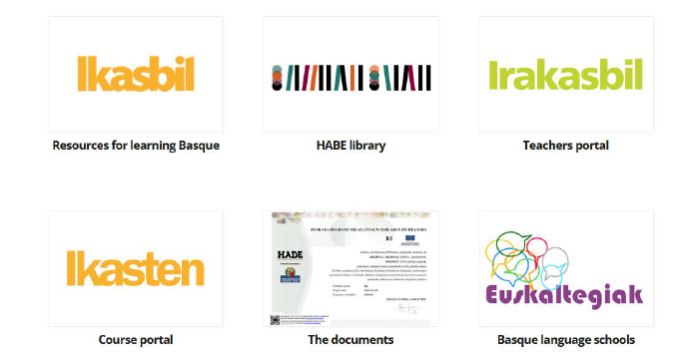


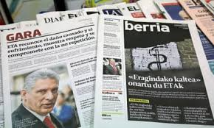
ONLINE RESOURCES
HABE (Basque autonomous region)
Euskaltzaindia- Royal Academy of the Basque Language
Online dictionnaries (Elhuyar/ Euskaltzaindia)

Slide 14
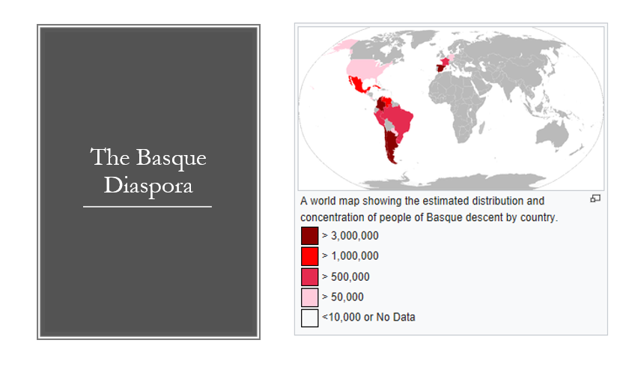

Slide 15
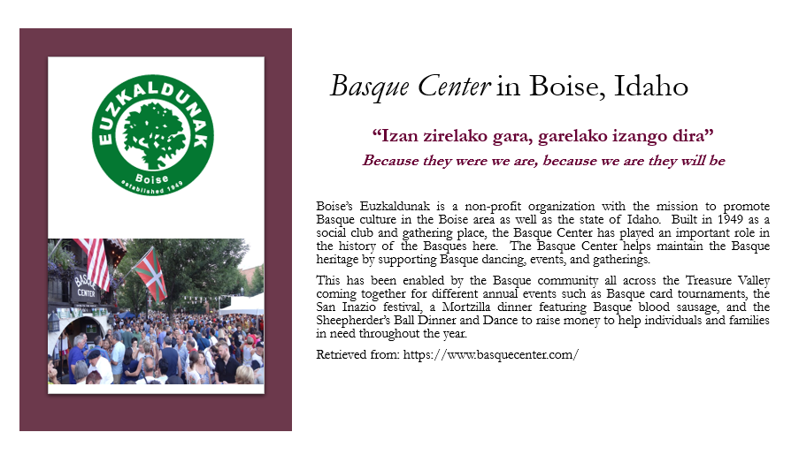

Slide 16
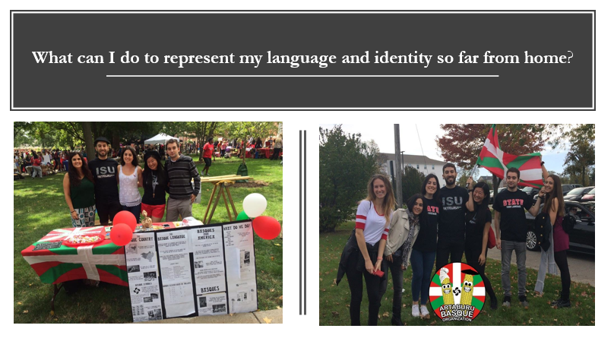

Slide 17
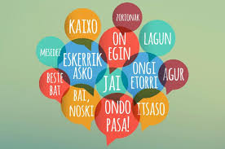
EUSKERA 1.0
Non Indo-European language
Easy spelling (phonetical)
  5 vowels: a, e, i, o, u (Welsh w)
  No: c, v, ñ, ll, q, y, w
  Special combinations: ts, tz, tx (English ch)
  X = English sh
No prepositions but declination
Examples:
  • Aberystwyth oso bizia da = Aberystwyth is very lively
  • Aberystwythek leku interesgarri asko dauzka = Aberystwyth has many interesting places
  • Aberystwythen nago = I am in Aberystwyth
Sentence structure - SOV: Subject + Object + Verb (very flexible)
Examples:
  • Alex Aberystwythen bizi da → Alex lives in Aberystwyth
  • Aberystwythen bizi da Alex → Alex lives in Aberystwyth

Slide 18
EUSKERA 1.0
Kaixo! - (Helo!)
Egun on – (Bore da)
Arratsalde on- (Prynhawn da)
Gabon- (Nos da)
Ongi etorri - (Croeso)
Zer moduz? - (Sut wyt ti?)
Eskerrik asko! - (Diolch in fawr yawn!)
Barkatu – (Sori)
Agur! - (Hwyl!)
Nola duzu izena? – (Pwy dych chi?)
Ni Jaione naiz- (Jaione dw i)
“Basque also boasts some of the most poetic compound words I have ever come across. Take ilargi (moon), a mystical blend of hil (dead) and argi (light), meaning “light of the dead.” Or maitemindu (to fall in love), which captures both the beauty and pain of love, combining maite (beloved) and min (pain). And hodeiertz (horizon) evokes a stunning image of the boundary between sky and earth, merging hodei (cloud) and ertz (edge).”
https://www.leveraginglanguages.com/post/euskera-s-revival-a-community-s-fight-to-keep-a-language-alive

Slide 19
The study
jaione.diazmazquiaran@monash.edu

Slide 20
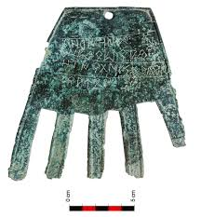
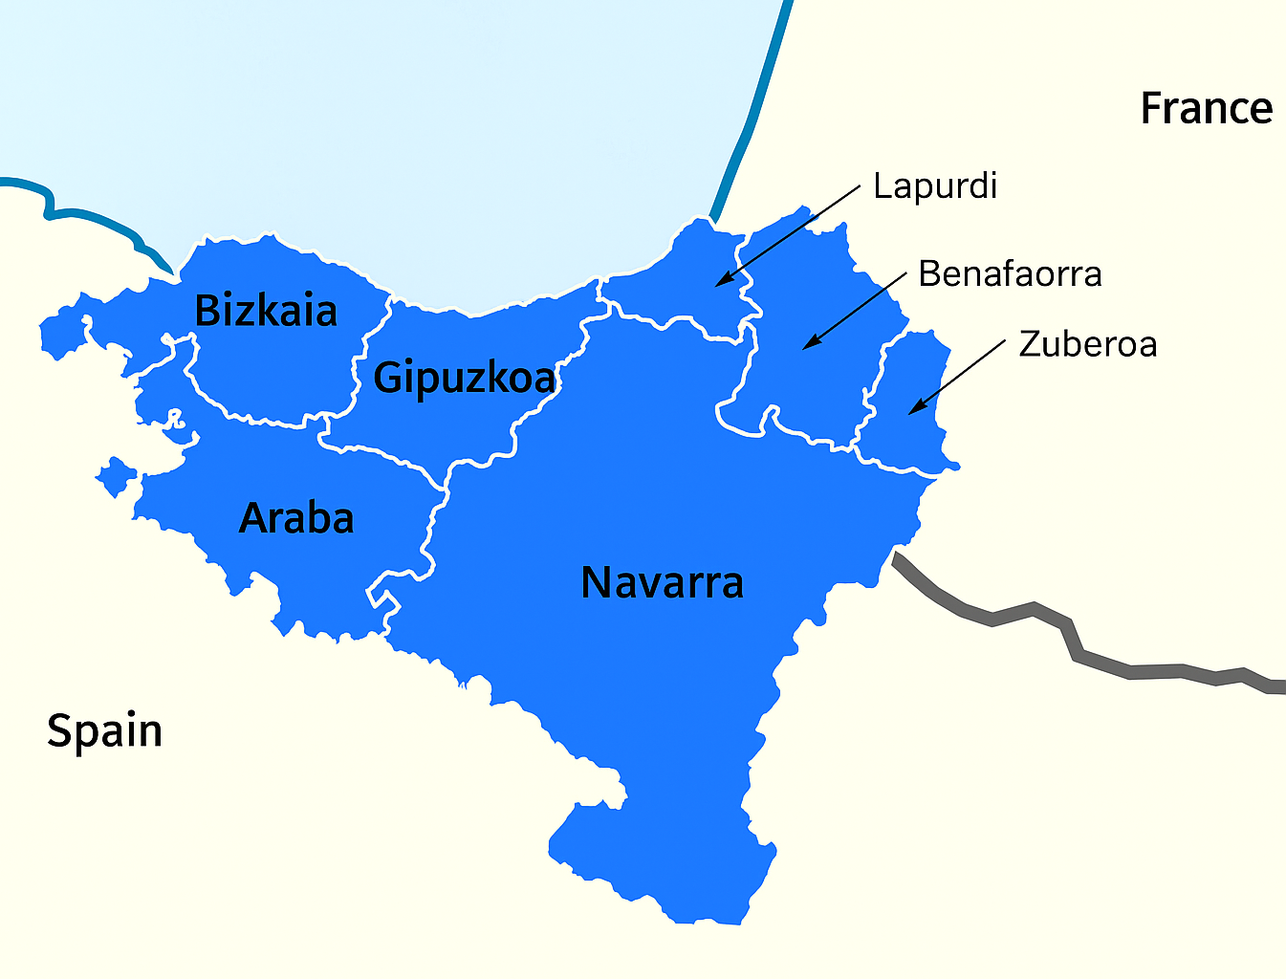
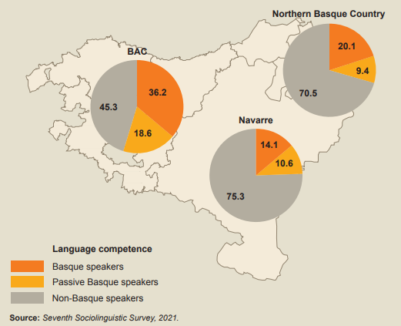
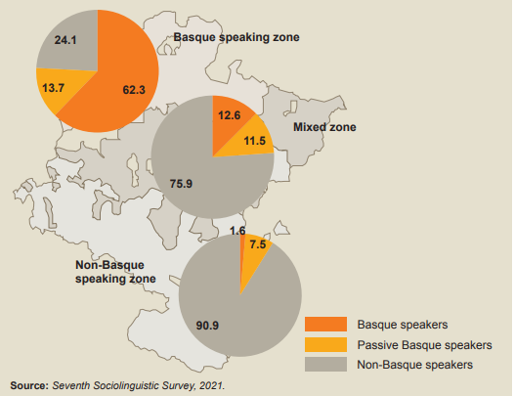
SOCIOLINGUISTIC CONTEXT IN NAVARRE
Irulegiko eskua (2021) and its famous inscription “sorioneku”, one of the earliest known written examples of the Basque language
The three linguistic zones

Slide 21
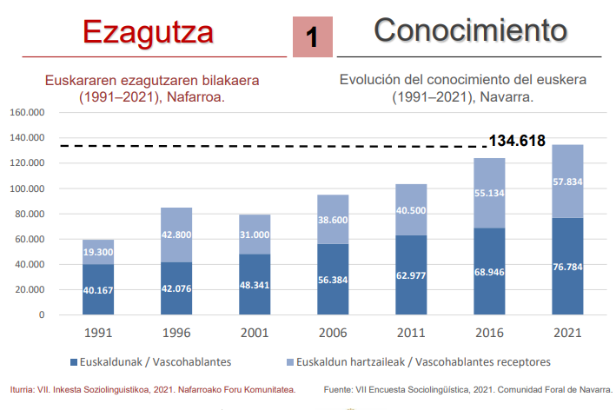
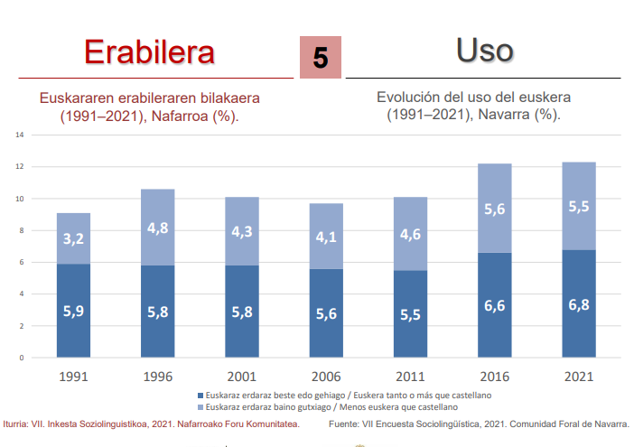
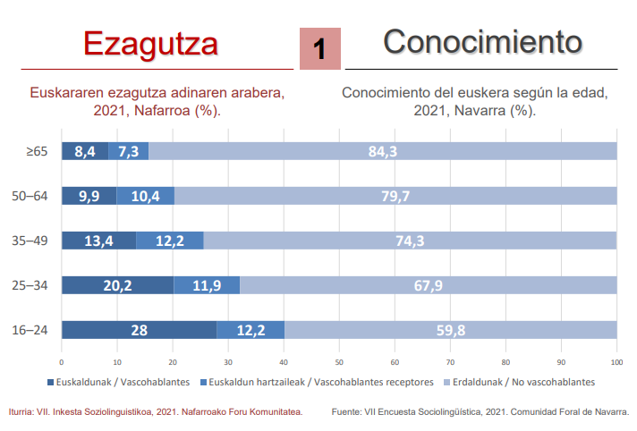
SOCIOLINGUISTIC CONTEXT IN NAVARRE

Slide 22
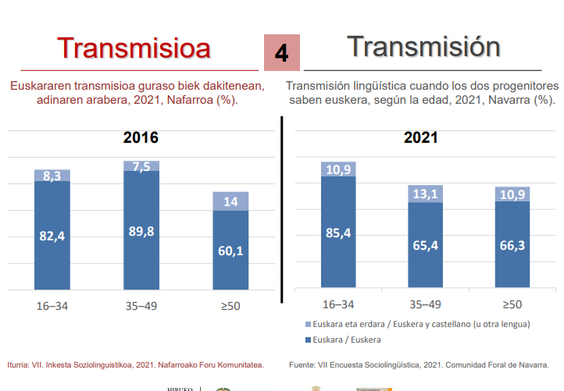
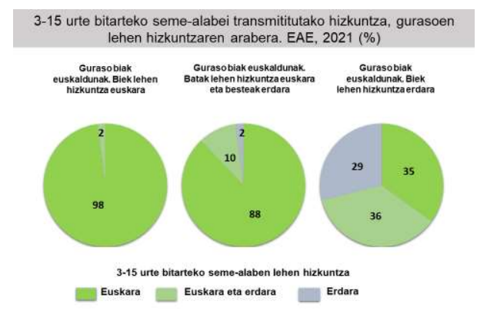
SOCIOLINGUISTIC CONTEXT IN NAVARRE

Slide 23
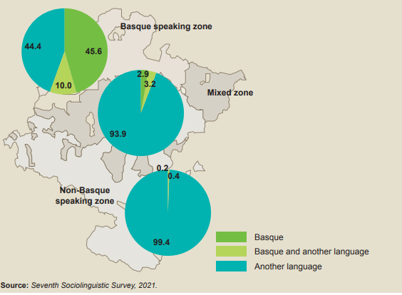
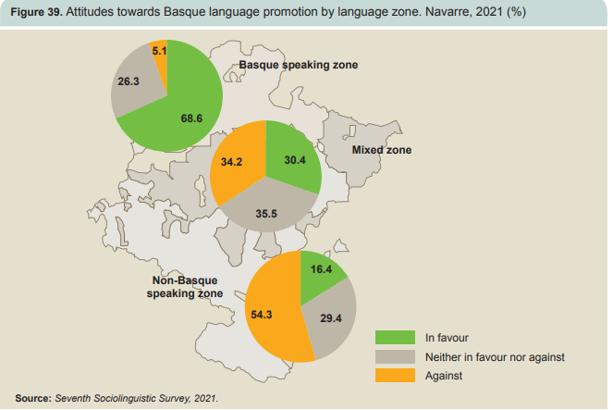
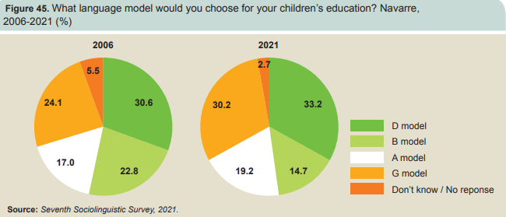
EDUCATIONAL CONTEXT
Increase in Model D enrolments.
Families from migrant background encouraged to enrol their children in Model D – specially in the Basque-speaking zone.
The social, functional and integrative value of Basque.
In Navarre, 20.6% of Primary Education students enrolled in public schools are of migrant origin (Nafarroako Gobernua, 2025).
The majority of these students come from Spanish-speaking countries in Latin and South America, followed by people from Morocco, Portugal, China and Romania (Ikuspegi, 2020).

Slide 24
RESEARCH GAP IN THE STUDY
In the Basque context, the complex dynamics between parental aspirations for the societal integration of their children, teachers’ challenges in balancing language policies with their students’ needs, and students’ struggles to reconcile their multilingual linguistic identities remain underexplored.
Little is known about how migrant learners—both Spanish and non-Spanish speakers—relate to Basque and the other languages in their multilingual repertoires, insights that are essential for leveraging their full linguistic resources to support learning.
Goal: To cultivate environments where linguistic plurality is normalized and pedagogical translanguaging is sustainable, placing the use and knowledge of Basque at its core

Slide 25
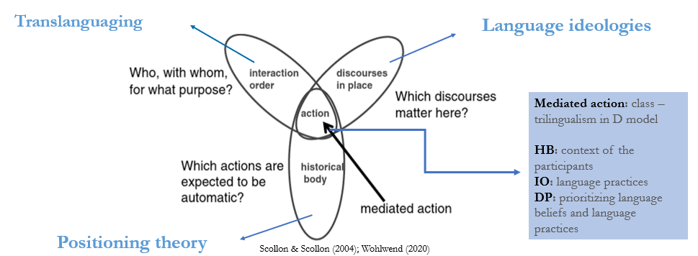
CONCEPTUAL FRAMEWORK AND STUDY DESIGN
Qualitative case study based on ethnographic methods: Nexus analysis and three conceptual lenses
  Participants’ language practices
  Different language perceptions and expectations
  Institutional structures
  How do discourses intersect across scales in this context?

Slide 26
LINKING NEXUS ANALYSIS TO THE RQ, CONCEPTUAL FRAMEWORK AND DATA COLLECTION METHODS
Component of NA | Research sub-question | Conceptual lens | Data collection method
Historical body of participants | 1. How do pupils from migrant families in the Basque Country relate to the languages in which they interact at home and at school? | Positioning Theory (reflexive and interactive) | Interviews; identity texts
Discourses in place | 2. How do parents and teachers’ language expectations relate to the ways in which these students use language(s) at school, and do these align ? | Language ideologies (Ruiz, Lo Bianco, De Jong) | Interviews
Interaction order | 3. What are students’ language practices in informal interactions during playground time and in formal classroom instruction at school, and how are these enabled and/or constrained? | Translanguaging & Bourdieu | Observations (classroom & playground)
How are students’ language practices in language and content-area classrooms mediated by their perceptions of language and the expectations of their parents and teachers?

Slide 27
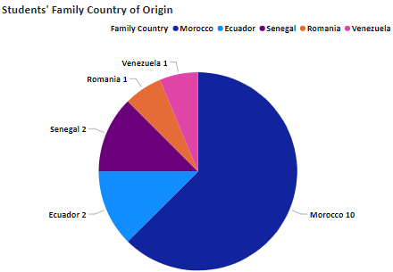
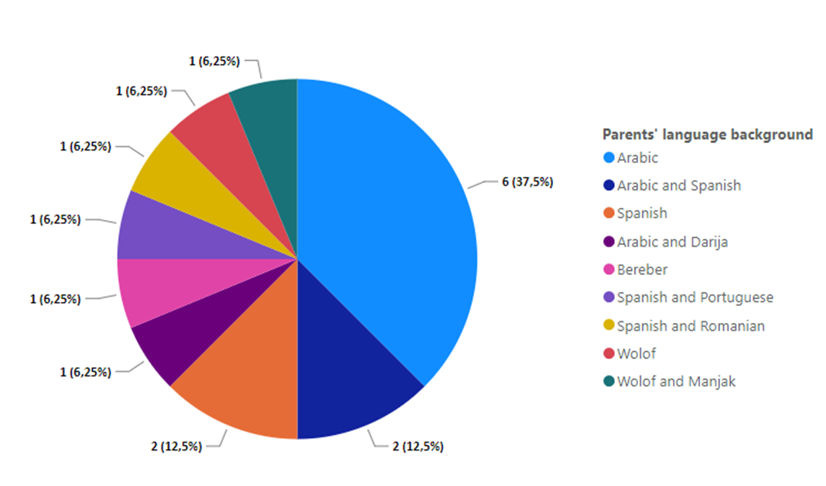
PARTICIPANTS
16 students
15 families
10 teachers (generalist and specialist)

Slide 28
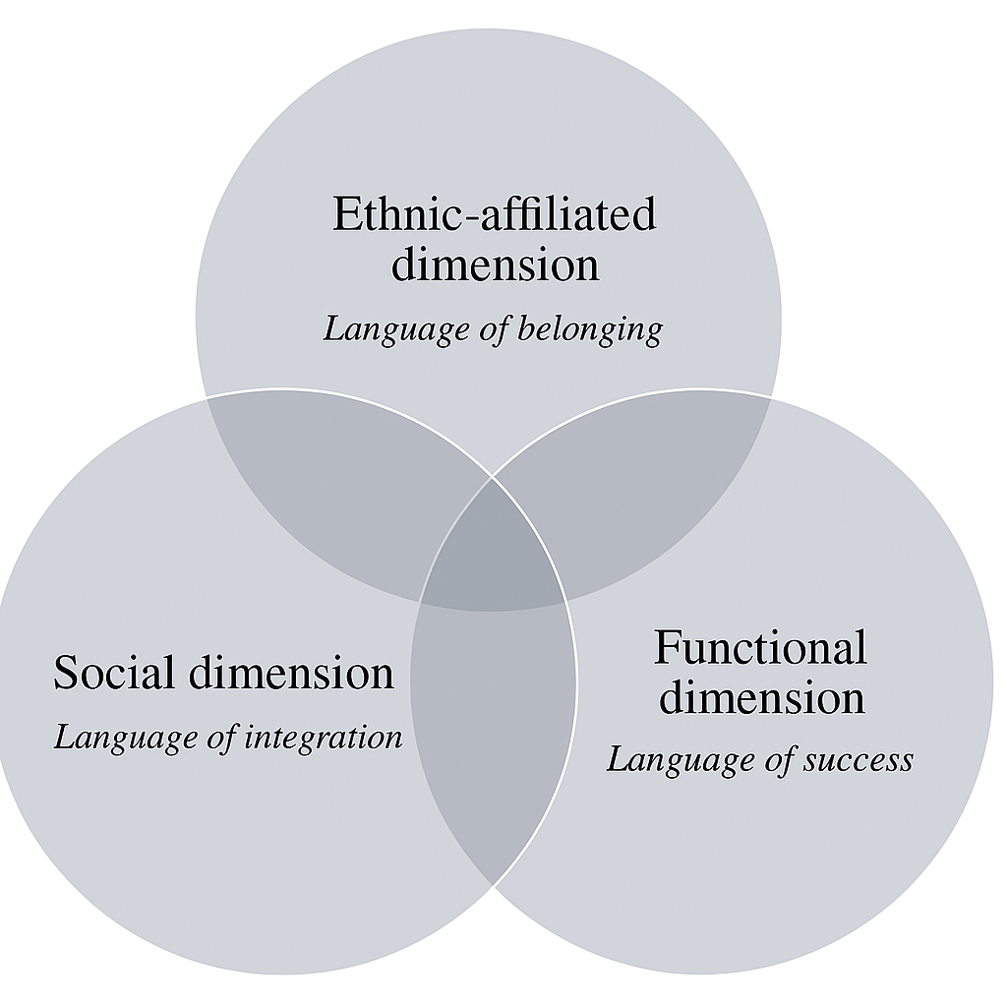
FINDINGS- RQ1
How do pupils from migrant families in the Basque Country relate to the languages in which they interact at home and at school?
Students’ relationships with their languages are complex, multilayered and evolve over time. Different degrees of emotional attachment across dimensions, their attitudes show varying levels of preference and predisposition for each language.
  Home language: Reflects ethnic identity; some students show strong emotional attachment, linking it to belonging and group membership.
  Basque
    -Non-Spanish home language students: Deep connection, used for social integration and making local friends.
    -Spanish-as-home language students: Seen as functional, tied to school success; can feel like a barrier to self-expression.
  Spanish: Mainly in the social dimension. Offers opportunities (e.g., language brokering for parents) or threats (interfering with home language or Basque).
  English: Linked to the functional dimension, associated with international opportunities and broader communication.
Students’ perceptions towards languages

Slide 29
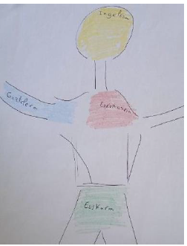
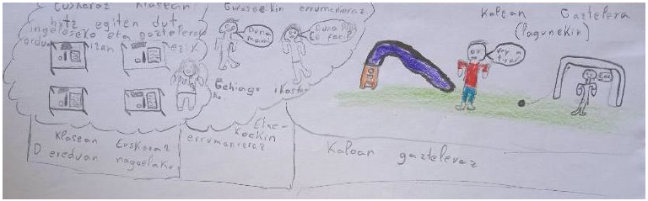
FINDINGS- RQ1
How do pupils from migrant families in the Basque Country relate to the languages in which they interact at home and at school?
Perceptions towards home language
“For me Romanian is very important because I can communicate with my family, specially my grandparents […] I would like more people to know Romanian so that I can also use the language while being here, not only when I am back in Romania […] My parents don’t give that much importance to Spanish because I already know it very well, same as Basque, so they speak more to me in Romanian.” (Andrei, 10).

Slide 30
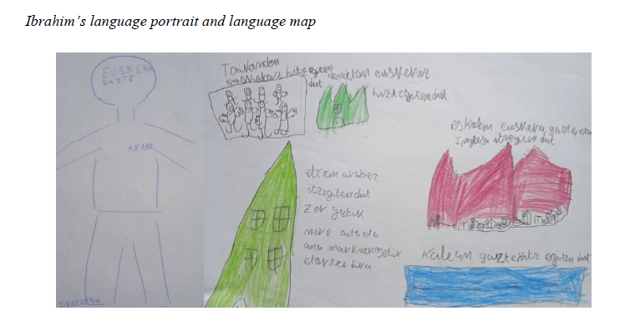
FINDINGS- RQ1
How do pupils from migrant families in the Basque Country relate to the languages in which they interact at home and at school?
Perceptions towards home language
“My parents say the most important thing for us is Arabic because I am Muslim, it is my religion and I need to learn it. Arabic is very important to me and I use it a lot, also to communicate with my family”
(Ibrahim, 10).

Slide 31
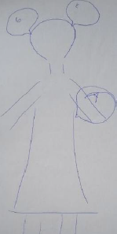
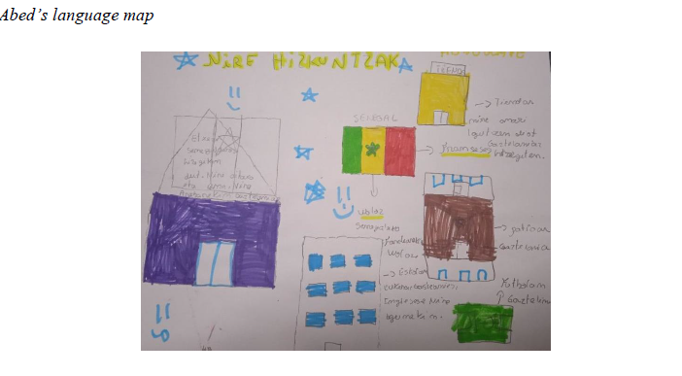
FINDINGS- RQ1
How do pupils from migrant families in the Basque Country relate to the languages in which they interact at home and at school?
“I help my parents with translations, for example when we go shopping, or with they speak with their local friends… I listen and tell them what they need to understand, I use Wolof to help my mum in shops and then tell the vendors what my mummy wants in Basque. That way it is possible to speak to friends from here” (Abed, 9).
Perceptions towards Basque
“When a classmate’s parents speak to my mum in Basque, or when we receive emails and phone calls from the school in Basque, I explain what they mean to her. Dad doesn’t know Basque either so I also help him translating” (Nadia, 9).

Slide 32
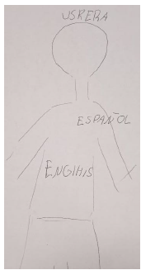
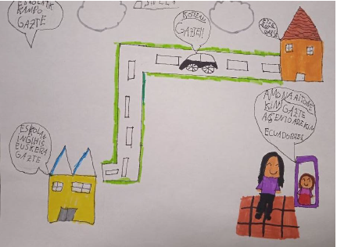
FINDINGS- RQ1
How do pupils from migrant families in the Basque Country relate to the languages in which they interact at home and at school?
Perceptions towards Basque
“Spanish is my home language. It doesn’t mean that I completely hate Basque, it’s more the trauma behind it, especially when my parents changed me from A to D model. I lost my friends. I know a little bit of Basque but in 4th grade things are getting to be complicated, at home I need the translator all the time when doing homework. I can’t tell things because I can’t explain myself in Basque and I am fed up. Also, I am starting to forget words in Spanish because now everything is in Basque” (Ari, 9).

Slide 33
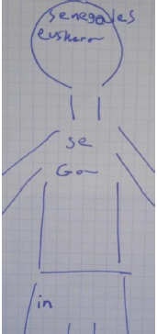
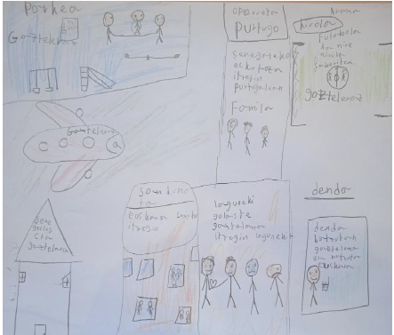
FINDINGS- RQ1
How do pupils from migrant families in the Basque Country relate to the languages in which they interact at home and at school?
Perceptions towards Spanish
“My father gets angry if I speak in Spanish at home. He says that we are not Basque nor Spanish, we are from Senegal and we need to know the language not to forget about our roots. I feel they don’t like much Spanish, so I try using Wolof with them at home as much as possible […] I think that in class, what would help me the most would be for teachers to say things in Basque and Spanish, it would help me understand more easily and know more vocabulary as I feel behind my classmates many times” (Amina, 11).

Slide 34
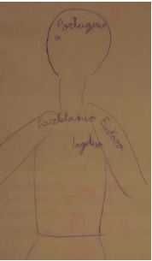
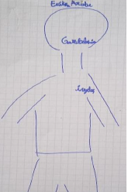
FINDINGS- RQ1
How do pupils from migrant families in the Basque Country relate to the languages in which they interact at home and at school?
Perceptions towards English
“My favourite languages right now are English and Portuguese, because I really want to know more, as a challenge because they are difficult languages, especially English. I want to use it in the future when I travel and become a person who can speak many, many languages” (Carlos, 10).
“Personally, I would pick English to know more, I find it easy to learn. Many people speak it in many different countries and I just love it. I want to travel the world when I grow older” (Nabil, 10).

Slide 35
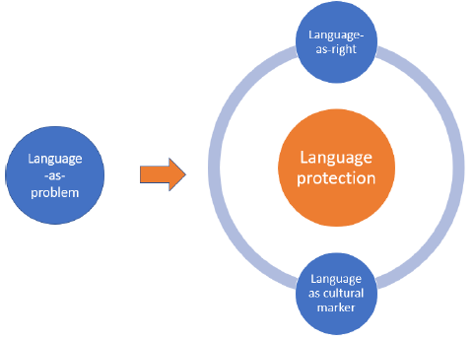
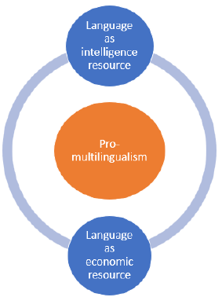
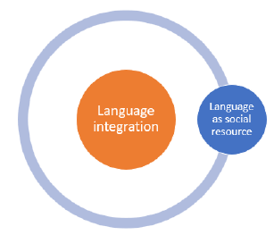
FINDINGS- RQ2
How do parents’ and teachers’ language expectations relate to the ways in which immigrant students use language(s) at school, and do these align?
Language integration
Local languages serve as key tools for social integration and communication.
Language protection
Pro-multilingualism
Minoritized or heritage languages must be protected from the dominant language, which is seen as a threat to cultural identity and linguistic rights
Individuals’ multilingual abilities are holistic and beneficial, emphasizing the cognitive and economic value of knowing multiple languages.

Slide 36
FINDINGS- RQ2
How do parents’ and teachers’ language expectations relate to the ways in which immigrant students use language(s) at school, and do these align?
Parents
Few times home literacy practices were closer to monolingual beliefs- language protection of minoritized home languages as markers of cultural and religious identity.
A common pro-multilingualism ideology: languages as tool for success. Higher allowance of language flexibility, some cases transitioning to local languages (Moroccan families)
High expectations for their children’s academic performance, but low involvement at the school
“At home we speak Arabic. To speak with children, we use Arabic. It is their home language, they need to know it. We pray in Arabic, but they need to learn how to read and write it to read the Coran. Omira only knows how to speak in Arabic […] She attends lessons on the weekend. We also like her to know more languages, so she goes to after-school robotic lessons in Basque and English lessons at an academy” (Omira’s father, Morocco).
“I knew that if we were going to stay here, Basque was essential for them, for school and future jobs. However, my kids are not feeling that love towards Basque but a rejection towards it. It is mandatory at school, which creates pressure towards speaking it. Some local kids told Benjamin “If you don’t speak in Basque we are not going to talk to you.” They really feel marginalized. I don’t get along with parents of local kids either, they tend to shift languages in parent meetings. By now I have learned to accept and live with it” (Benjamin’s mother, Ecuador).

Slide 37
FINDINGS- RQ2
How do parents’ and teachers’ language expectations relate to the ways in which immigrant students use language(s) at school, and do these align?
Teachers
Pro-monolingual protective beliefs of Basque and strong attachment to educational policies- symbol of being euskaldun
Advocating pro-multilingual beliefs, claiming not to be discriminatory- multilingualism is natural and enriching.
Valuing communication over linguistic purity during content lessons- this could reveal tensions between policy adherence and practical classroom needs.
No mention of pedagogical translanguaging in the classroom but request for more teacher training.
“I always speak in Basque, with local and immigrant students alike, even if it is difficult with the latter. I think parents should sometimes be held accountable for these difficulties. But they decided to enroll their children in the D model for a reason. Plus, the school is a Basque-only zone. They need Batua to do well in their subjects. We see what happens in the hallways, playground, they speak nothing but Spanish. I have a performance show everyday where I am Iker 1 in Basque lessons, and Iker 2 in Spanish lessons” (Iker, Generalist).
“I am quite flexible; in language lessons we talk about aspects of the language itself, so we use Basque and I focus on its correct use…but I can’t tell them ‘Don’t speak a word in Spanish’ during other subjects. They wouldn’t speak at all and I value communication and the interaction between them. They speak a lot of Spanish outside of the class at home and with friends, which is detrimental to the maintenance of Basque, but you have to balance. Do you want a good environment in class over the language they are using?” (Marta, Generalist).

Slide 38
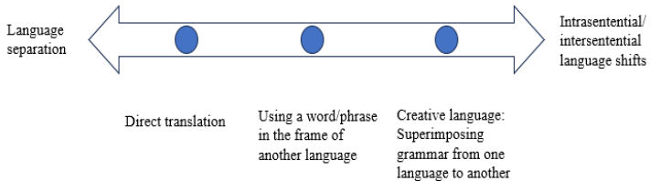
FINDINGS- RQ3
What are immigrant students’ language practices in informal interactions during playground time and in formal classroom instruction at school, and how are these enabled and/or constrained?
Students engaged in language separation when giving answers to specific activities, specially in language lessons.
Students moved between intra/inter-sentential language shift and fluid shifts to support their own argument when reasoning and thinking.
Students used Basque for meaningful purposes and communication goals
Teachers using recast strategies to stick to Basque-only use. Policing of Basque in Basque lessons more than content lessons.
Language fluidity in English lessons- only legitimizing certain forms of multilingualism- Basque as scaffolding tool.
There were some instances of Basque policing on behalf of their local classmates during collaborative activities
Spanish was very present in student-student interactions in group work, board-game activity and playground.
No instance of home languages other than Spanish was observed.

Slide 39
FINDINGS- RQ3
What are immigrant students’ language practices in informal interactions during playground time and in formal classroom instruction at school, and how are these enabled and/or constrained?
1. Teacher: “Eta nola amaitzen da istorioa, Benjamin?” [And how does the story end, Benjamin?] 2. Benjamin: “Pues susto bat… pues es que ez dakit…” [There is a fright…well I don’t know…] 3. Teacher: “Agian berriz irakurri beharko duzu ez?” [Maybe you will have to read it again, right?] 4.Teacher: “Orain gazteleraz. ¿Qué le gustaba hacer a Mariela?” [Now, in Spanish. What did Mariela like doing?] 5. Benjamin: “Le gustaba leer” [She liked reading] 6. Teacher: “Bai? Hori ulertzen da, Nadia? ¿Y tranquila, qué significa? Lasai egotea ez?” [Yes? Did you understand, Nadia? And patient, what does it mean? To be calm, right?] 7. Nadia: “Bai.” [Yes]
Basque Spanish
Spanish lesson at Mendia Eskola
Language separation
Direct translation
Using a word/phrase in the frame of another language
Fluid shift of languages: intra/intersentential shifts

Slide 40
FINDINGS- RQ3
What are immigrant students’ language practices in informal interactions during playground time and in formal classroom instruction at school, and how are these enabled and/or constrained?
1. Benjamin: “…con h, …sin h” [with h…. without h…] 2. Ibrahim: “A ver si te gusta…espérate…kontuz e…” [Let’s see if you like it… wait… be careful] 3. Alif: “Con h…” [with h] 4. Nadia: “No corras tanto que igual está mal, begira zer dagoen” [Don’t rush because maybe it’s wrong, look at this] (…) 5. Nadia: “Ahurra h-rekin” [‘Ahurra’ with h] 6. Teacher: “Oso ongi” [Very well]
1. Bashir: “¿Tú cuál dirías?” [Which one would you say it is?] 2. Local Student 1: “2, 4… es 1 …” [2, 4…. it’s 1] 3. Bashir: “Hablamos en Euskera que tenemos una persona…” [Let’s talk in Basque because we have a person…] 4. Local Student 2: “Ikastetxe batek… zer da hau?” [A school… what is this?] 5. Bashir: “No sé no sé… espera espera… al 5 creo que no da” [I don’t know I don’t know… wait wait… I think it can’t be 5] 6. Local Student 1: “¡Trae la calculadora!” [Bring the calculator!] 7. Local Student 2: “Bashir, euskeraz!” [In Basque!] 8. Bashir: “¡Iván, trae la calculadora!” [Ivan, bring the calculator!]
Basque Spanish
Basque lesson at Mendia Eskola
Basque Spanish
Math lesson at Lorea Eskola
Language separation
Direct translation
Using a word/phrase in the frame of another language
Fluid shift of languages: intra/intersentential shifts

Slide 41
DISCUSSION POINTS
How are students’ language practices in language and content-area classrooms mediated by their perceptions of language and the expectations of their parents and teachers?
1) Alignment and flexibility:
When parents and teachers share complementary linguistic goals, students experience balanced multilingualism, strong cultural belonging, and high linguistic competence. Flexible alignment allows heritage and Basque language use to coexist productively. Students aware of legitimate modes of expression in each context.
2)Misalignment and tension:
Divergent expectations—teachers enforcing strict Basque immersion vs. parents valuing Spanish for identity and Basque for academic success—create student uncertainty and selective bilingualism. Such tension mirroring parents’ ambivalence can lead to compartmentalized or hesitant and insecure Basque use, lack of confidence, reflecting home language norms. Spanish-infused linguistic choices.
3)Toward multilingual integration:
When teachers accommodate students’ linguistic resources (selective translanguaging) and parents promote multilingualism (e.g., Nabil’s case), students develop empowered, flexible linguistic identities and exert agency in linguistic choices (more fluid shifts between languages). Recognizing all languages as assets supports confidence, belonging, and agency across all languages in their repertoire.

Slide 42
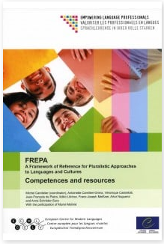
IMPLICATIONS
Support and empower teachers
  Provide focus groups opportunities with guidance and professional development to help teachers balance policy demands with classroom realities. Foster teacher agency in implementing multilingual approaches (Gartziarena & Altuna, 2023; Kirsch, 2018)
  Establish realistic, context-sensitive expectations for the learning and teaching of Basque and other languages, considering holistically both local and pupils from migrant backgrounds. Higher level, more grammar/ prioritizing oral skills. Remedial language classes?
  Move from language knowledge to active language use- How can we call on institutional and administrative support?
Foster whole-school, multilingual strategies
  Learn about students’ linguistic and cultural backgrounds and use tools like identity texts to recognize their abilities and experiences (D’Warte, 2020).
  Design comprehensive, school-wide approaches that value all languages present in the community- school linguistic landscape (Little, 2024). Useful tools: European Language Portfolio (ELP), UNESCO Multilingual Education Guidance, and CARAP-FREPA (Framework of Reference for Pluralistic Approaches to Languages and Cultures)
  Intervention- sustainable pedagogical translanguaging to normalize multilingualism and support both minority and home languages while ensuring breathing spaces for Basque, measure results
Strengthen Home–School communication
  Build trust and open dialogue between families and schools through exchange of sociocultural and linguistic information, recognizing language and cultural barriers (Pérez-Izaguirre, 2018).
  Encourage communication between parents and children about what they have learned. Try to be in contact with Basque outside of school: media, apps, local events, festivities, gigs…
  Increase participation and collaboration between local and migrant families- appoint a “Basque support” contact. Promote inclusive after-school events, multilingual reading events, language workshops, cultural celebrations supporting children’s cultural and social adaptation

Slide 43




CLASSROOM DYNAMIC
Objectives:
  Reflect on the Basque sociolinguistic and educational context, any similarities with Cymru?
  Reflect on the situation of Cymraeg and activities/initiatives for its promotion
  Identify key sectors, stakeholders, challenges, and opportunities
  Explore key factors to get the activation of speakers for the language through local initiatives
  Generate actionable strategies across sectors
SECTOR | BASQUE EXAMPLE | CURRENT SITUATION IN CYMRU | POTENTIAL ACTION
Education
Media
Policy
Community

Slide 44
CLASSROOM DYNAMIC
Basque context
Strong institutional support + community engagement
Media visibility reinforces language use
Bilingual education requires trained teachers and resources
Socioeconomic incentives encourage uptake
Cymru context?
Current use of Welsh in education, media, workplaces
Policy and government support
Socioeconomic status of speakers
Community attitudes
Key stakeholders: How to engage high-influence/low-interest or empower high-interest/low-influence actors?

Slide 45
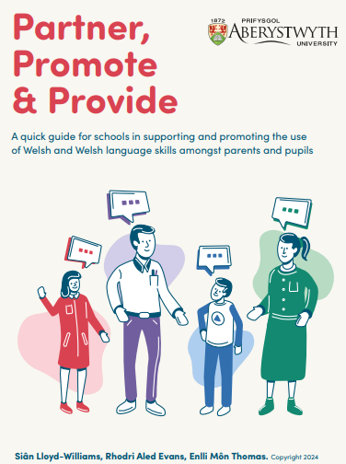
CLASSROOM DYNAMIC
Please fill in the two questions bellow. We will then discuss them as a group. Follow the link:
https://www.menti.com/ale2s3e52yqq
Effectiveness of its use
Street measurement
Knowledge vs use of language
Effectiveness of initiatives to promote the language
Social media initiatives and apps
Community engagement and cultural promotion
Socioeconomic dimensions: prestige, employment, urban vs rural
Lloyd-Williams, S., Evans, Rh. A., and Thomas, E. M. (2024) Partner, Promote & Provide: A quick guide for schools in supporting and promoting the use of Welsh and Welsh language skills amongst parents and pupils. Aberystwyth University

Slide 46
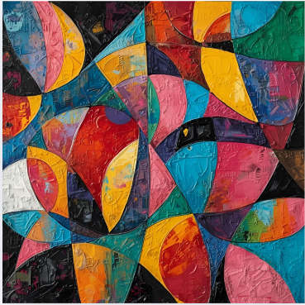
Diolch!
Eskerrik asko!

