Slide 1
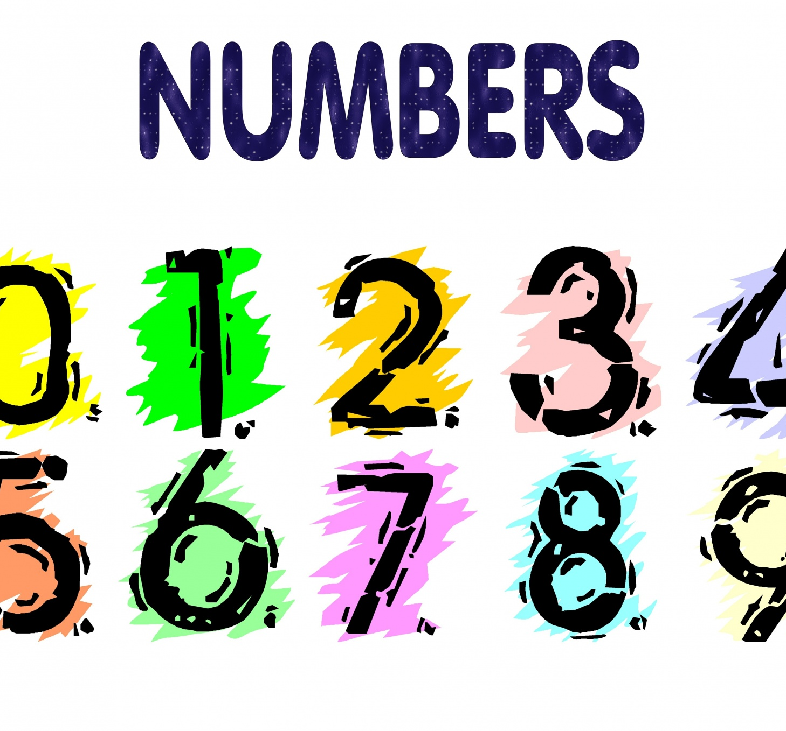
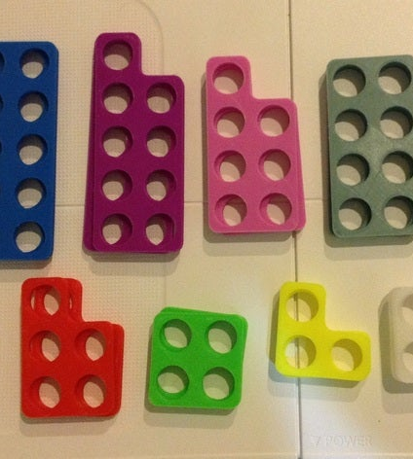
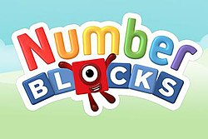
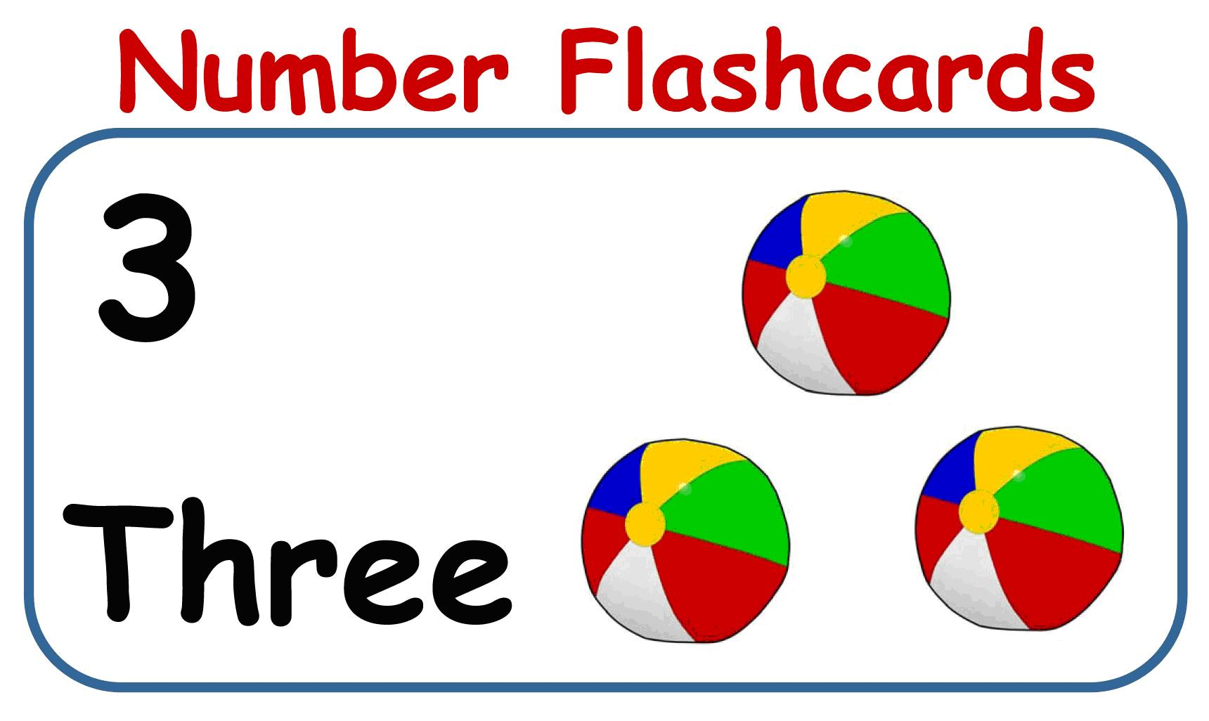
Presentation of Resource Pack
Numbers count
SJIE5001
By Lisa Knight
1910193

Slide 2
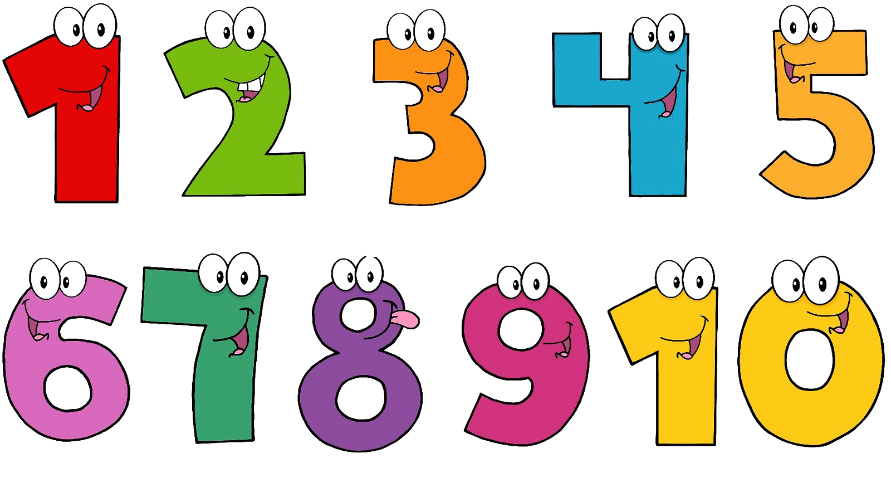
Aims & Objectives
The aim of this presentation is to discuss how numicon can act as an effective resource, in supporting children aged between 3-7 facing difficulty with numeracy.
Objectives:
Discuss the purpose of numicon
Analyse how numicon can be used to develop knowledge, skills and understanding
Demonstrate how numicon can be used to assess the progress of learners
Critically reflect on the effectiveness of numicons in the classroom

Slide 3
What is Numicon?
The aim of Numicon is to make numbers real for children through them being able to see and touch them. It fits in with the Maths Mastery approach that’s used in many schools, providing a concrete object to represent each number. Numicon are brightly coloured shapes , each representing a number from 1-10. It also has a multi-sensory approach that’s known to help learning.
(The Schoolrun, n.d).
Notes:
For example, the number one Numicon shape has one finger hole and the number 10 Numicon shape has ten holes.
since maths is an abstract concept, using can children to make ideas more concrete. This resource is most useful for children with suspected or confirmed additional needs and can be used to support the development of any child.
Numicon resources provide an innovative approach to maths that helps children to visualise numbers and understand the connections between them.
Abstract - Concrete

Slide 4
What skills can numicon help develop?
Children will learn through four stages using numicon:-
Pattern
Ordering
Early calculating
Counting
It can help to develop skills in areas other than numeracy, for example:
Names of colors
Fine motor skills
Confidence & self-esteem
(Oxford Owl, n.d; Numicon, n.d; Wing, 2007)

Slide 5





Learning Outcomes
Foundation Phase
Stage one
Reasoning
Spoken Language
Problem Solving
Stimulus
Shapes
Confidence
Fun
Interactive
Visual
Values
Colours
Numbers
With the chosen resource, children should show some understanding and knowledge of numeracy from what is listed in the diagram .

Slide 6
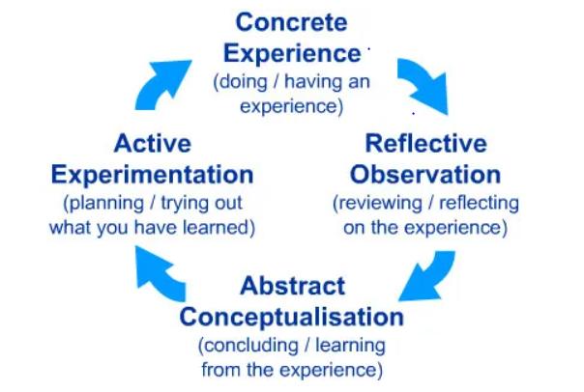
Theory to Practice
McLeod, 2017

Slide 7
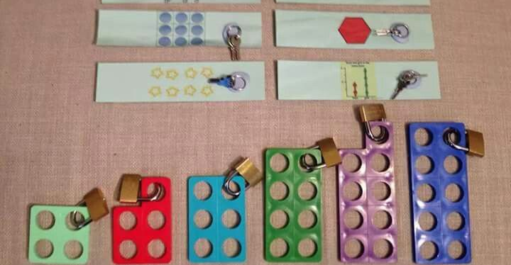
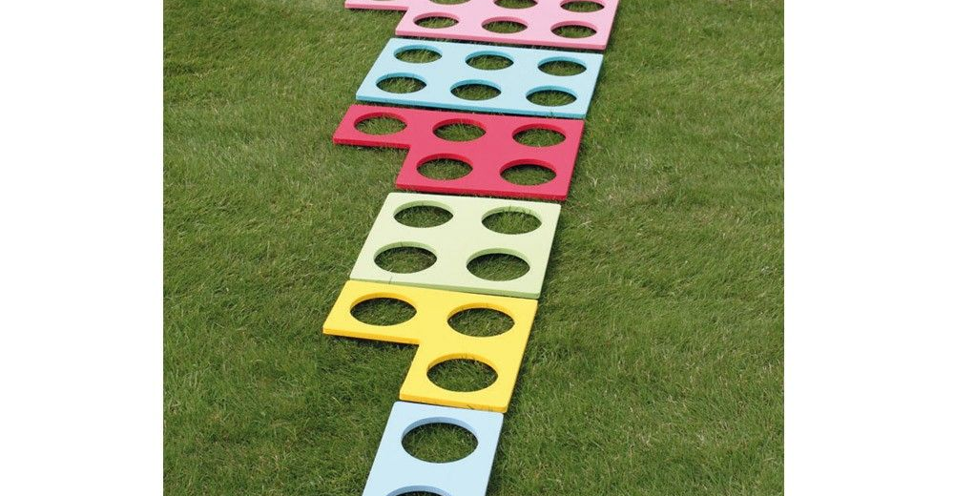
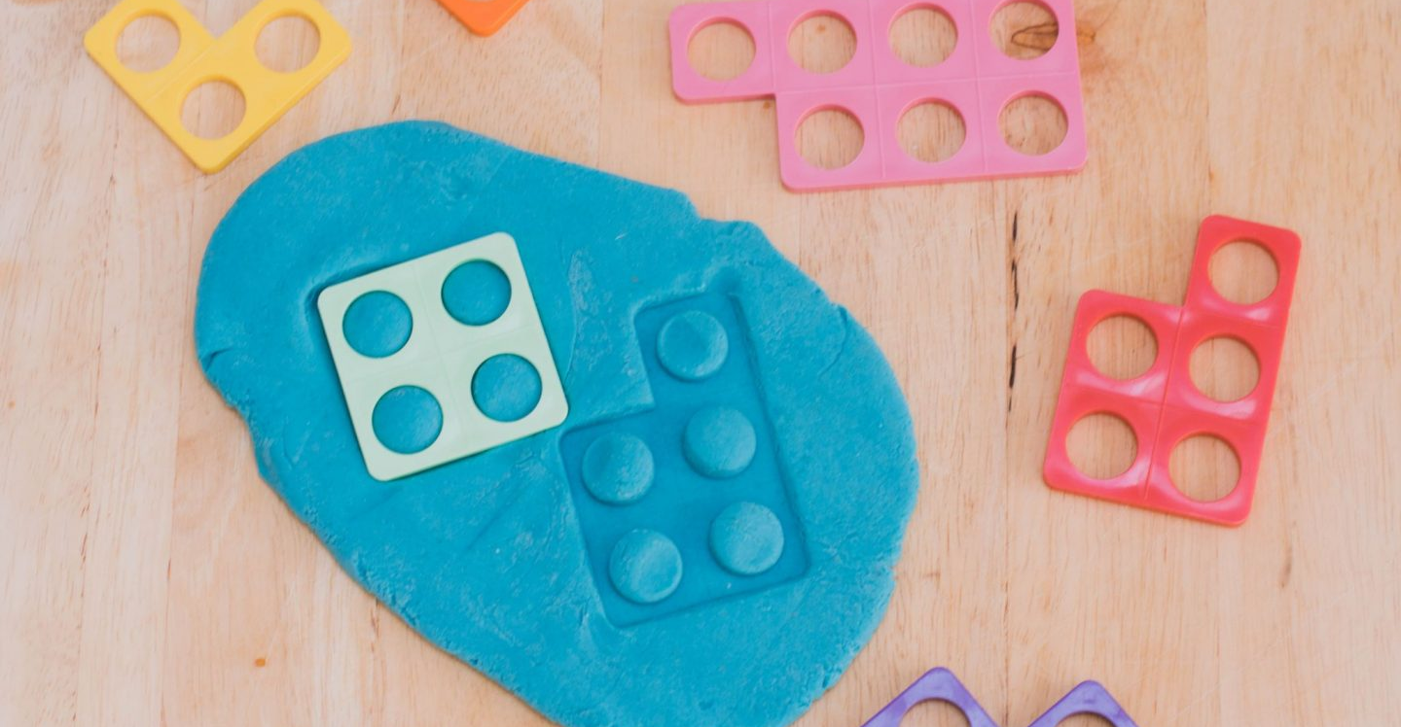
Numicon in practice
Unlock the padlock
Exploring using giant pieces.
Exploring through playdough.
Notes:
Practice fine motor skills, talk about numbers and colour's or just have fun playing with padlocks
Try ordering them, printing with them, filling the holes for counting, beanbag throwing and drawing around the pieces.
You can add a physical dimention to your numicon work .
The children loved rolling the numicon pieces onto the dough and then counting the bumps. This encourages counting and learning shapes.

Slide 8
Barriers to Learning in Numeracy
Some learners may still experience difficulties in learning maths for a number of reasons some factors could be social and environmental factors such as :
Very limited early languages and literacy
Family history of learning disabilities
Sensory and visual impairments
Social and emotional difficulties
Cognitive problems e.g memory loss
Language barrier

Slide 9
Accessing and Monitoring
Observe learners using numicon – monitor using tracking sheet
Review results from formal and informal assessments
Communicate with learners to check their understanding

Slide 10
Critical Evaluation
Using number skills.
Use number facts and relationships.
Estimate and check..
Manage money.
Measure Length, weight/mass, capacity.
Time.
Shape.
Movement.
Pattern.
Calculate using mental and written methods .
Not every child want to learn the curriculum like previously discussed.
Advantages and disadvantages of using numicon

Slide 11
References
McLeod, S. (2017). Kolb's Learning Styles and Experiential Learning Cycle. Available at: https://www.simplypsychology.org/learning-kolb.html (Accessed: 12 January 2021)
Numicon. (n.d). Engaging students in Maths Through hands-on activities with Numicon. Available at: https://www.numicon.co.nz/uploads/66441/files/Engaging_students_in_Maths__NIP__inclusion.pdf (Accessed: 6 January 2021).
Oxford Owl. (n.d). What is Numicon? Available at: https://home.oxfordowl.co.uk/maths/numicon-guide-for-parents/ (Accessed: 6 January 2021).
Oxford Primary School. (2016) Supporting Mathematics in the Welsh National Curriculum Numicon Firm Foundations and the Foundation Phase Mathematical Development Area of Learning. Available at: http://fdslive.oup.com/www.oup.com/oxed/primary/maths/numicon/NumFFWalesFoundation.pdf?region=uk (Accessed: 5 May 2021)
The School Run (n.d). What is numicon? Available at: https://www.theschoolrun.com/what-is-numicon#:~:text=The%20aim%20of%20Numicon%20is,that's%20known%20to%20help%20learning. (Accessed: 12 December 2020).
Wing, T. (2007). ‘Teaching number skills and concepts with Numicon materials.’ Down Syndrome Research and Practice, 12(1), pp. 22-26. DOI: 10.3104/practice.2018

Slide 12
Bibliography
Department for Education. (2020) Mathematics guidance: key stages 1 and 2. Available at: https://assets.publishing.service.gov.uk/government/uploads/system/uploads/attachment_data/file/954511/Maths_guidance_year_1.pdf (Accessed: 2 January 2021)
Dowler, A. (2009). What Works for Children with Mathematical Difficulties? Available at: https://www.catchup.org/resources/735/what_works_for_children_with_mathematical_difficulties.pdf (Accessed: 9 March 2021).
The Highland Council Psychological Service. (2017). Assessment and strategies for teaching Numeracy: Including Pupils with Numeracy Difficulties. Available at: assessment and strategies for teaching numeracy - Highland https://www.highland.gov.uk › identifying barriers. (Accessed: 9 March 2021).

