Slide 1

Initial Pitch
The Team
Bright Nyakamha- Project And Research Manager
Course : Computer Networks and Cyber Security
Sam Wattis- Design, Development and security Manager
Course :Computer Networks and Cyber Security
Ethan Richards- Testing & quality Control

Slide 2
Idea ?
To create a mobile app
The target Market – Business community
End users – tertiary students & Freshers

Slide 3
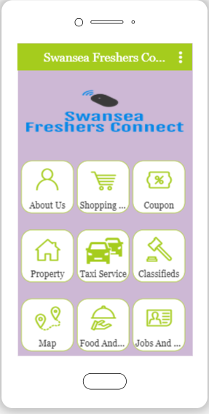
Design illustration
Easy to use interface with navigation icons to business interest area
A point of interest map of business interest
Rating system for users for experience
Sign in/up process
Make text readable and legible
Make navigation simple

Slide 4
Unique Selling points !
idea differentiation?
The app will be specifically tailored to promote only products and services for tertiary institute students.
All in one platform for tertiary students in Swansea.
Classified peer to peer business
Real time communication for business

Slide 5
initial requirements
Initial Requirements
Logo
Sign up and login
App analytics
Navigation Menu
Content material
UI
Native map
Device hardware and access
Roadmap

Slide 6
Design Specification
High Definition Quality images and right aspect ratio
Design for fingers not cursors
Design for an accessible interface aware of colour blindness.
Make app fast and responsive
Make clear when loading is occurring
Optimise push notification
Secure app through encryption and obfuscation
Implement strong authentication

Slide 7
Market
Is There Market ?
The estimated knock on effect of students on the Welsh economy is estimated over £5 billion.
Swansea is home to over 24,000 students studying at Swansea University or University of Wales Trinity St David.
Swansea's population is 244,500 (2016), and is projected to grow to 270,000 by 2036.
There is a niche market open for exploitation that can provide an all in one service that is provided through different
competitors
There are 107,700 people in employment in Swansea. Swansea's status as the regional retail, leisure, educational and[1] administrative centre for South West Wales is reflected in the high proportion of employment in the service sectors

Slide 8
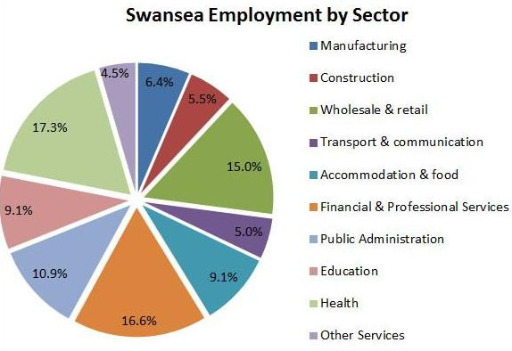
Employment Pie chart

Slide 9
Market
Competitor analysis?
There is competition from platforms such as Gumtree, Zoopla, Universities and Colleges web sites [2]
Swansea myuni arrival app.
UWTSD Hub /MYDAY.
Students Beans .
Save the student .
National union of students .

Slide 10
Planning and production
Hardware resources – computers and mobile phones.
Software –PhoneGap, visual studio.
Programming languages –HTML , CSS & JS .
Cloud server to host the app .
Microsoft project for project tracking .
Human resources- Web Developer, Tester, Project manger .

Slide 11
Business
Trading Name
Swansea Freshers Connect(LLP)[5]
Logo

Slide 12
Business
Slogan
Making Students business make sense !
Legal Classification
App will be designed to adhere to the GDPR requirements
Freshers Connect is a Limited Partnership Co (LLP)
Freshers connect will trademark logo and name.
Will use copyright to protect the apps source code.
User generated content will be screened through correct categorisation
Digital millennium copyright act – it exempts Fresher's connect from direct and indirect liability of internet providers and intermediaries.

Slide 13
Mission Statement
Our mission is to bridge the gap between Swansea students and business community. Empower local business and promote student savings.

Slide 14
Objectives
To create build an interactive mobile application that provides a platform to companies by which they can engage with students in real time.
To provide a classifieds section to enable private sale of goods and services.
To create and students accommodation sharing and renting services within the app.
Services provided by students including fitness training, language tuition and IT help.
Create opportunities for companies to advertise voluntary work, placements and internships
We plan to charge for advertisement? We propose to have a 2 tier system, free and small charge for priority adverts

Slide 15
Team Working and Management
Utilise interactive services of WhatsApp, Microsoft teams, email and mobile telephone.
Weekly team progress reviews.
Share documentation over google drive with read and write rights.
Peer to peer review of tasks. [4]

Slide 16
References
Swansea.gov.uk. (2019). Swansea - Key facts and figures about Swansea. [online] Available at: https://www.swansea.gov.uk/businessfactsandfigures [Accessed 25 Nov. 2019].
Porter,M.(2004).competitive strategy. New York[etc]:The Free Press.
Swansea.gov.uk. (2019). Swansea - Key facts and figures about Swansea. [online] Available at: https://www.swansea.gov.uk/businessfactsandfigures [Accessed 25 Nov. 2019].
Teamwork.com. (2019). Project Management Software for Higher Performance | Teamwork Projects. [online] Available at: https://www.teamwork.com/project-management-software/ [Accessed 1 Dec. 2019].
Lothian, N. (1984). How companies manage R & D. London: Institute of Cost and Management Accountants.

Slide 17
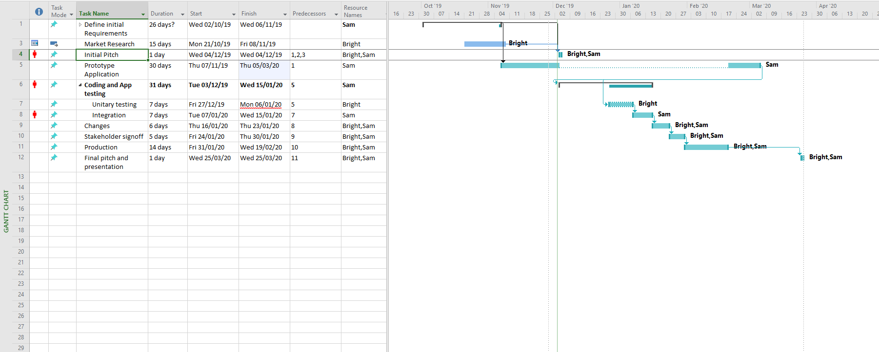
Gantt Chart

Slide 18
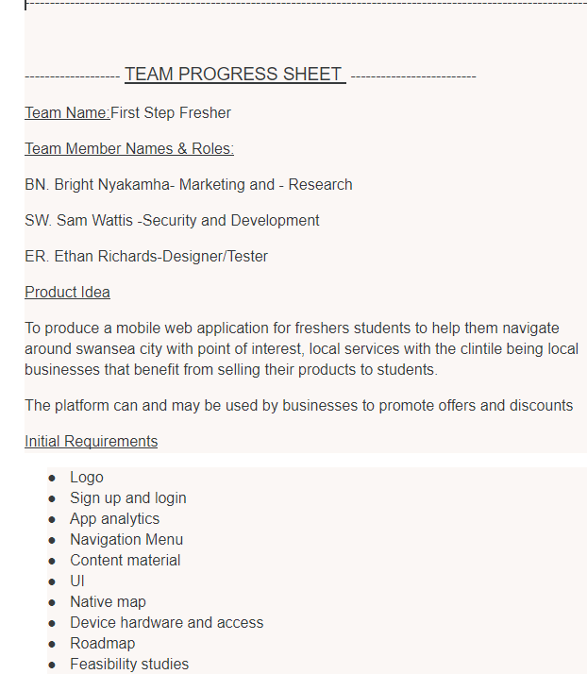
Team Progress Report Sheet

