Slide 1
Bating and Personal Care
User Experience design
George Anderson, Rikeeta Grewal & Luke Servini

Slide 2
The topic of discussion that myself and my group have chosen is bathing and personal care. By first utilising a number of research methods the aim of this assignment is to engage in a conversation that reveals tasks in our everyday lives that can be improved upon through product design.
Understanding the user experience and interaction with a product is key to understanding and engaging in user experience design.
Statement of intent
For this project the main aim is to redesign a bathing or personal care product that ultimately will benefit the end user in, economising time and enhancing performance for ease of use. Ultimately the aim is to design a product that is compact and dynamic

Slide 3
Introduction
What is personal care?
Personal Care includes: assistance with dressing, feeding, washing and toileting, as well as advice, encouragement and emotional and psychological support.
The Department of Work and Pensions (DWP) defines this as attention required in connection with bodily functions. Bodily functions can include dressing, washing, bathing or shaving, toileting, getting in or out of bed, eating, drinking, taking medication, and communicating. Seeing and hearing are also considered to be bodily functions.

Slide 4
LOOK

Slide 5
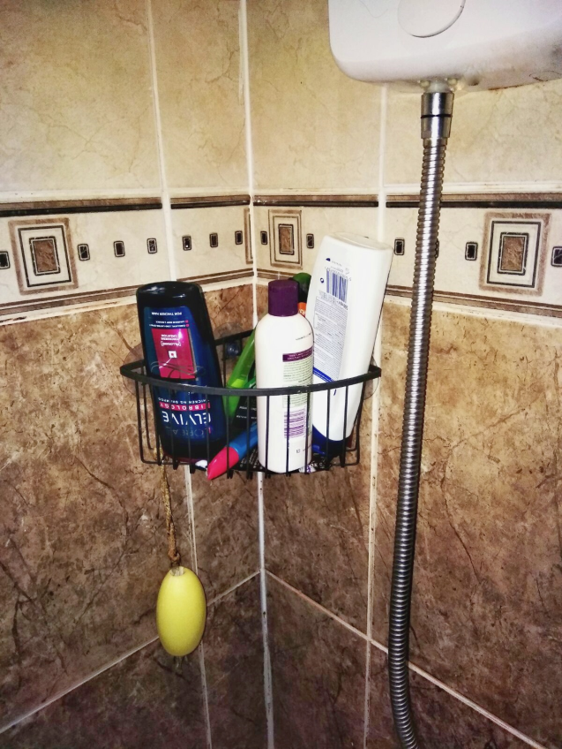
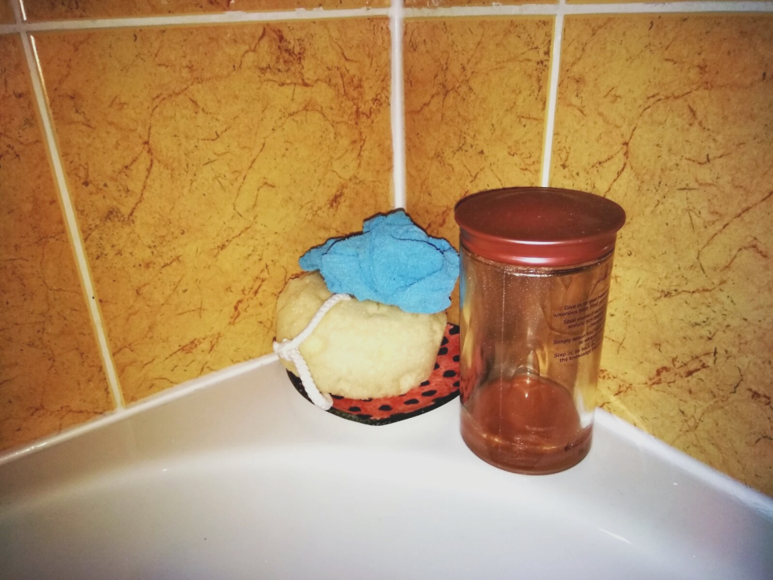
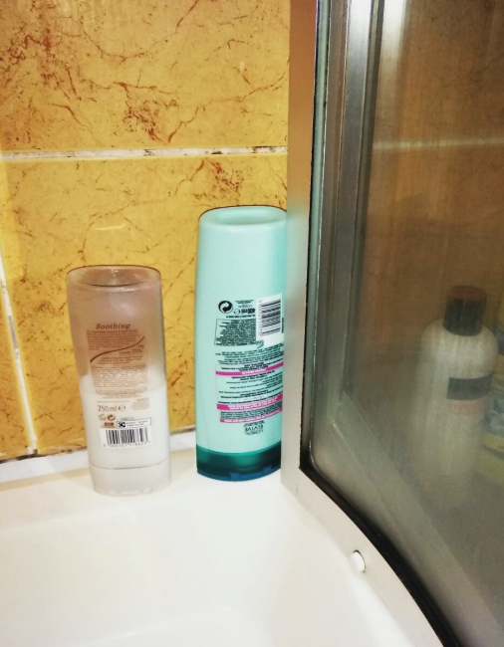
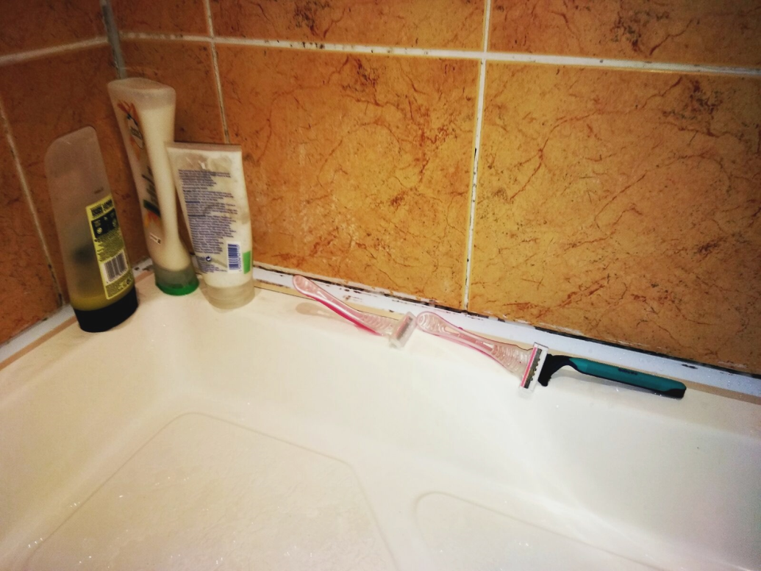

Slide 6
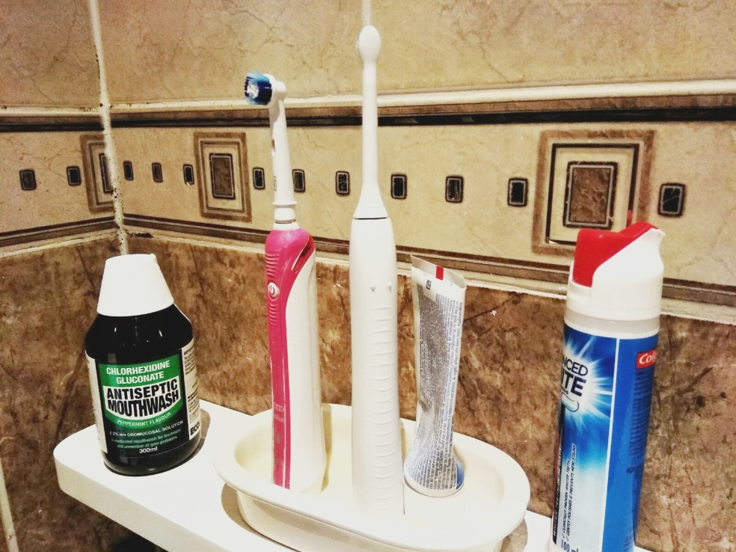
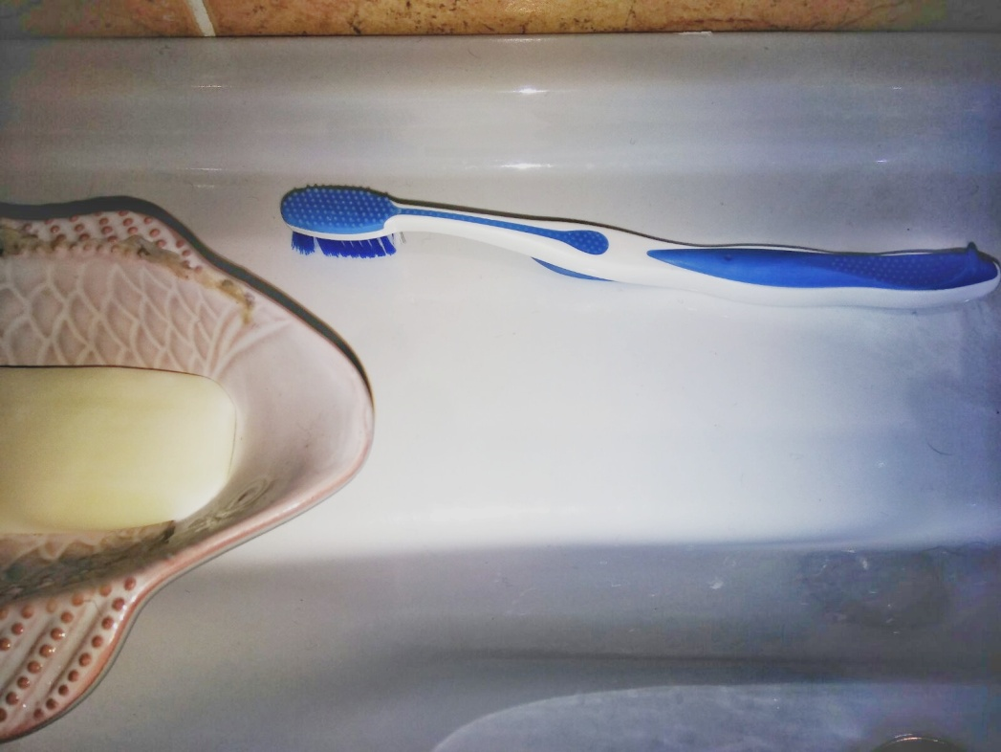

Slide 7
ASK

Slide 8
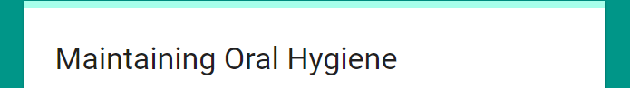
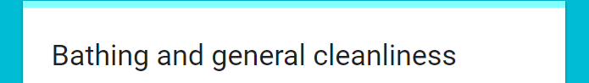
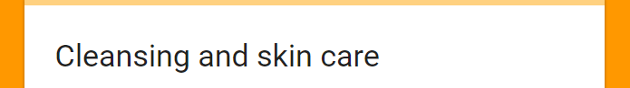

Slide 9
LEARN

Slide 10
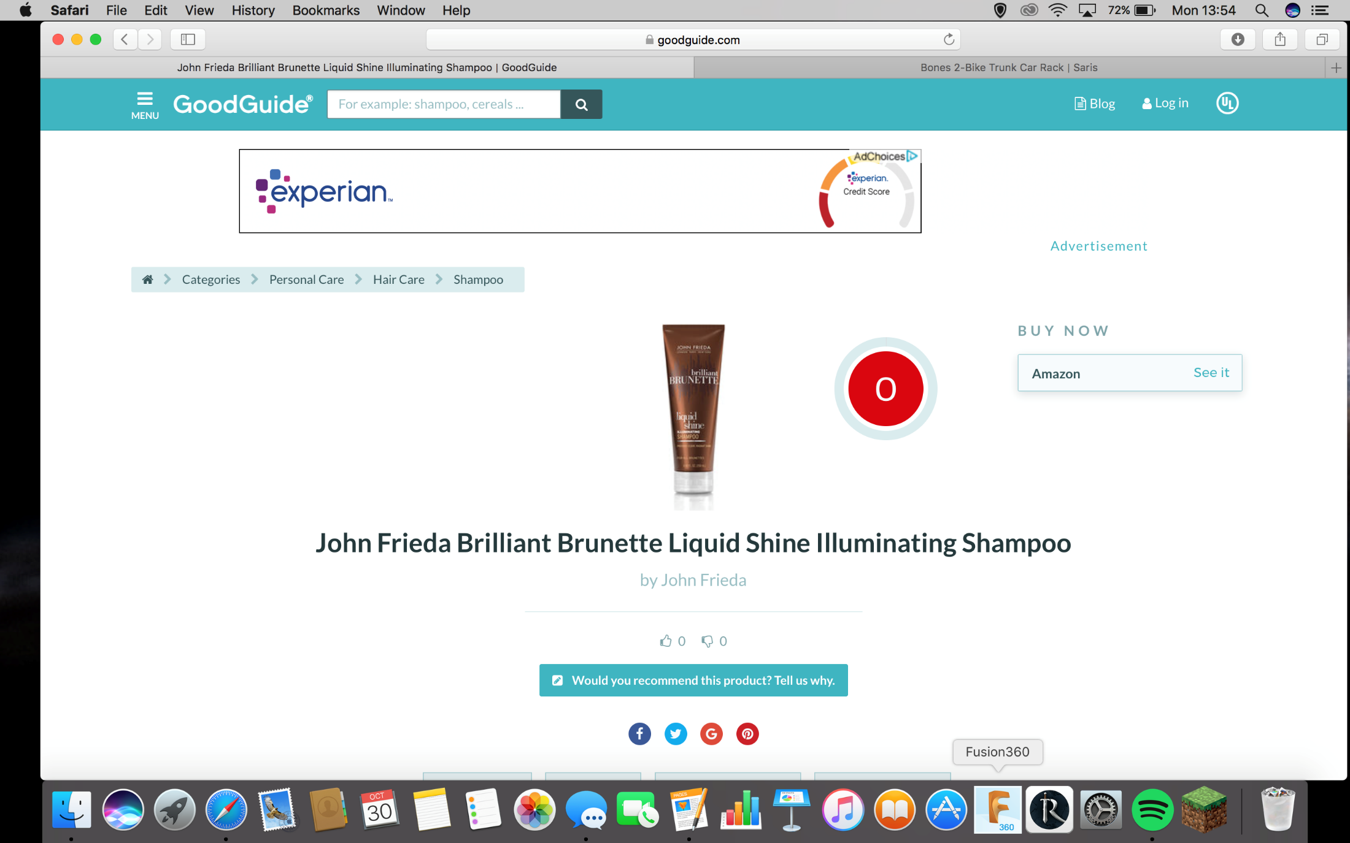

Slide 11
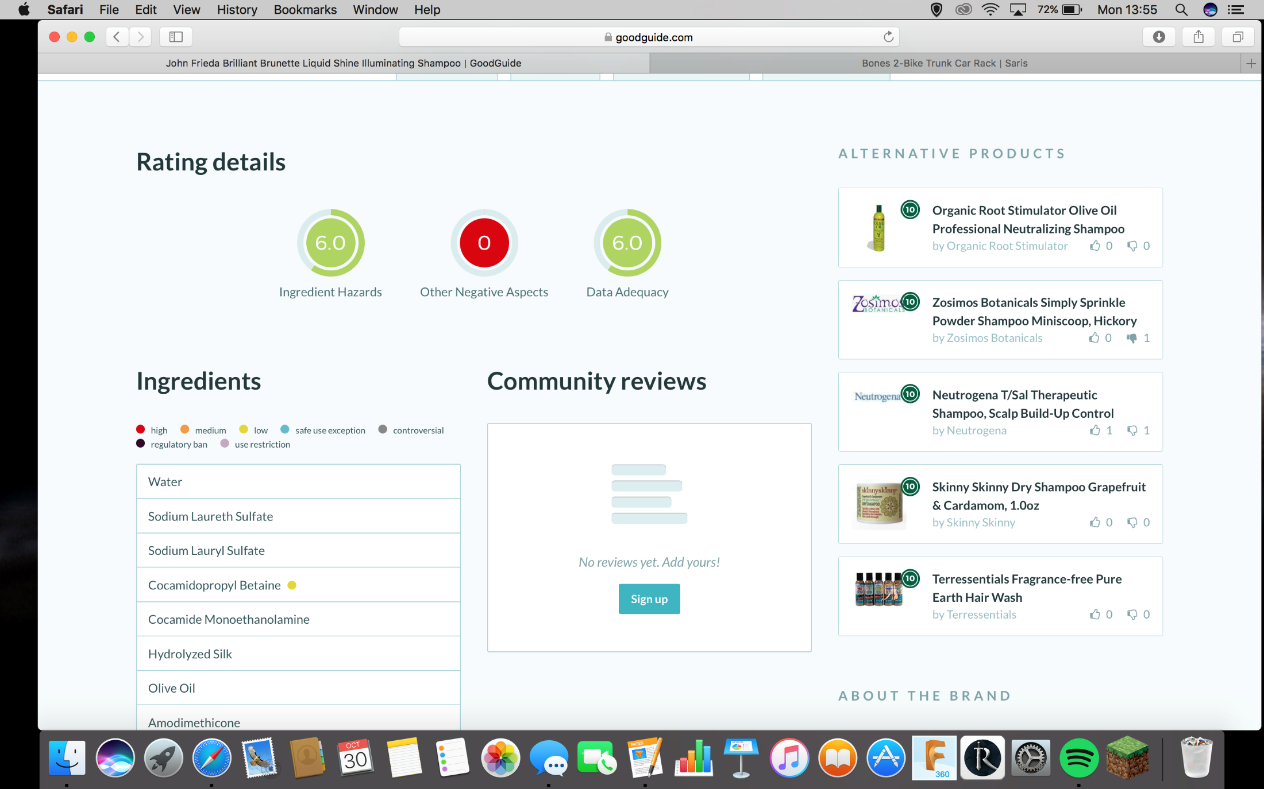

Slide 12
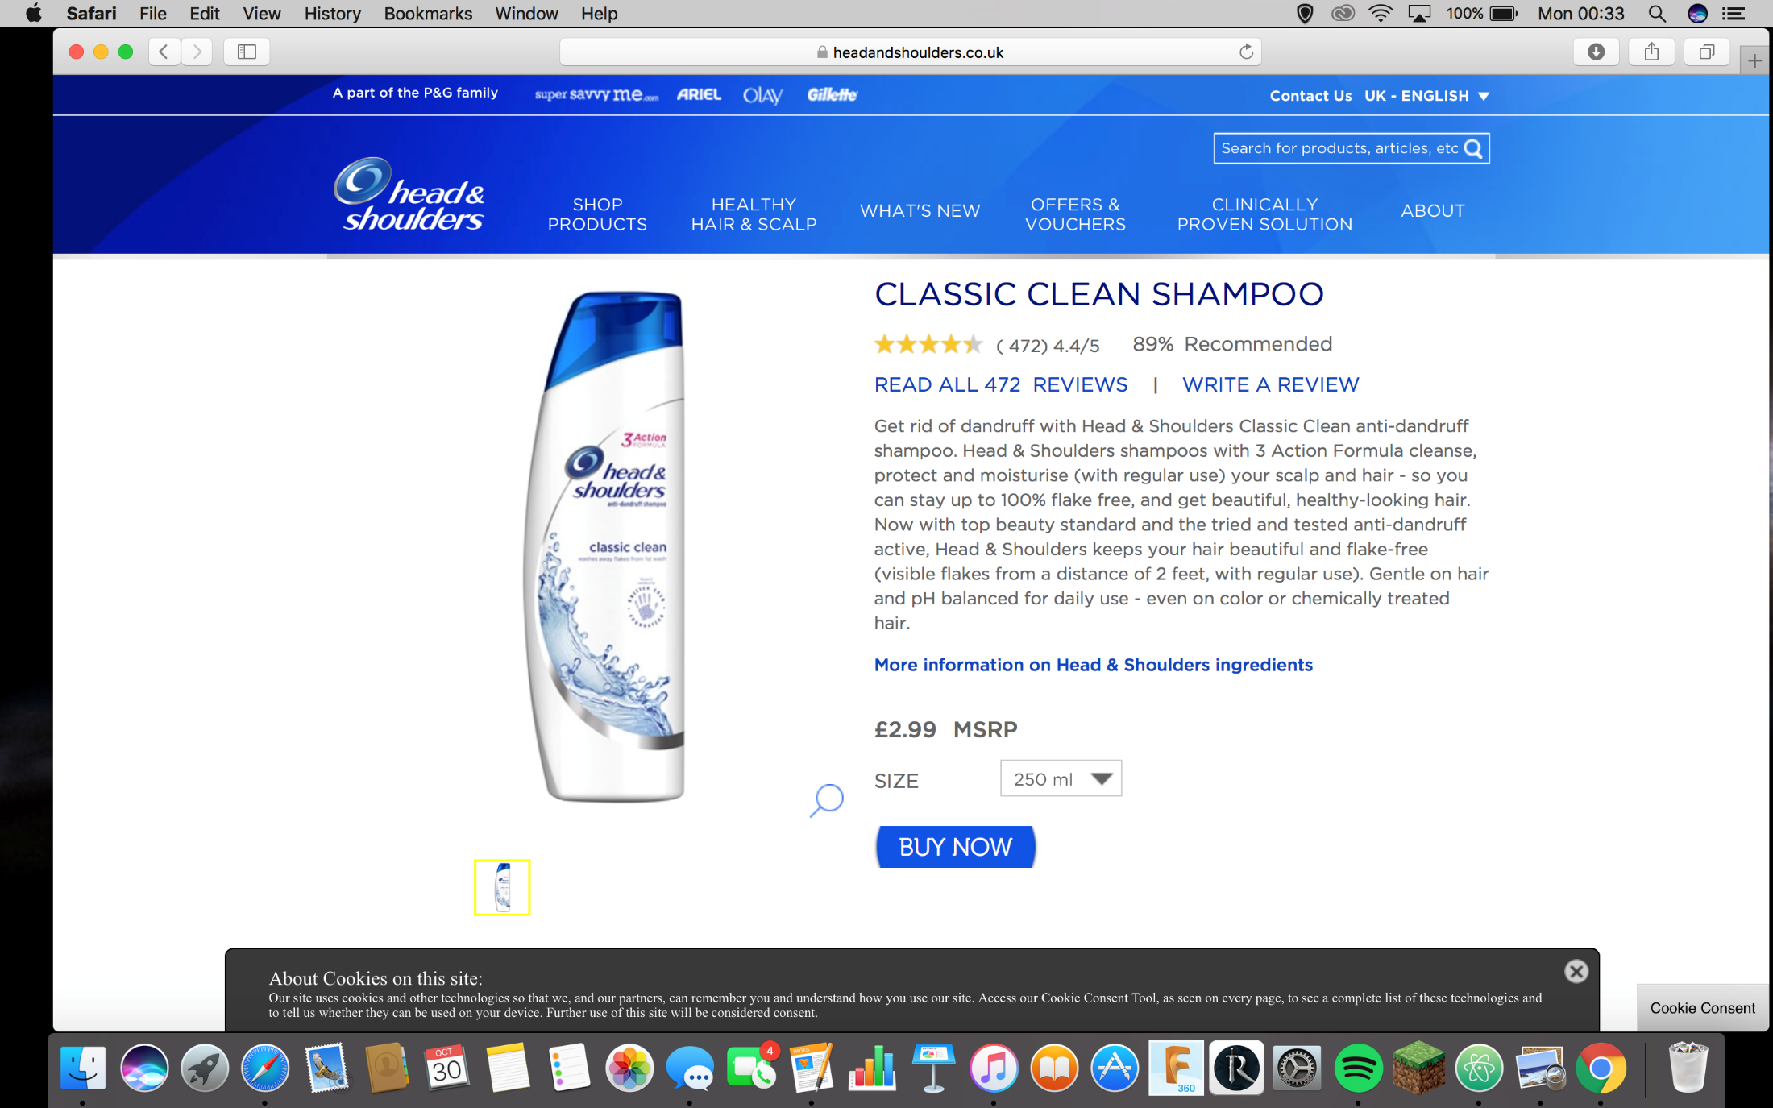



Slide 13
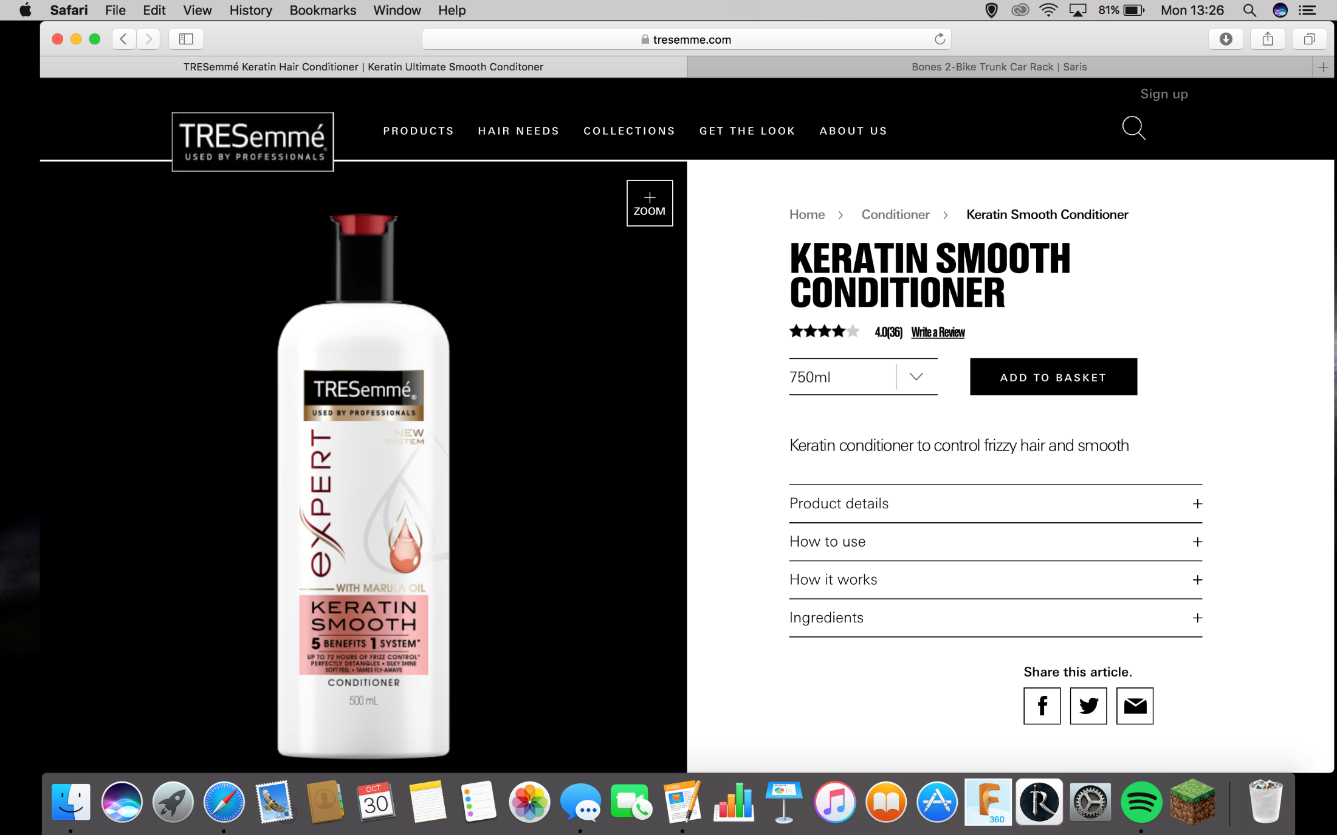



Slide 14
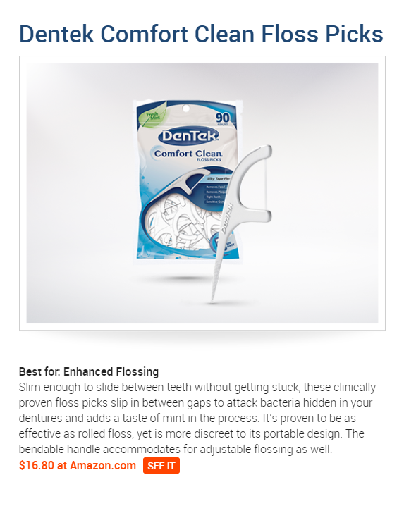
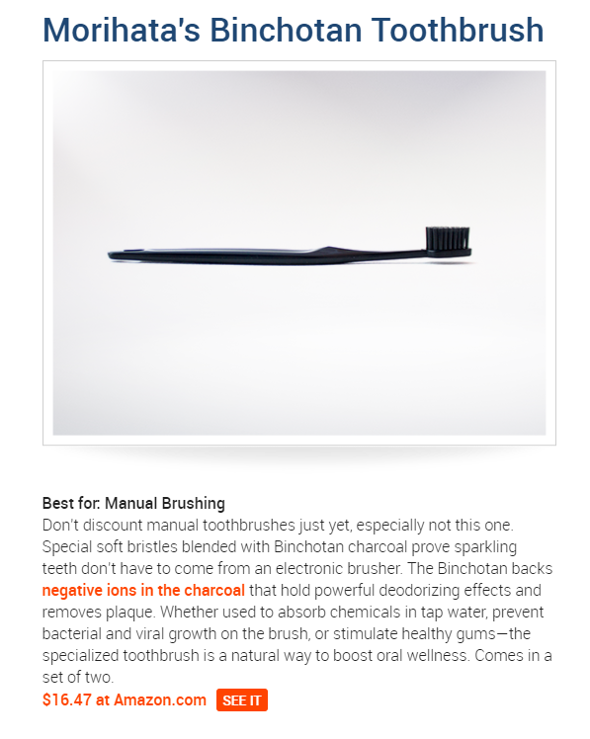

Slide 15
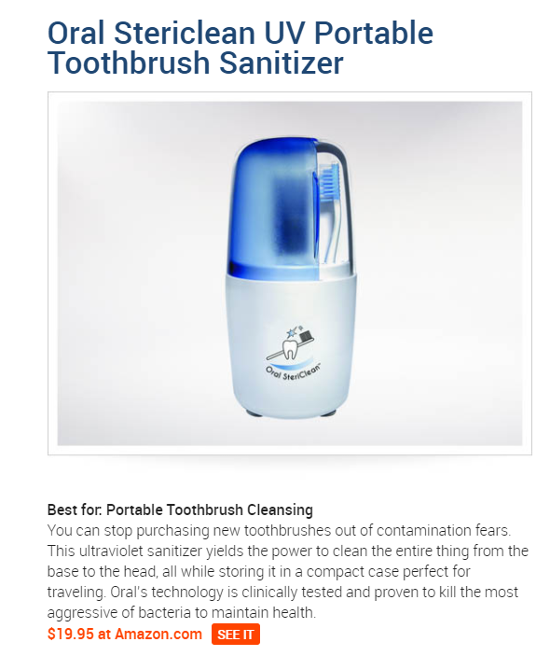
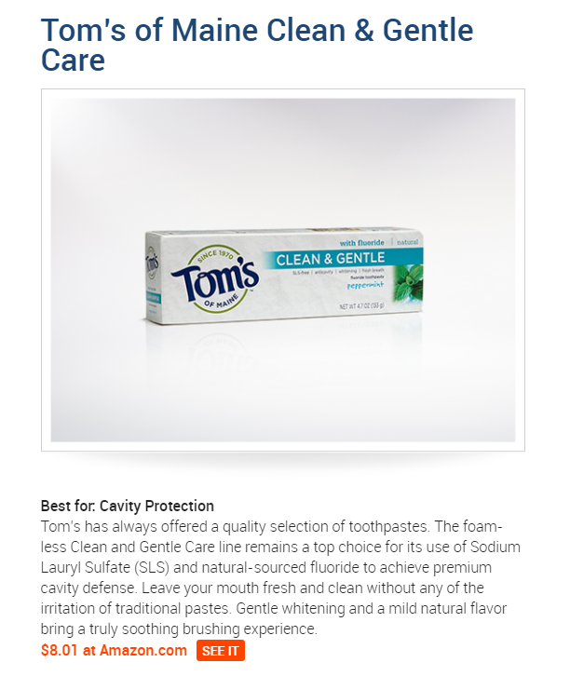

Slide 16
Questionnaire results

Slide 17
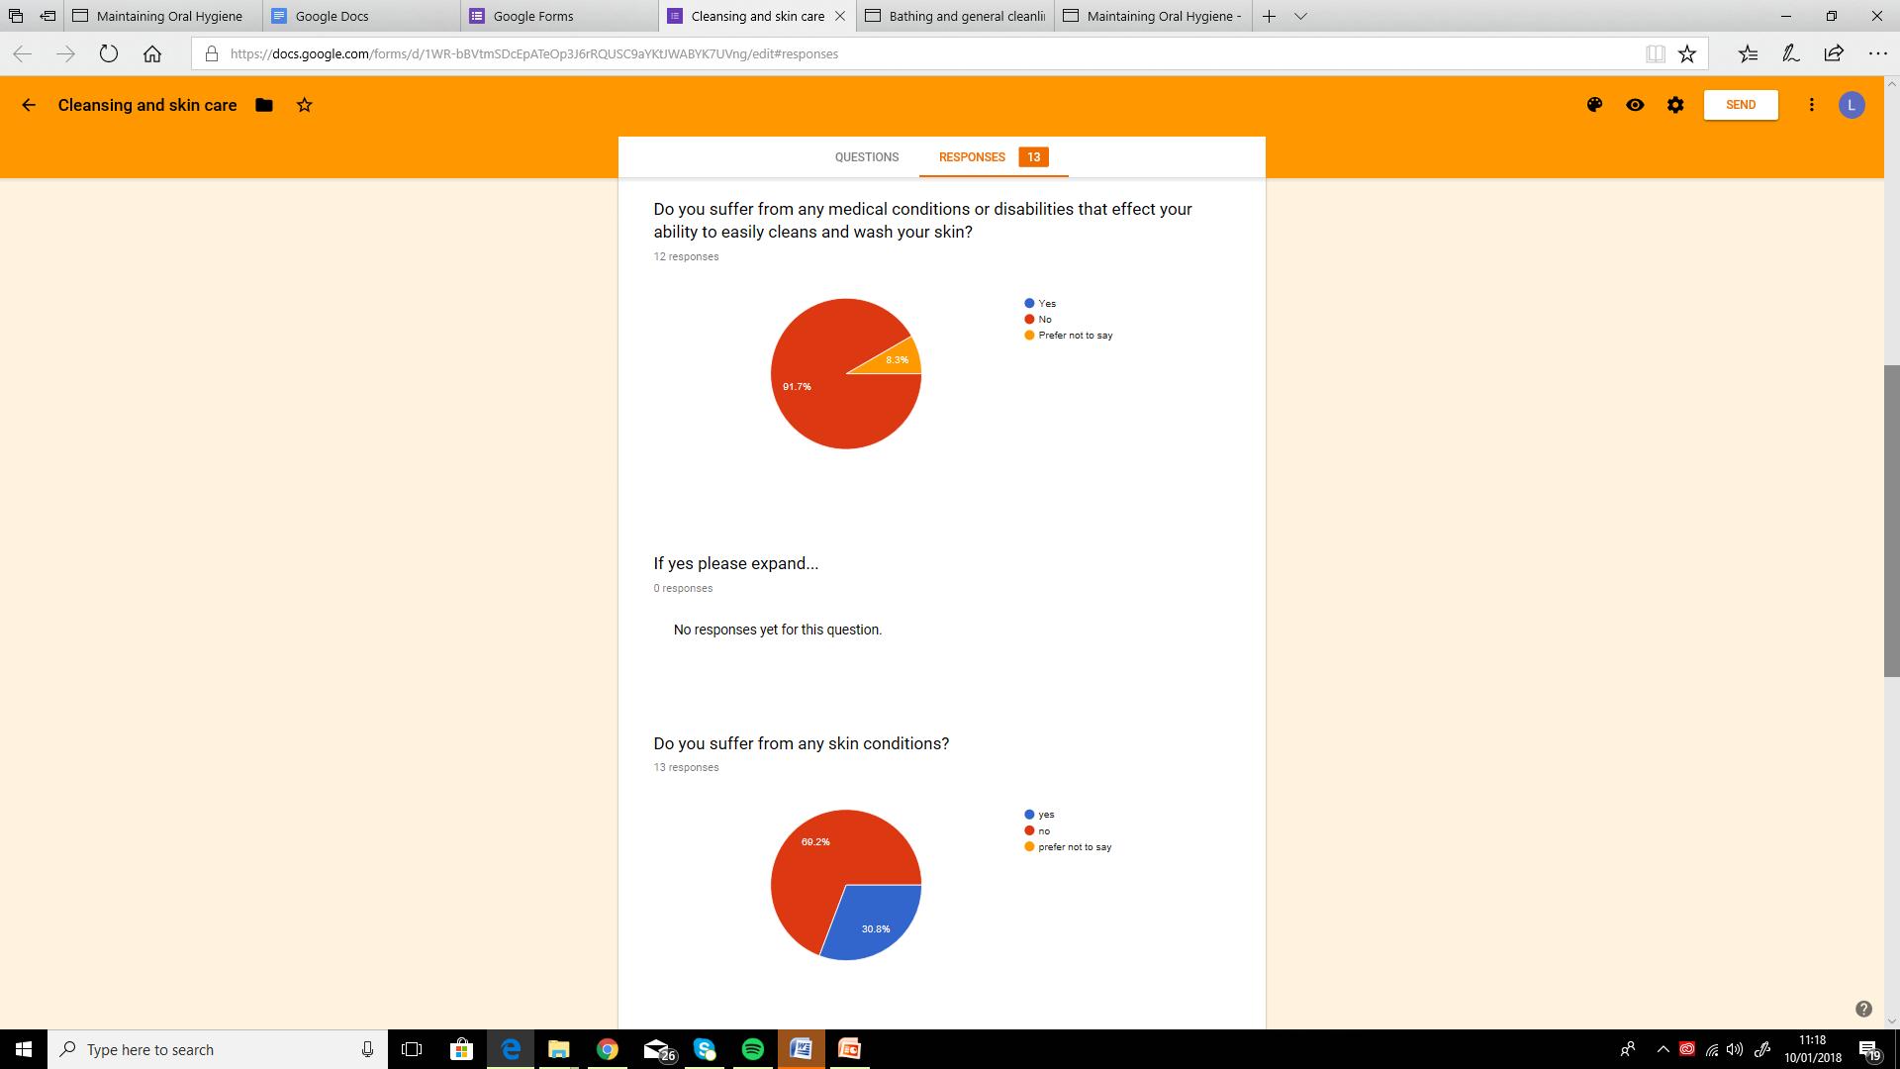
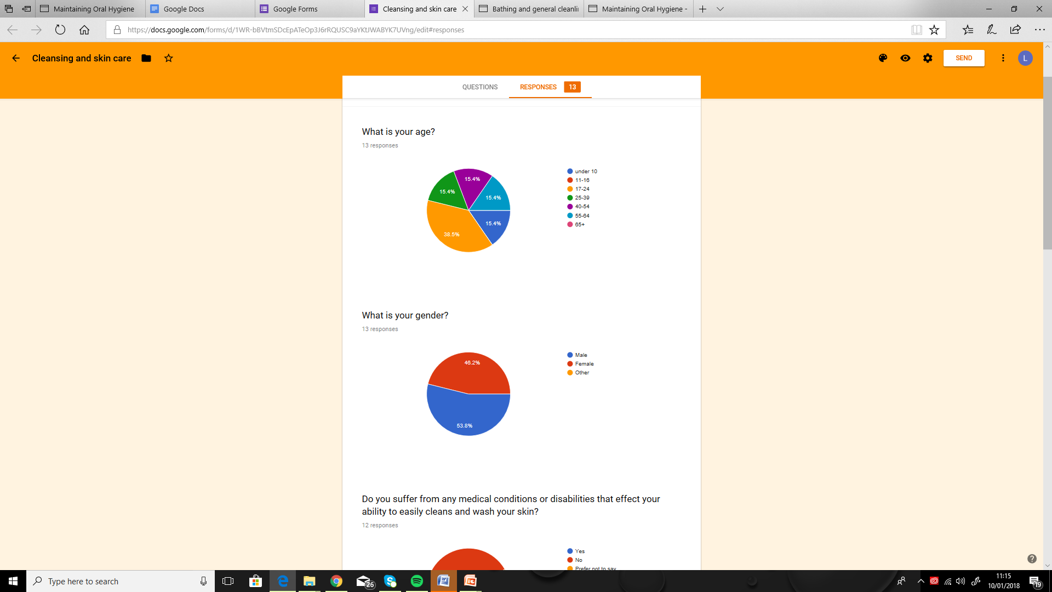
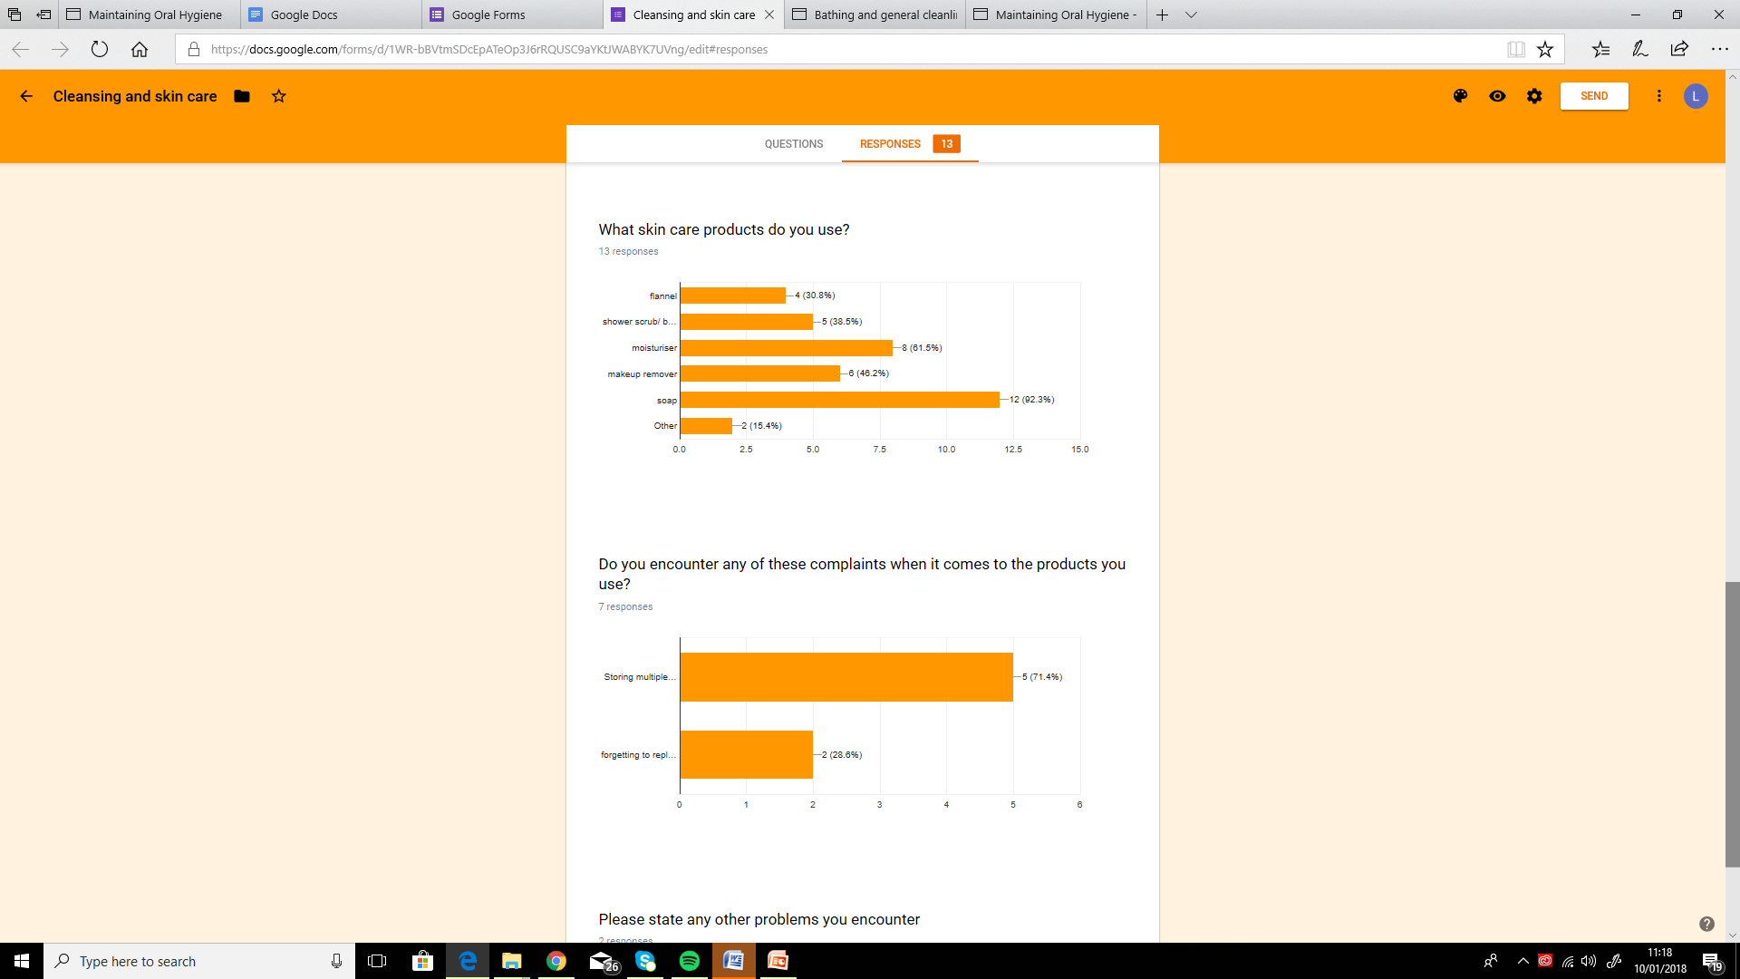

Slide 18
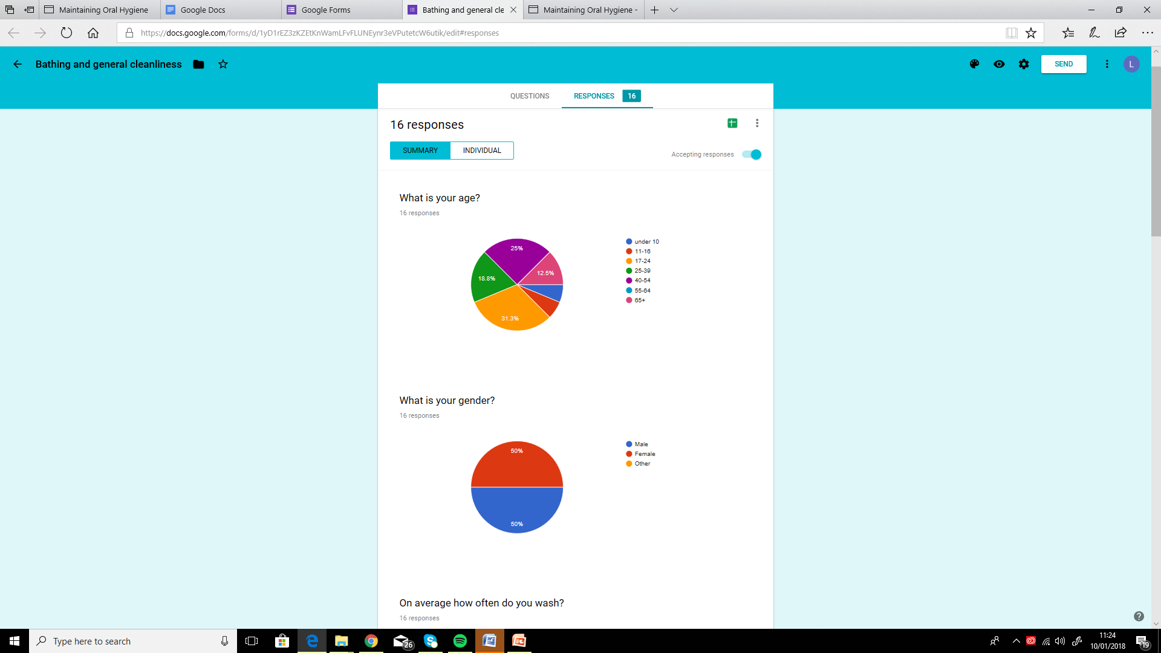
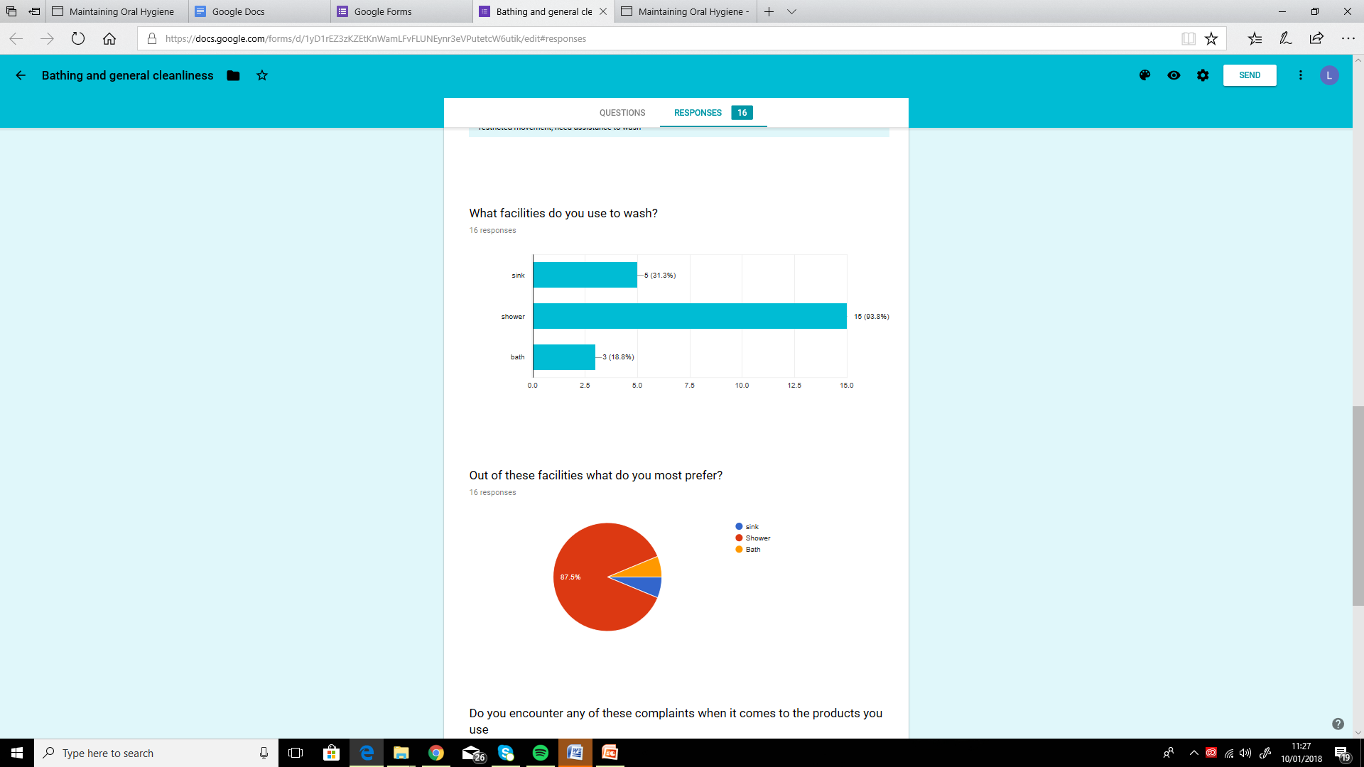
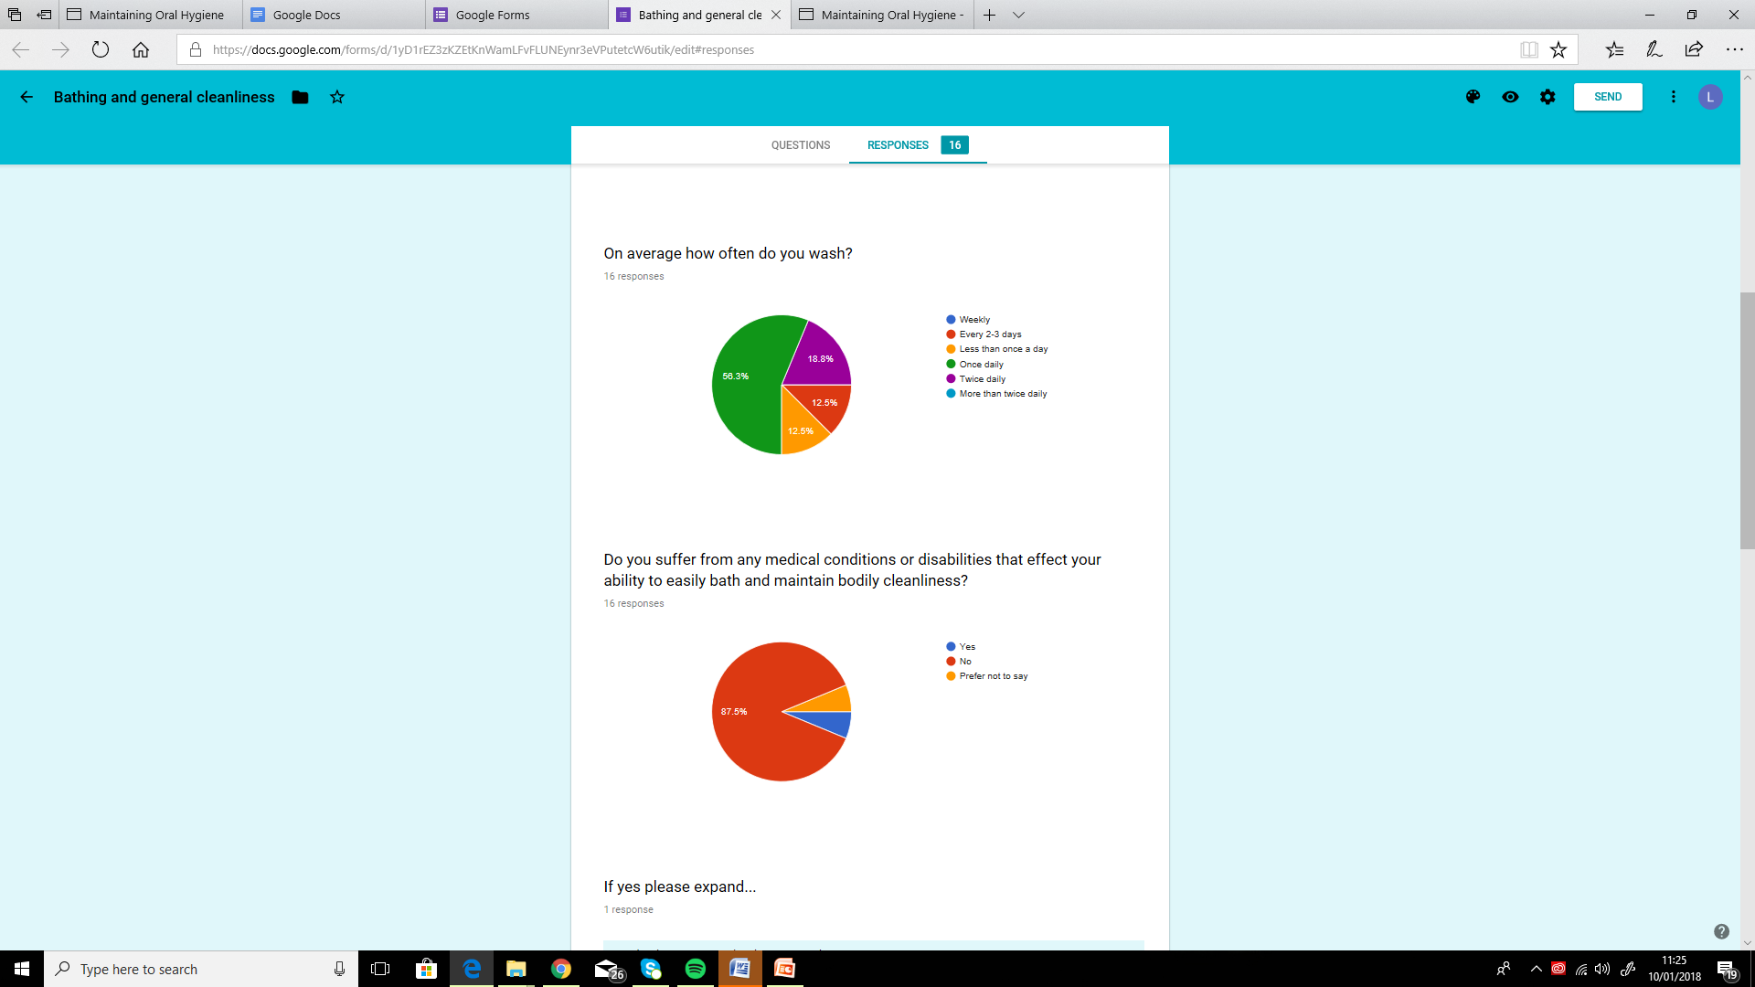
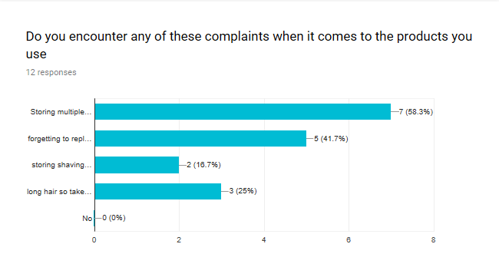

Slide 19


