Slide 1

Recruitment and Training Development at Tesco
Name: Silvana Montalvo Riofrio
.Student number: 2130452
Module code LCLM5002
.Lecturer name: Sukhpreet Grewal
Job role: Customer Service Assistant
Esta foto de Autor desconocido está bajo licencia CC BY-SA

Slide 2
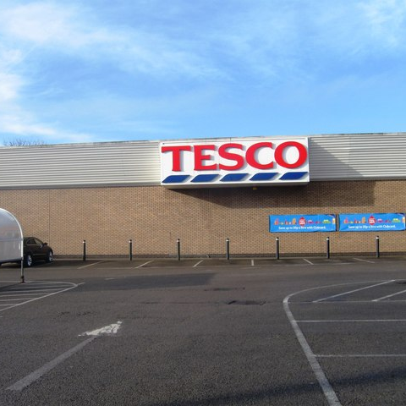
Introduction to Tesco
Recruitment Process
Job Analysis
Job Description
Person Specification
Learning & Development Needs
Learning Theories
Conclusion
References
Esta foto de Autor desconocido está bajo licencia CC BY-SA

Slide 3
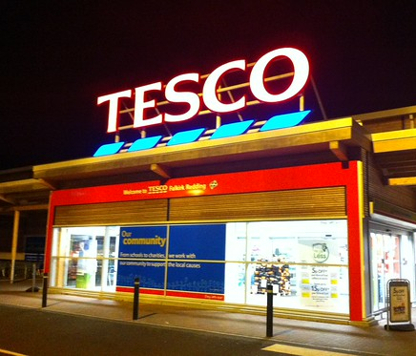
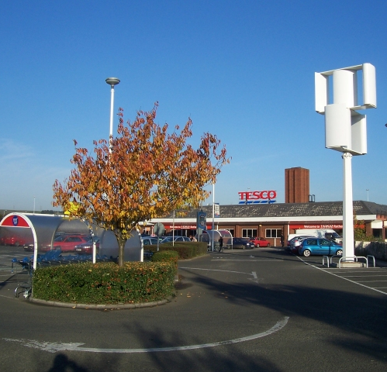
Introduction to Tesco
Introduce the organisation.
Founded in 1919
One of the largest retailers in the UK
Employs thousands of employees
Focuses on customer satisfaction and teamwork
Esta foto de Autor desconocido está bajo licencia CC BY-SA
Esta foto de Autor desconocido está bajo licencia CC BY-NC-ND

Slide 4
Importance of Recruitment
Example points:
Ensures the organisation hires qualified employees
Improves team performance
Supports business growth

Slide 5
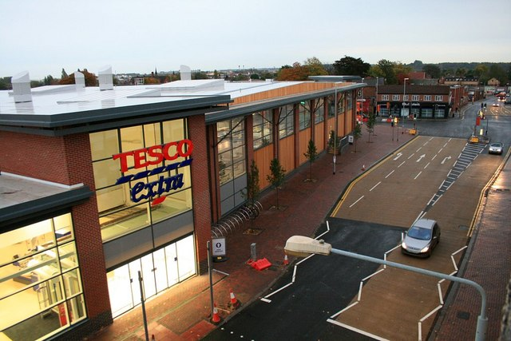
Recruitment Process at Tesco:
Identify job vacancy
Conduct job analysis
Advertise job vacancy
Review applications
Conduct interviews
Select candidate and offer job
Esta foto de Autor desconocido está bajo licencia CC BY-SA

Slide 6

Job Analysis
Definition:
Job analysis identifies the tasks, responsibilities and skills required for a job.
Example for Tesco:
Tasks:
Assist customers
Operate checkout
Restock shelves
Maintain store cleanliness
Esta foto de Autor desconocido está bajo licencia CC BY-SA

Slide 7

Job Description
Example:
Job Title: Customer Service Assistant
Responsibilities:
Provide excellent customer service
Operate checkout systems
Assist customers with enquiries
Maintain store displays

Slide 8

Person Specification
Skills required:
Good communication skills
Customer service skills
Teamwork ability
Basic numeracy skills
Friendly attitude
Esta foto de Autor desconocido está bajo licencia CC BY-SA

Slide 9
Learning and Development Needs
Customer service training – ensures excellent interactions with customers
Health and safety training – keeps staff and customers safe
Product knowledge training – helps staff answer queries and guide customers
Communication skills training – improves teamwork and customer engagement

Slide 10
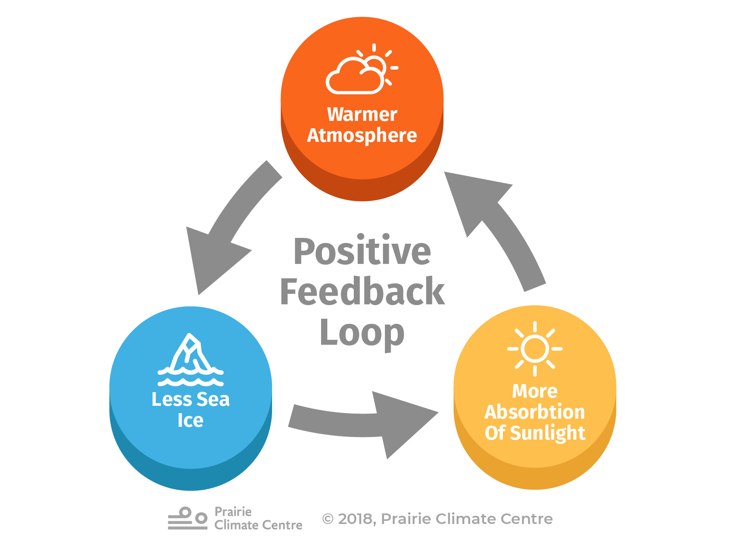
Behaviourist Learning Theory
Behaviourist theory focuses on learning through rewards and reinforcement.
Example in Tesco:
Staff receive positive feedback and incentives for good customer service.
Esta foto de Autor desconocido está bajo licencia CC BY-NC-ND

Slide 11
Cognitivist Learning Theory
Cognitivist learning focuses on understanding and processing information.
Tesco example:
Online learning modules
Problem-solving exercises

Slide 12
Humanist / Experiential Learning
Learning through experience and reflection
Employees learn best when they actively participate and reflect on their actions
Tesco Examples
On-the-job training – learning while performing daily tasks
Mentoring by experienced employees – guidance and feedback
Job shadowing – observing experienced staff to learn practical skills

Slide 13


Conclusion
Summarise key points:
Effective recruitment helps Tesco hire suitable employees.
Job analysis and job descriptions guide the recruitment process.
Training and development improve employee performance.
Learning theories support effective training programmes.
Esta foto de Autor desconocido está bajo licencia CC BY

Slide 14

REFERENCE
Armstrong, M. (2020) Armstrong's Handbook of Human Resource Management Practice. 15th edn. London: Kogan Page.
Bratton, J. and Gold, J. (2022) Human Resource Management: Theory and Practice. 7th edn. London: Palgrave.
CIPD (2023) Resourcing A. (1984) Experiential Learning: Experience as the Source of Land Talent Planning. London: CIPD. Available at: https://www.cipd.co.uk/ (Accessed: 18 March 2026).
Garavan, T., Carbery, R. and Rock, A. (2021) Strategic Human Resource Development. 2nd edn. London: Routledge.
Kolb, D. ?|”?hild. London: Routledge.
Skinner, B.F. (1953) Science and Human Behavior. New York: Macmillan.
Tesco (2024) About Tesco. Available at: https://www.tescoplc.com/ (Accessed: 18 March 2026).
Esta foto de Autor desconocido está bajo licencia CC BY-SA

