Slide 1

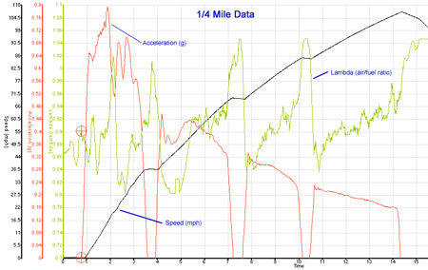
Data Acquisition:
Introduction to data traces
Level : Bsc Level 3
Lecturer :Tim Tudor
Email : timothy.tudor@sm.uwtsd.ac.uk

Slide 2
Standard channels
We will look at common channel traces
Speed
RPM
Lateral G
Steering
Throttle
How can we display the data?

Slide 3
Standard channels
Graphical Traces
Data logger analysis software can usually display the data traces in 2 ways
  Parameter versus time
  Parameter versus distance travelled
The logger logs the parameter against time, but if speed is measured against time, distance can be calculated.
Both trace types are useful but for comparison between laps or drivers the distance option is the most commonly used.

Slide 4
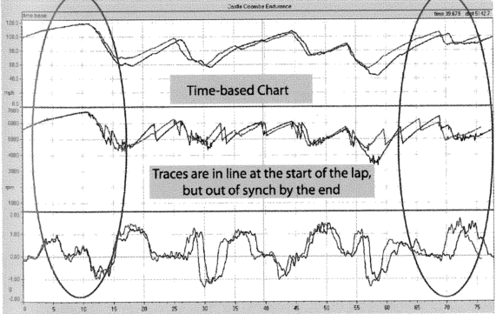
Standard channels
Time traces

Slide 5
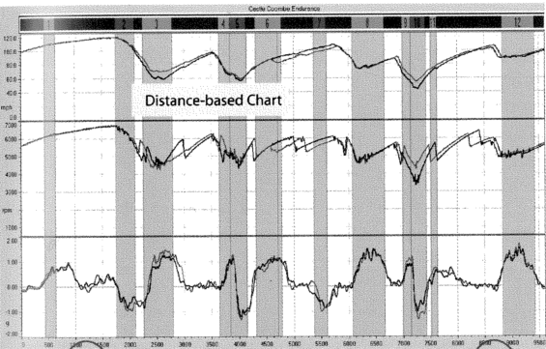
Standard channels
Distance traces

Slide 6
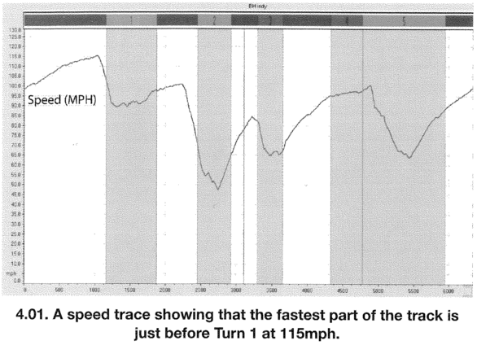
Standard channels
Speed Traces

Slide 7
Standard channels
Speed Traces
The trace shows speed versus distance.
Speed traces rise and fall, showing the vehicle speed at any point on the lap.
Obviously the speed generally increases on straights and drops in the corners.
Ultimately the only trace we’re interested in.
  Increasing speed is the objective of all our efforts
  Good place to start analysing as it is the final product

Slide 8
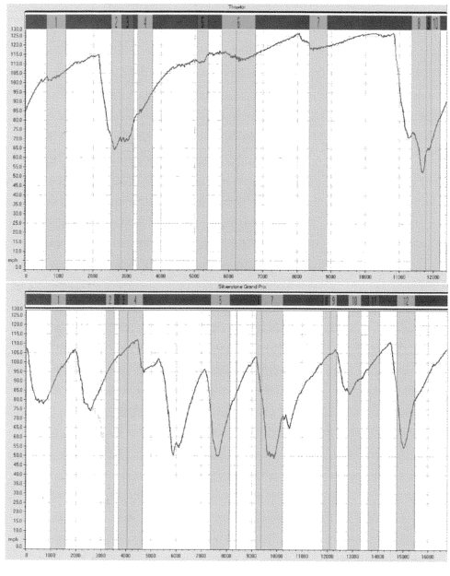
Standard channels
Speed Traces
The two traces show two very different speed traces, from two different types of tracks.
The top trace shows a high speed track with only two significant braking zones
The lower track is obviously much more technical with many braking zones and short straights

Slide 9
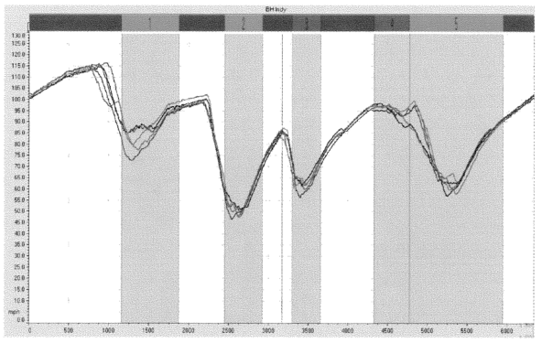
Standard channels
Speed Traces - Overlays
Overlaid speed traces allow simple comparison between laps and possibly different drivers/cars!
In the traces below it is obvious there have been inconsistencies in corners 1 and 5 and these corners should be looked at in more detail

Slide 10
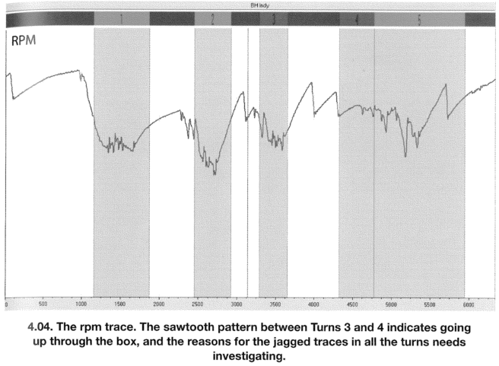
Standard channels
Engine Speed (RPM)
Reasons for interest in Engine speed
  Has the engine been over revved?
  Is peak RPM being achieved at end of straight?
  Is RPM too low in any of the turns? (outside power band)
  Shift times and points on circuit?
  Does the RPM drop out of the power band during gear changes?

Slide 11
Standard channels
Engine Speed (RPM)
Notice
  Rise in RPM on straight
  Drop during braking for turn 1
  Jagged trace in early part of T1. Partly due to bumpy track/traction.
  Gear change indicated by climbing trace followed by sudden drop, followed by gradual climb. E.g. Between T3 and T4

Slide 12
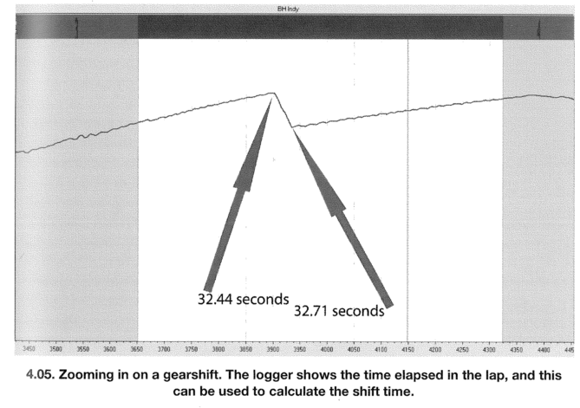
Standard channels
Engine Speed (RPM)
By measuring time between top and bottom of the drop on the RPM trace we can calculate the time taken for a gear change. Is a driver changing too slowly?

Slide 13
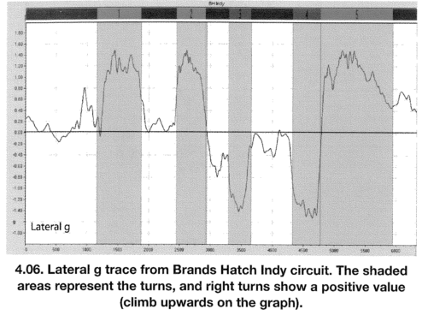
Standard channels
Lateral G
Trace shows cornering force. Required for track maps. (if no GPS)
Gives a measure of how much lateral grip the vehicle has.
Can give insight to
  Effect of varied racing lines
  Driving style – Aggressive or smooth.
  Effect of set-up changes

Slide 14
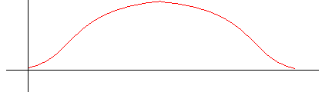
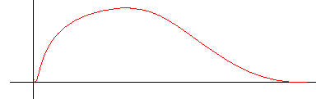
Standard channels
Lateral G
Classical constant radius line –
  Symmetrical with smooth build up and decay of lateral acceleration
Pragmatic line, braking deep, late turn in and apex, power on early –
  Asymmetric trace builds steeply and decays very gradually.

Slide 15
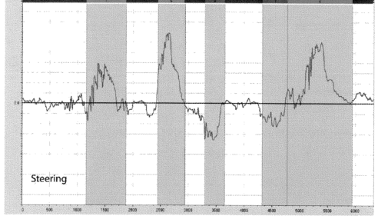
Standard channels
Steering
Looks a similar to lateral acceleration trace – This is because it is the steering that causes the lateral acceleration (Build up of front slip angles creates yaw)
Gives information on how steering is applied.
  Calm smooth drivers have a smoother trace.
  Jagged traces show someone who puts too much work into steering wheel. Nervous or overdriving.

Slide 16
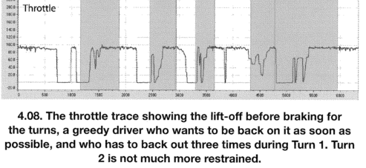
Standard channels
Throttle
Instantly recognisable.
  Either full on during acceleration (60-80%of lap)
  Or full off during braking
  Or transition stage where power is faded in.

Slide 17
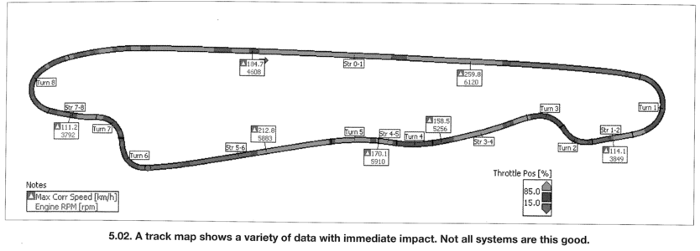
Displaying data
Track Maps
Track maps can be displayed to show maximum and minimum values of parameters in each sector.
Normally have a cross hair showing position of vehicle at certain point in data.

Slide 18
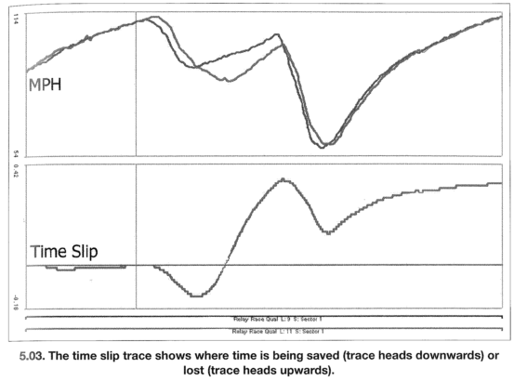
Displaying data
Time Slip
Time slip traces calculate and graphically display the differences in elapsed times for two laps, plotted against distance.
The baseline is usually the quickest lap from a test session
They are useful to highlight where time is being gained or lost for two different laps.
  May highlight driver, car, setup, line differences.
Note:
Driver brakes 40m earlier
Carries more speed
Applies throttle earlier

Slide 19
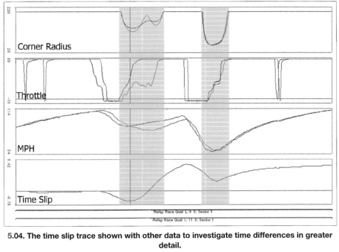
Displaying data
Time Slip

Slide 20
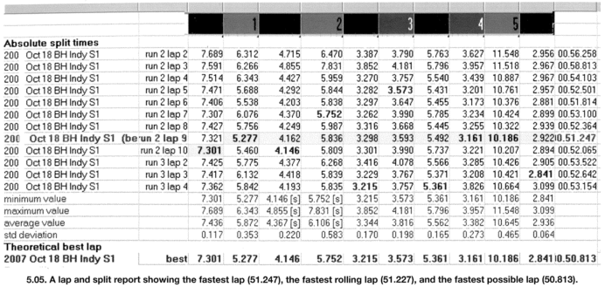
Displaying data
Sector/Split Times
Sector time displays can show times for each individual sector. From these times one can calculate
  Fastest theoretical lap – Is this realistic?
  Fastest rolling lap

Slide 21
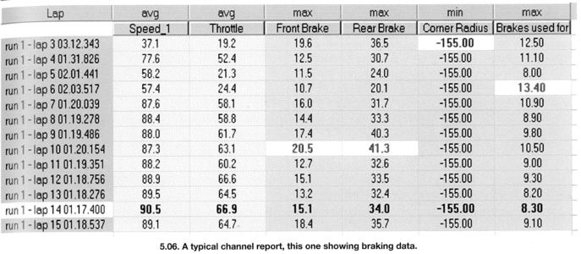
Displaying data
Channel Reports
Channel reports show maximum, minimum or average values for parameters during each lap, session, or sector!
Are useful for monitoring engine values / health
Quick reference for handling (max Lat G, speed), driver (steering rate, yaw rate, brake pressure, long/lat G), engine (RPM, oil/water pressure and temperature)

Slide 22
Displaying data
Histograms
Show percentage or a particular variable occurring within a specific band. E.g. Percentage of time throttle between 0-25, 25 and 75, and 75 and 100%.
Often used for RPM, throttle position and speed
RPM shows percentage of time spent in different ranges of the rev range. Is it operating in its power curve? Is gearing correct?
Speed gives us an idea of the circuit type and therefore requirements of the car. Agile or stable? Also shows effect of changes made to setup or car.
Throttle histograms show how much thottle is being used. More throttle, faster lap! Distinctive shape with most time spend either wide open or fully closed during braking!

Slide 23
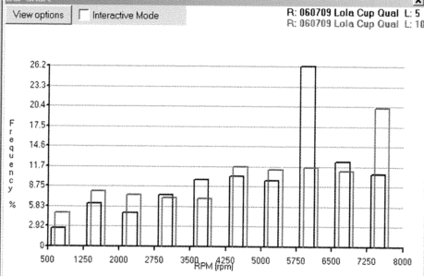
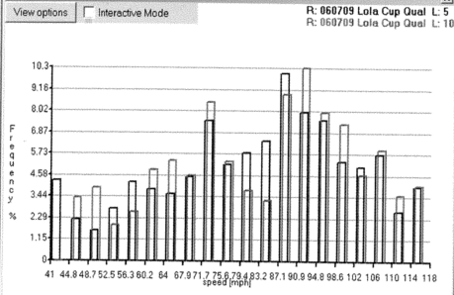
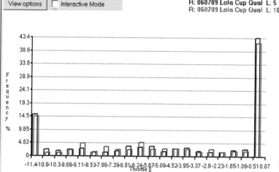
Displaying data
Histograms

Slide 24
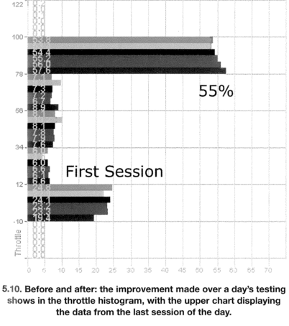
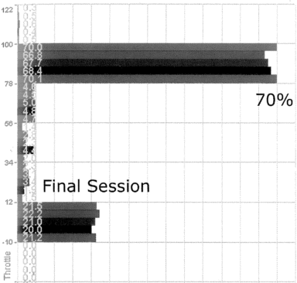
Displaying data
Histograms -Throttle

Slide 25
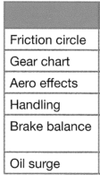
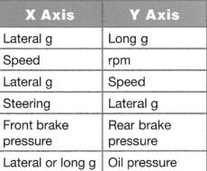
Displaying data
X-Y Plots
Plot one variable against another
For example

Slide 26
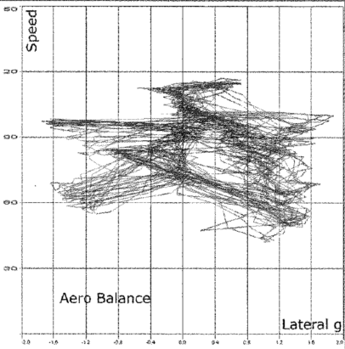
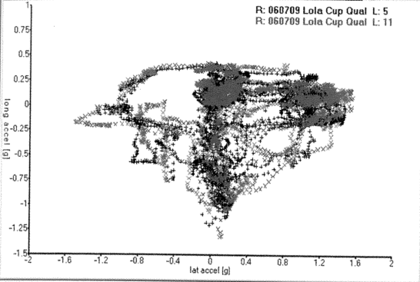
Displaying data
X-Y Plots

Slide 27
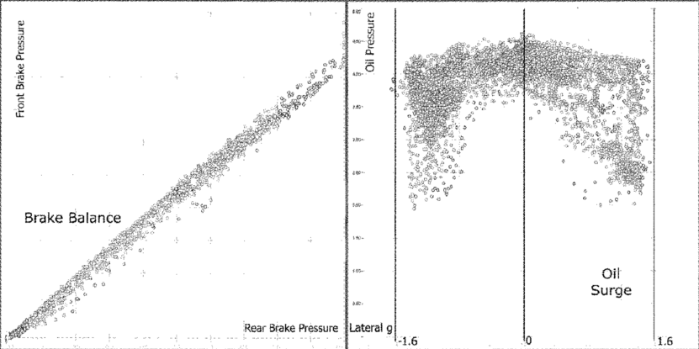
Displaying data
X-Y Plots

Slide 28
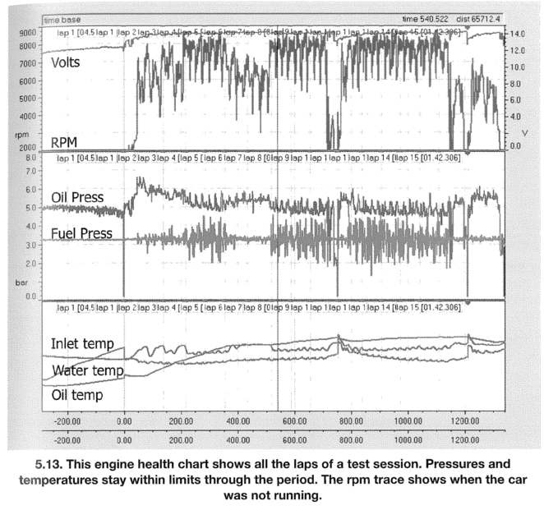
Displaying data
Standard screen layouts
Sometimes it is useful to set up screen layouts which include all the data, presented in specific forms, required to analyse an aspect of a vehicle, such as
  Engine
  Driver
  Handling
  Transmission
  Aerodynamics
  .......

Slide 29
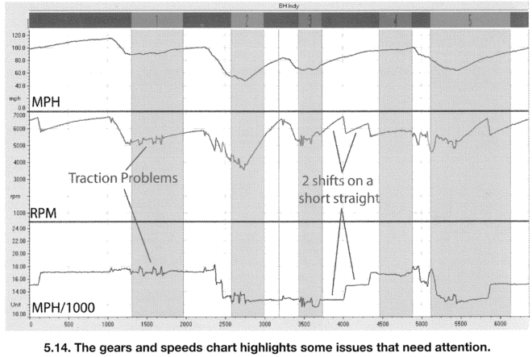
Displaying data
Transmission

Slide 30
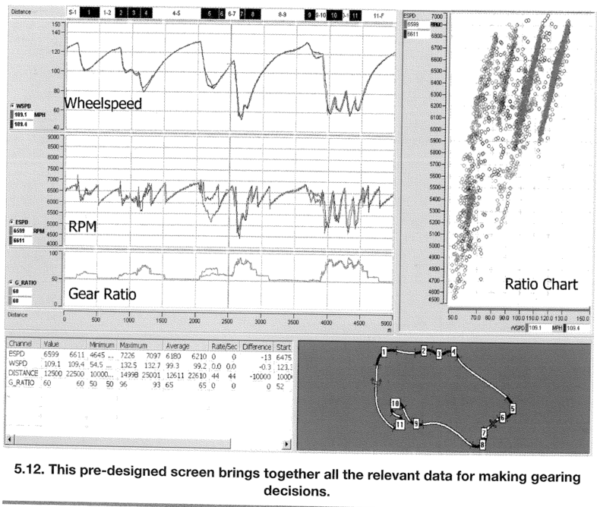
Displaying data
Transmission – Screen Layout
The standard layout on the right includes and presents important data required for transmission matching such as,
  Wheel Speed
  Engine Speed
  Gear Ratios
  Min corner speeds
  Max straight speeds

Slide 31
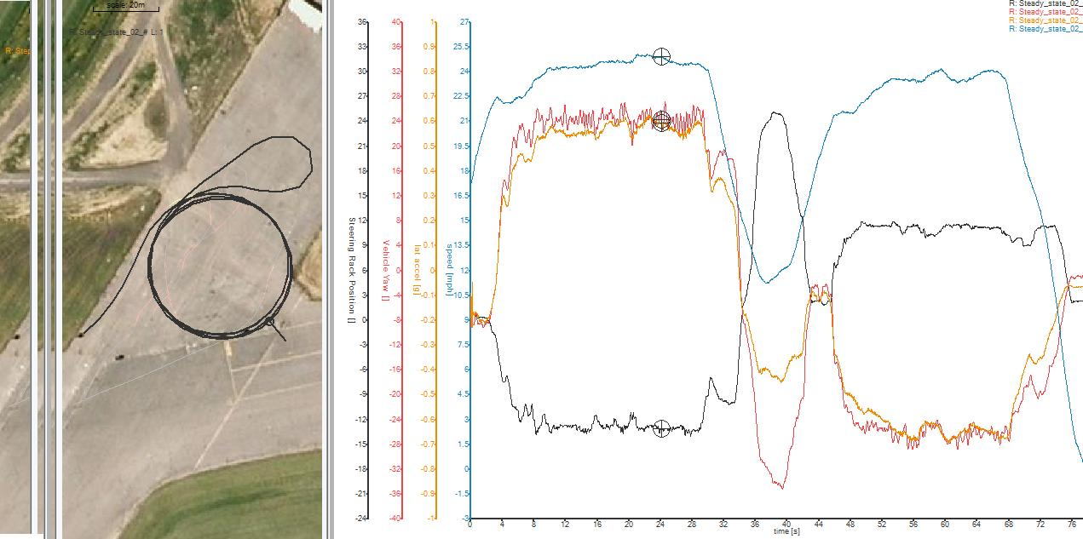
Data Traces
Steady State

Slide 32
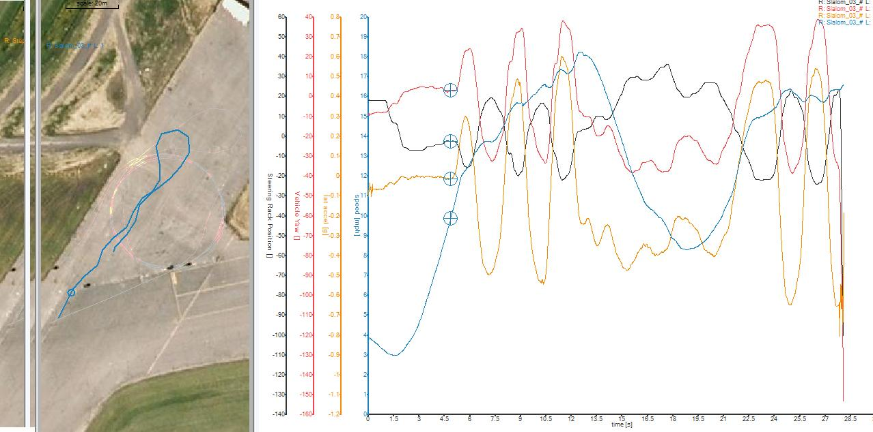
Data Traces
Slalom

Slide 33
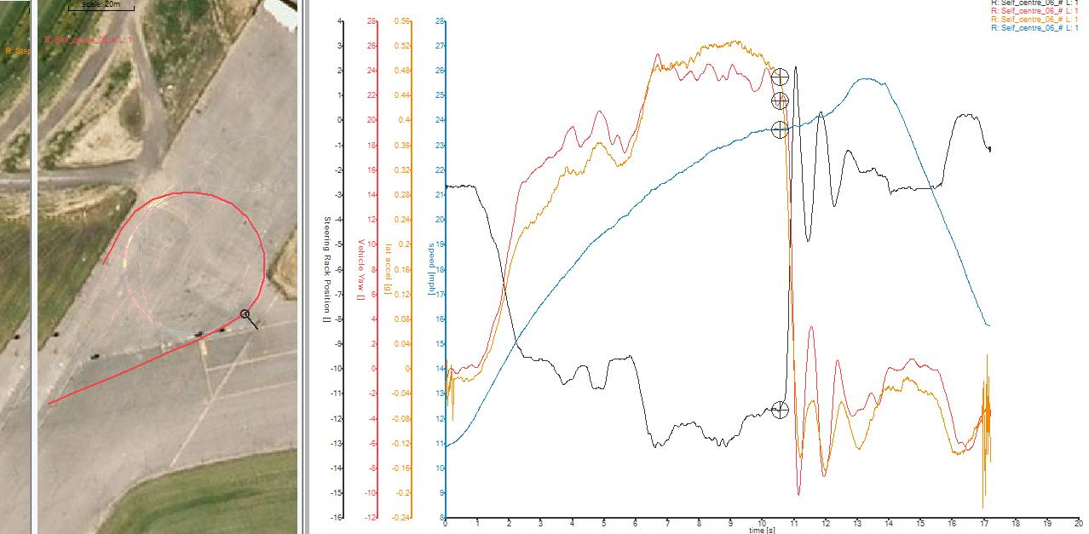
Data Traces
Self Centre

Slide 34
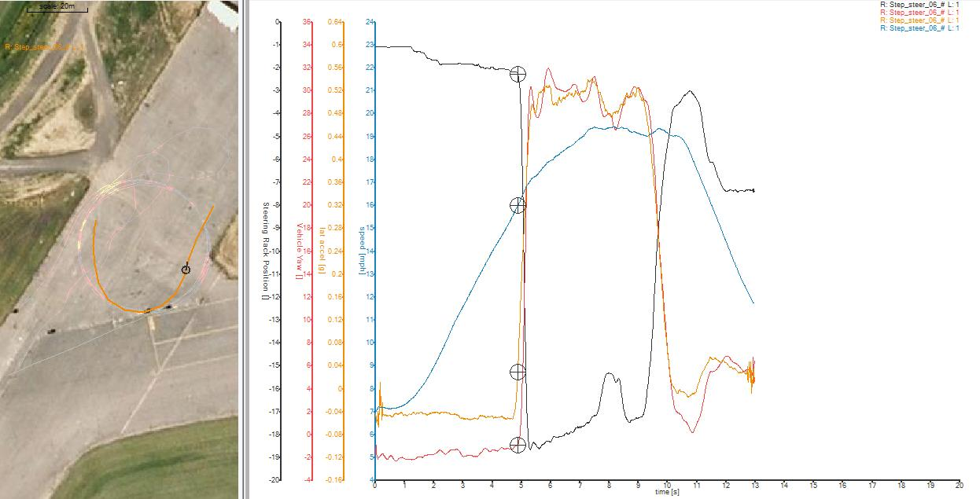
Data Traces
Step-Steer

